Slide 1
Terminology binding
The challenge of complex use cases

Slide 2
Use case
Haemofilia app
  Patient reported bleeding
  Used for monitoring medication effectiveness
One entry is a patient reporting about a bleeding episode
How to model a bleeding episode?

Slide 3
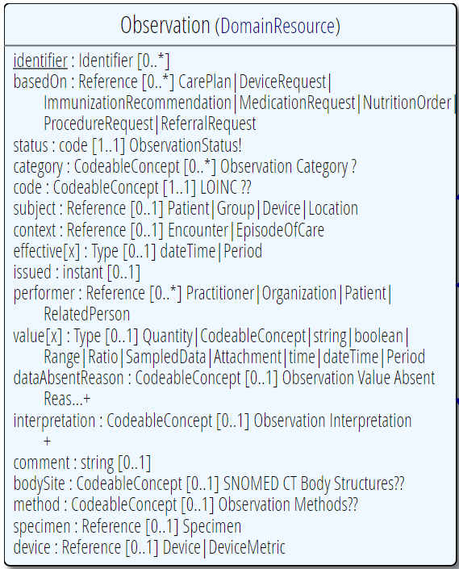

Is a bleeding an Observation or a Condition?
364105007 |Blood, lymphatics/immune system observable (observable entity)|

Slide 4
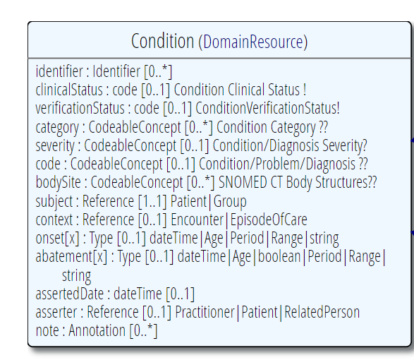
Is a bleeding an Observation or a Condition?
131148009 |Bleeding (finding)|

Slide 5
Combined meanings(Simplified)
Bleeding (1 outcome)
  Spontaneous (spontaneous, traumatic… 2 outcomes )
  Where is the bleeding? (muscle, joint, in urine…. 7 outcomes)
  Where is the bleeding localized? E.g. Right hand, left hand, abdomen… 100 outcomes)
All 1400 outcomes get their own code

Slide 6
Combined meanings(Simplified)
14 bleedings
100 localizations

Slide 7
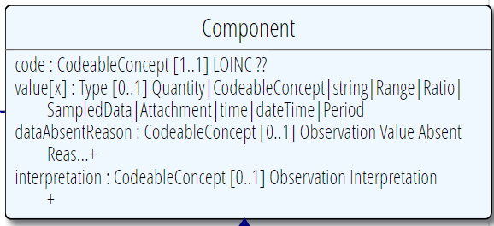
Combined meanings(Simplified)
2
7

Slide 8
Combined meanings – more challenges
When we ask: Where is the bleeding? (muscle, joint, in urine…. 7 outcomes)
  Some are body structures, and some are specimens?
The body structures have sides (right/left) – representation in the model/in the terminology?
There are more attributes than those that I have represented here. The model ended up containing four different SNOMED coded components and a SNOMED coded body site – representing one combined meaning.

Slide 9
The big question
How do we guide people to harmonize their modelling practice?

