Slide 1
Topics from ECE project group
Bruce Goldberg, MD, PhD

Slide 2
Complication model revisited

Slide 3
Current definition of complication in editorial guidelines
A complication is a disorder caused by another disorder, procedure, or event which is not a natural progression or expected outcome of its cause; temporally may be During and After the causative disorder, procedure, or event.

Slide 4
Results of survey
 |  | Complication (Y/N)
SCTID | FSN | Reviewer 1 | Reviewer 2 | Reviewer 3 | Reviewer 4 | Reviewer 5 | Reviewer 6 | Reviewer 7 | # complications | # not complications
724557008 | Acquired iron deficiency anemia due to decreased absorption (disorder) | N | N | N | N | Y | N | N | 1 | 6
724816007 | Acquired anhidrosis co-occurrent and due to primary autonomic disorder (disorder) | N | N | N | N | Y | ? | N | 1 | 6
721283000 | Acidosis due to type 1 diabetes mellitus (disorder) | Y | Maybe | N | N | Y | N | N | 2 | 5
431804003 | Acquired scleral show due to eyelid deformity (finding) | N | N | N | N | Y | N | N | 1 | 6
698741009 | Acute complete quadriplegia due to spinal cord lesion between first and fourth cervical vertebra (disorder) | Y | N | N | N | Y | N | N | 2 | 5
762353009 | Acute headache due to traumatic injury of head (disorder) | N | N | N | Y | Y | N | N | 2 | 5
722095005 | Acute kidney injury due to circulatory failure (disorder) | Y | N | N | Y | Y | N | N | 2 | 5
698755001 | Acute paralysis due to lesion of spinal cord (disorder) | Y | N | N | N | Y | N | N | 1 | 6
429224003 | Acute renal failure due to acute cortical necrosis (disorder) | N | N | N | N | Y | N | N | 1 | 6
707323002 | Anemia co-occurrent and due to chronic kidney disease (disorder) | Y | N | N | N | Y | N | N | 1 | 6
413532003 | Anemia due to blood loss (disorder) | N | N | N | N | N | N | N | 0 | 7
413533008 | Anemia due to chronic blood loss (disorder) | N | N | N | N | N | N | N | 0 | 7
707753007 | Angular cheilitis due to lack of adequate intermaxillary vertical dimension (disorder) | Y | N | N | Y | Y | N | N | 3 | 4
53868003 | Anterior cord syndrome co-occurrent and due to closed fracture of C1-C4 level (disorder) | Y | N | N | Y | Y | N | N | 3 | 4
233864007 | Aortic regurgitation due to cystic medial necrosis of aorta (disorder) | Y | N | N | Y | Y | N | N | 3 | 4
361272001 | Cerebellar ataxia due to alcoholism (disorder) | N | Y | N | Y | Y | N | N | 3 | 4
438513002 | Cerebral degeneration due to Parkinson's disease (disorder) | Y | N | N | Y | N | N | N | 2 | 5
705128004 | Cerebral infarction due to embolism of middle cerebral artery (disorder) | N | N | N | Y | Y | N | N | 2 | 5
1.60243E+16 | Cerebrovascular accident due to occlusion of right cerebellar artery (disorder) | N | N | N | N | Y | N | N | 1 | 6
717936002 | Classic onset hemorrhagic disease of newborn due to vitamin K deficiency (disorder) | Y | N | N | N | N | N | N | 1 | 6
722369003 | Congenital nephrotic syndrome due to diffuse mesangial sclerosis (disorder) | Y | N | N | Y | Y | N | N | 3 | 4
1.62367E+16 | Delirium due to methamphetamine intoxication (disorder) | N | N | N | N | Y | N | N | 1 | 6
6.72511E+14 | Dysarthria due to and following hemorrhagic cerebrovascular accident (disorder) | Y | N | N | Y | Y | N | N | 3 | 4
1.08522E+15 | Rectal hemorrhage due to chronic ulcerative proctitis (disorder) | N | N | N | Y | N | N | N | 1 | 6
735173007 | Shock co-occurrent and due to anaphylaxis (disorder) | N | N | N | N | Y | N | N | 1 | 6
 | Totals |  |  |  |  |  |  |  | 41 (23%) | 134 (77%)

Slide 5
Possible approaches
Model all disorders due to other disorders with a parent of 116223007 |Complication (disorder)| or
Model no disorders due to other disorders with a parent of 116223007 |Complication (disorder)|
  May use Complication as an additional description with as needed
  or
Model new content with a parent of complication only if requestor indicates this is a complication or if similar to an existing SNOMED concept modeled with a parent of 116223007 |Complication (disorder) or
Model existing content with a parent of 116223007 |Complication (disorder)|if the word ”complication” is included in the FSN
  Model descendants of concepts with “complication” in the FSN with a parent of 116223007 |Complication (disorder).

Slide 6
Injuries

Slide 7
Is there a need to retain unspecified as to whether traumatic or nontraumatic injuries as opposed to considering all injuries traumatic unless specified as nontraumatic
Should 417163006 |Traumatic AND/OR non-traumatic injury (disorder)|be retired

Slide 8
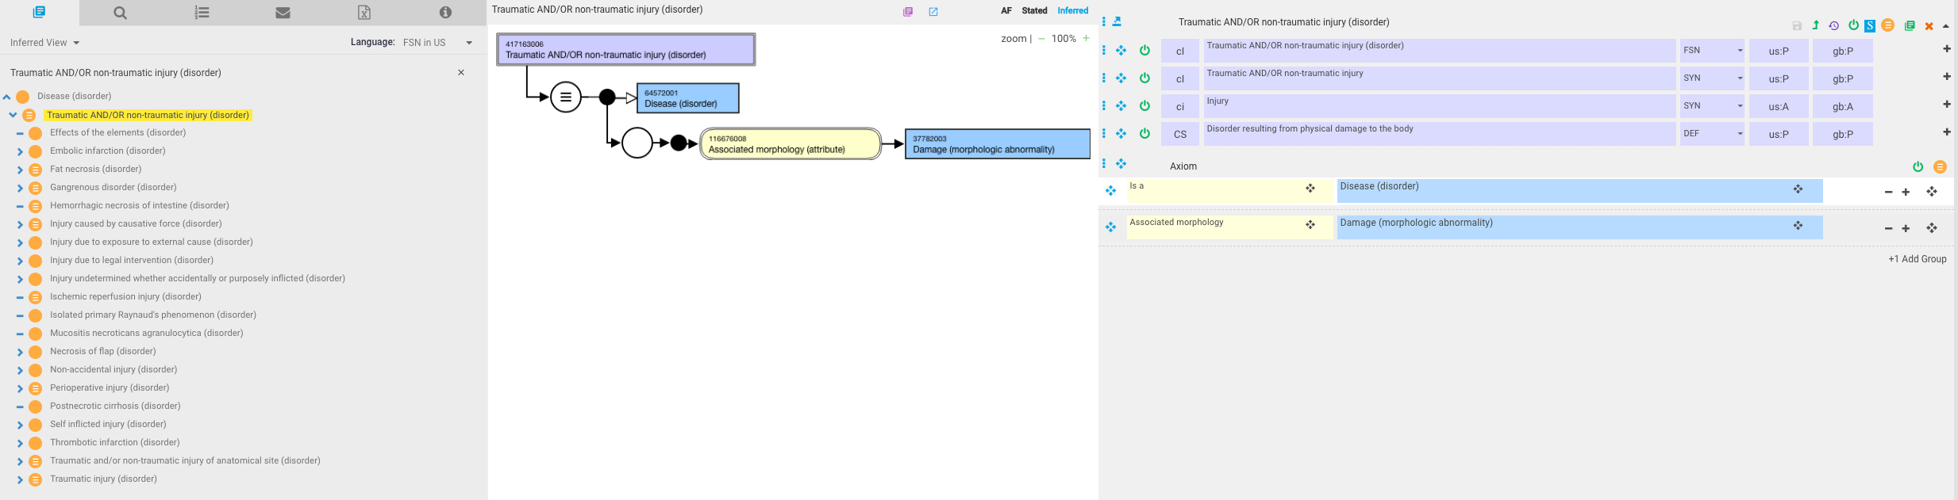
Injury
The current model for injury (traumatic or nontraumatic) is fully defined with an associated morphology of damage
The meaning of damage as a subtype morphologic abnormality is unclear, many sources provide circular definitions of injury and damage
Specific types of injury would need to have morphologies that are subtypes of damage which is not always the case in order to be fully defined

Slide 9
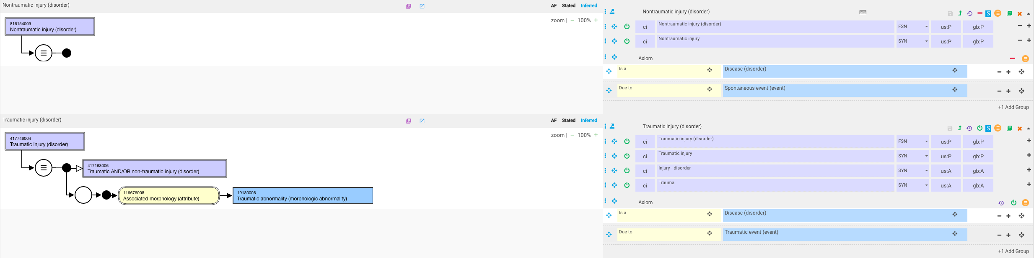
Proposed models for Traumatic injury (disorder) and new concept Nontraumatic injury (disorder)

Slide 10
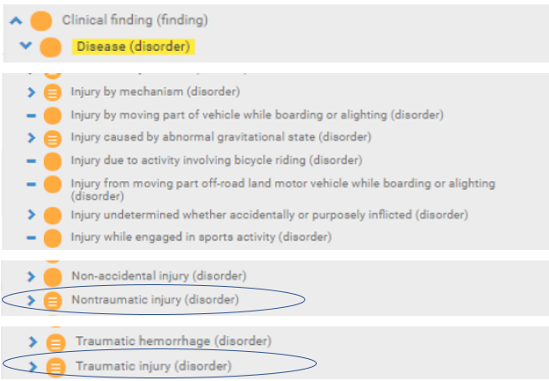
Injury concepts after inactivating 417163006 |Traumatic AND/OR non-traumatic injury (disorder)|

Slide 11
Fractures

Slide 12
Examples in SNOMED of fractures that are represented as both pathological fractures and traumatic fractures
id | fsn
704173002 | Pathological fracture of ankle (disorder)
16114001 | Fracture of ankle (disorder)
424455005 | Pathological fracture of clavicle (disorder)
58150001 | Fracture of clavicle (disorder)
409667007 | Pathological fracture of femur (disorder)
71620000 | Fracture of femur (disorder)
445527009 | Pathological fracture of fibula (disorder)
75591007 | Fracture of fibula (disorder)
424644003 | Pathological fracture of foot (disorder)
15574005 | Fracture of foot (disorder)
1.13152E+16 | Pathological fracture of mandible (disorder)
263172003 | Fracture of mandible (disorder)
1.13152E+16 | Pathological fracture of maxilla (disorder)
263156006 | Fracture of maxilla (disorder)
409666003 | Pathological fracture of neck of femur (disorder)
5913000 | Fracture of neck of femur (disorder)
426777008 | Pathological fracture of patella (disorder)
51037009 | Fracture of patella (disorder)
426115002 | Pathological fracture of pelvis (disorder)
77493009 | Fracture of pelvis (disorder)
704172007 | Pathological fracture of phalanx of finger (disorder)
18171007 | Fracture of phalanx of finger (disorder)
704168008 | Pathological fracture of phalanx of foot (disorder)
21351003 | Fracture of phalanx of foot (disorder)
704171000 | Pathological fracture of proximal end of femur (disorder)
263225007 | Fracture of proximal end of femur (disorder)
704170004 | Pathological fracture of radius (disorder)
12676007 | Fracture of radius (disorder)
704169000 | Pathological fracture of rib (disorder)
33737001 | Fracture of rib (disorder)
422469006 | Pathological fracture of scapula (disorder)
9682006 | Fracture of scapula (disorder)
704167003 | Pathological fracture of ulna (disorder)
54556006 | Fracture of ulna (disorder)

Slide 13
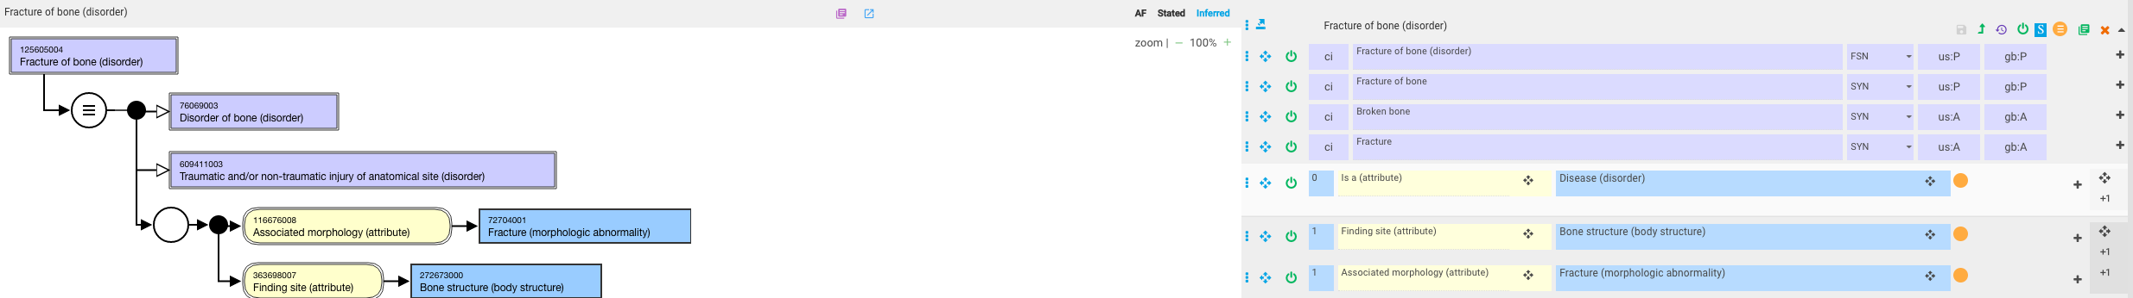
125605004 |Fracture of bone (disorder)|

Slide 14
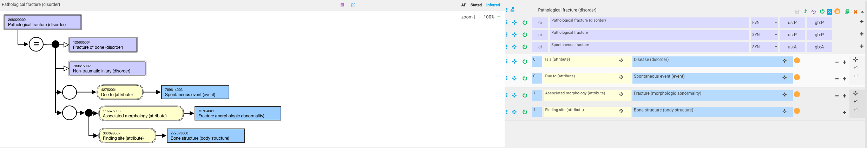
268029009 |Pathological fracture (disorder)|

Slide 15
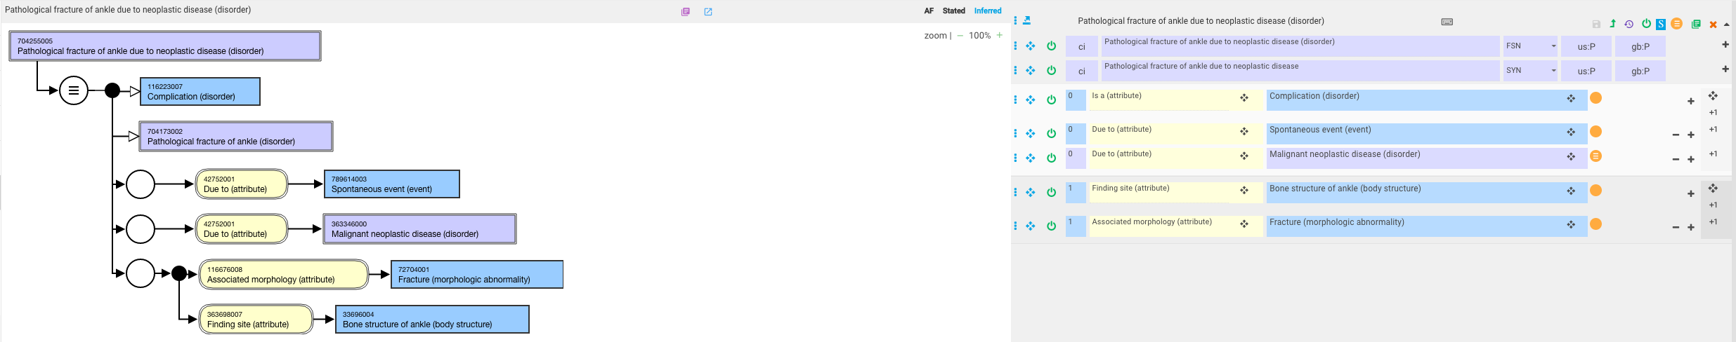
704255005 |Pathological fracture of ankle due to neoplastic disease (disorder)|

Slide 16
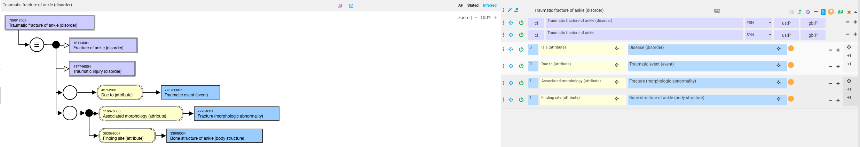
789617005 |Traumatic fracture of ankle (disorder)|

Slide 17
Decisions
Should all fractures except pathological fractures be considered to be traumatic injuries and thus 125605004 |Fracture of bone (disorder)|(perhaps renamed as Traumatic fracture of bone) and 268029009 |Pathological fracture (disorder)|be siblings?
Or
Should 125605004 |Fracture of bone (disorder)|subsume all other fractures including pathological fractures?

Slide 18
Multiple due to and/or causative agent relationships

Slide 19
Is it appropriate to use multiple due to and/or causative agent relationships to represent to model causal chains?

Slide 20
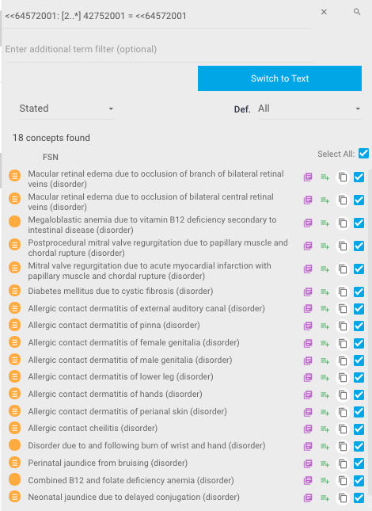
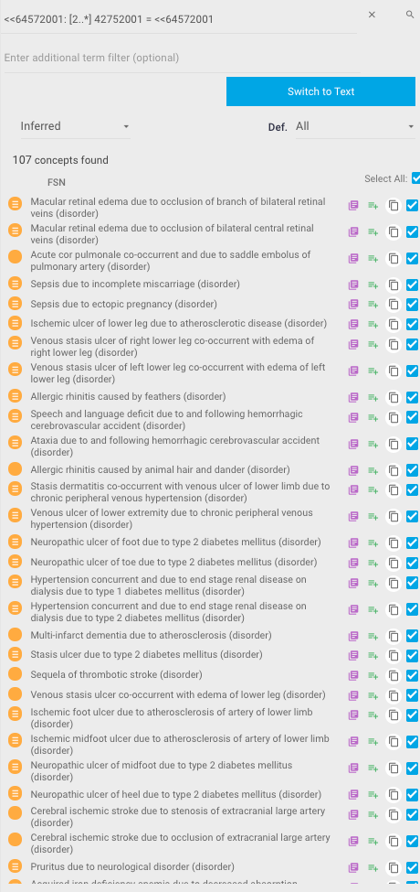
Concepts modeled with 2 or more due to relationships
<<64572001: [2..*] 42752001 = <<64572001

Slide 21
Disorders due to another disorder for which the parent disorder is defined with a due to relationship
These represent a causal chain
Examples
  717946000 |Megaloblastic anemia due to vitamin B12 deficiency secondary to intestinal disease (disorder)|
  206442000 |Perinatal jaundice from bruising (disorder)|
  17140000 |Neonatal jaundice due to delayed conjugation (disorder)|
  95343001 |Ulcer of skin caused by ischemia due to hypertensive disease (disorder)|
  420996007 |Coma associated with malnutrition-related diabetes mellitus (disorder)|

Slide 22
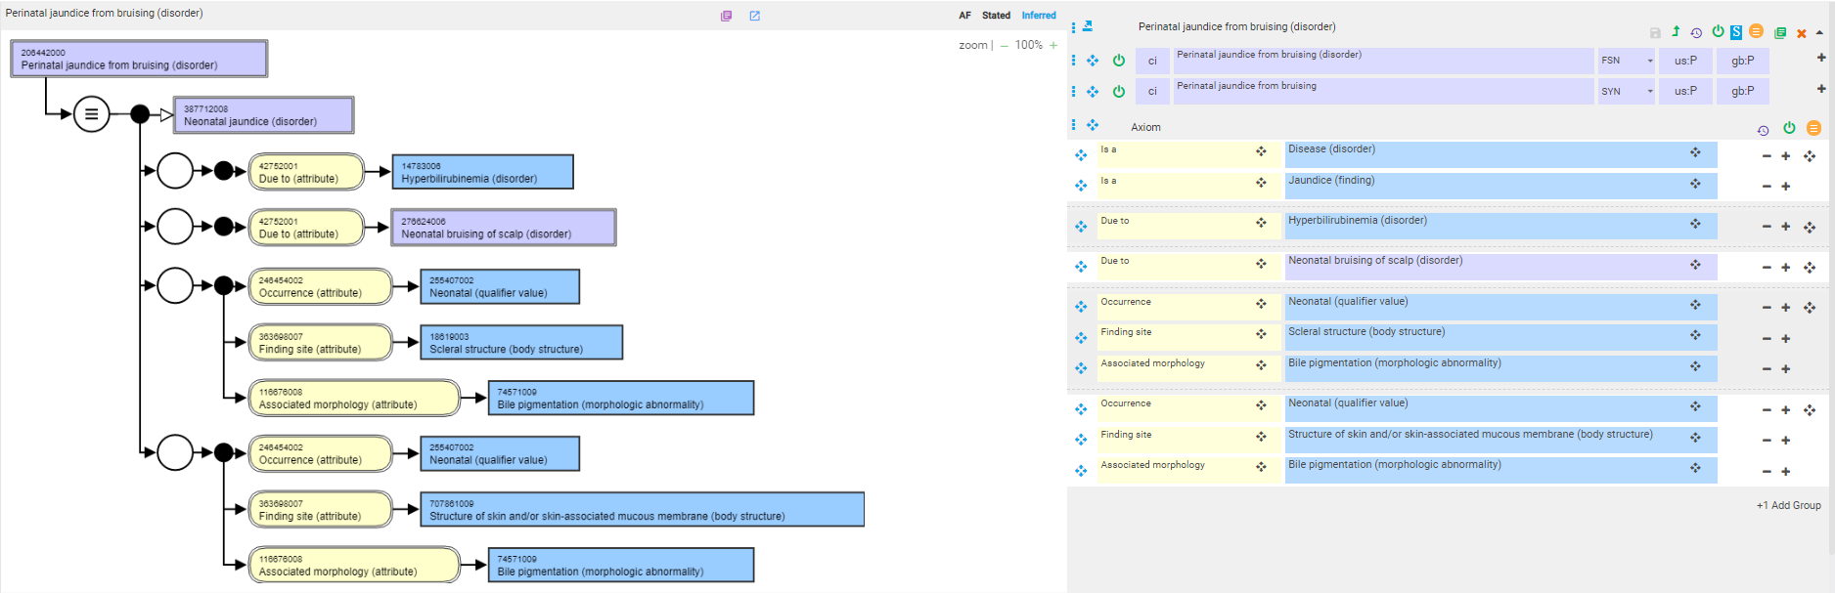
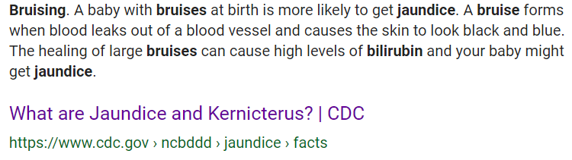
206442000 |Perinatal jaundice from bruising (disorder)|
Perinatal/neonatal jaundice is due to hyperbilirubinemia

Slide 23
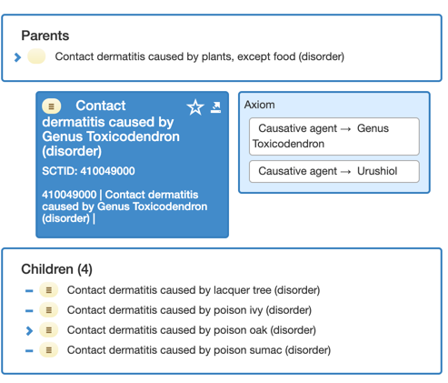
>1 causative agent
Descendants of this concept are all caused by a different plant of the genus Toxicodendron but all of the plants contain the same causative allergenic substance, Urushiol
There is no linkage between Genus Toxicodenron (organism) and Urushiol (substance)

