Slide 1
Editorial policy for simple co-occurrence

Slide 2
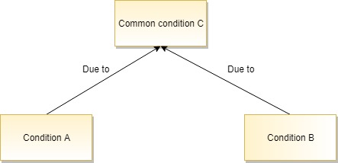
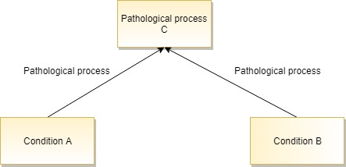
Definition of simple co-occurrence
Two or more conditions in which a causal relationship between the conditions is absent or unknown but are related either by a common causal relationship or pathological process

Slide 3
Use cases
Multi-component (genetic) syndromes
Manifestations of multi-system disorders
Overlap syndromes

Slide 4
Syndromes
The individual conditions comprising syndromes are usually associated by a common cause such as a genetic mutation
Syndromes may comprise a few common features as well a number of less common features
  Example 717785002 |Coloboma of macula with brachydactyly type B syndrome (disorder)|
    Common features: bilateral macular colobomas and apical dystrophy of the hands and feet (brachydactyly type B)
    Uncommon features: single kidney, hearing loss, uterine anomaly
As there is currently no model for genetic diseases, it is recommended that for now, genetic diseases consisting of multiple conditions be modeled using only simple co-occurrence of the most common/consistent features.
For less common features model the feature co-occurrent with the common features
    Example Hearing loss co-occurrent with Coloboma of macula with brachydactyly type B syndrome (disorder)

Slide 5
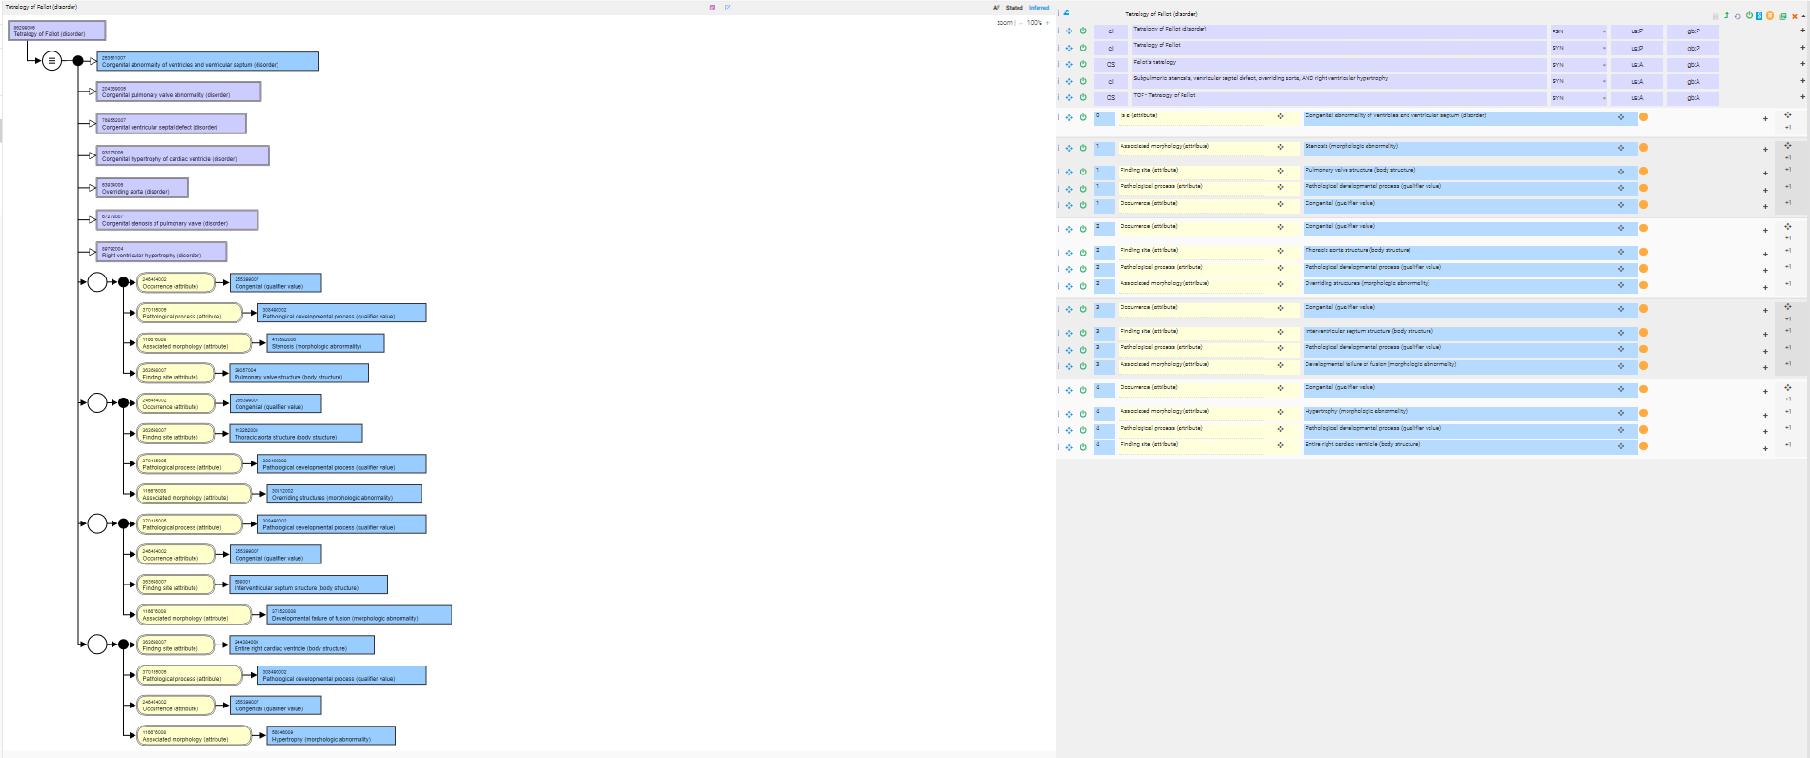
86299006 |Tetralogy of Fallot (disorder)|

Slide 6
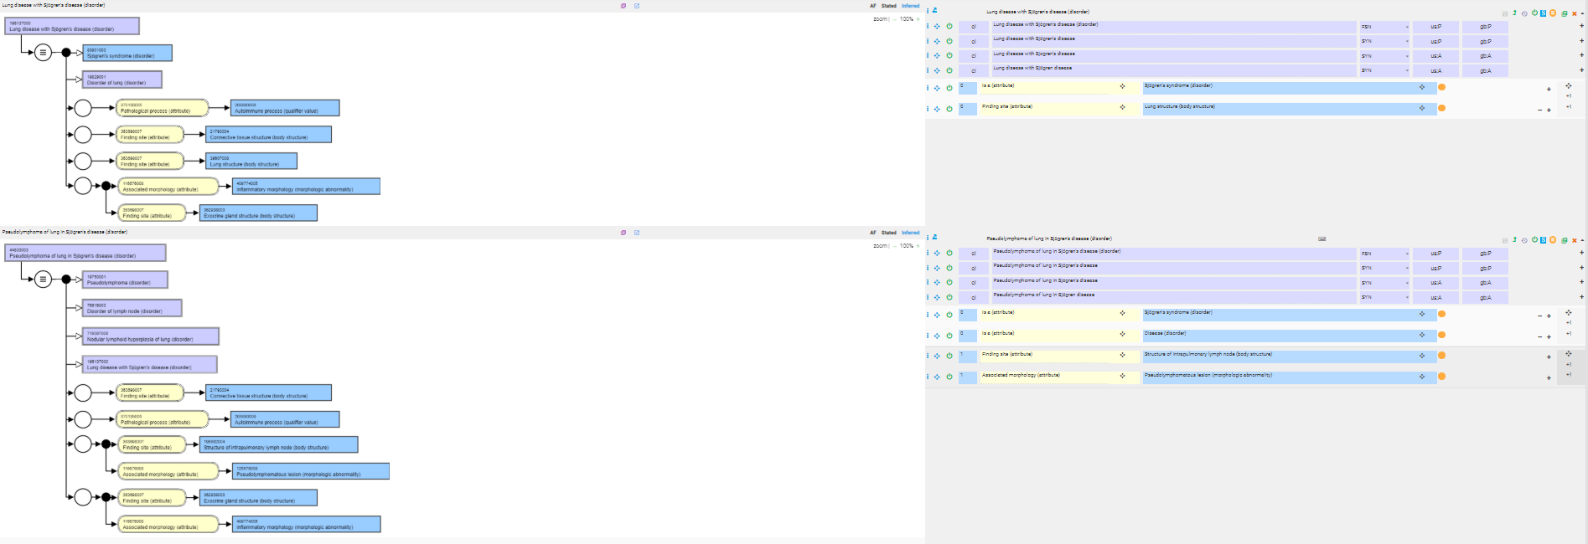
Manifestations of multisystem disorders

Slide 7
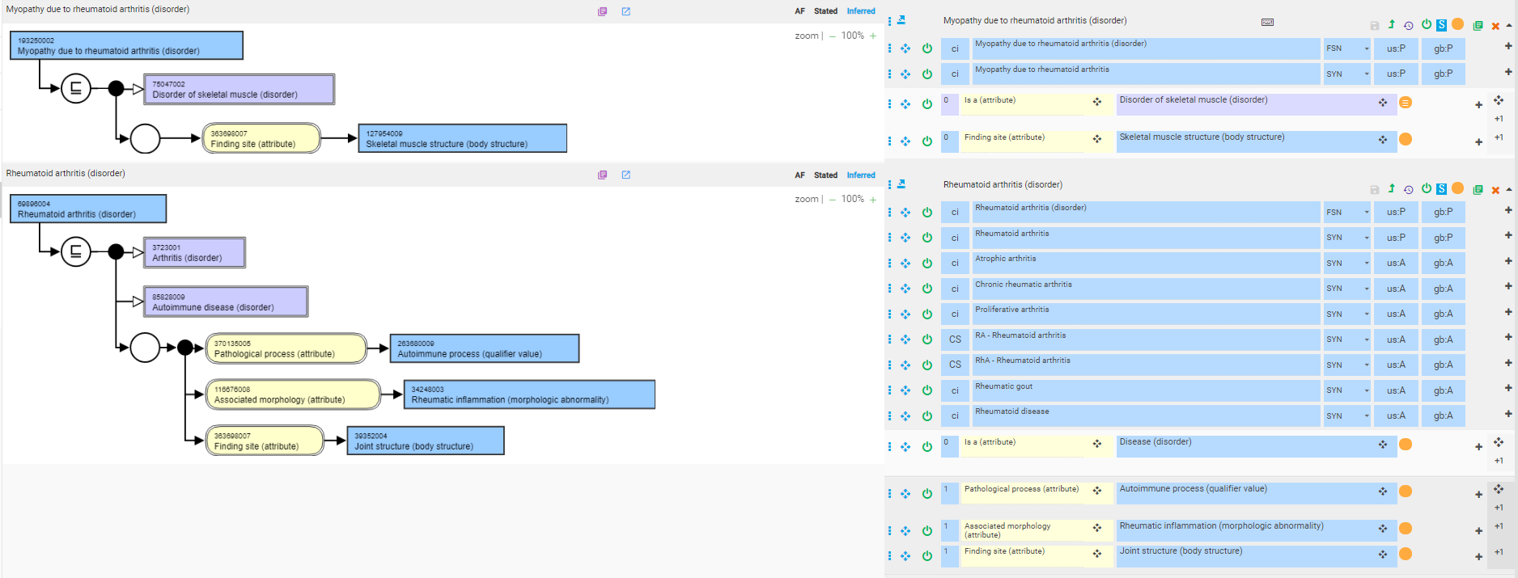
Manifestations of multisystem disorders where the multisystem disorder is named and modeled as the primary manifestation

Slide 8
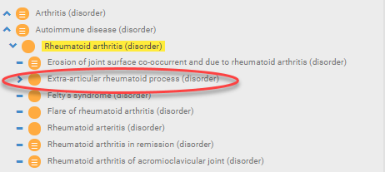
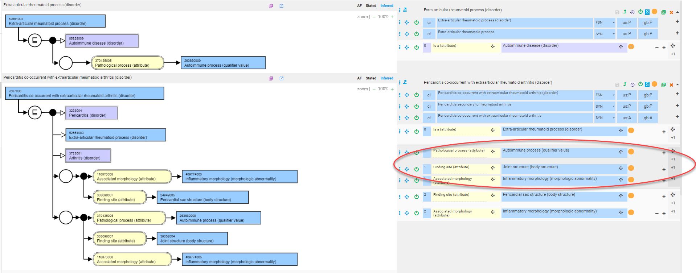
Manifestations of rheumatoid arthrits

Slide 9
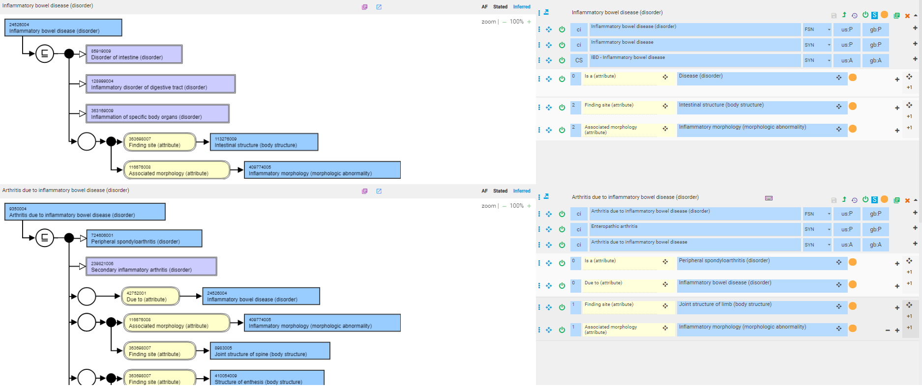
Other systemic disorders for which this approach would be useful
Create a new concept of extra-intestinal inflammatory bowel disease as a sibling of Inflammatory bowel disease

Slide 10
Simple co-occurrence - recommendations
Do not create new concepts where there is just a random coincidental occurrence of multiple conditions.
Existing concepts may be retained

