Slide 1
Secondary disorders and gout

Slide 2
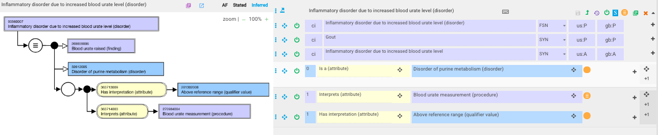
Gout – current model
The FSN states this is an inflammatory disorder but there is no mention of inflammation in the model

Slide 3
Is hyperuricemia a necessary condition for gout?
Many articles report that acute flares of gout can occur with normal uric acid levels but do not clearly state that individuals with gout never have elevated uric acid at some point during their disease.

Slide 4
Hyperuricemia and Gout
Not all patients with hyperuricemia develop gout. In the United States, 21% of the population have hyperuricemia, and 4% have gout.1 The 5-year cumulative incidence of gout was 0.5% in men with uric acid levels of 6 mg/ dL or less (to convert to mmol/L, multiply by 59.485) and 30.5% in those with levels of 10 mg/dL or higher. Uric acid levels may fluctuate and possibly decrease during an acute episode, but if normal, measuring uric acid 2 to 3 weeks after an acute attack has resolved will provide an accurate baseline and may aid in establishment of the diagnosis. Acute gout cannot be excluded by the presence of a normal serum urate level.
Mayo Clin Proc. n August 2017;92(8):1234-1247 n http://dx.doi.org/10.1016/j.mayocp.2017.05.026 www.mayoclinicproceedings.org n ª 2017 Mayo Foundation for Medical Education and Research

Slide 5
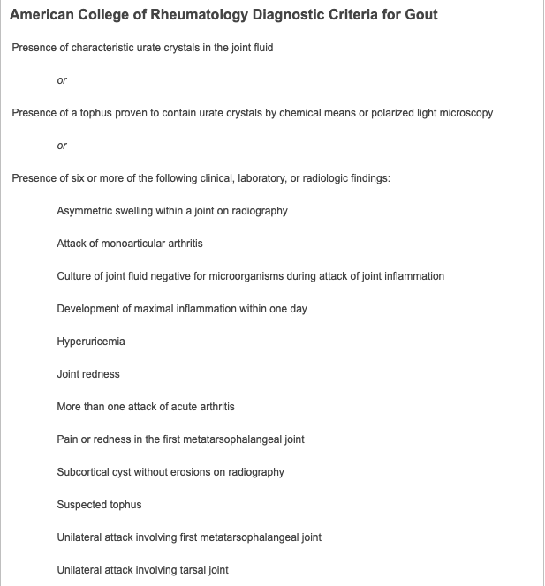
Diagnostic criteria for gout
Hyperuricemia appears to be neither sufficient or necessary for diagnosis of gout

Slide 6

Gout – proposed revision to model
Or 112654002 |Deposition of sodium urate crystals (morphologic abnormality)|?

Slide 7

Secondary gout proposed revision to model

Slide 8
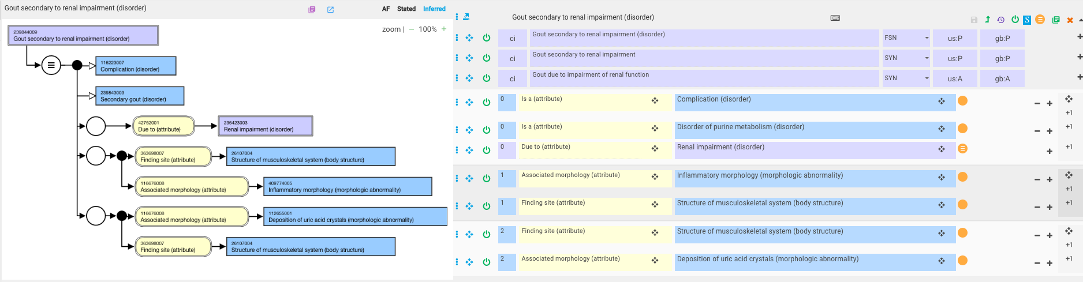
Gout secondary to other diseases - 1

Slide 9
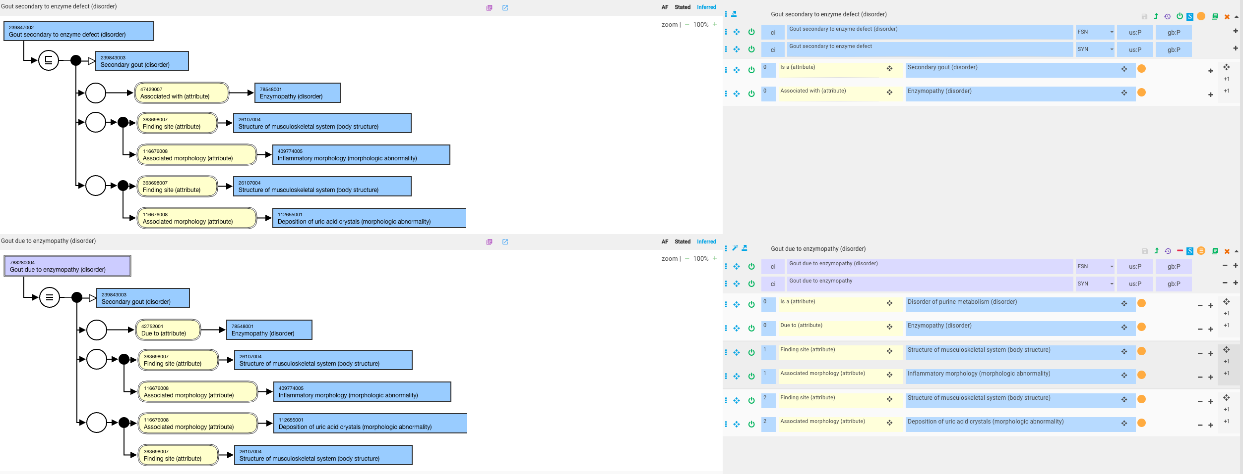
Gout secondary to other diseases - 2
Original model
Revised model. Not a complication

Slide 10

Gout secondary to substances

Slide 11

Gouty tophus
Tophus is a manifestation of gout

Slide 12
The Tophus in Calcium Pyrophosphate Deposition Disease
  James C. C. Leisen, MD; Eric D. Austad, MD; Gilbert B. Bluhm, MD; John W. Sigler, MD; et al.
  JAMA. 1980;244(15):1711-1712. doi:10.1001/jama.1980.03310150047031
  Abstract
  A 61-year-old man had a tophus on the third finger of his right hand. There was no history of arthritis, no laboratory abnormality, and no chondrocalcinosis. Crystalline material from the tophus was identified as calcium pyrophosphate dihydrate by x-ray diffraction.

Slide 13
CHOLESTEROL “TOPHUS”
ADEL G. FAM, MICHAEL SUGAI, ELIE GERTNER, and ANTHONY LEWIS
Arthritis and Rheumatism, Vol. 26, No. 12 (December 1983)
Subcutaneous tophi containing monosodium urate crystals are common in gout. Subcutaneous crystal deposition and “tophus” formation are, however, rare in other forms of crystal-induced arthritis. There are only a few reports of periarticular, subcutaneous, tophus-like swellings containing deposits of calcium pyrophosphate dihydrate (1-3) or hydroxyapatite crystals (4). We describe a unique case of subcutaneous cholesterol granuloma presenting as a tophus-like swelling containing masses of cholesterol crystals.

Slide 14
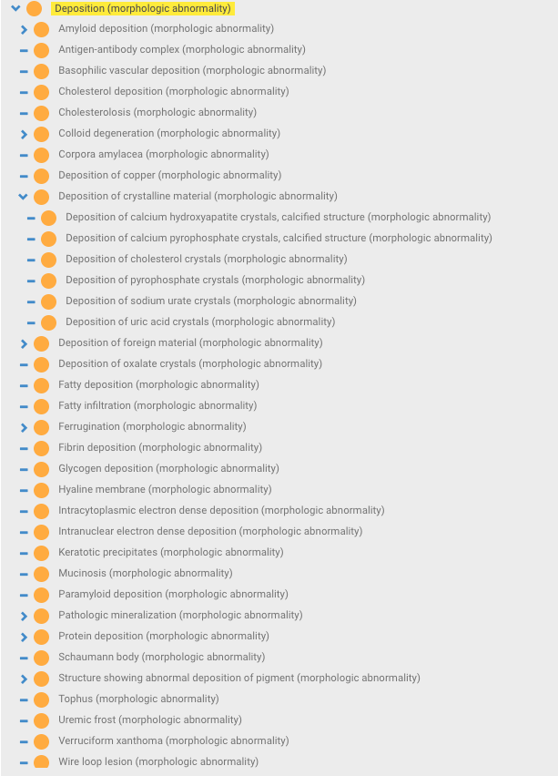
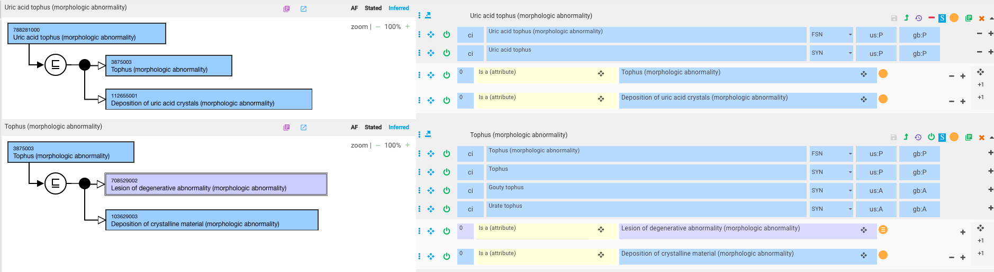
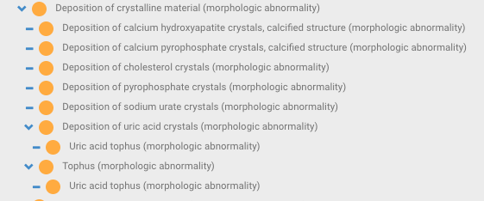
Deposition (morphologic abnormality) hierarchy
Current Deposition morphology hierarchy
New concept: Uric acid tophus (morphologic abnormality)

Slide 15
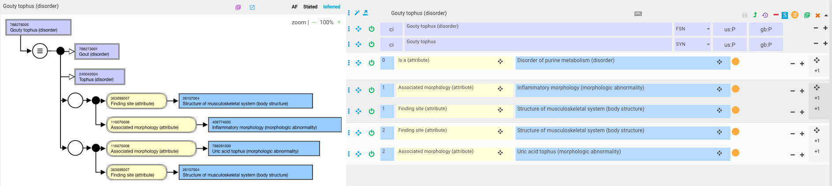
Gouty tophus revised

Slide 16

Gouty arthritis
Original model
Revised model. Not a complication
Arthritis is a manifestation of gout

