Slide 1
Neuralgia – finding or disorder

Slide 2
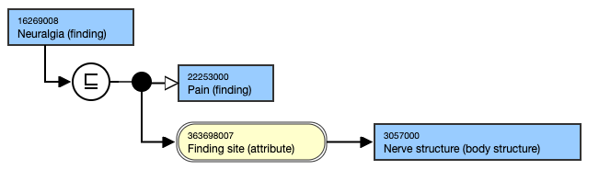
16269008 |Neuralgia (finding)|
Question arose as to whether neuralgia and its subtypes are findings or disorders

Slide 3
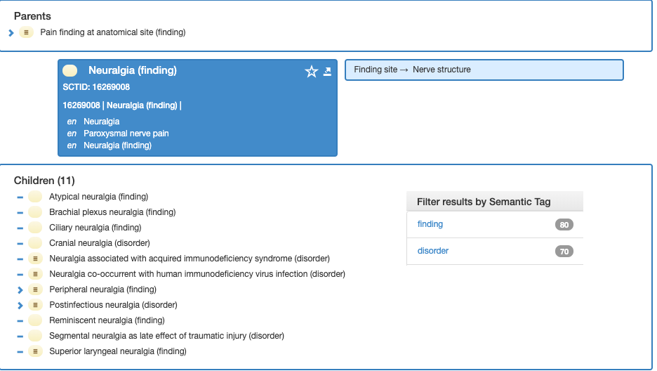
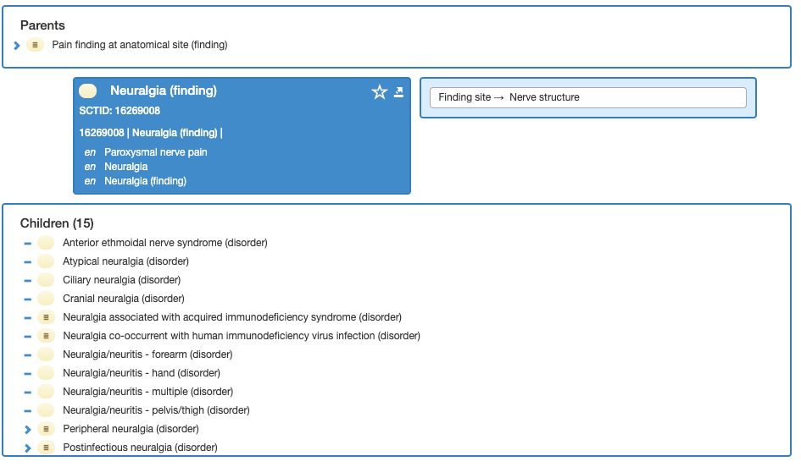
16269008 |Neuralgia (finding)|
Daily Build Browser
SNOMED CT Browser

Slide 4
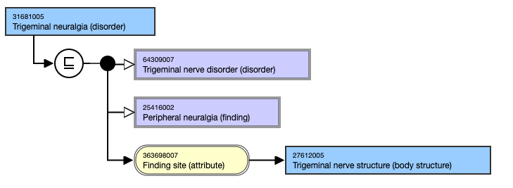
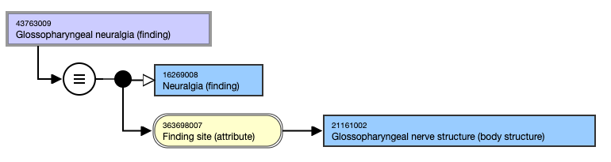
Subtypes of neuralgia

Slide 5
Decision from July 2, 2019 authors call
Symptoms such as pain or neuralgia are always findings.
Symptoms due to disorders are disorders
  16638401000119101 | Neuralgia of nerve of bilateral lower limbs (disorder) should be a finding

Slide 6
Is trigeminal neuralgia a finding or disorder? – comments from Jim Case July 3, 2019
If we refer back to the discussion we had in London on the nature of condition vs. occurrence, then trigeminal neuralgia, from my understanding would fall into the former category as it is a chronic condition.
  What this means is that, as we have found in other areas, lexical decomposition is often not sufficient to get the full understanding of the meaning of a term.
  In the example of sciatica, we have the issue that in some cases, besides the ever present pain,there may be leg weakness, indicating a neuropathy beyond the sensory nerves... so we run into the issue that clinically we have a term that has a broad coverage of clinical signs associated with the sciatic nerve that may be an occurrence or it may be a more chronic condition due to other pathology such as disc protrusion.
So going back to the original question as to whether neuralgia is a finding or a disorder, we need to go back to the causal chain.
  If we accept that neuralgia "only" occurs following some form of damage or irritation to the nerve, it would be reasonable to argue that these are "conditions" because they imply more than just the symptom of pain, but damage to the nerve with a manifestation of pain.
  However, this would be a deviation from other existing pain findings that also imply damage to the site of the pain (e.g. 247373008 |Ankle pain (finding)|).
  So what makes neuralgia special?
    For named syndromes, making them disorders is understandable, but for pain in a specific body region without any other qualification, seems they have been viewed as findings.
    So an even more general question, is neuralgia a neuropathy?
    Neuropathy is a disease, damage or dysfunction of a nerve and is currently a disorder concept and Neuralgia is not a subtype, yet it would seem to fit under the definition of neuropathy.
    If we decide to keep neuralgia as a finding, then we would need to make sure that all pain disorders had both Neuralgia and Disease as parents (which looks like the case currrently).
    Looking at the SNOMED browser and the daily build, I would need to go back to the authors to determine the sources of the differences (it appears the semantic tags have been changed) for this release

Slide 7
Comments from Paul Amos – July 3, 2019
I think this goes to the root of my concerns and demonstrates the tension between our approach to recording information as clinicians and how we as clinical terminologists choose to model symptoms and disorders etc. As clinicians we take a history and conduct an examination and then record something which is interpreted as a diagnosis but which in many cases is nothing more than a 'summary' of our findings. To state that a patient has trigeminal neuralgia is nothing more than restating the symptoms which the patient has described but put into medical parlance. The patient requires further investigation in order to establish the cause of the neuralgia so that we can then apply the appropriate treatment. In my opinion, the subtypes of Trigeminal neuralgia might include Trigeminal neuralgia due to multiple sclerosis, Trigeminal neuralgia due to microvascular compression, trigeminal neuralgia due to malignant schwannoma (rare, I know) and these would correctly have a semantic tag of "disorder" because as a general rule it is only a clinical statement at this level of detail which can be actioned appropriately to treat the disorder. This is not to say that we should not give treatment based upon symptoms alone, however this is usually as an interim measure to control symptoms until the underlying disorder is establish and the specific treatment applied. Therefore, the symptom of trigeminal neuralgia may be treated with analgesics until the definitive diagnosis has been established. With respect to the recording habits of our fellow clinicians, I accept many will choose to record just "Trigeminal neuralgia". Given that the preferred term/synonym does not carry the semantic tag does it matter whether the clinician is aware of whether terminologically it is in the class of "findings" or "disorders" ? There are a couple of wider issues which relate to the discussion on Findings/Disorders/Diseases: Would it be possible/useful to create a set of criteria which support a class of "Disorders" based upon the discussion above which would be conceptually and terminologically disjoint with a class of "symptoms/Findings"? While it is possible to create a set of concepts based upon the pattern "Symptom/Finding XXX due to disorder YYY (disorder)" this would lead to a level of combinatorial explosion. Therefore, my preferred option would be to have a finding of "Trigeminal neuralgia" and a diagnosis of "Malignant schwannoma of the trigeminal nerve". But it might be considered an acceptable price to pay for clinician acceptance - system suppliers would have to compute equivalence between the 2 approaches in order to ensure consistency in extraction criteria and decision support algorithms.

Slide 8
Comments from Paul Amos – July 3, 2019
I think we might be placing too much weight on the perceived distinction between finding and disorder. The question is when does something rise to the qualification as a "disease", vs is just a point in time finding. It really depends on how one views each of these conditions. For example, sciatica, in and of itself, is just a pain symptom (and could be transient, having experienced that myself) or it could be chronic, which implicated an underlying condition that is causing the pain, but the pain is still just a finding. One might symptomatically treat the pain, but the main focus would be to treat the underlying inciting cause, no? So, I am still relatively comfortable with making unqualified symptoms "clinical findings". If we make sciatica a finding (and remodel it to be what it is, "Pain in the sciatic nerve", what would be major issues?

Slide 9
Comments from Paul Amos – July 9, 2019
Further to some additional research I would like to push back on the assertion that neuralgia results solely from injury or damage to the nerve.
A recent review "Trigeminal Neuralgia, Glossopharyngeal Neuralgia, and Myofascial Pain Dysfunction Syndrome: An Update ( see: https://www.ncbi.nlm.nih.gov/pmc/articles/PMC5554565/ ) gives a comprehensive review of myofacial pain and TN in particular and lists the various causes according to the classification according to Eller et al (2005) ( see: https://www.ncbi.nlm.nih.gov/pubmed/15913279 ) . The final class in the classification; TN7: atypical facial pain and facial pain auxiliary to a somatoform pain issue, requiring mental testing for indicative diagnostic affirmation.
This is not uncommon in patients who present with neuralgia/pain to neurologists in which a somatoform cause needs to be excluded and is usually included as part of the differential diagnosis until a physical cause is established.
If we believe this to be acceptable clinical practice are we wise to assert and model this concept based solely upon an injury/damage causation when a psychological cause may be the underlying mechanism, even if it is the least likely we would fail the "necessarily true" criteria for modelling the concept.

Slide 10
Comments from Jim Case July 30, 2019
I agree that if there can be determined to be an underlying pathological process, that the entity in question would "most likely" fit under disorder.
I would need more convincing in the area of all disorders being continuents, especially when dealing with diseases in remission, which we have currently said are not subtypes of disease but if they were continuents, then they would need to be subtypes of the relevant disease.
Likewise, clinical manifestations of a disease may persist. so are they occurrents or continuents?
The whole discussion around the separation within SNOMED of findings and disorders I think is leading down the path of continuent and occurrent, but does not clearly distinguish when the same entity can be both or either.
All we can state is that there is a class of objects that exists in reality of either an occurrrent or a continuent, which is determined at the point in time of the observation (or decision point).
In OGMS, diseases are considered to be dispositions and may be consistent with what we used in allergies, calling them propensities (which has a synonym of disposition). The question is whether we can systematically apply this to concepts in the clinical findings hierarchy...
  Comment form Bruce Goldberg - With regard to the last statement that diseases in OGMS are dispositions, the path we followed for awhile in ECE was Stefan's approach that conditions are either abnormal structures, dispositions or pathological processes which works for allergies. We attempted to expand this to other domains and were unsuccessful.

