Slide 1
Proposal for modeling traumatic and nontraumatic injuries
Bruce J. Goldberg, MD, PhD

Slide 2
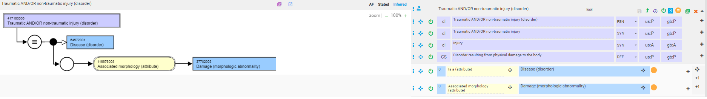
Injury

Slide 3
Proposal for modeling traumatic and nontraumatic injuries
Traumatic injuries
  Remove associated morphology <<417746004 |Traumatic injury (disorder)|relationships
  Add due to 773760007 |Traumatic event (event)|relationship
  Inactivate 419945001 |Traumatic injury due to event (disorder)|, 400209005 |Injury caused by causative force (disorder)| and 71677004 |Injury due to exposure to external cause (disorder)| sameAs 417746004 |Traumatic injury (disorder)|
Nontraumatic injuries
  Create new concept in event hierarchy, 788131004 |Spontaneous event (event)|
  Model nontraumatic injuries with a due to 788131004 |Spontaneous event (event)|relationship
  Note there are a number of existing primitive nontraumatic disorders in SNOMED with specific morphologies (such as rupture, perforation, blister, hematoma) that are not included under 37782003 |Damage (morphologic abnormality)|. These will need to be reviewed as to whether they do represent damage (injury) and if so the proposed model can be appropriately applied.

Slide 4
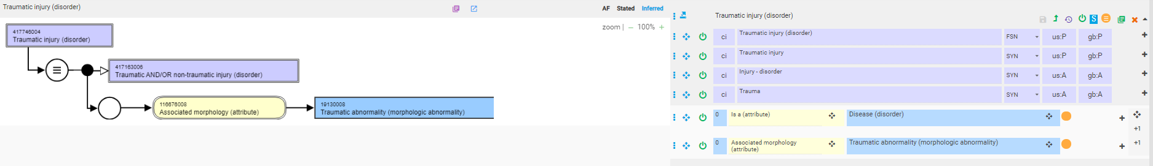
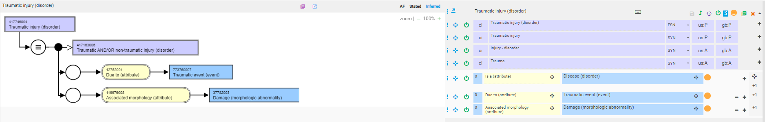
Traumatic injury
Current model
Proposed model

Slide 5
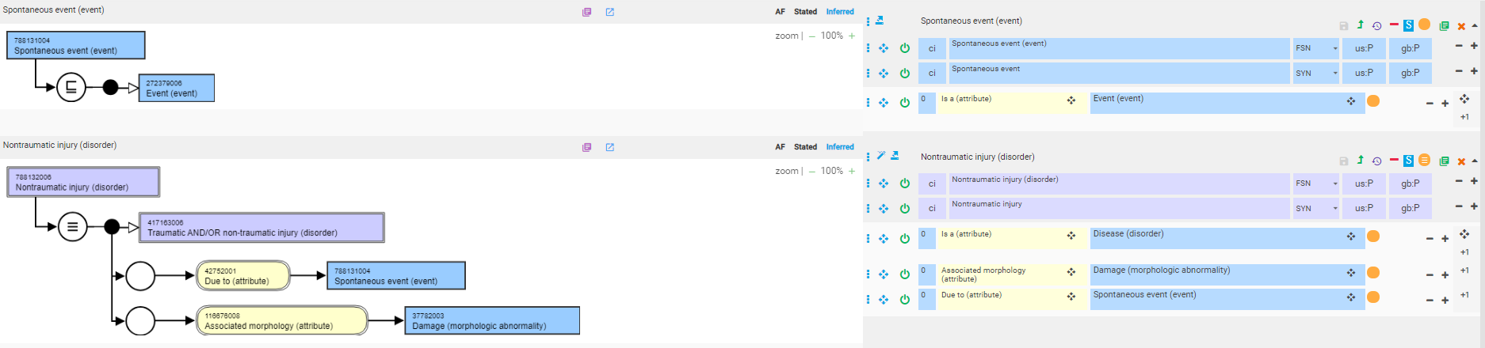
Nontraumatic injury (new concept)

Slide 6
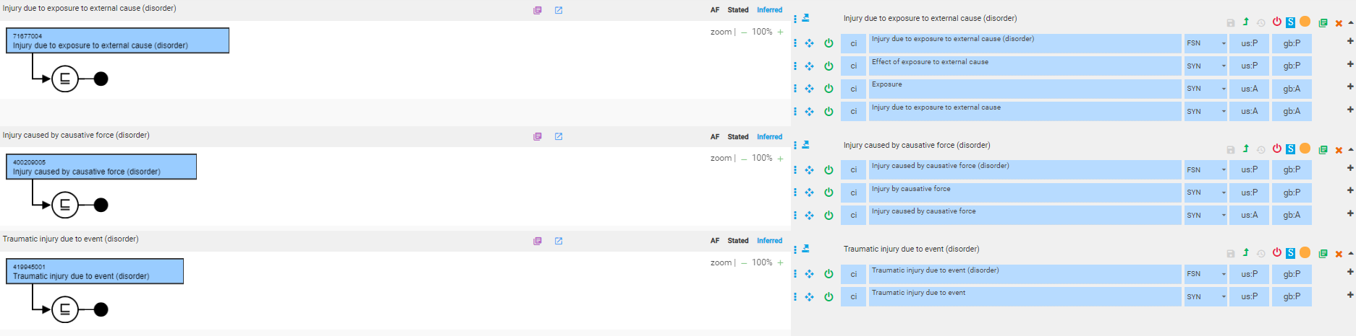
Duplicate concepts

Slide 7
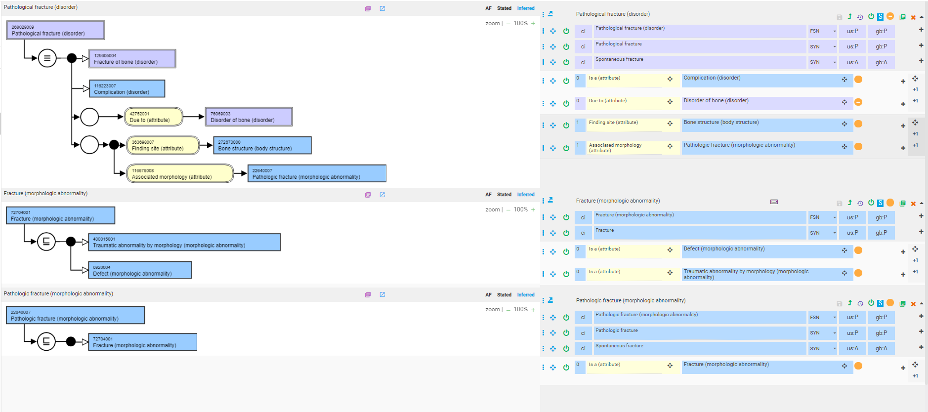
Pathological fracture – current model

Slide 8
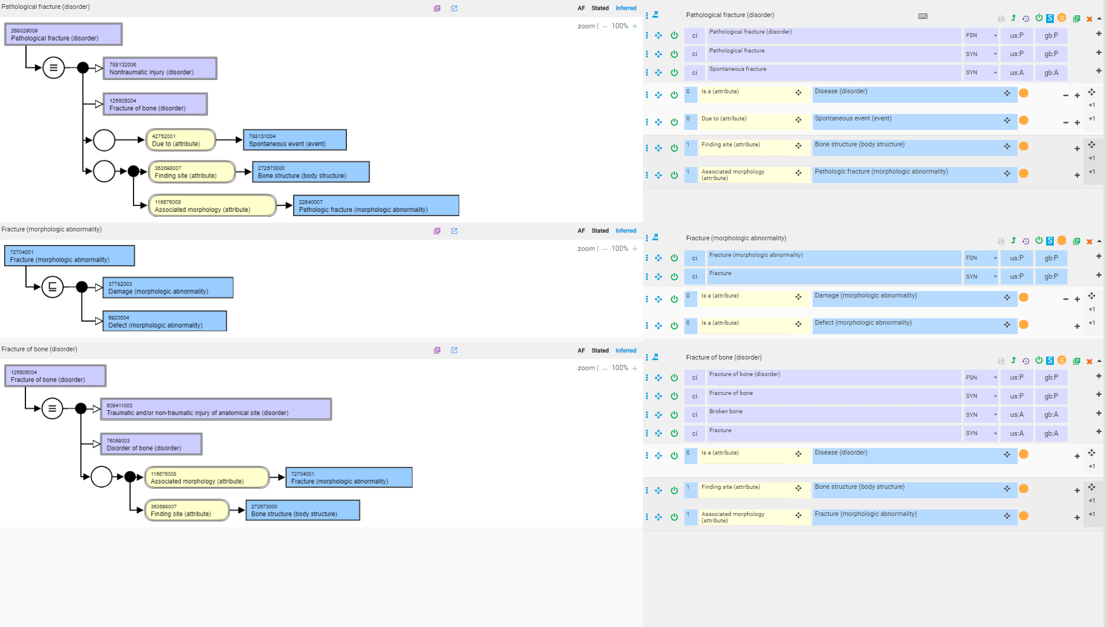
Pathological fracture – proposed model - 1

Slide 9
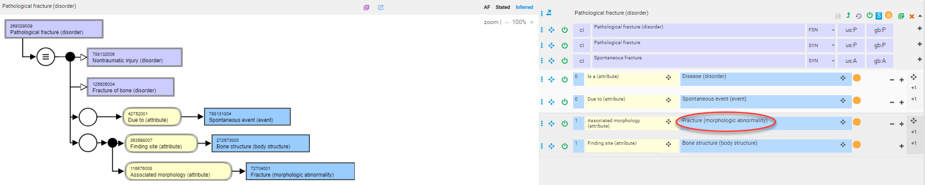
Pathological fracture – proposed model - 2

Slide 10
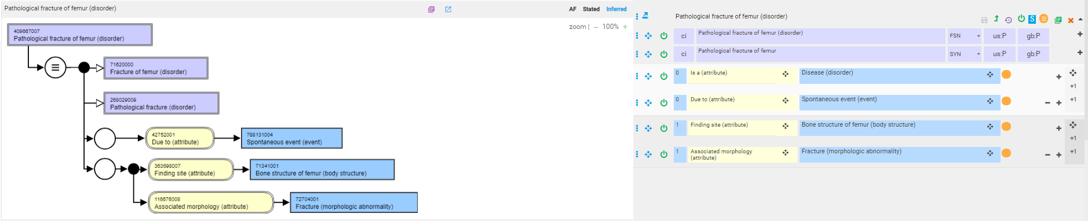
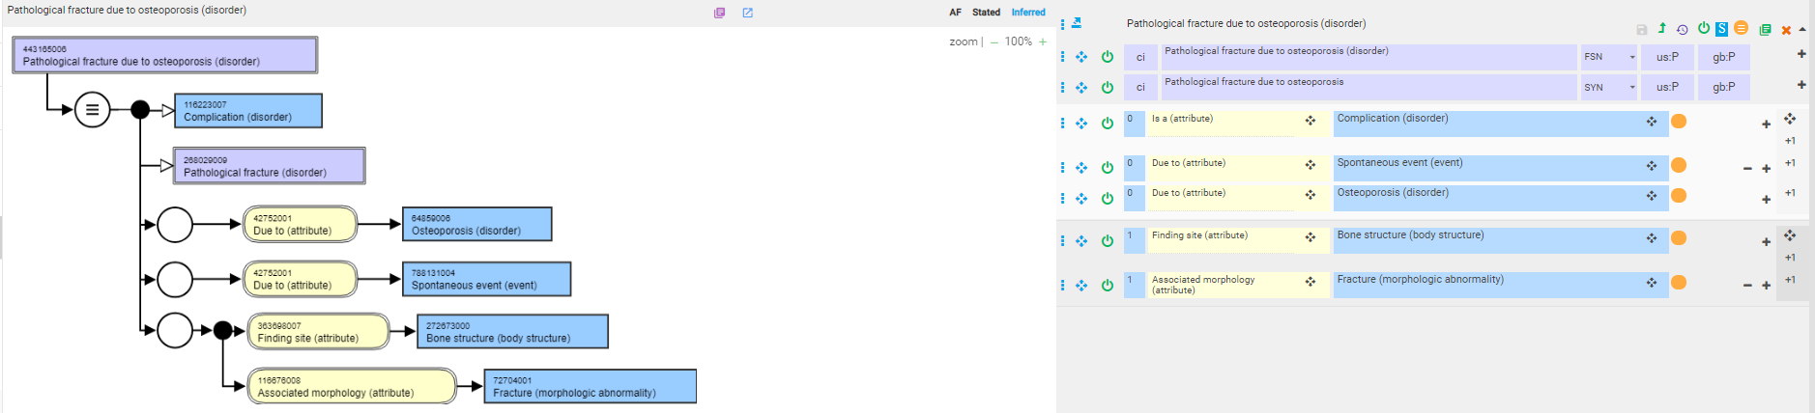
Pathological fracture subtypes using proposed model - 1

Slide 11
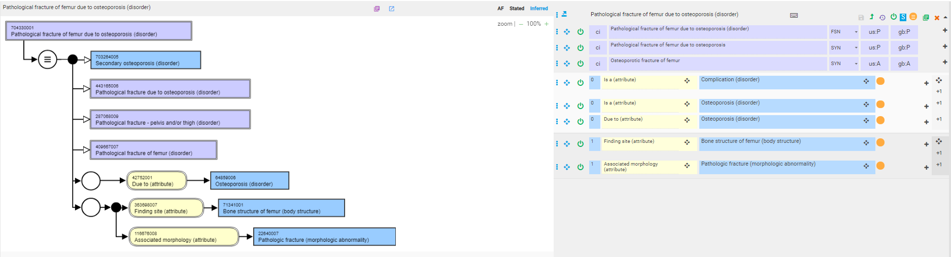
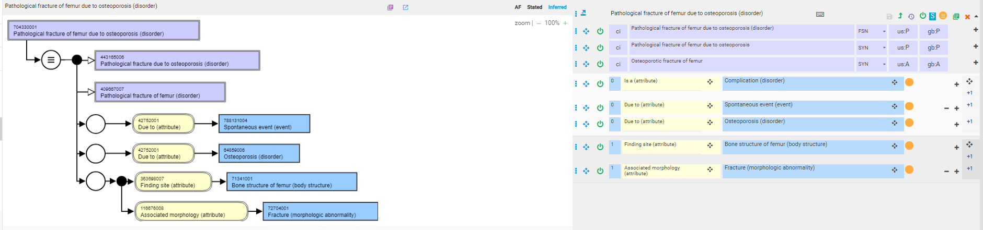
Pathological fracture subtypes using proposed model - 2
Current model
Proposed model

Slide 12
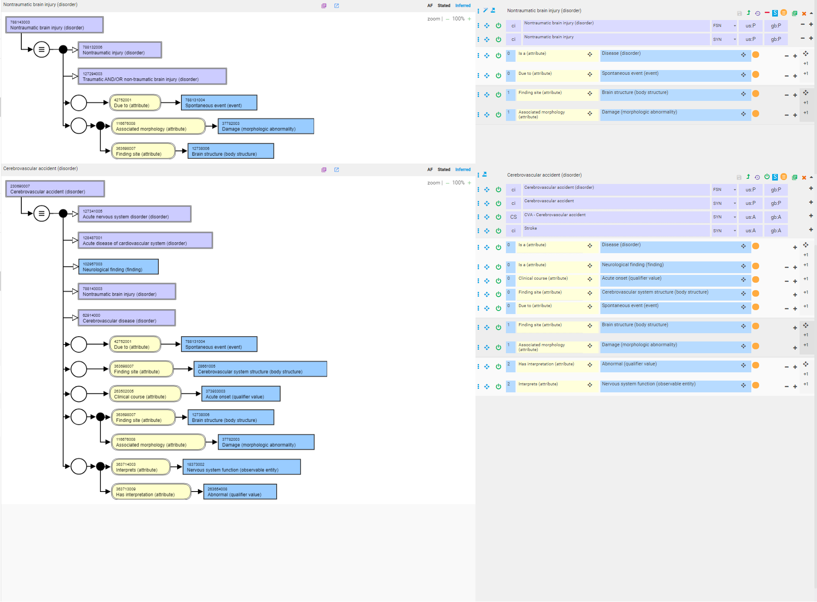
Nontraumatic brain injury and stroke

Slide 13
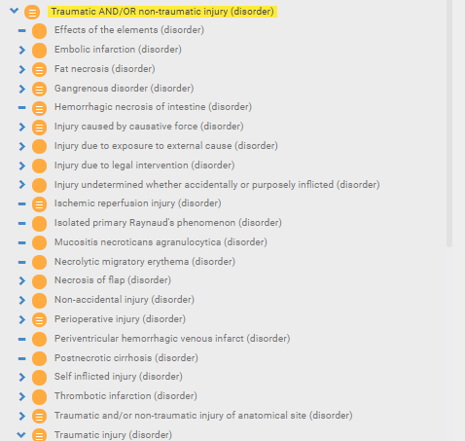
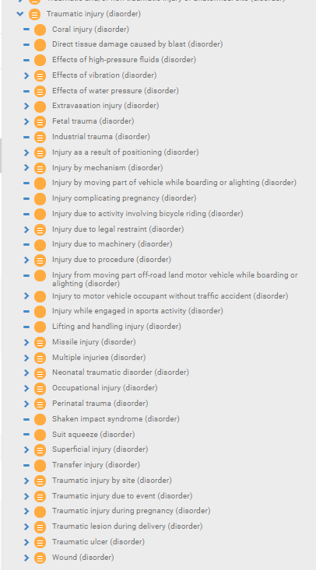
Current injury hierarchy

Slide 14
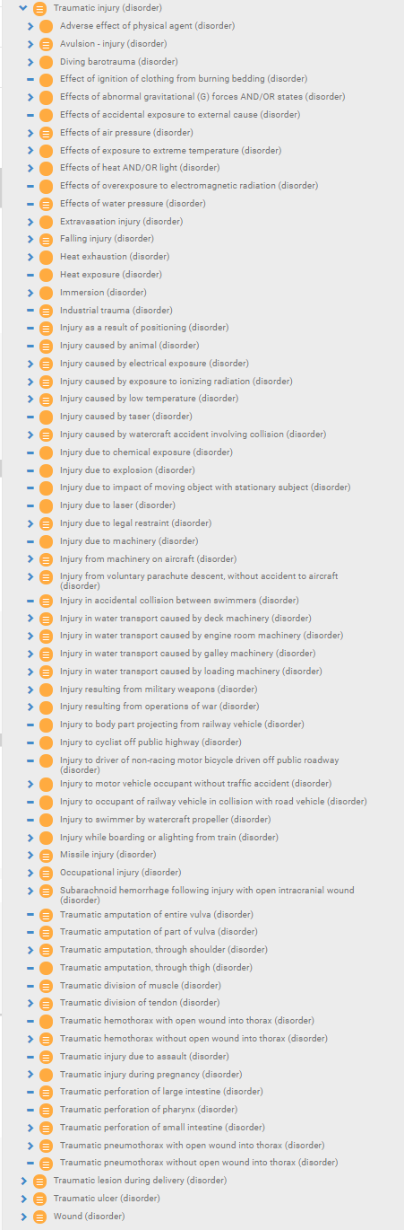
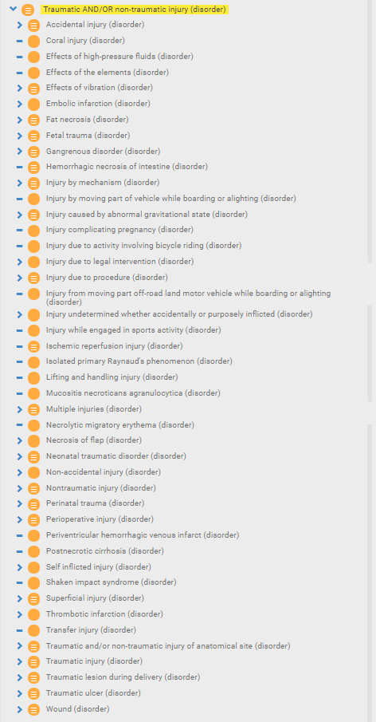
Proposed injury hierarchy

