Slide 1
Editorial policy for simple co-occurrence

Slide 2
Simple co-occurrence
A statement consisting of more than one clinical finding or disorder occurring at the same time represented as separate isA relationships to the constituent conditions
In general, this model should be avoided in favor of just representing the individual conditions in separate statements
A valid use case however would be to group together conditions that are strongly associated by means other than due to or after relationships and representing such conditions as separate statements would result in a loss of the association between the conditions

Slide 3
Syndromes 1
Syndromes
  Definitions
    A combination of symptoms and signs that together represent a disease process - MedicineNet.
    A combination of medical problems that commonly go together and that show the existence of a disease – Cambridge dictionary.
    A group of symptoms that consistently occur together or a condition characterized by a set of associated symptoms.
  Naming
    Eponyms – e.g. Kousseff syndrome
      The association of conotruncal heart defects, myelomeningocele and craniofacial dysmorphism
    Constituent conditions – e.g. Hypotrichosis, osteolysis, periodontitis, palmoplantar keratoderma syndrome (disorder)
      Sometimes an acronym is used e.g. CREST syndrome (Calcinosis, Raynaud's phenomenon, Esophageal dysfunction, Sclerodactyly, Telangiectasia

Slide 4
Syndromes 2
The individual conditions comprising syndromes are usually associated by a common cause such as a genetic mutation
Syndromes may comprise a few common features as well a number of less common features
  Example 717785002 |Coloboma of macula with brachydactyly type B syndrome (disorder)|
    Common features: bilateral macular colobomas and apical dystrophy of the hands and feet (brachydactyly type B)
    Uncommon features: single kidney, hearing loss, uterine anomaly
Model with common features
  For less common features model the feature co-occurrent with the common features
    Example Hearing loss co-occurrent with Coloboma of macula with brachydactyly type B syndrome (disorder)

Slide 5
Syndromes 3
Terming
  FSN should list the common features
    Example 716996008 |Hypoplasia of corpus callosum and mental retardation with adducted thumbs and spasticity and hydrocephalus syndrome (disorder)|
  Eponym may be an additional description or the PT if in common use
    L1 syndrome
Model for syndromes should be enhanced to include mode of inheritance, causative mutation, protein abnormalities when known

Slide 6
Overlap syndromes
Single condition with features of > 1 disease
  Examples
    276657008 |Overlap syndrome (disorder)|
    10692761000119107 |Asthma-chronic obstructive pulmonary disease overlap syndrome (disorder)|
  Terming
    FSN X-Y overlap syndrome
    Additional description X (co-occurrent ) with Y

Slide 7
Describing particular features of a systemic disorder
  129564003 |Ankylosing spondylarthritis and eye lesions (disorder)|
  28880005 |Rheumatoid carditis (disorder)|
  87442008 |Pericarditis co-occurrent and due to scleroderma (disorder)|
    The above represent manifestations of an underlying systemic disorder.
    There are a variety of names (and models) used to describe these in SNOMED including use of “with”, “and”, “in”, secondary to, due to, co-occurrent, co-occurrent and due to, associated with
    The systemic disorder in many cases is named for the most prominent manifestation and is modeled in that manner e.g. rheumatoid arthritis is really a systemic disease but is modeled as a kind of arthritis.
    It is useful to distinguish the systemic disorder from the most prominent manifestation of that disorder
    Rheumatoid carditis represents a similar inflammatory process occurring in the heart as in the joints and is thus not a complication of rheumatoid arthritis

Slide 8
Diseases with multisystem involvement
Scleroderma with multisystem involvement (disorder)
Behcet's disease with multisystem involvement (disorder)
Rheumatoid arthritis with multisystem involvement (disorder)
Ankylosing spondylitis with multisystem involvement (disorder)
Wegener's granulomatosis with multisystem involvement (disorder)
Primary Sjögren's syndrome with multisystem involvement (disorder)
Secondary Sjögren's syndrome with multisystem involvement (disorder)
Systemic lupus erythematosus with multisystem involvement (disorder)
Primary antiphospholipid syndrome with multisystem involvement (disorder)
Secondary antiphospholipid syndrome with multisystem involvement (disorder)

Slide 9
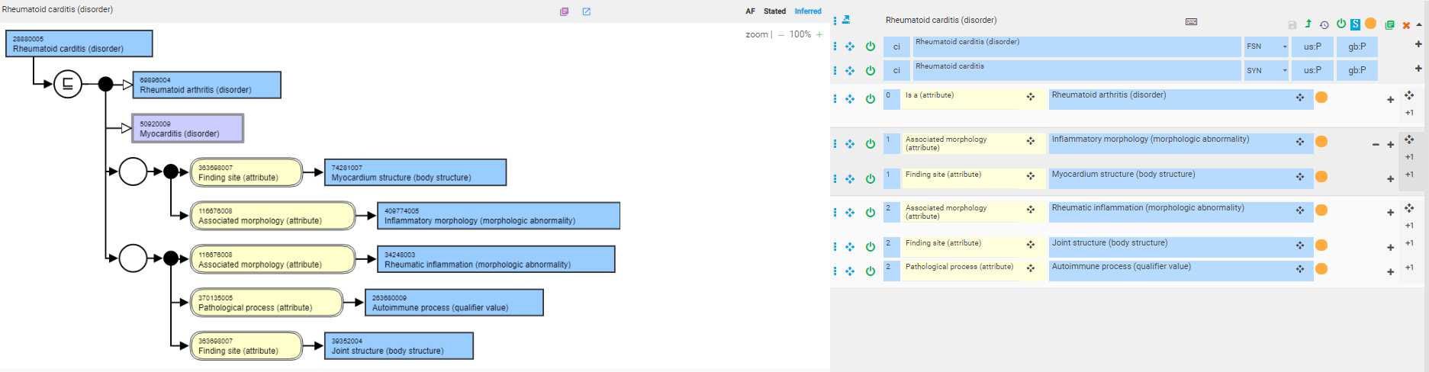
Rheumatoid carditis – current model

Slide 10
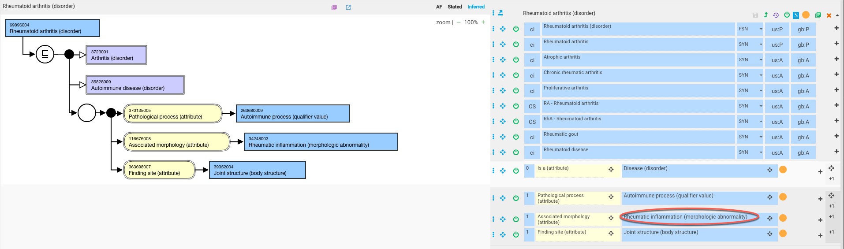
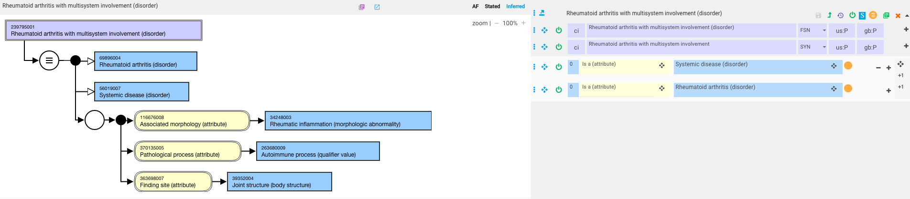
Rheumatoid arthritis and rheumatoid arthritis with multisystem involvement
Defining concept by adding Systemic disease (disorder) as an additional parent will not help to autoclassify manifestations of systemic rheumatoid arthritis as these manifestations are not systemic diseases

Slide 11
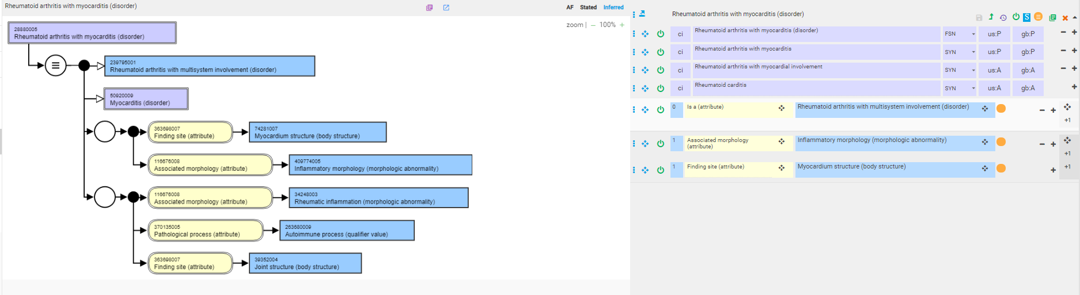
Rheumatoid arthritis(co-occurrent) with myocarditis - proposed

Slide 12
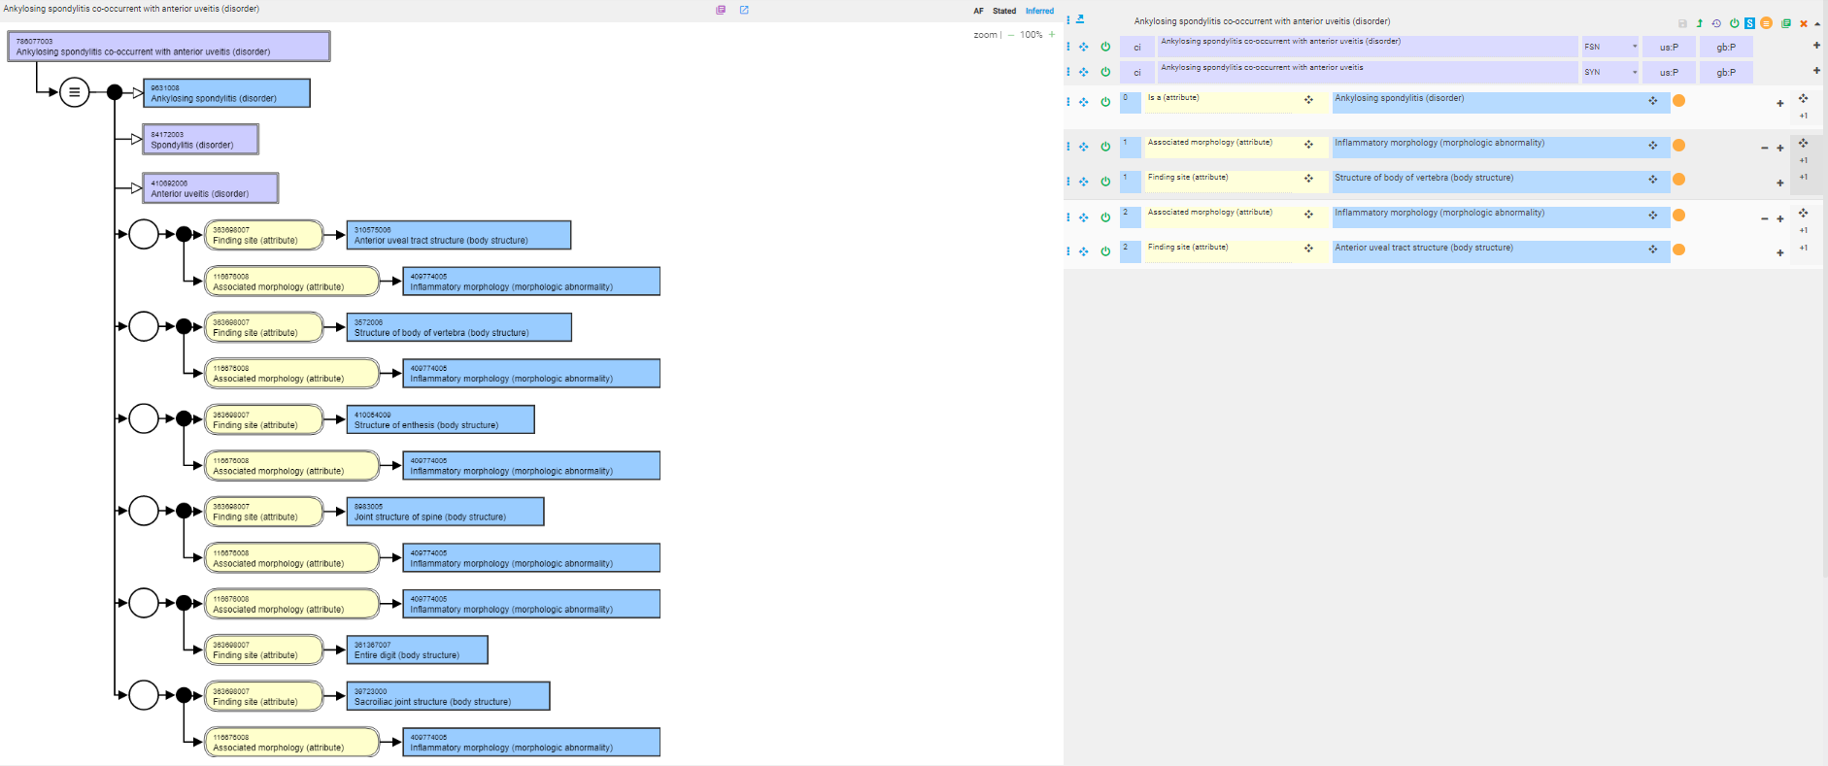
Ankylosing spondylitis co-occurrent with anterior uveitis
Current model

Slide 13
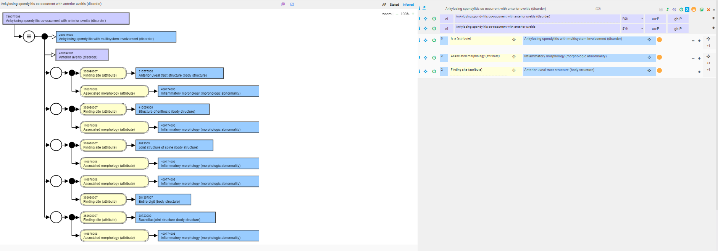
Ankylosing spondylitis co-occurrent with anterior uveitis - proposed

Slide 14
Other disorders
Scleroderma with multisystem involvement (disorder)
Behcet's disease with multisystem involvement (disorder)
Wegener's granulomatosis with multisystem involvement (disorder)
Systemic lupus erythematosus with multisystem involvement (disorder)
The above disorders are by definition multisystem disorders
  Can inactivate the above concepts and replace with the base disorders
  Model manifestations of the above disorders subtypes of the base disorder and the manifestation

Slide 15
Disorders occurring at more than 1 anatomic site (excludes combined sites)
238656002 Lichen planus of palms and soles (disorder)
271577005 Fracture of shaft of tibia and fibula (disorder)
1.08535E+15 Cleft of soft palate and cleft lip (disorder)
302952007 Congenital fistula of rectum and anus (disorder)
705123008 Closed fracture of anterior column and posterior column of acetabulum (disorder)
65775005 Open fracture of upper end of radius AND ulna (disorder)
Would also include overlapping malignant neoplasms

Slide 16
Disorders with more than 1 morphology
237464003 Fissure and fistula of nipple (disorder)
195319003 Embolism and thrombosis of the brachial artery (disorder)
204431007 Atresia and stenosis of aorta (disorder)
200686006 Cellulitis and abscess of heel (disorder)
2.95501E+14 Calcification and ossification of muscle of foot due to burn (disorder)

Slide 17
Disorders occurring at more than 1 anatomic site or with more than 1 morphology
Concepts on previous 2 slides can be represented as separate statements without a loss of meaning
Issue is that many of these are common associations and have high usage in EHRs due to a requirement to decrease the number of clicks in documenting

Slide 18
What about these?*
Display Name | NOTE | Comment | Total usage
Asthma w allergic rhinitis |  | Common predisposition | 1013
Chronic obstructive bronchitis w acute bronchitis |  | Acute exacerbation of chronic obstructive bronchitis? | 59
Female cystocele W complete uterovaginal prolapse |  |  | 56
Abdominal pregnancy W IUP |  |  | 34
Demoralization and apathy |  |  | 17
Colon spasm w diarrhea | Rejected in USCRS |  | 15
Cheek and lip biting | Rejected in USCRS |  | 7
Congenital dislocation of left hip w subluxation of right hip |  | Congenital dislocation with congenital subluxation? | 6
Congenital dislocation of right hip w subluxation of left hip |  | Congenital dislocation with congenital subluxation? | 1
* Source KP

Slide 19
Summary and recommendations
Use co-occurrence for 2 or more conditions that occur together more frequently than by chance alone and by representing the conditions as separate statements the notion of an association is lost and may thus be construed as two independent entities randomly occurring during the same encounter:
Associations may be:
  A common cause such as a genetic mutation
    Models need to be developed for genetic diseases that incorporate a causal relation to the mutation
  A common pathological process and/or morphologic abnormality
  A single entity with features shared by 2 or more conditions
  An unknown association
Examples
  Multi-component syndromes
  Overlap syndromes
  Conditions as part of systemic disorders
Do not allow simple co-occurrence for 2 conditions that can be represented as separate statements without a loss of meaning

