Slide 1
SNOMED CT content references and resources
Bruce Goldberg
Jeff Pierson
April 2019

Slide 2
Outline of discussion
Background
Organization of work
Proposals

Slide 3
Background
Sources of information are needed to validate and curate SNOMED content
There are many possible sources of varying quality
There can be disagreement among sources
Evaluation of sources is time consuming on ad hoc basis
Standardized sources promotes consistency of content

Slide 4
Organization of work
Evaluation method of references and resources
Prioritization of content areas
Source development
Documentation

Slide 5
Proposals
Evaluation test
Recommend using Currency, Relevance, Authority, Accuracy, and Purpose Test
“CRAAP” Test
Widely used to assess literature and has been adapted for online sources
Scores each section from 1 to 10
Contains sample questions to assist rating and consistency

Slide 6
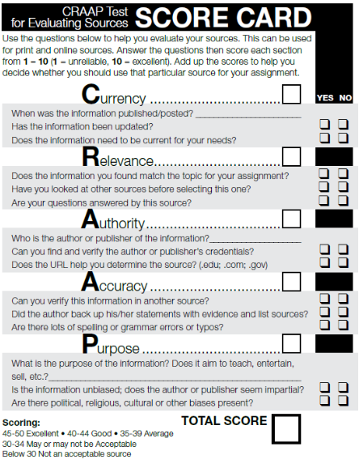
Proposals
Evaluation test
Currency
Relevance
Authority
Accuracy
Purpose

Slide 7
Proposals information Designation
Looked at designation of “Primary” and “Secondary” sources
Recommend not using this designation due to possible confusion
https://hsl.lib.umn.edu/biomed/help/primary-secondary-and-tertiary-sources-health-sciences

Slide 8
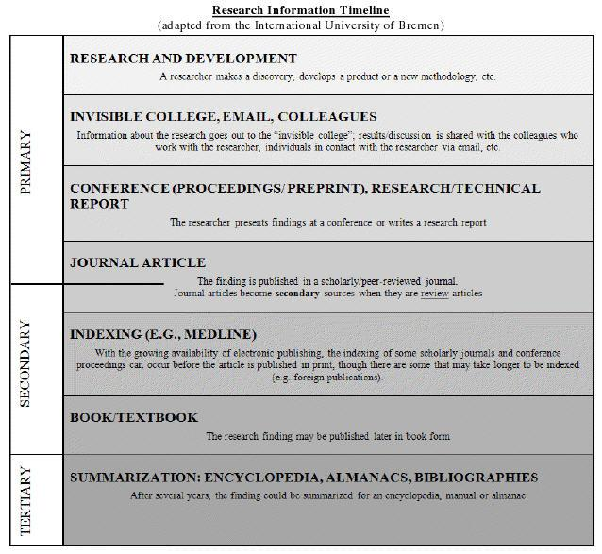
Proposals
Primary
Secondary
Tertiary sources

Slide 9
Proposals information Designation
Recommend designation of “Preferred” and “Alternate” information sources
Preferred source – first line information
  Meaning CRAPP rating 45 or greater
  Can have more than 1 primary source
  Designated by subject area
Alternate source – supplemental information
  Meaning CRAPP rating 40 or greater
  Can have more than 1 alternate source
  Designated by subject area

Slide 10
Prioritization of sNOMED content areas For development of references and resources
Initial priority is based upon the hierarchies and subhierarchies identified for the quality improvement projects
These have been grouped together into subject areas

Slide 11
Prioritization of sNOMED content areas For references and resources
Allergy, hypersensitivity, intolerance, adverse reactions
Anatomical structure – anatomical morphology
Arthritis
Cardiovascular disease
Burns, ulcers and wounds
Cancer and neoplasm
Eye disease
General medical
General surgery
Infectious disease
Organisms
Diabetes
Congenital diseases
Orthopedic
Fracture
Skin disease
Products and substances

Slide 12
Prioritization of sNOMED content areas For references and resources
Additional SNOMED hierarchies and sub-hierarchies content areas for development
308916002 |Environment or geographical location (environment / location)|
272379006 |Event (event)|
363787002 |Observable entity (observable entity)|
373873005 |Pharmaceutical / biologic product (product)|
260787004 |Physical object (physical object)|
363679005 |Imaging (procedure)|
123038009 |Specimen (specimen)|
254291000 |Staging and scales (staging scale)|
105590001 |Substance (substance)|

Slide 13
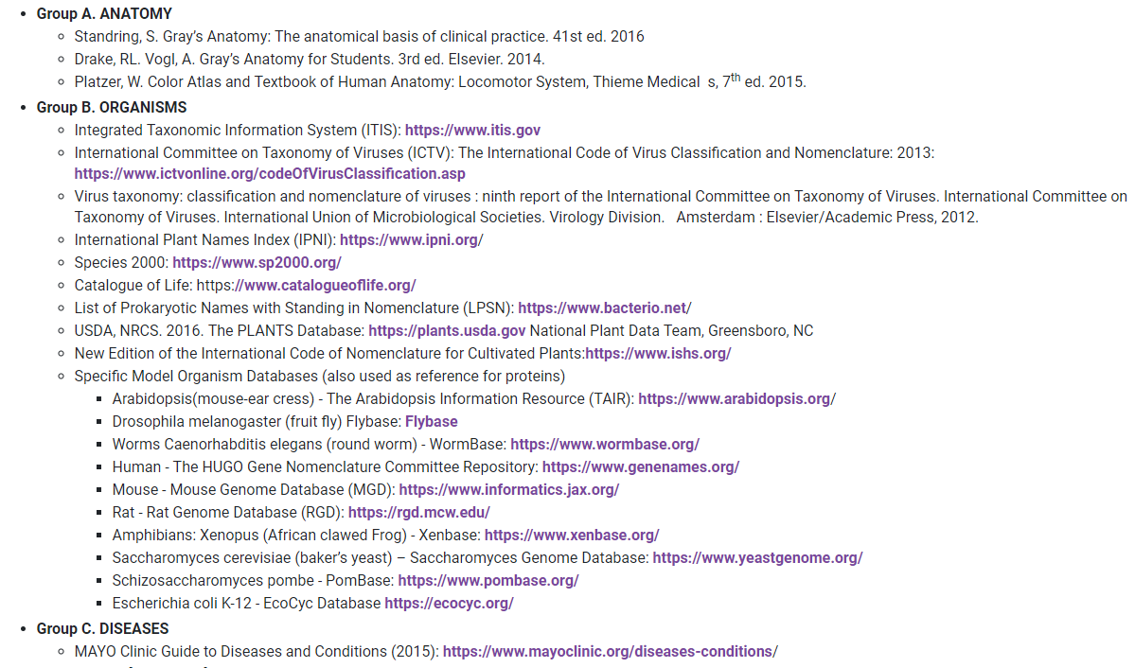
Development of reference and resources
Possible sources
U.S. National Library of Medicine MeSH Authoritative Reference Sources

Slide 14
Development of reference and resources
Possible sources
Broad online sources – access to online library
  UpToDate
  DynaMed
  Onesearch
  STAT!Ref
  Taber’s Medical Dictionary
  Access Medicine
  Other…

Slide 15
Development of reference and resources
Possible sources
Examples of other specific sources
  Reputable websites, OMIM, Orphanet, HUGO, HPO, etc.
  Foundational Model of Anatomy
  Consensus documents from Medical content areas
  Pubchem
  NCBI Taxonomy Browser
  NIH Toxnet - ChemIDplus

Slide 16
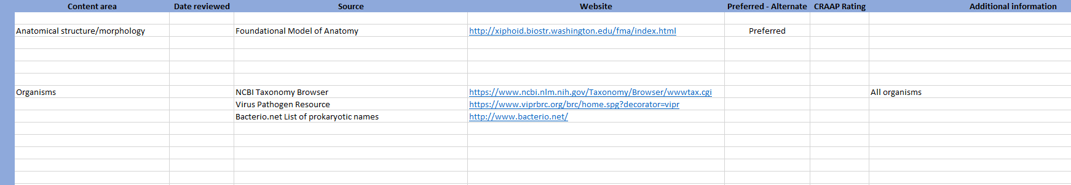
Development of reference and resources
Recommend Grid and online library
Recommend using the curated sources to develop an online library for SNOMED authors

Slide 17
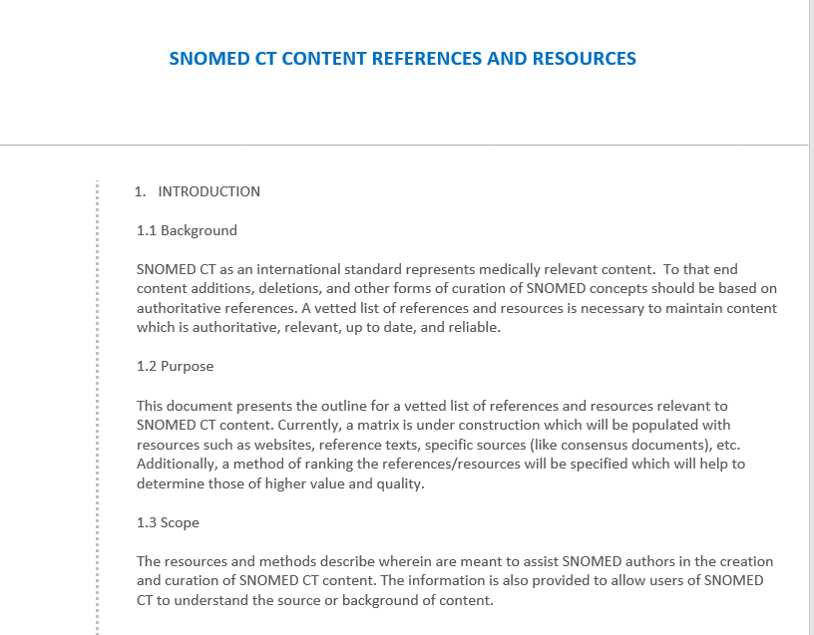
Documentation

Slide 18
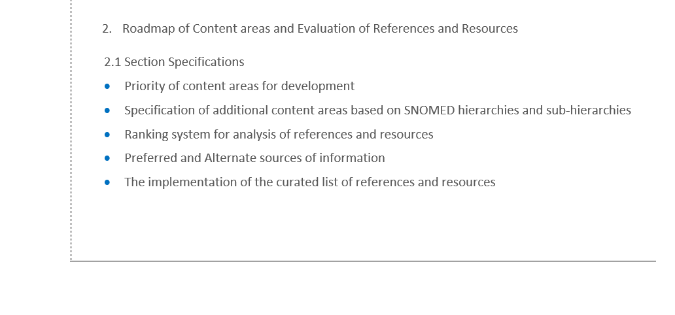
Documentation

Slide 19
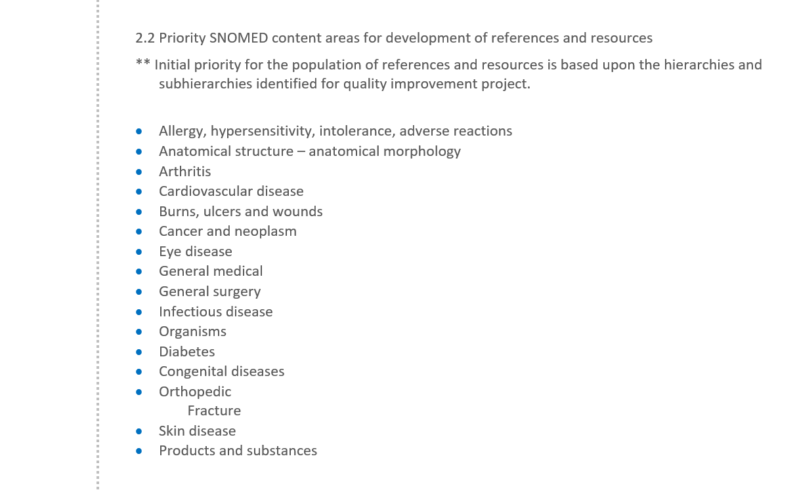
Documentation

Slide 20
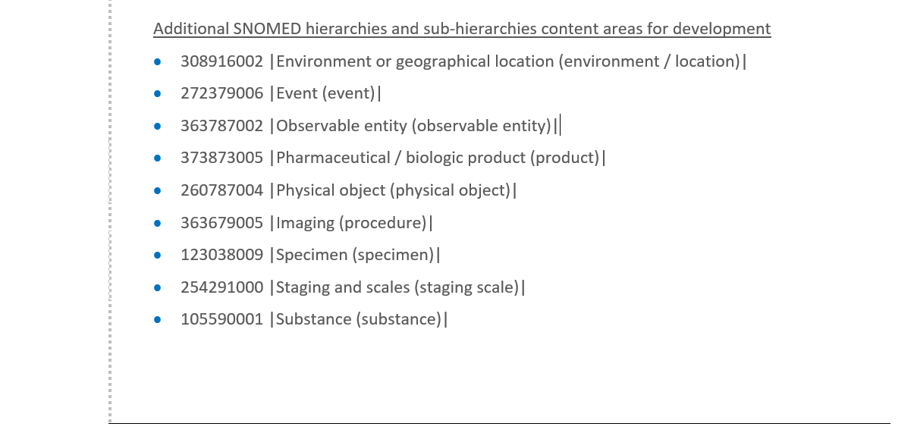
Documentation

Slide 21
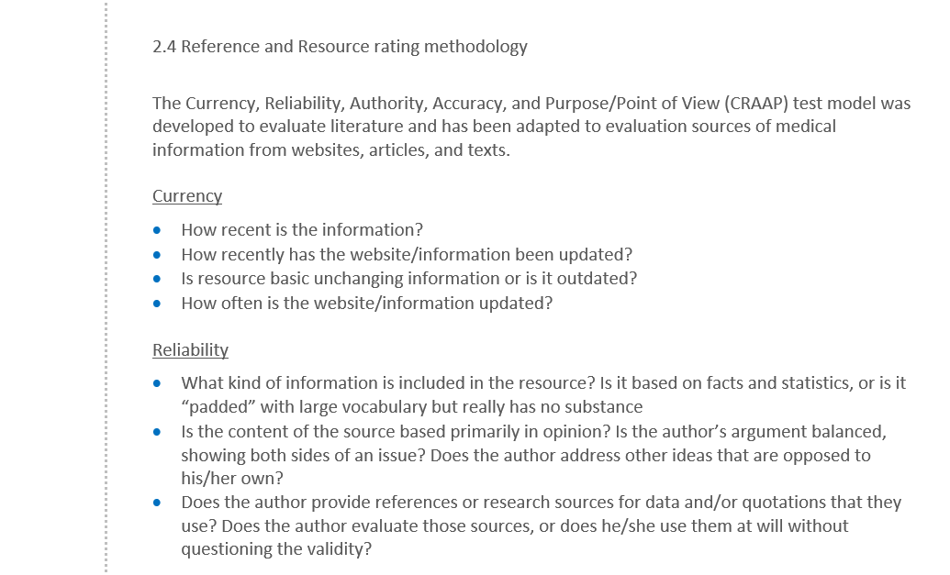
Documentation

Slide 22
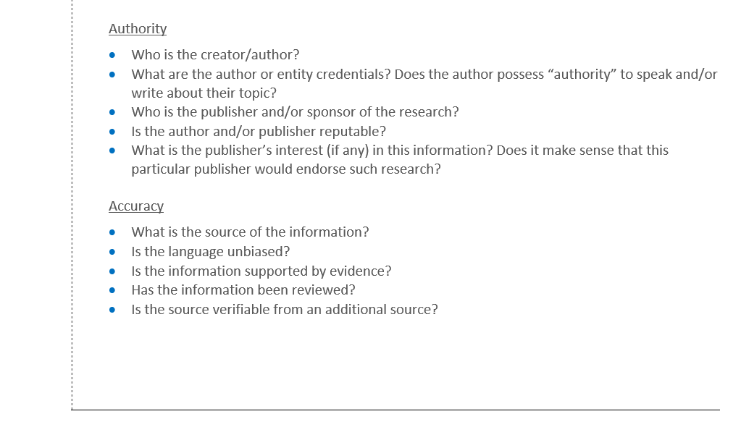
Documentation

Slide 23
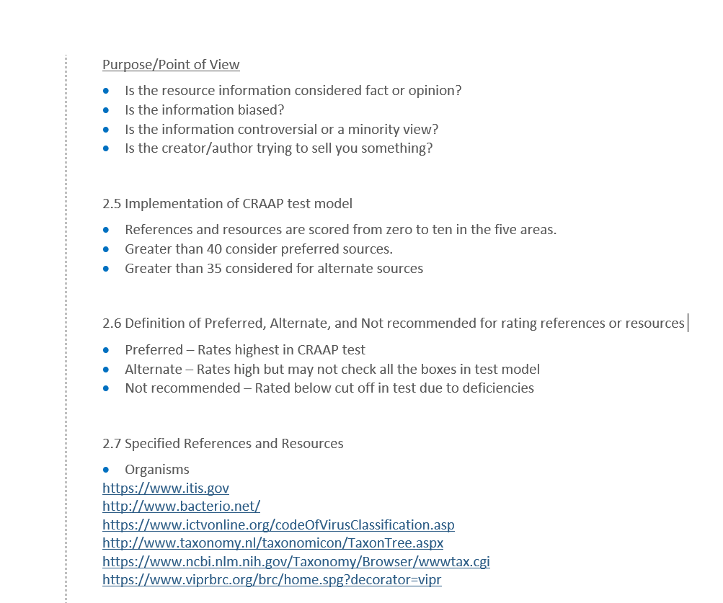
Documentation

Slide 24
Outstanding questions
Who performs the rating of sources?
Accessing online resources
Use of “non-online” sources and keeping them up to date
Other questions

