Slide 1



Genomics Session
“MAKING IT REAL”
Vancouver
Ian Green
Customer Relations Lead, Europe and Clinical Engagement Business Manager
17th, October 2018

Slide 2
AGENDA
9:00-10:30
Introductions (IGR)
Session introduction (CGU)
East London experience (CGU)
Questions (CGU)
10:30-11:00 Break
11:00-12:30
Current SNOMED Genomics developments
Richard Gain –Clinithink
Nebraska, US (Scott Campbell)
Questions/discussion (CGU)
12:30-13:30 Lunch
13:30 – 14:00 Closing Plenary (Oceanview 5&6)
14:00-15:30
Global picture (Peter Goodhand)
Organisation
GA4GH roadmap
Current status and proposed future plans (IGR)
• Wrap-up (CGU)
15:30-16:00 Break

Slide 3
Current status and future plans
Agenda
Strategy review
Content enhancement
  Orphanet
  HPO update
  Future partnerships
Pilot sites
Opportunities for Partnerships

Slide 4
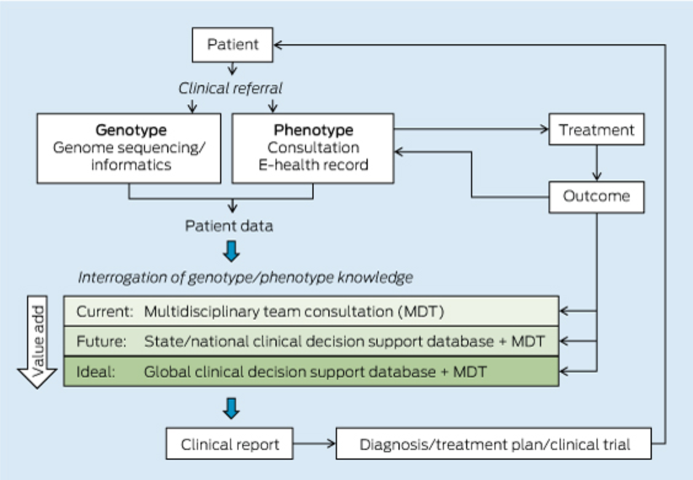
Genomics Strategy
Individual genomic data
Accurate clinical data
Alignment to the existing body of knowledge
Mattick JS, et al. The impact of genomics on the future of medicine and health.
Med J Aust. 2014 Jul 7;201(1):17-20.

Slide 5
Strategy objectives
Objective 1: Identify key stakeholders with appetite for trial/adoption of SNOMED CT for Genomic Medicine
Objective 2: Identify and gather use cases to support and validate SNOMED CT in the context of Genomic Medicine
Objective 3: Restructure domain knowledge around clinical genomics in SNOMED CT
Objective 4: Demonstrate added value provided by SNOMED CT in the context of Genomic Medicine
Objective 5: Raise awareness around SNOMED CT globally, and reinforce its suitability for supporting Precision Medicine

Slide 6
Key SNOMED International Tactical Directions 2015-2020 - Genomics
From a Genomics perspective, the key tactical direction is
To ensure that the content in the SNOMED CT International Release:
Provides the required level of clinical data within EHR’s to support Genomics data exploration
Provide content within the SNOMED CT International Release that reflects the changes in global clinical practice driven by Genomics developments
Provide sufficient coverage of content within SNOMED CT to support future precision medicine initiatives
In addition, activities to support Genomics will include the following:
Derivative products that provide linkages to the main existing global Genomics terminologies and classifications to support interoperability and ease of data transfer
Development of an extension to the SNOMED CT concept model that supports the requirements of the global Genomics community, particularly in respect of data interrogation, data analytics and precision medicine functionality within EHR’s

Slide 7
Goal of activities related to Genomics
To support delivery of the SNOMED International Product Strategy
To expand the user base of SNOMED CT, to include the Genomics community and vendors operating within the Genomics arena
Influence, leverage and align with global Genomics terminologies and classifications to increase the effective and efficient use of SNOMED CT
Develop the SNOMED CT International release and related products to reflect the changes in clinical practice driven by global Genomics developments
Collaborate with global Genomics bodies to ensure effective, consistent and sustained content development
Genomics Standards Development Organizations
Global Genomics Terminology and Classification organisations
Professional clinical bodies (international normally)
Focus on SNOMED CT product and services developments that support global interoperability within the clinical and genomics arenas

Slide 8
Objectives of activities related to Genomics
SNOMED International WILL NOT duplicate all Genomic terminology within SNOMED CT, but rather provides a means of access for SNOMED CT users to global genomics terminology resources
Enable users of SNOMED CT to access Genomics content and leverage standards related to Genomics through the development of derivative products to support interoperability
Contribute to global developments of Genomics standards to address the needs of healthcare professionals, EHR vendors and end users, and other SNOMED CT stakeholders
Leverage expertise from other organizations involved in the development and usage of genomics data
Strengthen the position of SNOMED CT and related products in the marketplace within the realm of Genomics
Promote implementation and adoption of SNOMED CT within the global Genomics community
SNOMED International will identify and partner with Genomics organizations globally to leverage knowledge and connectivity

Slide 9
Principles for activities related to Genomics
Any proposed SNOMED CT content development should:
Be clinically validated
Supported by clear statement of use case requirements
Be resourced adequately, through identification of internal or external resource, with identified funding stream for current developments and future support
Include a review of existing SNOMED CT content
Any proposed derivative development should:
Be compatible with and supportive of SNOMED International values, strategy and priorities with clear benefits to its stakeholder/customer base
Have an agreed plan for all steps towards delivery, identifying and agreeing SNOMED International resources across lines of business
Be based on a clear written statement of financial/resource commitments for SNOMED International and the collaborating body
Produce a clear development and maintenance plan for the derivative product

Slide 10
Content enhancement
Use case requirements/drivers
Capture and sharing of granular phenotype information in EHR’s
Ability to convert SNOMED EHR data into a form used by Genomics researchers (HPO, OMIM)
Representation of rare diseases within EHR’s to support a large number of national genomics strategies
What’s required ?
Content, content, content . . . (just in terms of HPO, SNOMED CT is “missing” . . . 5 - 6,000 concepts)
Increased phenotype content
Increased rare disease content
Development of SNOMED concept model to support specific use case specifications
Creation of a SNOMED to HPO map (longer term deliverable HPO SNOMED CT map)
Creation of a SNOMED to OMIM map (longer term deliverable OMIM SNOMED CT map)

Slide 11
INSERM (Orphanet)
Summary of collaborative agreement
Orphanet is a database in the EU for rare diseases and orphan drugs, and is available to the general public. It contains information about 6,000 diseases
SNOMED International has a formal agreement in place, and work has been underway since 2016 to incorporate (and model) Orphanet content in SNOMED CT
Part of the agreement includes the creation of a linkage table between SNOMED CT and Orphanet, which will be created when the all content has been added to SNOMED CT
Orphanet contains concepts, text definitions and synonyms
Aim of the agreement is to provide rare disease coverage within SNOMED CT and to provide a working solution for Genomics researchers and reporting of rare disease data.

Slide 12
INSERM (Orphanet)
Work undertaken so far
Work has focused on the inclusion of rare disease content into the international release
Inclusion of text definitions for a number of rare diseases to assist clinicians using content in EHR’s
Updating content in the international release as Orphanet content changes as understanding of rare diseases increased

Slide 13
Human Phenotype Ontology (HPO)
Summary
HPO provides a standardized vocabulary of phenotypic abnormalities encountered in human disease. HPO currently contains approximately 15,000 terms and over 120,000 annotations to hereditary diseases. HPO also provides a large set of HPO annotations to approximately 4000 common diseases.
Aim of work with HPO is to identify phenotypic content for addition to the SNOMED CT International release, and to provide derivative products to enable cross-walk between SNOMED CT and HPO
HPO will provide SNOMED CT with a link to phenotypic content required in clinical practice, ensuring we have complete coverage
To support genomic research, a linkage derivative will be created and maintained between SNOMED CT and HPO

Slide 14
Human Phenotype Ontology (HPO)
Way forward (Proposals)
Clinical and phenotype work stream in GA4GH has a work item specified to deliver a SNOMED HPO map for existing SNOMED CT content (aim for Jan, 2019)
Map will be published through GA4GH in a human readable format, and by SNOMED international in RF2 format
Formalizing an agreement between SNOMED international and HPO to support the development of phenotype content
  Work requires gap analysis of current SNOMED CT content compared with HPO
  Comparison of HPO and SNOMED CT logical models
  Specification of authoring guidance for new SNOMED CT content additions
  Expansion of SNOMED HPO map (specification of update process)
  Implementation guidance

Slide 15
Pilot sites (current and future)
Addenbrooks
Utilizing SNOMED CT in local Biobank, to support national cancer reporting and local discovery processes.
Queensland Genomics
Finalizing agreement for inclusion of SNOMED CT in population-based Genomics project, to record diagnosis and phenotype data
In evaluation process
PanelApp (UK) – to be agreed
Inclusion of diagnosis data in SNOMED CT form, currently using OMIM
ClinMed (US)
Currently reviewing Orphanet (rare disease content) for inclusion database

Slide 16
Future terminology partnerships
Online Mendelian Inheritance of Man (OMIM)
OMIM is a comprehensive, authoritative compendium of human genes and genetic phenotypes, containing information on all known Mendelian disorders and over 15,000 genes. OMIM focuses on the relationship between phenotype and genotype.
OMIM will provide SNOMED CT with detailed content covering human genes and phenotypes, essential for the future development of personalized medicine.
Aim of work with OMIM is to identify content for addition to the SNOMED CT International release, and to provide derivative products to enable cross-walk between SNOMED CT and OMIM
In the context of content originating from Orphanet, it will provide additional genetic detail
In the context of disorders, it will provide additional genetic detail and guidance on current terming
To support analytics within clinical practice and genomics research, it will be essential to develop a supporting concept model

Slide 17
Future terminology partnerships
Disease Ontology (DO)
DO has been developed as a standardized ontology for human disease with the purpose of providing the biomedical community with consistent, reusable and sustainable descriptions of human disease terms, phenotype characteristics and related medical vocabulary disease concepts
Links to DO will provide SNOMED CT with insight into the changing definitions and terming of disease, driven by Genomic advances. This will be essential for SNOMED CT to keep up to date with changing clinical practice, genetic research and to support future personalised medicine initiatives
Aim of work with DO is to identify content for addition to the SNOMED CT International release, and to provide derivative products to enable cross-walk between SNOMED CT and DO

Slide 18
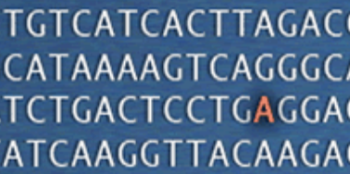
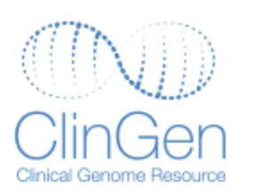

Opportunities for Partnerships
ClinVar - is a freely accessible, public archive of reports of the relationships among human variations and phenotypes, with supporting evidence
ClinGen - is dedicated to building an authoritative central resource that defines the clinical relevance of genes and variants for use in precision medicine and research.
PanelApp - crowdsourcing tool to allow gene panels to be shared, downloaded, viewed and evaluated by the Scientific Community

Slide 19
Future view
ORPHANET
HPO
CLINICAL (EHR)
OMIM
GENOMICS (RESEARCH COMMUNITY)
DERIVATIVE PRODUCTS
DO
SNOMED CT

Slide 20
Context - Future of medicine
PRECISION MEDICINE
DIAGNOSIS
SNOMED CT (EHR)
THERAPEUTIC DECISION SUPPORT
GENOMICS (HPO, OMIM, DO)
POPULATION HEALTH

Slide 21

Thank
you!
Please contact Ian Green – igr@snomed.org, or info@snomed.org for further information.
21

