Slide 1
The east London Inheritance
Charles Gutteridge

Slide 2
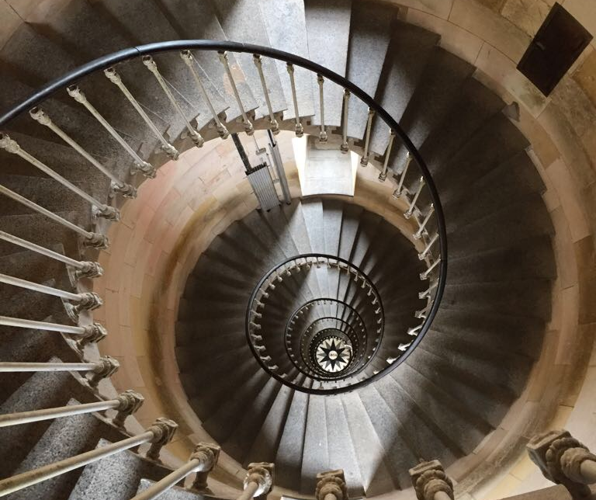
Finding signals
Whitechapel Road

Slide 3
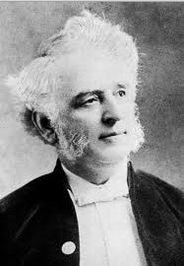
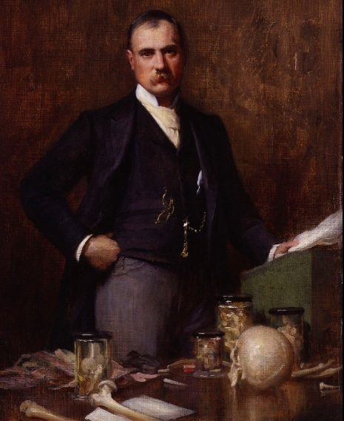
The London Hospital founded 1740

Slide 4
Publications
1862 Observations on an ethnic classification of idiots. John Langdon Down. London Hospital Reports 3, 259 -262
1959 Etude des chromosomes somatiques de neuf enfants mongoliens J. Lejeune Compt. Rend. Acad, Sci Paris 248. 1721-1722
1923 The elephant man and other reminiscences Sir Frederick Treves

Slide 5
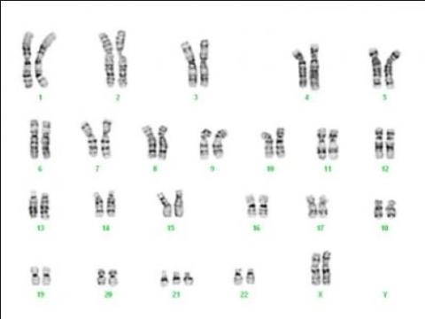
Karyotyping and Down’s Syndrome

Slide 6
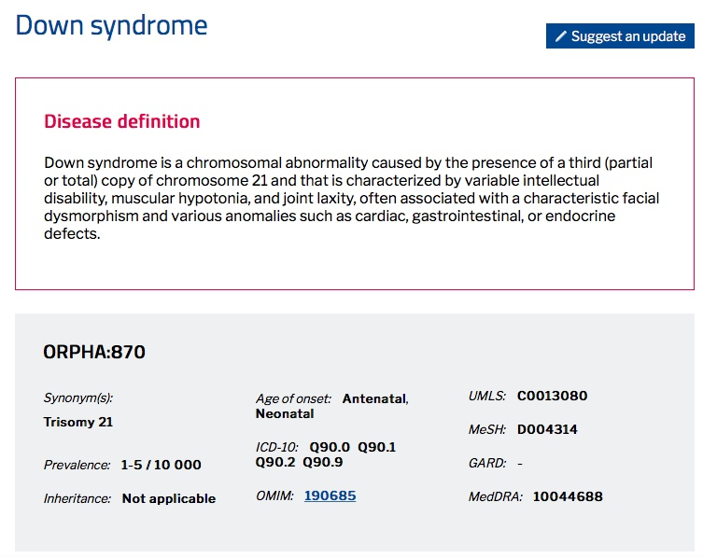
Classifiers at work

Slide 7
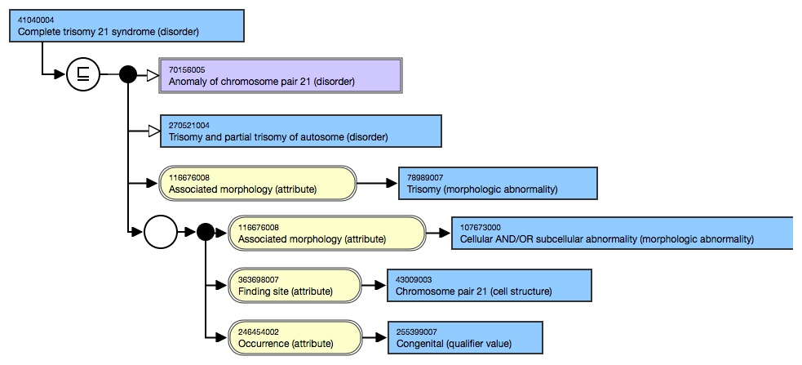
OWL at work

Slide 8
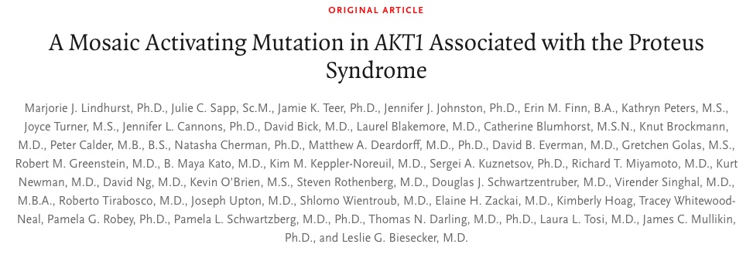
From concept to diagnosis

Slide 9
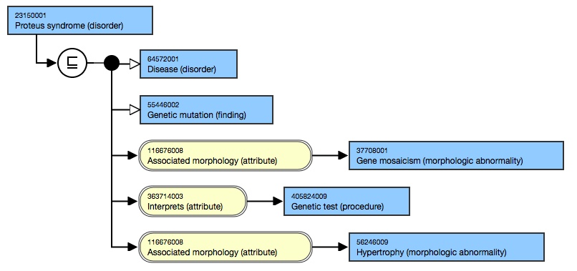
Protean classification

Slide 10
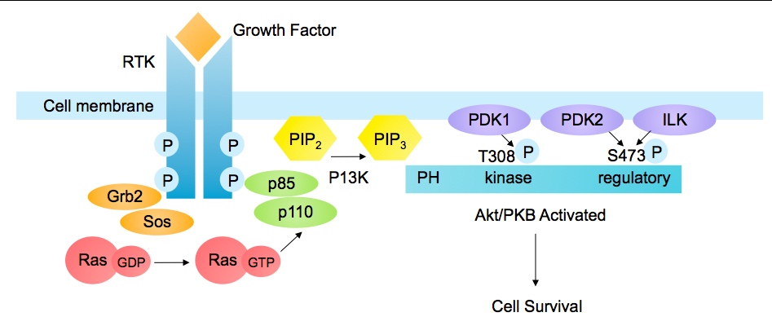
Mutation c.49G-A, pGlu17Lys
Molecular signalling

Slide 11
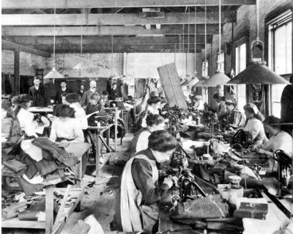
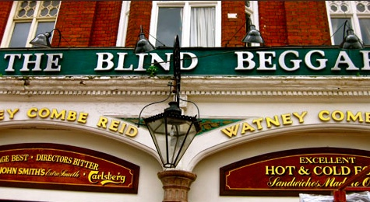
Back in east London

Slide 12
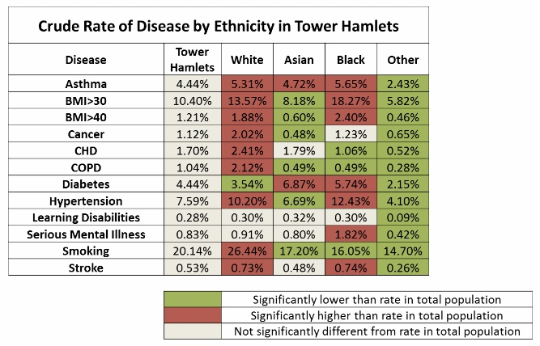
Determinants of health in east London

Slide 13
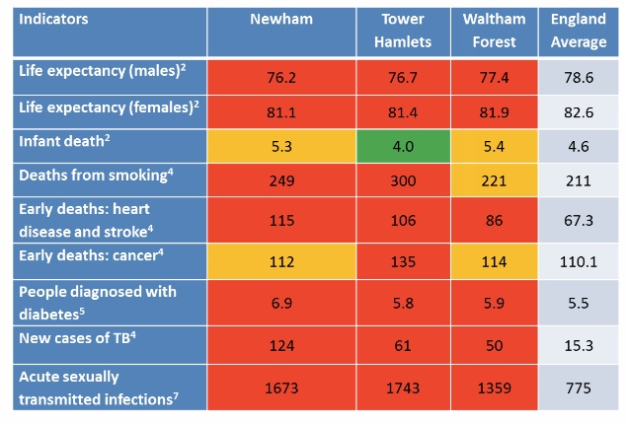
Living and dying in east London

Slide 14
East London 150 years later
From phenotype to genotype
Headquarters of Genomics England
Home of East London Genes and Health
Research groups
  NIHR Cardiac Biomedical Research Centre
  Barts Cancer Institute – Cancer Research UK
  Biobanking for cancer and cardiac

Slide 15
Where is the data?
East London –Health IT infrastructure
Primary care – 3 GP systems
Secondary care – 1 system: 2 domains
Mental health – 1 system : 2 domains
Community care – 1 system: multiple domains
Social care – at least 3 systems
Research databases

Slide 16
The first steps towards towards real time data sharing 2012 onwards
east London Patient Record (eLPR) 100k views a month
In patient context
Point to Point
Consent
Health information Exchange
Trust
#CollectShareUse

Slide 17
Current content of the real time eLPR view
Summary page of structured GP data including Read/SNOMED CT encoded problem and diagnosis data
Secondary care
  SNOMED CT encoded problem and diagnosis lists
  Structured discharge summaries
  Hospital ADT and appointments data
  Laboratory and imaging results
Mental health summary data (ICD10)
Social care

Slide 18
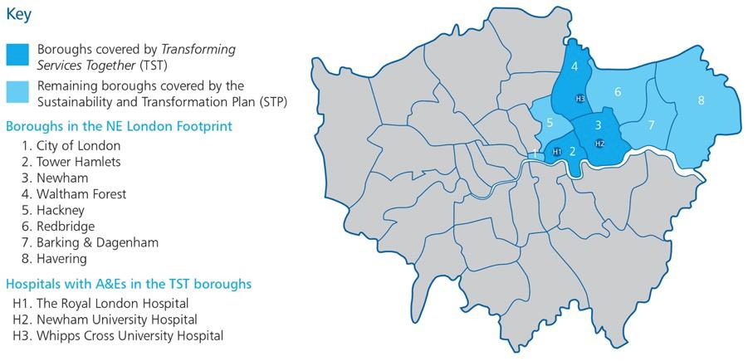
Local Geography for Discovery East London – Phases I / II
Phase II
#CollectShareUse

Slide 19
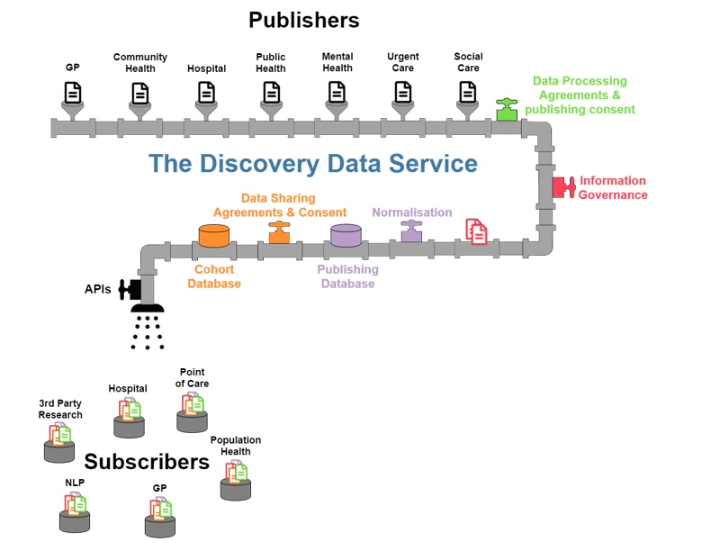

Slide 20
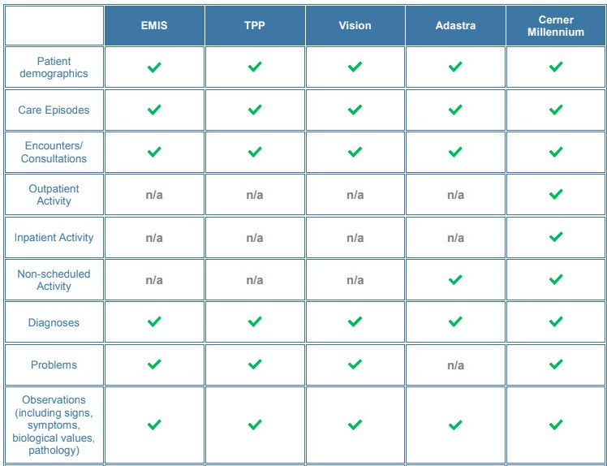
Some of the datasets held in the Discovery data service
SNOMED

Slide 21
East London Health IT- a plan for action
Tool box
1 Standards
2 Information
3 Use of data
4 Collaboration
5 Innovation
6 Education
Leveraging
health
informatics
Improving
health
outcomes –
reducing
health
inequalities

Slide 22
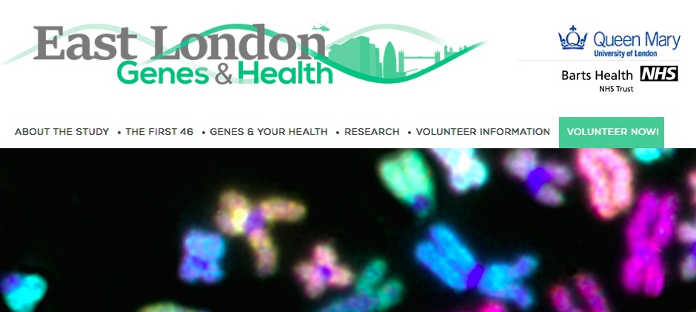

Slide 23
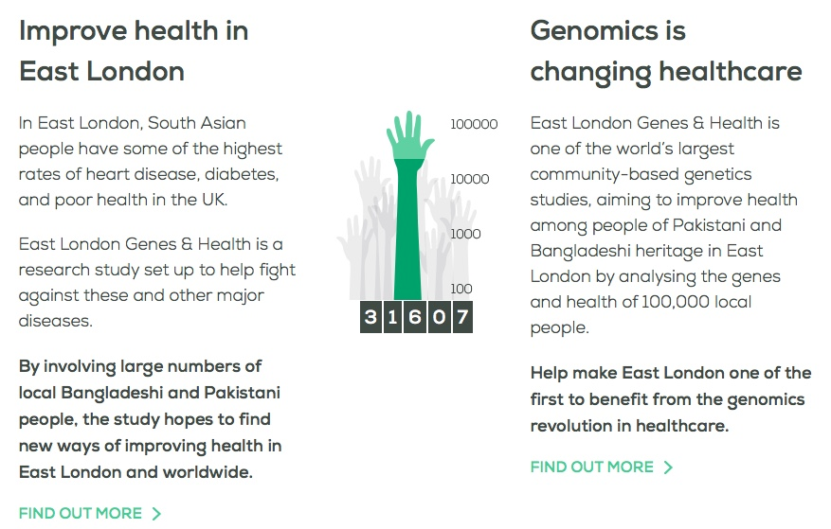

Slide 24
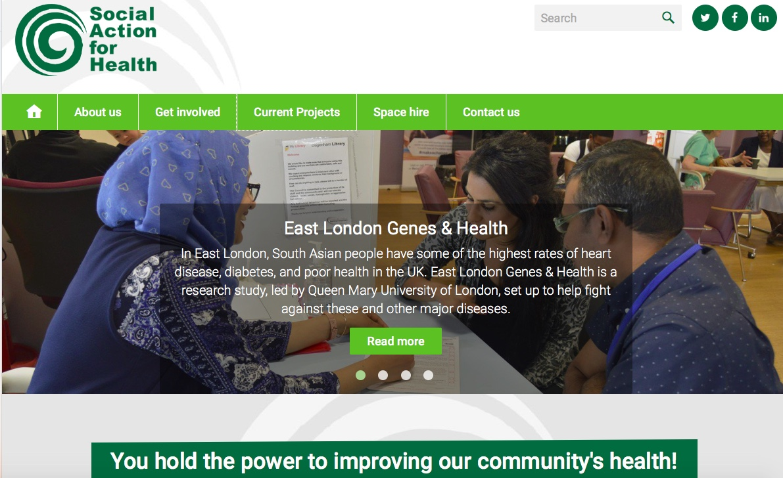

Slide 25
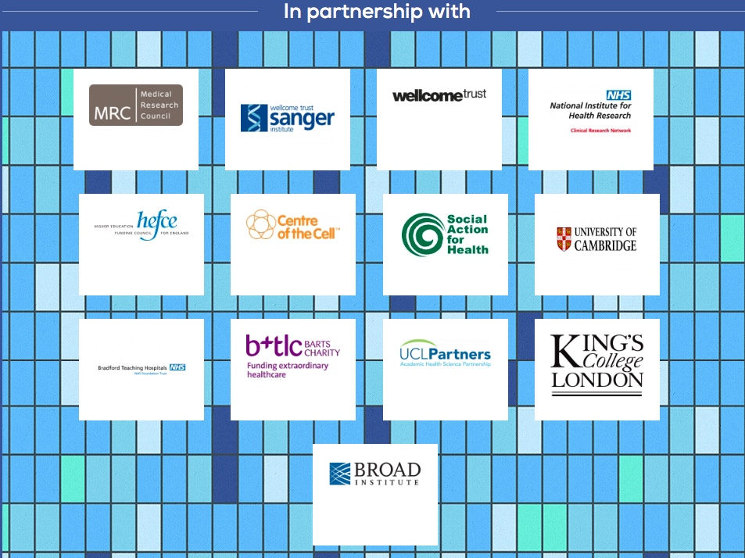

Slide 26
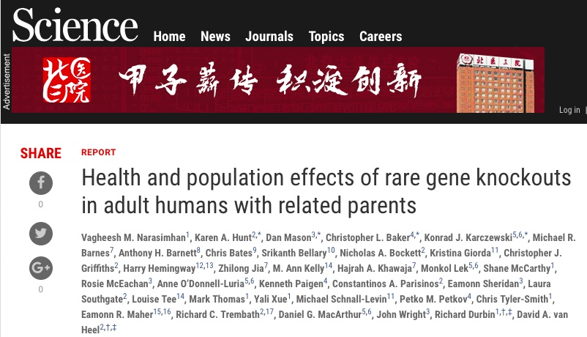

Slide 27
Developing the genotype cohort for EHR linkage
3222 British Pakistani with high parental relatedness
1111 Rare variant homozygotes
781 Predict for Rare homozygote Loss of Function genes

Slide 28
Drill down to recessive disease genes using OMIM catalogue and Read/SNOMED EHR
52 individuals with 54 rhLOF genotypes
6 linked to definitive Read coded primary health record diagnosis consistent with OMIM phenotype
3 additional possible cases
Errors account for 16
Possible reasons for 29 without connection: incomplete penetrance, late onset disease, mild symptoms, technical issues

Slide 29
Gene in OMIM catalogue matched to EHR
OMIM catalogue | EHR
Ciliary dyskinaesia (3) | Asthma, sinusitis, hayfever
Ichthyosis (2) | Eczema/dermatitis
Erythrokeratoderma (1) | Dermatitis
Miyoshi muscular dystrophy | Genetic syndrome of muscular dystrophy
Niemann-Pick disease | X-linked centronuclear myopathy
Night blindness | Impaired vision

Slide 30
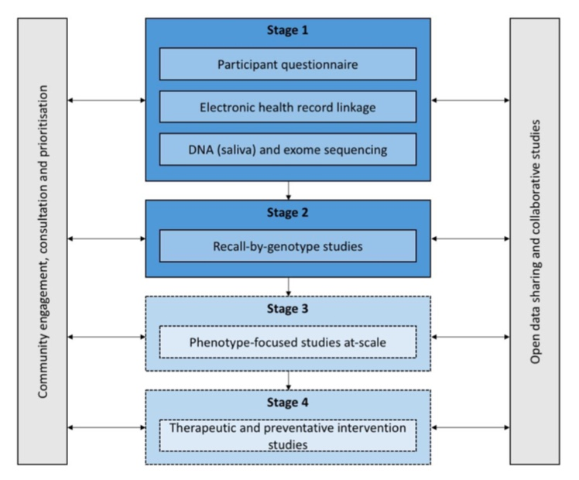
Where we are now
Staged approach to studies

Slide 31
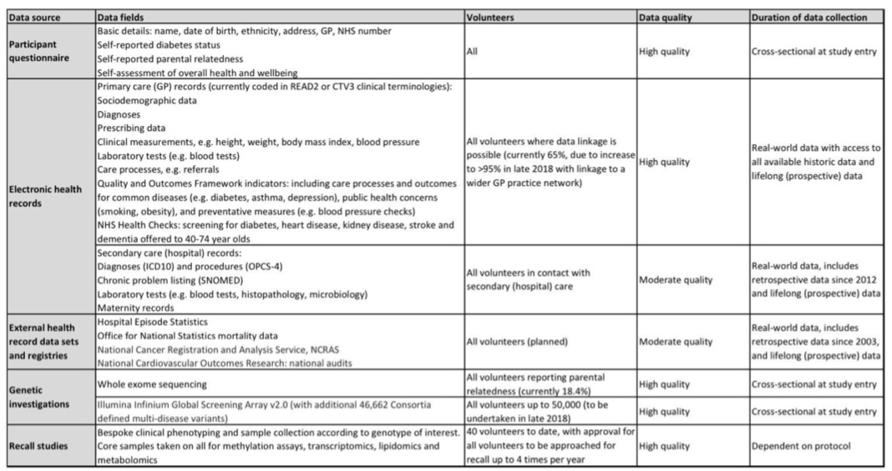
Current EHR data quality

Slide 32
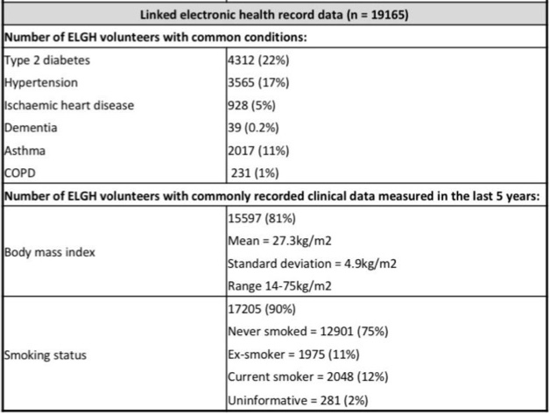
Snapshot of Linked EHR record data

Slide 33
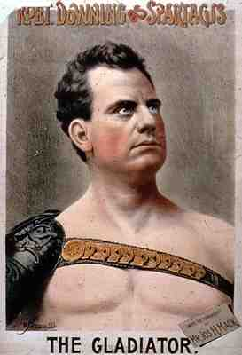
Connecting to front line staff
Make it simple and structure your data
Complete data consistently for every patient
Phenotype
Genotype

