Slide 1
Re-examination of co-occurrent and due to pattern

Slide 2
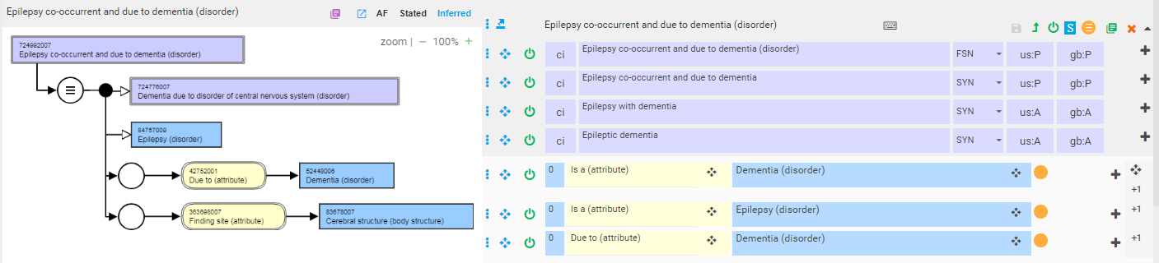
Recently identified issues with co-occurrent and due to
724992007 |Epilepsy co-occurrent and due to dementia (disorder)|
  This concept is inferring a parent of 724776007 |Dementia due to disorder of central nervous system (disorder)| but that doesn't seem to be right.

Slide 3
724992007 |Epilepsy co-occurrent and due to dementia (disorder)|
The problem on the previous page arises because Dementia is a superclass and is also related to itself by a due to relationship
This issue is not corrected by attempting to place a due to dementia in a role group containing a definition of epilepsy as shown on following slide

Slide 4
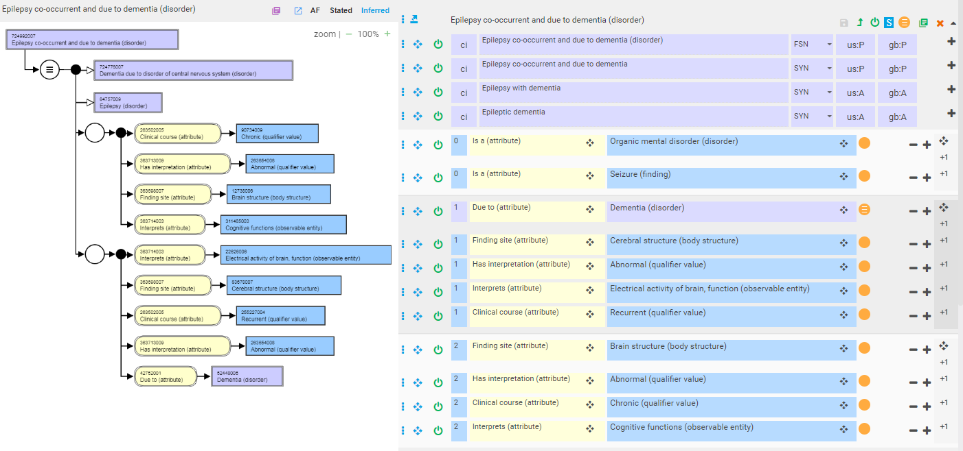
724992007 |Epilepsy co-occurrent and due to dementia (disorder)|

Slide 5
Can 2 disorders be co-occurrent during certain time periods but not others?
Co-occurrent patterns do not require that the complication and cause completely overlap

Slide 6
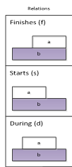
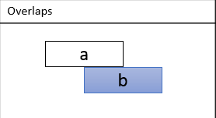

Co-occurrent and due to with respect to overlapping time intervals
Allen’s patterns compatible with co-occurrent and due to
Allen’s pattern incompatible with co-occurrent and due to
For a disorder to be co-occurrent and due to another disorder, the complication (a) cannot persist once its cause (b) has resolved or in other words, the complication must resolve prior to or coincident with the resolution of it’s cause
Formal representation of disorder associations in SNOMED CT
Edward Cheetham, Yongsheng Gao, Bruce Goldberg, Robert Hausam, and Stefan Schulz
Published 2015 in ICBO

Slide 7
Hernia complications
Hernia with intestinal obstruction
Hernia with gangrene

Slide 8
Hernia with intestinal obstruction
The complication (intestinal obstruction) is in this case, a transient phenomenon and can only exist while the cause (hernia) is present and thus this is a classic example of a co-occurrent and due to pattern

Slide 9
Hernia with gangrene
In this case, the complication (gangrene) is irreversible and can theoretically exist after the cause (hernia) is treated (unless addressed separately during the same surgical encounter which would be the usual case)
The question arises as to whether co-occurrence and due to only applies to situations where the resolution of the complication is a natural consequence of treating the cause or can also apply to clinical encounters during which the complication and cause may be independently treated at the same time

Slide 10
Problems applying the co-occurrent and due to pattern
Requires detailed knowledge of the natural history and treatment of the individual diseases
Similar combined disorders such as hernia with complications if interpreted variously as co-occurrent and due to vs. due to will result in some of these as subtypes of the cause and complication and others as subtypes of the complication only.
Applying the co-occurrent and due to pattern may result in incorrect subsumption

Slide 11
Rationale for documenting co-occurrence
Documenting both a complication and its cause may be required for adequate compensation (e.g. diabetic complications)

Slide 12
Proposal
Eliminate co-occurrent and due to pattern and just use due to
Document co-occurrence by separately recording X due to Y and X during the same encounter
Use of information model

Slide 13

Combo codes for documenting diabetic complications at Kaiser Permanente
Interface term
2 ICD9 codes

