Slide 1
Injuries
Traumatic and non-traumatic

Slide 2
417163006 |Traumatic AND/OR non-traumatic injury (disorder)|
64572001 |Disease (disorder)| :
116676008 |Associated morphology (attribute)| = 37782003 |Damage (morphologic abnormality)|

Slide 3
Definitions
Damage
  Physical harm that impairs the value, usefulness, or normal function of something (Oxford dictionary)
  Harm or injury (Cambridge dictionary)
Injury
  Hurt, damage, or loss sustained (merriam-Webster)
  Physical harm or damage done to a living thing (Cambridge dictionary)
Traumatic injury
  “A wound or a condition of the body caused by external force, including injuries inflicted by bullets, explosives, sharp instruments, blunt objects or other physical blows, chemicals, electricity, climatic conditions, infectious diseases, radiation, and bacteria, but excluding stress and strain.” Curtis v. DOJ, 2009 U.S. App. LEXIS 17200 (Fed. Cir. Aug. 4, 2009)

Slide 4
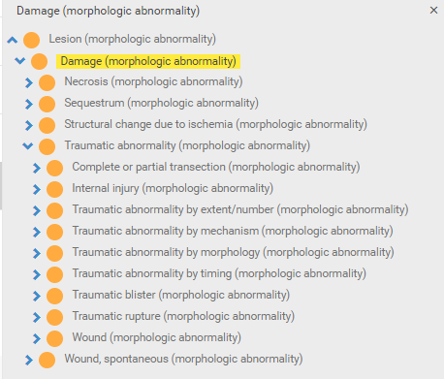
37782003 |Damage (morphologic abnormality)| and 19130008 |Traumatic abnormality (morphologic abnormality)|
What is the difference between 37782003 |Damage (morphologic abnormality)|and 49755003 |Morphologically abnormal structure (morphologic abnormality)| or 52988006 |Lesion (morphologic abnormality)|?

Slide 5
Injuries and trauma
Many injuries are modeled using 19130008 |Traumatic abnormality (morphologic abnormality)|but are ambiguous as to whether due to external forces
There is no way to assert a non-traumatic injury in SNOMED
    E.g. Cerebrovascular accident is considered a non-traumatic brain injury which would currently need to be modeled using damage resulting in being subsumed by traumatic and/or non-traumatic injury

Slide 6
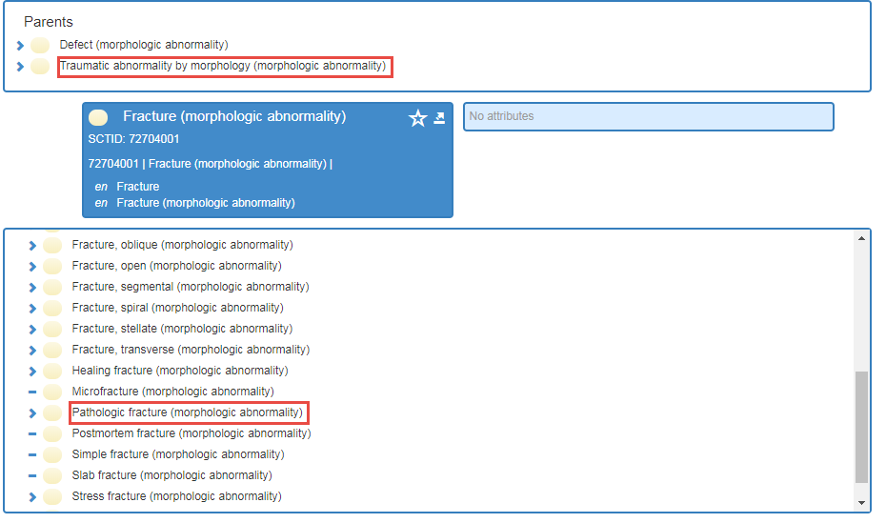
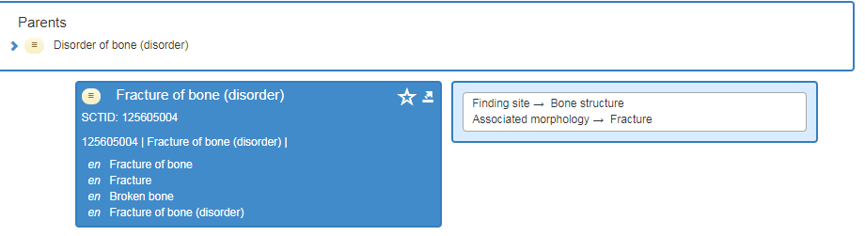
Fractures
Fracture (morphologic abnormality) Is a child of Traumatic abnormality by morphology but Fracture (morphologic abnormality) subsumes Pathologic fracture (morphologic abnormality)

Slide 7
Option 1
Create Non-traumatic abnormality (morphologic abnormality) under 37782003 |Damage (morphologic abnormality)|as a sibling of 19130008 |Traumatic abnormality (morphologic abnormality)| and create Non-traumatic injury (disorder) under 417163006 |Traumatic AND/OR non-traumatic injury (disorder)|as a sibling of 417746004 |Traumatic injury (disorder)|

Slide 8
Option 2
Create additional nontraumatic morphologies as needed similar to:
  736119007 |Nontraumatic blister (morphologic abnormality)|
  125672000 |Nontraumatic rupture (morphologic abnormality)|
  450424009 |Nontraumatic hematoma (morphologic abnormality)|
  450423003 |Nontraumatic hemorrhage (morphologic abnormality)|
  724355004 |Nontraumatic complete rupture (morphologic abnormality)|
  713264002 |Nontraumatic ruptured aneurysm (morphologic abnormality)|
  22640007 |Pathologic fracture (morphologic abnormality)|
Currently there are 64 Nontraumatic disorders, 51 are fully defined using one of the above morphologies, 13 are primitive due to lack of an appropriate morphology.

Slide 9
Option 3
Create Non-traumatic (qualifier value) under under 308489006 |Pathological process (qualifier value)|as a sibling of 263904004 |Traumatic (qualifier value)|

Slide 10
Test modeling of option 3
Contention is that “injury” is not a morphology but rather a pathological process which includes both traumatic and nontraumatic subtypes

Slide 11
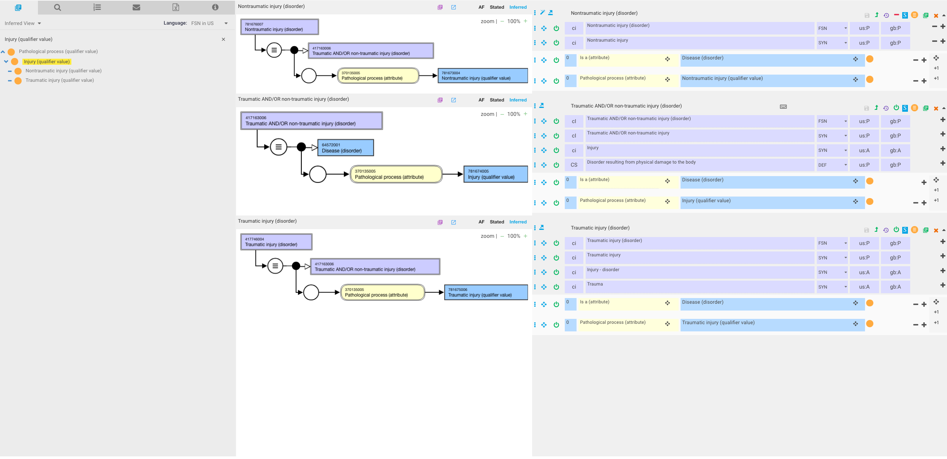
Injury

Slide 12
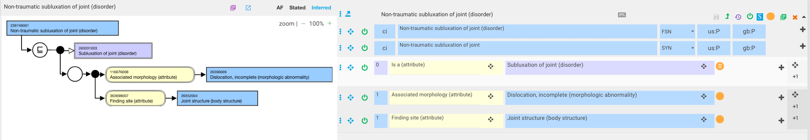
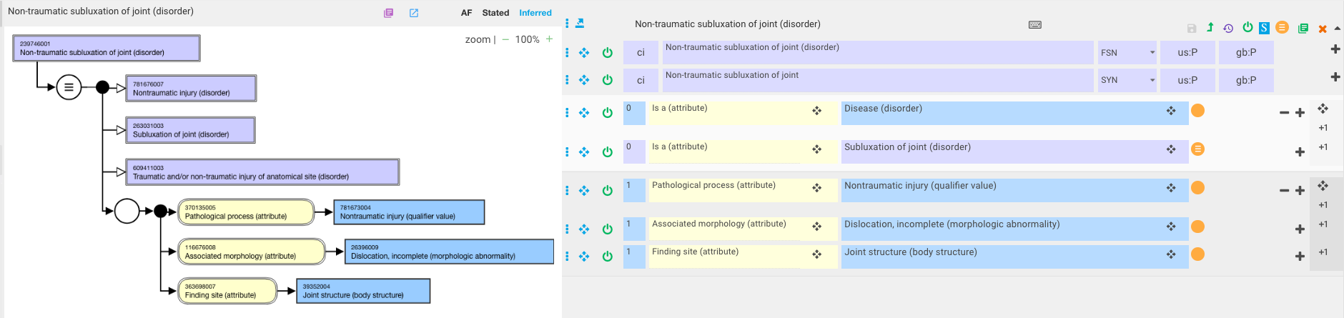
Non-traumatic subluxation of jointore
Before
After

Slide 13
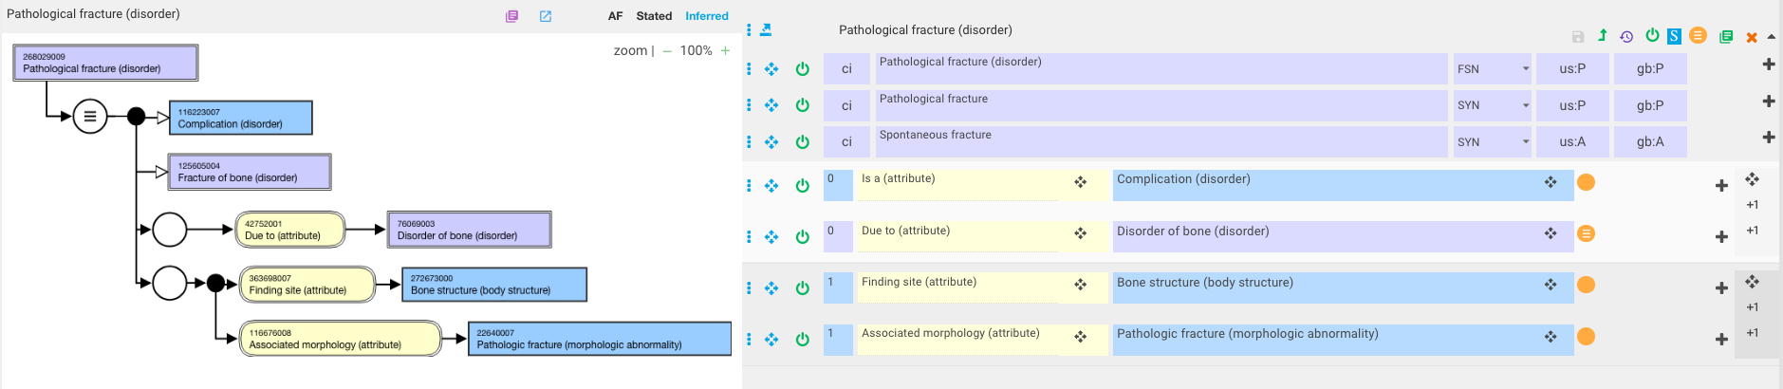
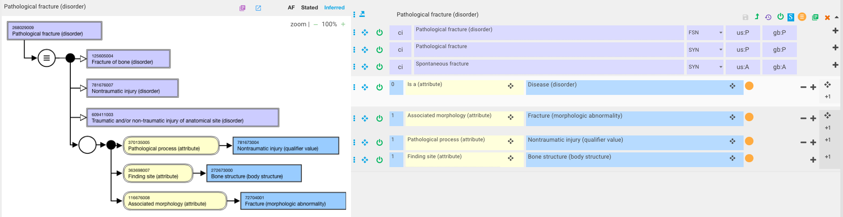
Pathologic fracture of fibula
Before
After

Slide 14
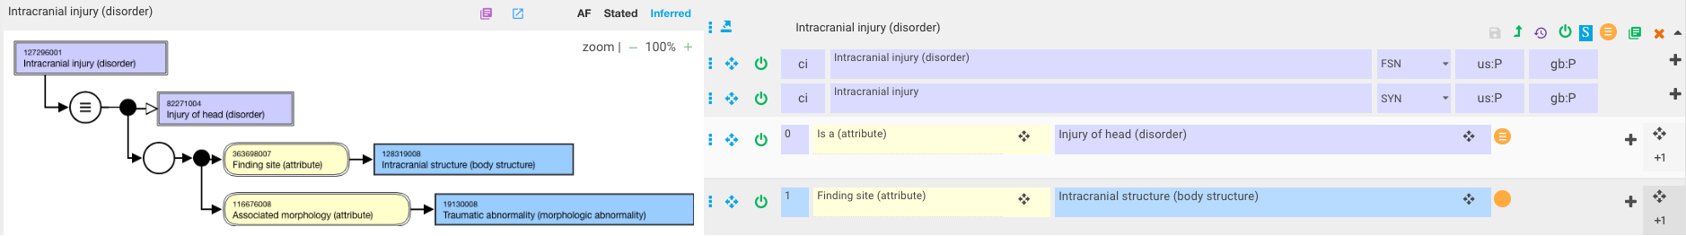
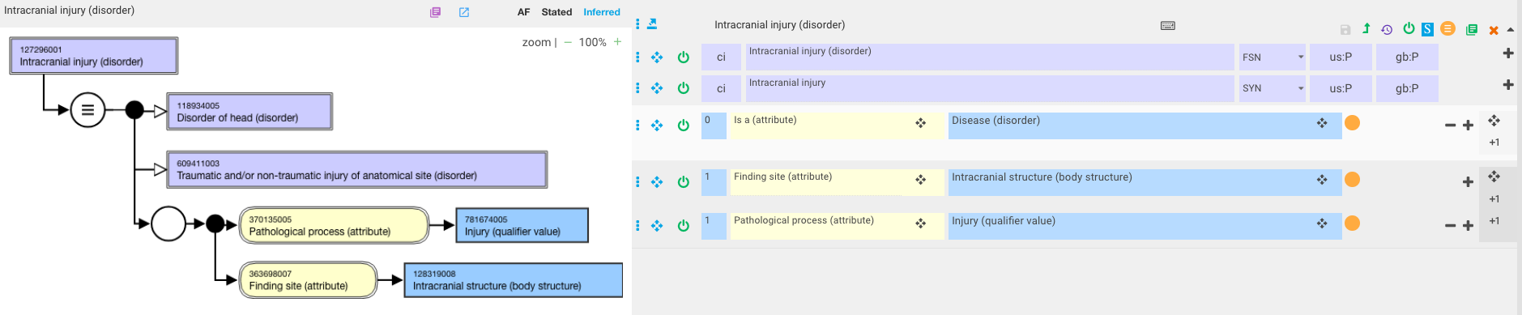
Intracranial injury
Before
After

Slide 15
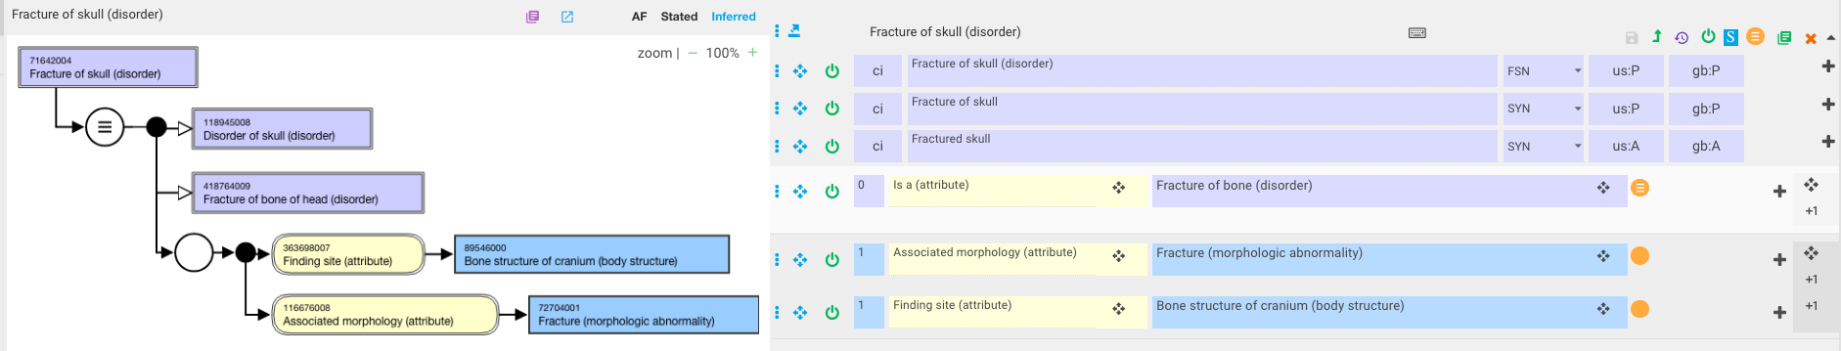
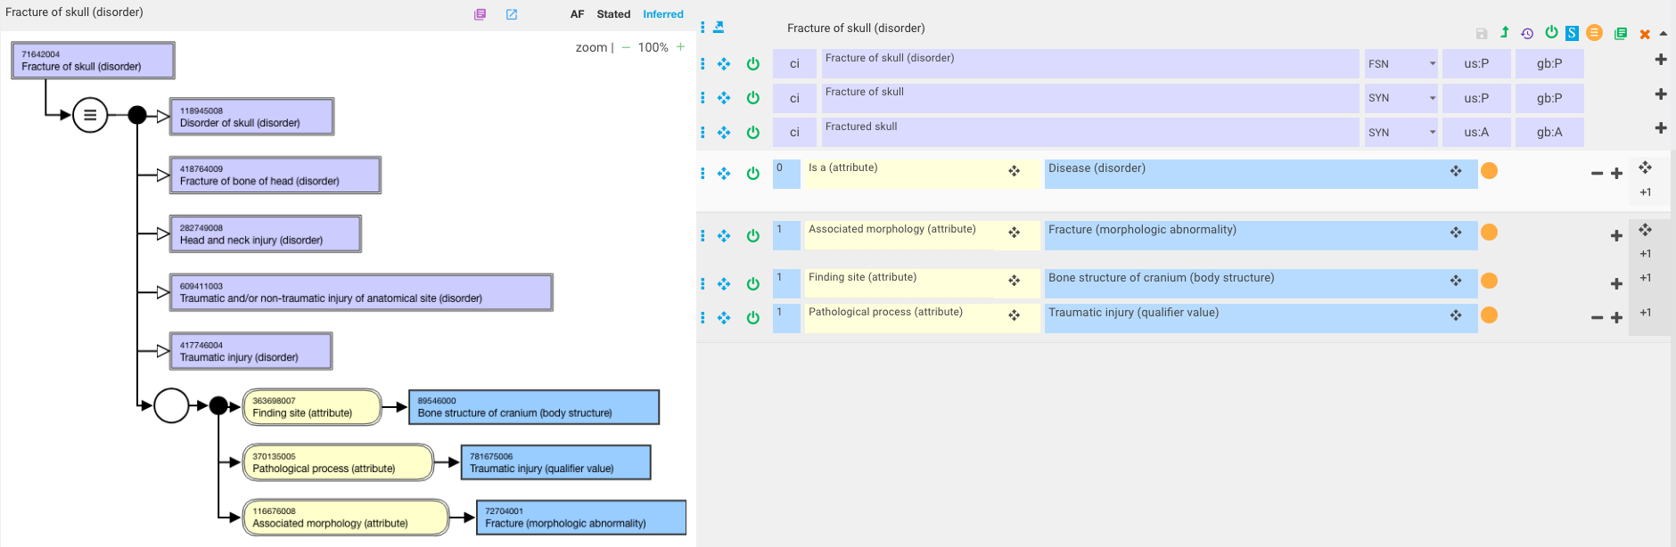
Fracture of skull
Before
After

