Slide 1
Evaluating sources of truth for elucidating the meaning of concepts
Bruce Goldberg
Jeff Pierson

Slide 2
Not uncommonly, while attempting to elucidate the meaning of an existing or proposed SNOMED CT concept, a review of the literature does not support a consensus definition.

Slide 3
Examples
General concept | Meaning 1 | Meaning 1 source | Meaning 2 | Meaning 2 source
Reactive arthritis | A spondyloarthritis occurring concomitantly or following an infection of the genitourinary or gastrointestinal tract typically caused by Chlamydia trachomatis, Yersinia, Salmonella, Shigella, Campylobacter, Clostridium difficile, and Chlamydia pneumoniae. | UpToDate® https://www.uptodate.com/contents/reactive-arthritis?search=reactive%20arthritis&source=search_result&selectedTitle=1~118&usage_type=default&display_rank=1 | Reiter's syndrome, also known as reactive arthritis, is the classic triad of conjunctivitis, urethritis, and arthritis occurring after an infection, particularly those in the urogenital or gastrointestinal tract. | Wu IB, Schwartz RA. Reiter's syndrome: the classic triad and more. J Am Acad Dermatol. 2008 Jul;59(1):113-21. doi: 10.1016/j.jaad.2008.02.04
Claudication | Intermittent claudication can be neurogenic or vascular. | Nadeau M, Rosas-Arellano MP, Gurr KR, et al. The reliability of differentiating neurogenic claudication from vascular claudication based on symptomatic presentation. Canadian Journal of Surgery. 2013;56(6):372-377. doi:10.1503/cjs.016512. | Intermittent claudication (IC) is defined by leg muscle pain, cramping and fatigue brought on by ambulation/exercise; relieved on rest; and caused by inadequate blood supply and is the primary symptom of peripheral arterial disease (PAD). | Intermittent claudication: An overview Meru, Ashwinkumar V. et al. Atherosclerosis , Volume 187 , Issue 2 , 221 - 237
Little league elbow | Medial epicondyle apophysitis, often called "little league elbow," is the most common injury affecting young baseball pitchers whose bones have not yet stopped growing. | https://www.columbiadoctors.org/condition/medial-epicondyle-apophysitis-little-league-elbow-pediatric | Little League elbow is the name used to describe a group of elbow problems related to the stress of throwing in children and young adolescents. Throwing can cause medial symptoms as well as lateral and posterior symptoms. | https://www.physio-pedia.com/Little_League_Elbow

Slide 4
Potential sources of truth
Subject matter experts
  Medical specialty societies.
  Clinical reference groups
Publications - print and online
  Textbooks
  Guidelines/practice parameters) from medical specialty societies.
  Publications in peer reviewed journals with high Impact status.
  Review articles/meta-analyses
Other sources
  WHO
  FMA

Slide 5
Journal Impact Factor
The impact factor (IF) is a measure of the frequency with which the average article in a journal has been cited in a particular year. It is used to measure the importance or rank of a journal by calculating the times it's articles are cited.
The calculation is based on a two-year period and involves dividing the number of times articles were cited by the number of articles that are citable.

Slide 6
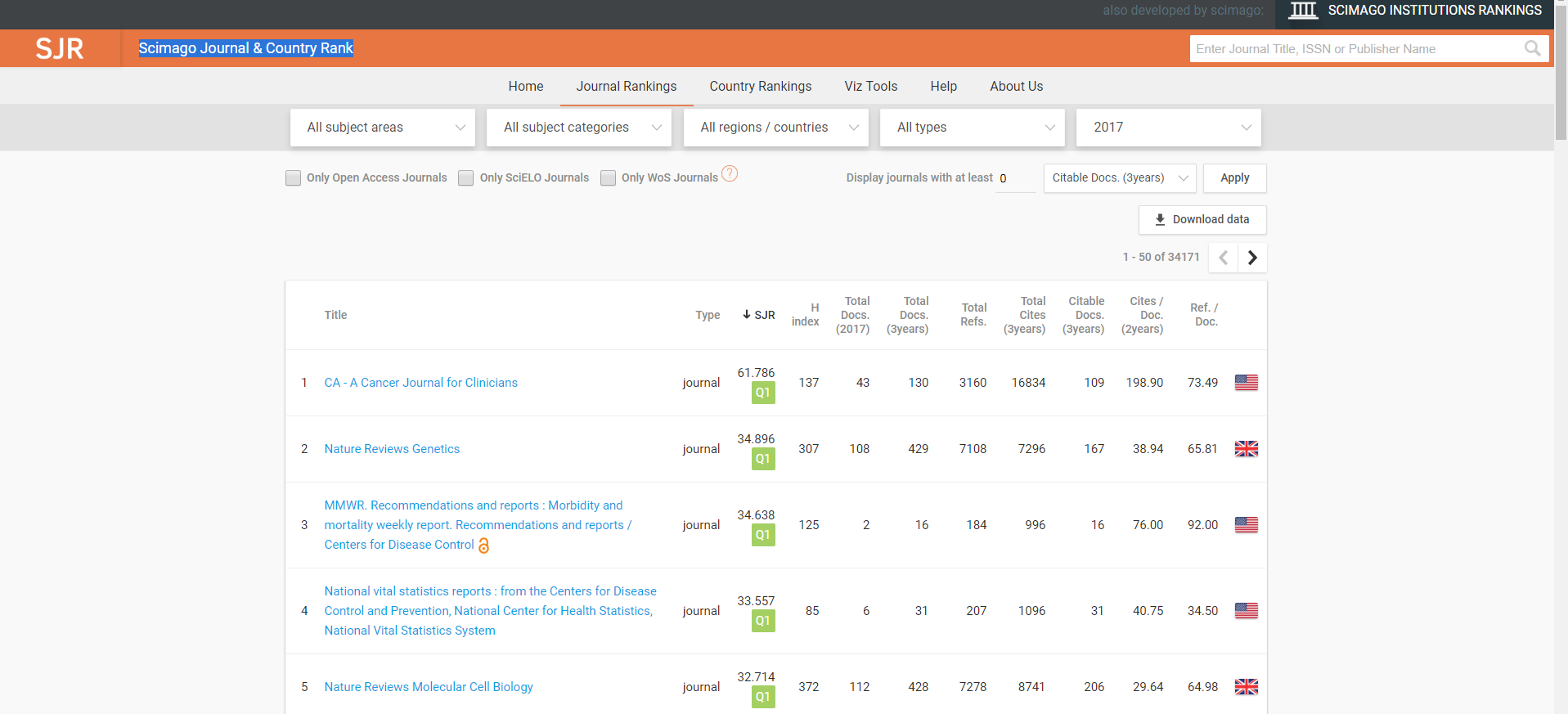
Determining journal impact factor https://www.scimagojr.com/journalrank.php?

Slide 7
Issues with assigning a source of truth
Disagreement among medical specialists.
Update of medical specialty guidelines lags behind newly published studies
Review articles may not represent the latest information available
Evolving data makes it difficult to assign a universal source of truth rather than a source of truth that merely exists at the time the initial query is made.
Primary sources reflect the true meanings and ideas put forth by authors, the information itself may not be completely objective, well-reasoned, or accurate.

Slide 8
Possible approaches to assigning a single source of truth for the meaning of SNOMED CT concepts
UpToDate®
  Thorough well documented reviews by experts
  Constantly updated. Date of last update indicated
  Opportunity to contact the authors for clarification through the website
  May not cover all possible topics

Slide 9

WHO
Conclusions
  WHO produces a number of high quality, high impact publications.
  There is no doubt that WHO is a credible organization and that health professionals throughout the world look to it for science-based guidance and advice. However, opportunities for improvement do exist.
  WHO must strive to maximize the reach and impact it can have with the significant investment it is making in publications.

Slide 10
WHO - 2
Publications may not be updated frequently
  The current World Health Organization definition of stroke (introduced in 1970 and still used) is “rapidly developing clinical signs of focal (or global) disturbance of cerebral function, lasting more than 24 hours or leading to death, with no apparent cause other than that of vascular origin.”
    During the 40 years since this definition as formulated, advances have been made in knowledge about the nature, timing, clinical recognition of stroke and its mimics, and imaging findings that require an updated definition
  International Classification of Diseases for Oncology, 3rd Edition (ICD-O-3)
    Creation date: 1976
    Last date change: 2000

Slide 11
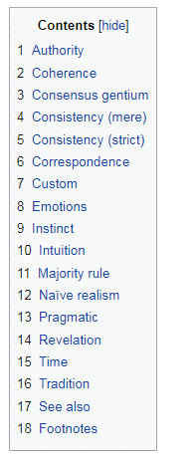
Evaluating sources of truth
In epistemology, criteria of truth (or tests of truth) are standards and rules used to judge the accuracy of statements and claims. The rules of logic have no ability to distinguish truth on their own.

Slide 12
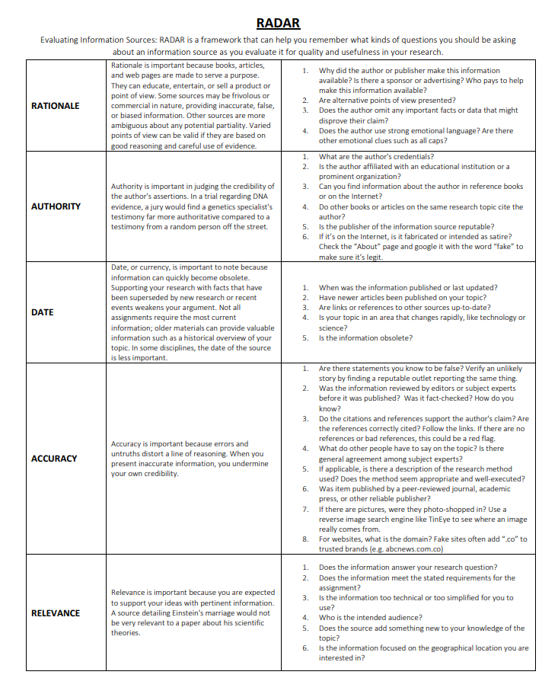
RADAR
Mandalios, J. (2013). RADAR: An approach for helping students evaluate Internet sources. Journal Of Information Science, 39, 470- 478. doi:10.1177/0165551513478889.

Slide 13
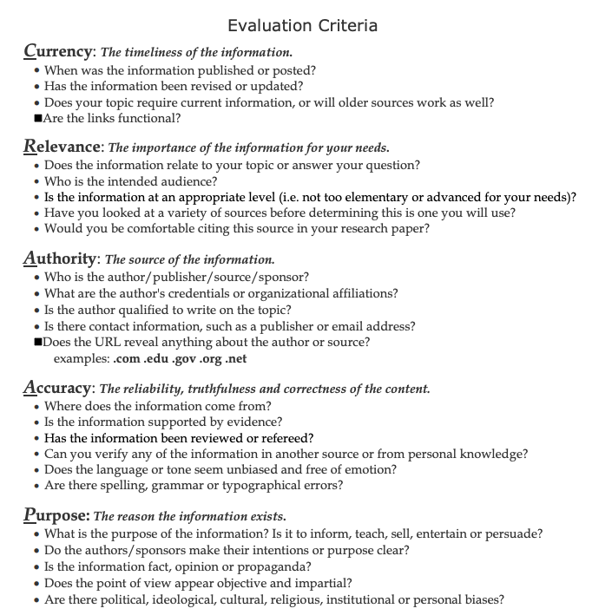
CRAAP Test
Meriam Library at California State University, Chico. (2010, September 17). Evaluating information-Applying the CRAAP test. Retrieved from http://www.csuchico.edu/lins/handouts/eval_websites.pdf

Slide 14
Potential approach to determine source of truth
In terms of SNOMED authoring workflow efficiency, consideration should be given to using UpToDate as a single source of truth if at all possible.
If UpToDate does not contain relevant content, apply RADAR/CRAAP using a ranking system for each measure (see next slide).
Devise acceptability criteria (total numeric score) for determining overall reliability of source

Slide 15
Possible ranking system for determining accuracy
Ranking system | Rank | Source | Examples
 | 1 | Created by authoritative entity | Organization - Orphanet, OMIM, Specialty concensus, Government site - CDC
 | 2 | Created by a peer reviewed independent entity | Up-to-date, Current reference books - Goldman-Cecil Medicine, etc.
 | 3 | created by bioscience research | PUBMED articles, journals, medical technologies, etc.
 | 4 | Created by entity that is reviewed by experts | Wiki pages - specialty - Eye Wiki
 | 5 | Created by entity without verified reviewer (expert) | Wiki pages
 | 6 | General library or internet search | Current? Information older that a set date are likely only of historical relevance
 | 7 | Specialty Experts | Global? - danger is only locally valid

Slide 16
Differences between 3 definitions of stroke
AHA/ASA consensus definition | AHA/ASA website | UptoDate® definition¹
Description: Acute neurological dysfunction | Description: N/A | Description: Acute neurologic injury
Sites: brain, spinal cord, retina | Sites: brain | Sites: brain
Types: Ischemic (due to infarction) Hemorrhagic (intracerebral, subarachnoid) Due to central venous thrombosis | Types: Ischemic (due to a clot obstructing the flow of blood to the brain Hemorrhagic TIA | Types: Ischemic (due to thrombosis, embolism, systemic hypoperfusion, central venous thrombosis) Hemorrhagic Due to occlusion of veins that drain the brain of blood
¹The definition of transient ischemic attack is changing with recognition that transient neurologic symptoms are frequently associated with permanent brain tissue injury.
²Author of this article is one of the authors of the consensus document

Slide 17
Proposed Cerebrovascular accident upper level hierarchy
Cerebrovascular accident
  Ischemic stroke
    Occlusive
      Thrombotic stroke
      Embolic stroke
    Due to systemic hypoperfusion
  Hemorrhagic stroke
    Due to cerebral hemorrhage
    Due to subarachnoid hemorrhage
  Stroke due to cerebral venous thrombosis

Slide 18
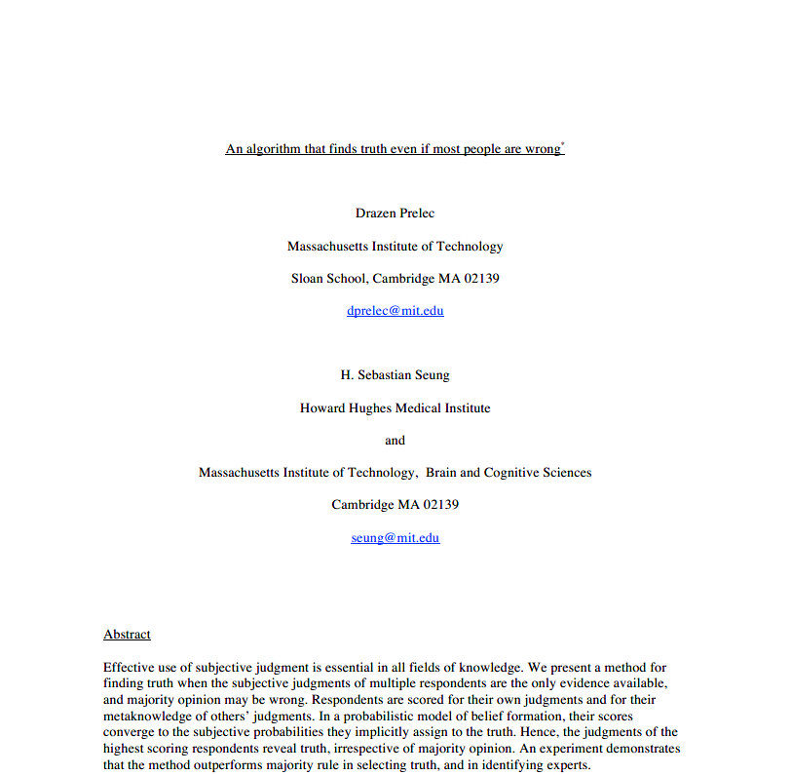
Algorithmic approaches to determining source of truth
The method selects the judgments of respondents who reveal superior meta knowledge — knowledge of others’ opinions.
The instrument for measuring meta knowledge is a mathematical formula called the Bayesian Truth Serum
As input to the formula, respondents provide their judgments and also their predictions of the distribution of judgments in a sample of peers.
These dual reports then undergo competitive, zero-sum scoring as a function of the sample statistics.

Slide 19
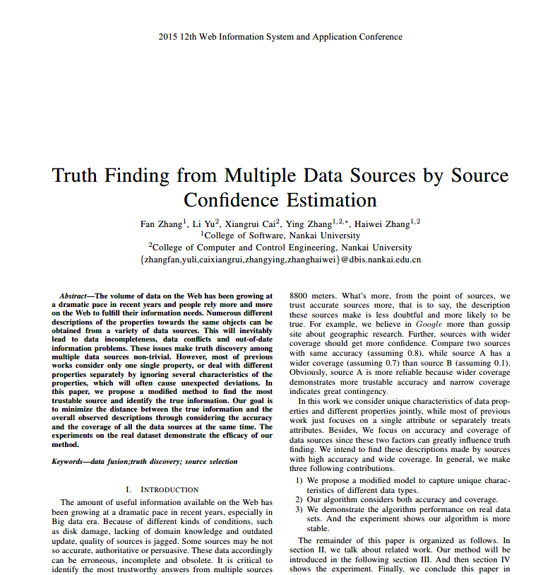
Algorithmic approaches to determining source of truth 2
We propose a modiﬁed model to capture unique characteristics of different data types.
  The algorithm considers both accuracy and coverage.

