Slide 1
Allergy Update

Slide 2
Briefing note - Changes to the modeling of hypersensitivity, allergy and pseudoallergy content in SNOMED CT
Purpose
  To update the Member Forum on the plans for implementation of a revised model for hypersensitivity conditions which includes both allergy and pseudoallergy (non-allergic hypersensitivity) content
Background
  In preparation for the implementation of this model, several new pathological process qualifier values have been added under 308489006 |Pathological process (qualifier value)|
Issues
  A number of issues have surfaced regarding the current modeling of hypersensitivity conditions:
  Several concepts residing under 419199007 |Allergy to substance (disorder)|have been modeled with fully defined stated parents which has resulted in inheritance of more than one causative agent which in turn may affect decision support algorithms. In addition, many descendants of this hierarchy that represent groupers will be affected by changes related to the substance hierarchy redesign.
  Fully defining the condition classes (473010000 |Hypersensitivity condition (disorder)|, 473011001 |Allergic condition (disorder)|and 609405001 |Pseudoallergic condition (disorder)|) using a pathological process relationship results in the disposition classes inheriting these relationships which is incorrect.
  The model for the 609328004 |Allergic disposition (disorder)|class is based on a temporal relationship to a sensitization process making the model incongruent with 609396006 |Pseudoallergic disposition (disorder)|as sensitization is only relevant to allergic dispositions.
  Neither allergic nor autoimmune diseases have relationships to 414029004 |Disorder of immune function (disorder)|
  There are several allergic conditions that are intermediate primitives and which have specific immunologic mechanisms that can be fully defined by the use of more specific pathological processes representing these mechanisms.

Slide 3
2019-January Release Plan
Immunoglobin E-mediated allergic contact hypersensitivity process (qualifier value) and Non-immunoglobin E-mediated allergic contact hypersensitivity process (qualifier value) will be created.
Hypersensitivity, allergy and pseudoallergy condition classes will be moved under 404684003 |Clinical finding (finding)| and modeled using GCIs in order to encompass allergic disorders, dispositions and processes (reactions).
Hypersensitivity, allergy and pseudoallergy dispositions (the latter renamed as Non-allergic hypersensitivity based on feedback from the Allergy CRG) will be moved under 404684003 |Clinical finding (finding)| and remodeled using proximal primitive parents with a role group consisting of 719722006 |Has realization (attribute)| with a value of 472963003 |Hypersensitivity process (qualifier value)| or an appropriate subtype and a causative agent relationship to a substance and follow a naming pattern of Hypersensitivity/Allergy/Non-allergic hypersensitivity to X (finding).
A new hierarchy of Intolerance to substance (finding) will be created.
414029004 |Disorder of immune function (disorder)|will be remodeled and fully defined using a pathological process of 769247005 |Abnormal immune process (qualifier value).
Changes in the substance hierarchy as the result of Allergy project requirements (Allergies-30 and Allergies-32):
  Inactivate the following two top level groupers/Allergen classes in substance hierarchy by reassigning their children to appropriate structural and/or functional parents :
    414052000 | Drug allergen by structure |
    414058001 | Drug pseudoallergen by function
Note: Other top level groupers (as specified in Allergies-19) will be inactivated in the future releases.
Inactivate “Allergy to X" concepts where X is a modification of a base substance and replace it with Allergy to the base substance
For further details concerning these proposed changes please refer to the content project, “ALLERGIES” (https://jira.ihtsdotools.org/projects/ALLERGIES/summary) and its various tasks

Slide 4
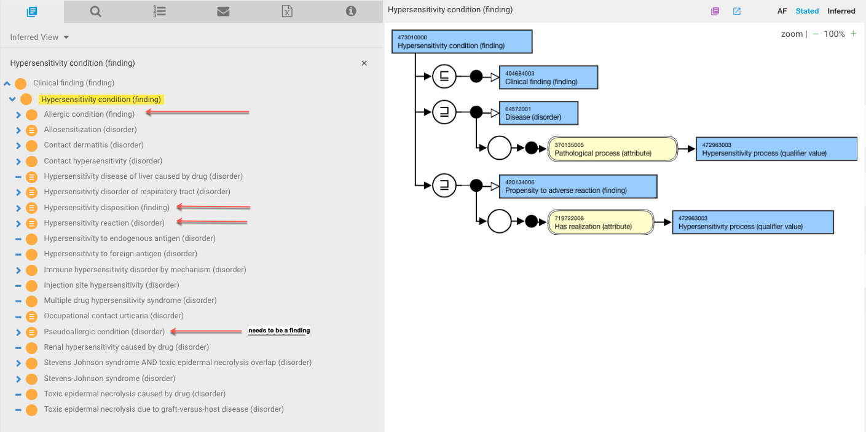
473010000 |Hypersensitivity condition (finding)|

Slide 5
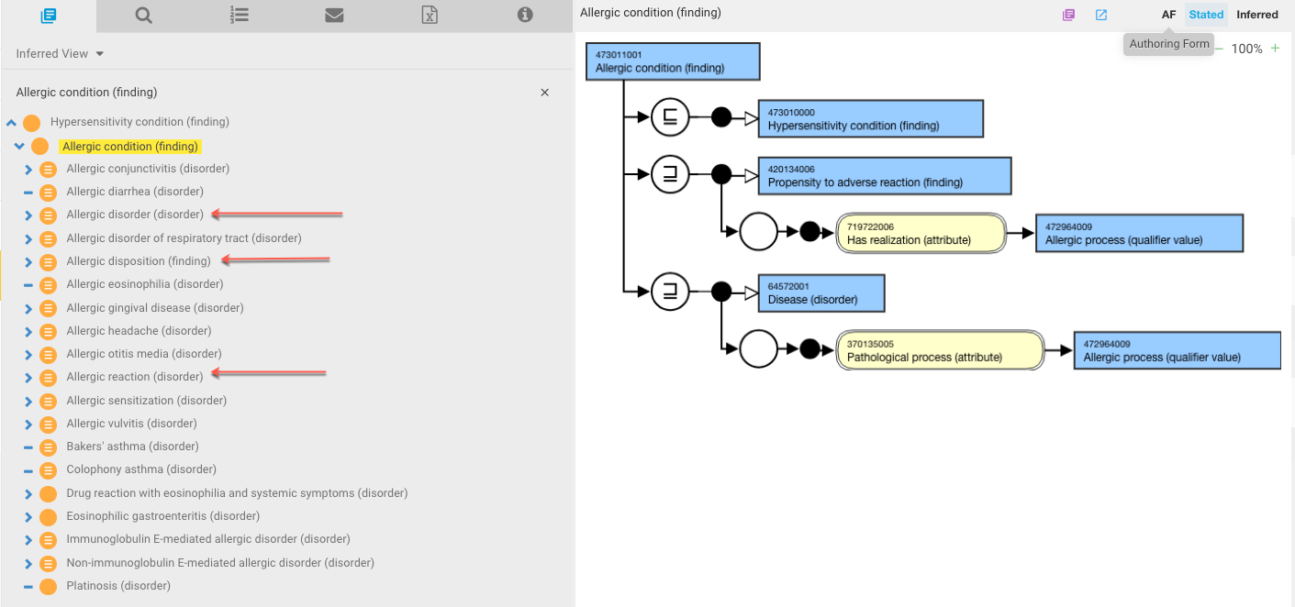
473011001 |Allergic condition (finding)|

Slide 6
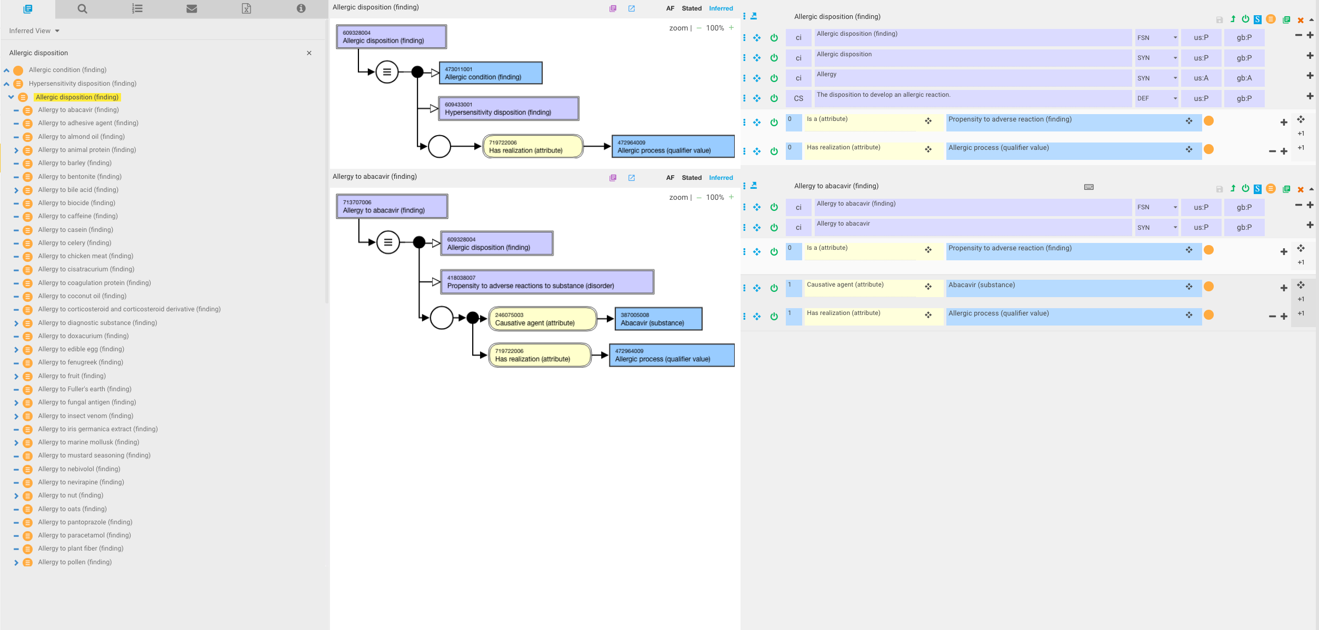
609328004 |Allergic disposition (finding)|

Slide 7
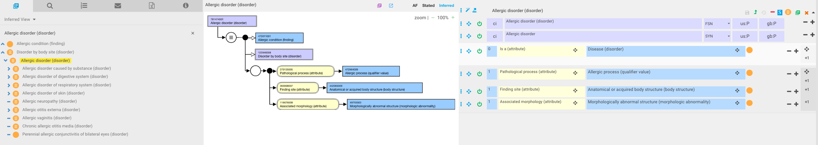
781474001 |Allergic disorder (disorder)|

Slide 8
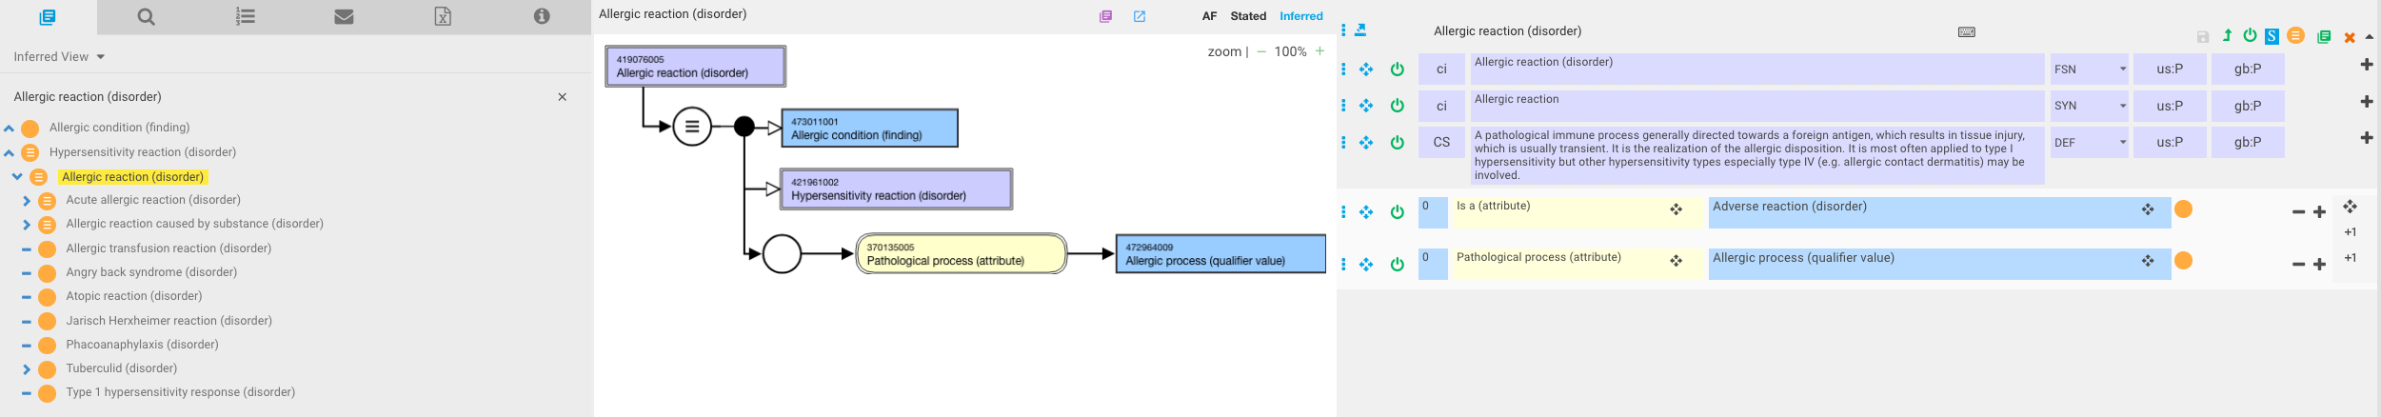
419076005 |Allergic reaction (disorder)|

Slide 9
Allergy and inflammation
Are allergic diseases and reactions always associated with a morphology of inflammation?

Slide 10
Allergic inflammation
The inflammation produced in sensitized subjects after exposure to a specific allergen(s). A single allergen exposure produces an acute reaction, which is known as an early-phase reaction or a type I immediate hypersensitivity reaction. In many subjects, this is followed by a late-phase reaction. With persistent or repetitive exposure to allergen, chronic allergic inflammation develops, with associated tissue alterations.
The development of allergic inflammation Stephen J. Galli1,2, Mindy Tsai1, and Adrian M. Piliponsky1
  1Department of Pathology, Stanford University School of Medicine, 300 Pasteur Drive, Stanford, California 94305, USA
  2Department of Microbiology and Immunology, Stanford University School of Medicine, 300 Pasteur Drive, Stanford, California 94305, USA

Slide 11
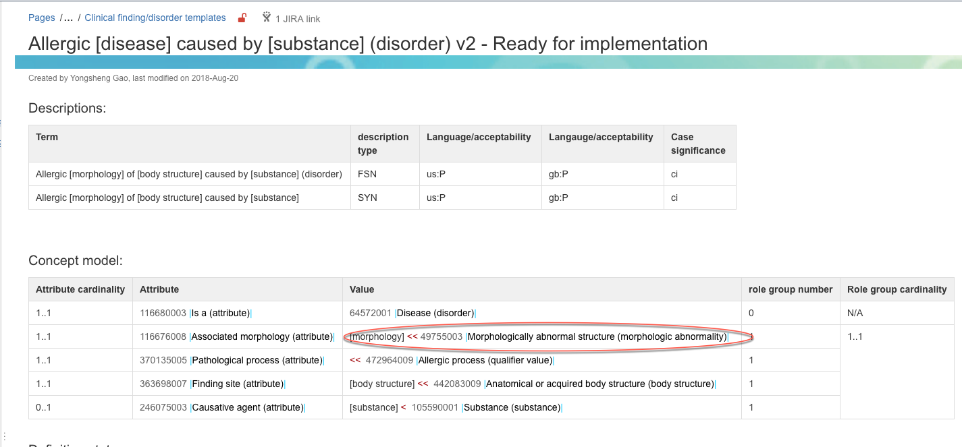
Current concept model for allergic disorder

Slide 12
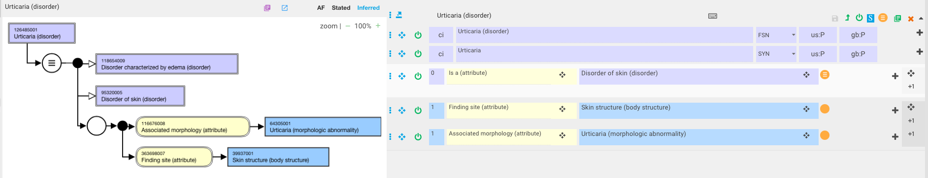
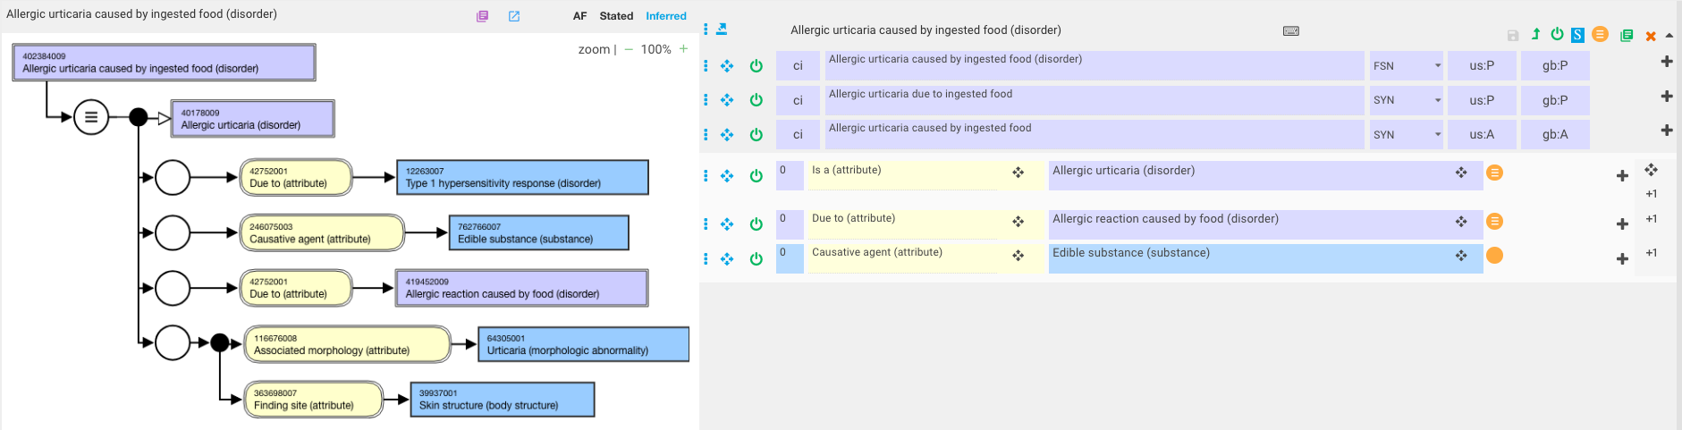
126485001 |Urticaria (disorder)|and 40178009 |Allergic urticaria (disorder)|

Slide 13
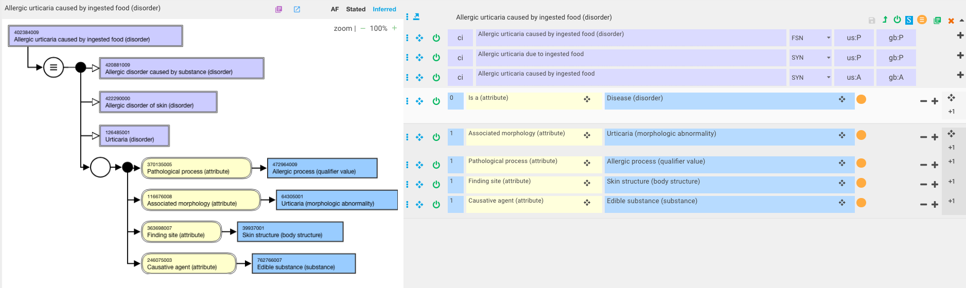
Revised model 402384009 |Allergic urticaria caused by ingested food (disorder)| (without inflammation morphology)

Slide 14
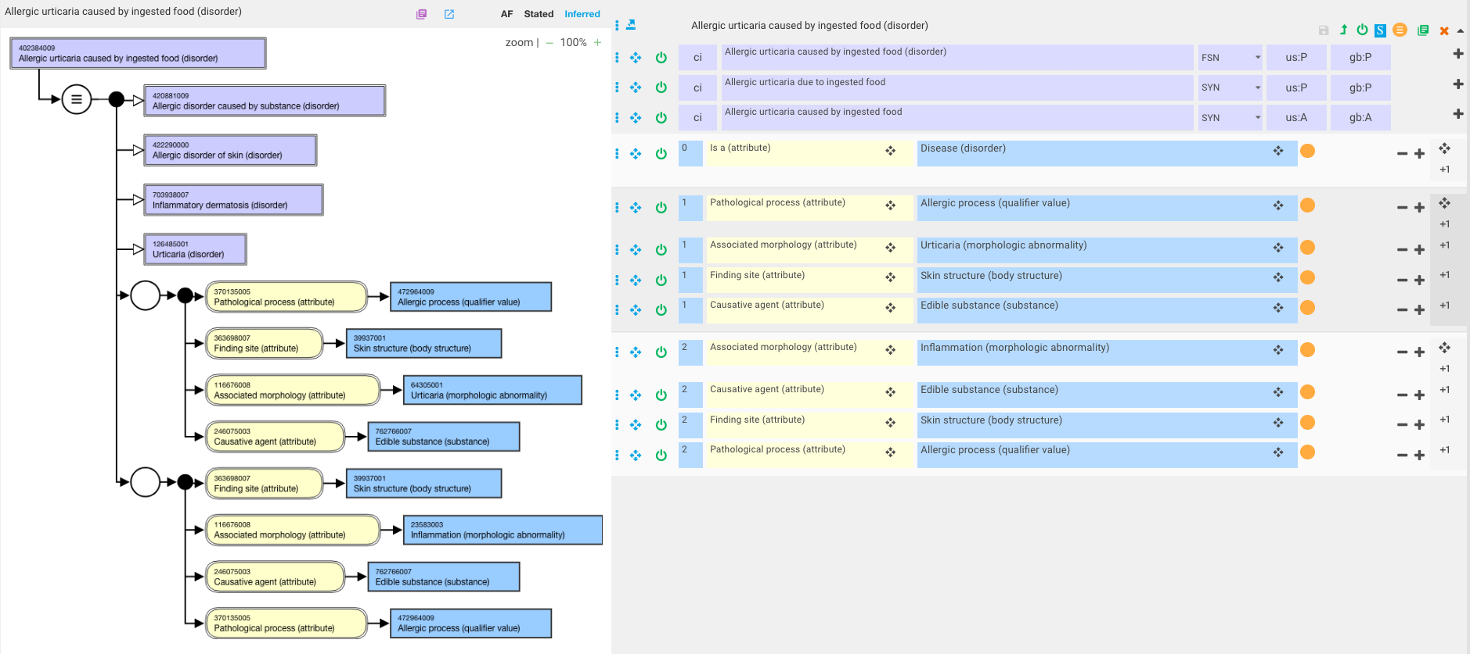
Revised model 402384009 |Allergic urticaria caused by ingested food (disorder)| (with inflammation morphology)

Slide 15
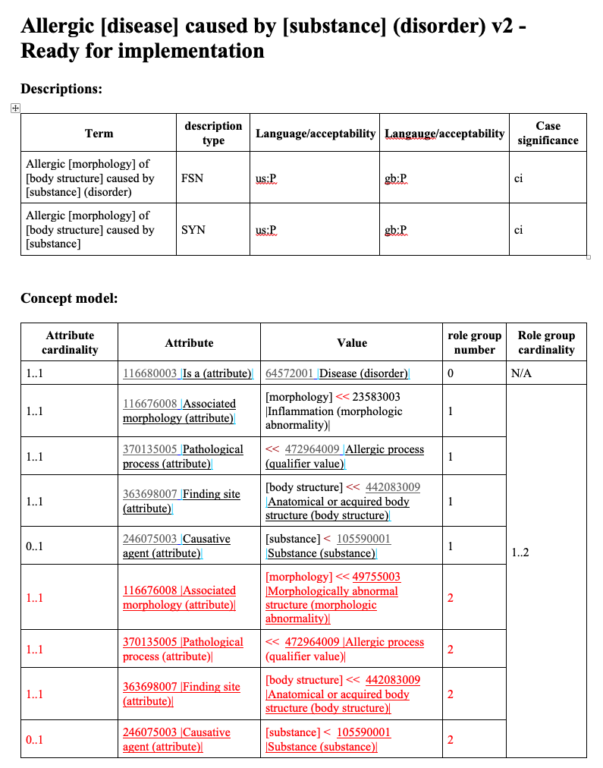
Revised Allergic disorder template

Slide 16
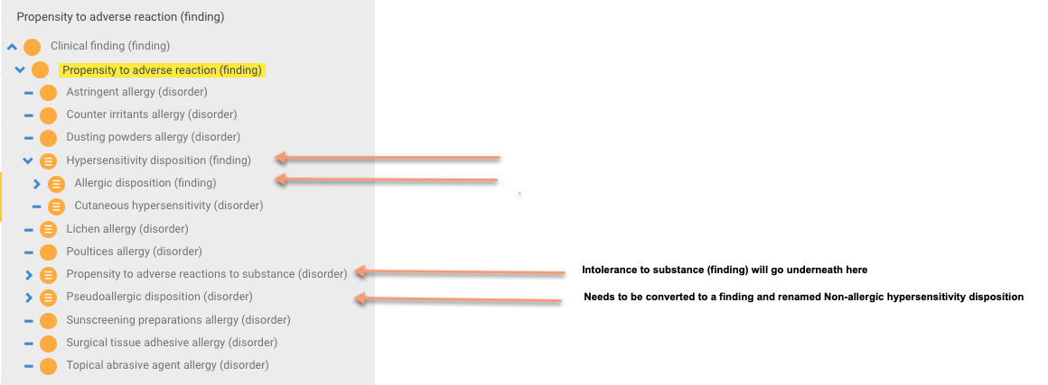
420134006 |Propensity to adverse reaction (finding)|

Slide 17
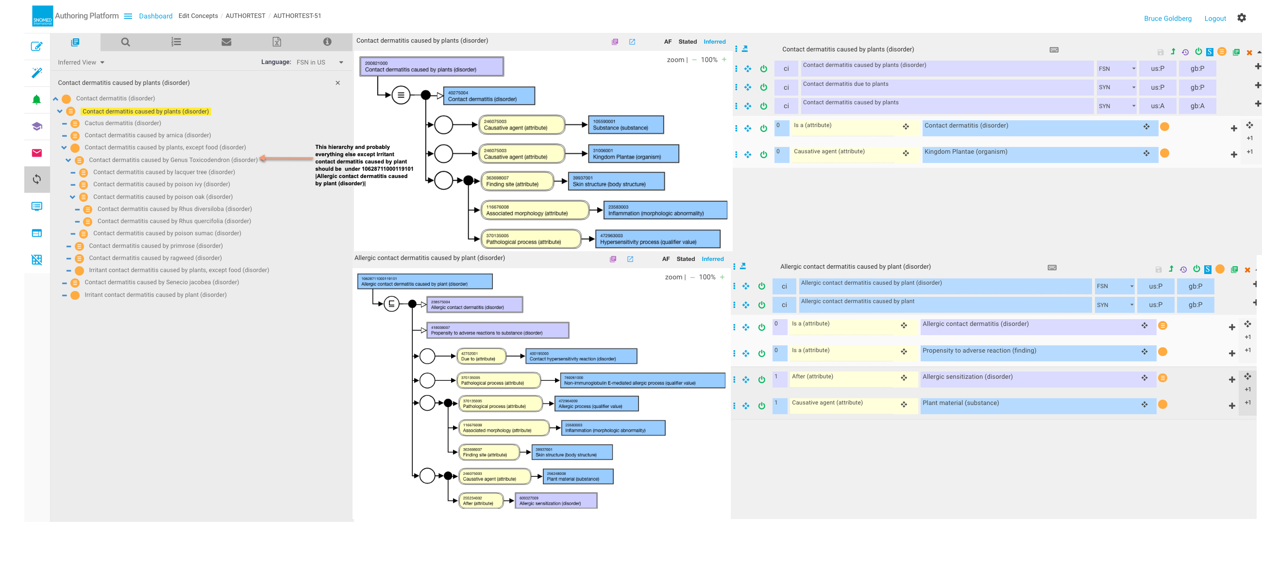
Allergic disorders caused by living organisms

Slide 18
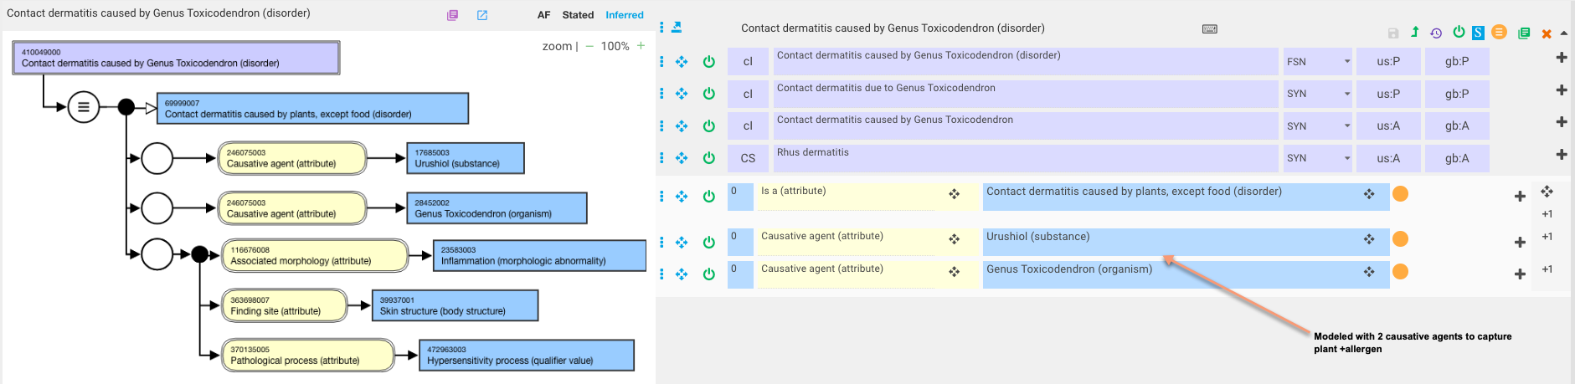
410049000 |Contact dermatitis caused by Genus Toxicodendron (disorder)|

Slide 19
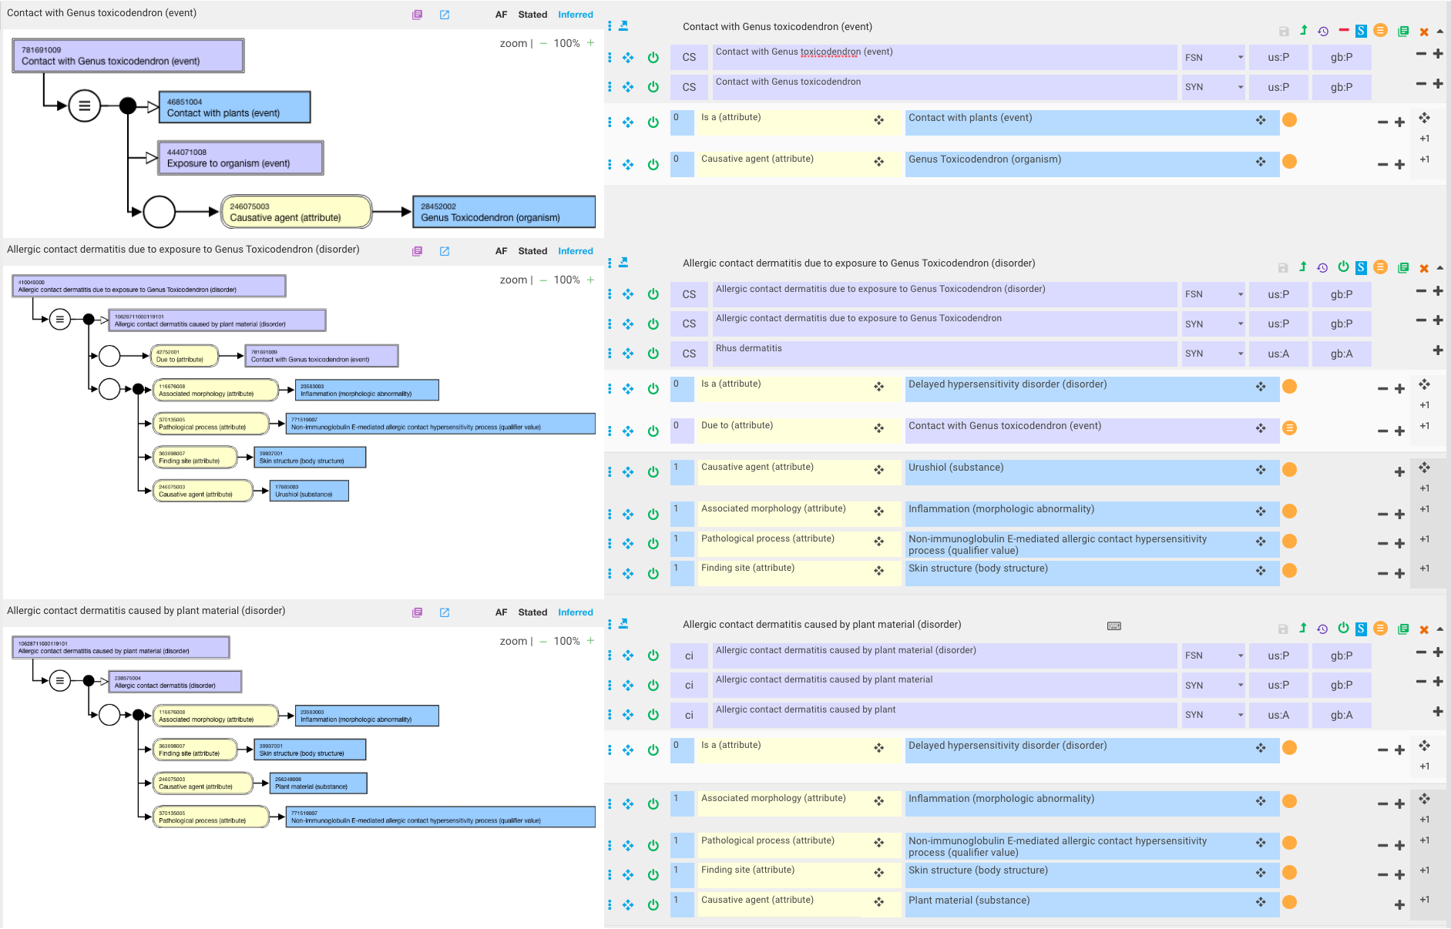
Improved model for410049000 |Contact dermatitis caused by Genus Toxicodendron (disorder)|

