Slide 1
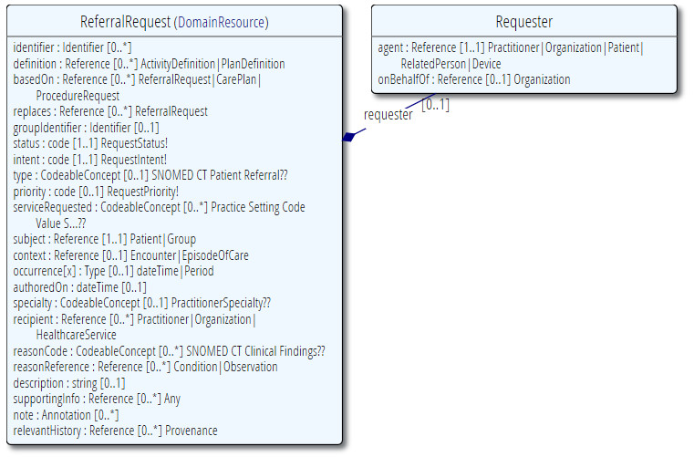
ReferralRequest
Scope: requests by one practitioner to another for an opinion, or to transfer of care to them (whether temporary or permanent)
Boundaries: close relation to ProcedureRequest. Some service referrals may be equally appropriately sent as ProcedureRequest
ProcedureRequest ⇨ requestor retains medicolegal authority for subsequent action
ReferralRequest ⇨ requestor transfers authority for subsequent action to service

Slide 2
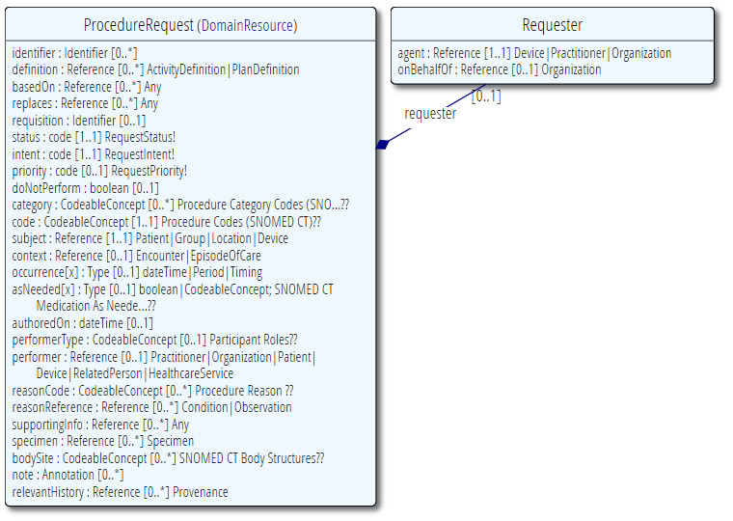
ProcedureRequest

Slide 3
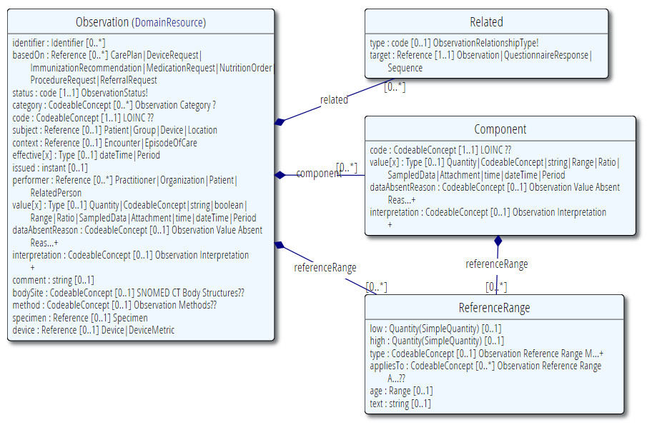
Observation

Slide 4
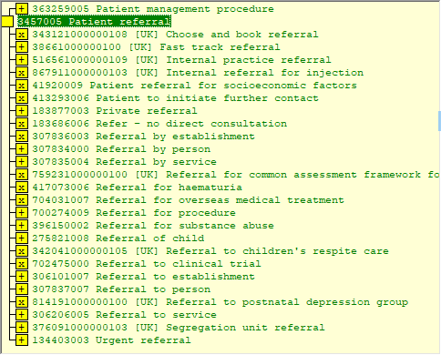
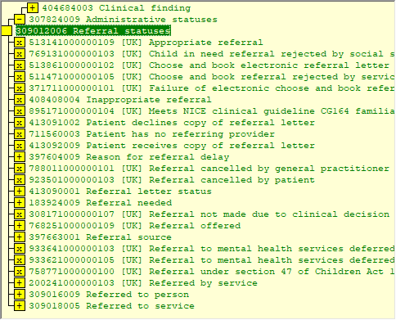
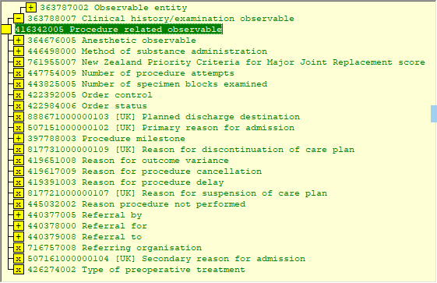
referred to/seen by/under care of/discharged from etc
As Procedure…
As Finding…
As Observable…

