Slide 1
Engaging with global clinical communities (on a day to day basis)
Ian Green
Clinical Engagement and Education Business Manager
Jane Millar
Collaboration Lead

Slide 2
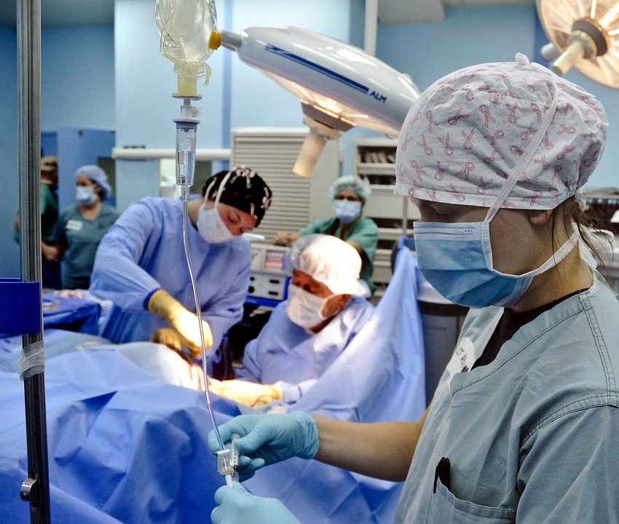

Vision of Clinical Engagement
Vision
To ensure that all activities of SNOMED International are influenced by global clinical communities
SNOMED International culture has a progressive and sustainable approach to engaging clinicians

Slide 3
Current position
Current state
Management Board
Management Board
Healthcare Professions Coordination Group (HPCG)
PHARMACY
SIG
IPaLM
SIG
IFP/GP
SIG
ANAESTHETICS
SIG
NURSING
SIG
DENTISTRY
SIG
MAP
SIG
IMPLEMENTATION
SIG

Slide 4
Current position
Current state
Clinical SIGs (Anaesthesia, Nursing, IPaLM, International Dentistry, Pharmacy, IFP/GP)
  Agreed terms of reference (ToR) in place
  Nominated leadership signed off by MB
  Allocated SNOMED International author liaison
  Oversight by MT member, providing coordination and guidance
  Representation on Healthcare Professionals Coordination Group (HPCG)
  Meet virtually and face to face at SNOMED International meeting(s) as required, based on work items
Note:
  Non functioning currently – Pharmacy SIG and IFP/GP SIG (except to support updates of GP/FP subset and SNOMED CT to ICPC2 map)

Slide 5
Role of clinical SIG’s (based on agreed ToR)
Current state
Provide access to global clinical experts
Provide clinical advice on content and implementation
Provide intelligence on global clinical developments
Provide clinical oversight for some SNOMED International products (e.g. GP/FP subset)
Contribute to delivery of specific pieces of work, as per SNOMED International work plan (e.g. general dentistry subset)

Slide 6
Current issues
Current state
Difficulty recruiting SIG leadership as chair required to:
  “Run” the group
  Manage agendas, minutes etc . . .
  Corrale volunteers to deliver (for agreed work plan items)
  Ensure international input and not personal views
  Clinicians are volunteers and have day jobs with other priorities
New clinical groups have an interest in global dialogue regarding SNOMED CT – content and implementation (e.g. physiotherapy)
Need to ensure SNOMED International resource is used effectively
Variable attendance
  Lack of leadership
  Lack of clarity on how their requirements are prioritised
  For some, feeling that their views are undervalued

Slide 7
Drivers for change
Case for change
Clinical engagement strategy
  Increase profile of SNOMED CT globally across all clinical groups
  Requirement to collaborate inter and multi professionally on content development and implementation
  Requirement for effective sharing and distribution of good practice
  Improved communication to a global network of clinicians
  Specification of clinical requirements for SNOMED International prioritization
Increasing demand from clinical bodies to have a “relationship” with SNOMED International
Local and national strategies specify more clinical validation
Putting in place 100+ clinical SIG’s to cover all specialties is not sustainable for SNOMED International

Slide 8
Requirements (aligned with Clinical Engagement strategy)
Proposed future model
Sustainable, scalable solution (future requirement for 100+ clinical specialties)
Open and transparent solution
Support mechanism for
  different levels of engagement and knowledge
  global communication, e.g.
    Clinician enquiries/discussion points
    SNOMED International requests for input to specific work items
  Cross working/multi-professional for specific topics, e.g. Genomics, Functioning, Diabetes
  individual and group engagement
Enable identification of clinical champions, as per strategy
Involvement across all time zones

Slide 9
Proposed model - principles
Proposed future model
Virtual
  Face to face - for specific agreed deliverables
  Face to face - if there is a clinical engagement event
Specialty based
Advisory
Open membership, including Vendors, multi-professional etc . . .
Route for identifying work items that have clinical global relevance
Topics raised by clinicians and SNOMED International
Group moderation provided by SNOMED International to provide support/guidance where appropriate

Slide 10
Proposed model – Format (1)
Proposed future model
Clinical Specialty Groups (e.g. IPaLM, Physiotherapy)
  Open
  Topic focus
  Forum for sharing and to support discussion
  Identification of rising global clinical themes
Project groups (e.g. Dentistry odontogram)
  Task and finish
  Delivering identified work plan items
  Specific membership based on skills/knowledge
  SNOMED International supported
  Funding based on project plan agreed by SNOMED International
  Project plan with deliverables and timescales based on SNOMED International work plan

Slide 11
Proposed model – Format (2)
Proposed future model
Specialty Editorial groups (e.g. GP/FP subset group)
  Ongoing
  Focused on specific BAU SNOMED International derivative product (e.g. GP/FP subset)
  Clinical validation
  Specific membership based on skills/knowledge
  SNOMED International supported
    Allocated SNOMED International author
    Additional SNOMED International staff, as products move into wider usage
    Collaboration lead where linked to an Agreement

Slide 12
The model
Proposed future model
MANAGEMENT TEAM
CLINICAL COORDINATION GROUP
CSG
CLINICAL ANAESTHESIA GROUP
CLINICAL
IFP/GP GROUP
CLINICAL DENTISTRY GROUP
CLINICAL NURSING GROUP
CLINICAL PHARMACY GROUP
CLINICAL IPaLM
GROUP
CLINICAL
SPECIALTY
GROUP
CLINICAL
SPECIALTY
GROUP
+ +
NEW GROUPS
SPECIALTY EDITORIAL/
PROJECT
GROUPS
GP/FP SUBSET
SPECIALTY
EDITORIAL
GROUP
DENTAL
PROJECT
GROUP
ICNP/SNOMED
SPECIALTY
EDITORIAL GROUP
EXISTING GROUPS

Slide 13
How the proposed model will work
Proposed future model
Confluence based site
Discussion forum
  Virtual meetings when required
Identify a domain lead over time, based on expertise
Discussion items raised by group members and/or SNOMED International – uni and multi-professional
Open membership, but need to be group registered to take an active part in discussions
Membership available to clinicians and non-clinicians
Group moderation provided by SNOMED International (Clinical Engagement business manager)
Notes:
----- Meeting Notes (30/11/16 09:46) -----
task allocation internal or external, need a reason to put one in place

Slide 14
Setting up Clinical Specialty Group (CSG)
Proposed future model
Confirm criteria/requirements for CSG
Publish clear statement of ways of working via Confluence site to manage clinician expectations
Set up Confluence site
Notification of CSG to clinicians, clinical groups and other potential stakeholders
Identify domain lead, over time based on expertise

Slide 15
Benefits
Proposed future model
  Provides a scalable solution for all clinical specialties
  Provides a framework for multi-disciplinary topics and working across professions
  Provides a flexible format for future developments
  Provides access to expertise from all clinical domains
  Provides a flexible platform to support discussion forums
  Provides a mechanism for different levels of engagement
  Provides a manageable approach to resource management for both current and future needs

Slide 16
Role of Clinical Coordination Group (CCG)
Proposed future model
Agree formation of a new CSG
Review work requests from CSG’s and provide recommendations
Provide oversight and cross fertilization of discussions/activities across all CSG’s
Provide mechanism for reaching agreement on conflicting clinical content requirements
Provide quarterly updates to Management Board including emerging themes, important clinical issues etc . . .
Group membership
  Clinical Engagement leads
  Management Board representative

Slide 17
Clinical Specialty Group – start up
Proposed future model
Announcement of new ways of working
Establish a framework for coverage of groups within Confluence
Central Confluence page for CSG’s
Migrate existing SIG’s to new structure

