Slide 1
HL7 Patient Care WG
Allergy and Intolerances Project Update
IHTSDO Business Meeting
Amsterdam
October 27, 2014

Slide 2
V3
DAM - published
Clinical Models – published (DSTU)
As DSTU need to develop test implementations
  Netherlands (Art Décor) and content
  Other? – use CDA R2 or C-CDA R1.1
    Add other items that are in V3 to augment
    Check with the SMART project (look at comments)
Concepts into SKMT vocabulary management system

Slide 3
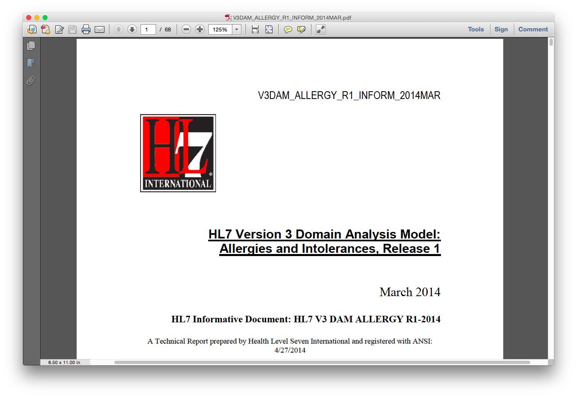
Allergies and Intolerances DAM

Slide 4
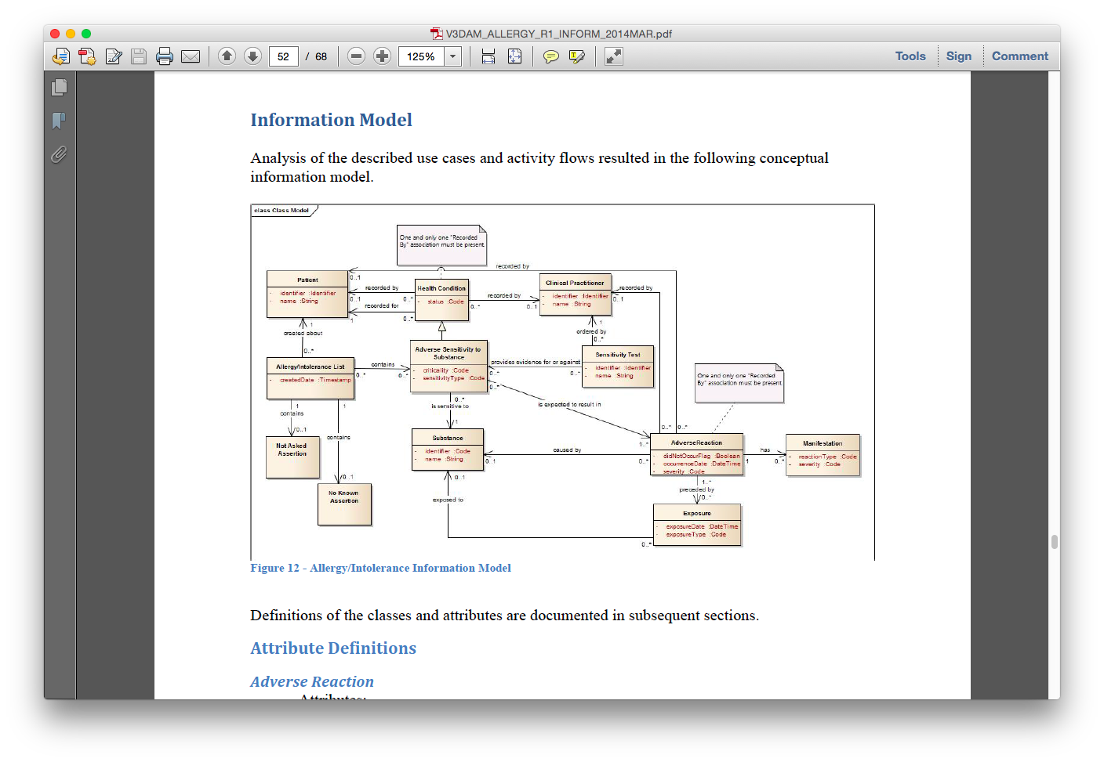

Slide 5
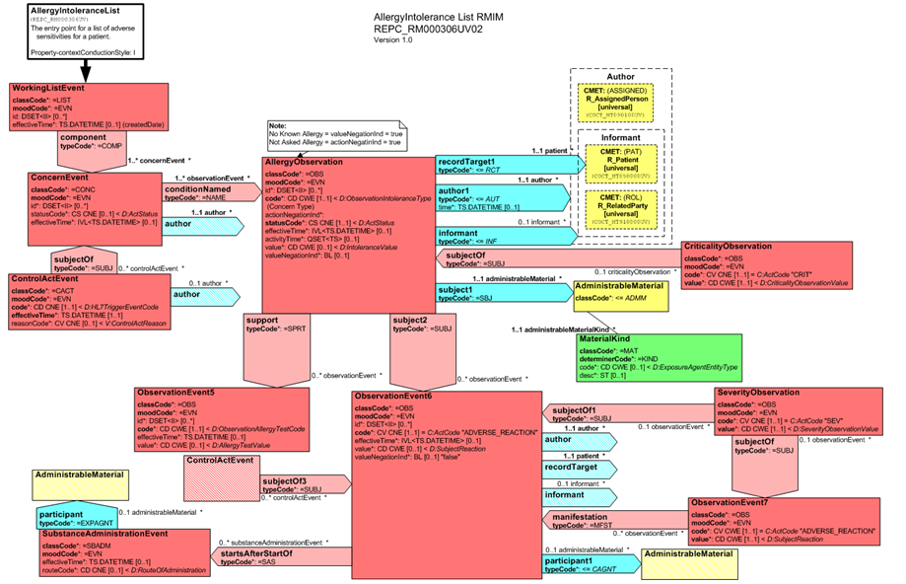
Allergy Model

Slide 6
C-CDA R1.1 Harmonization
Add criticality concept
  Deprecate severity observation for the condition
"Undeprecating" Allergy Status Observation and Problem Status C-CDA Templates
Allergy and Intolerance Type Value Set codes
  LOINC (?) for what type of allergy, intolerance or allergy/intolerance (unknown)
  Criticality values – SNOMED CT (?)
  Substances – SNOMED CT, RxNorm (US), UNII (US)

Slide 7
FHIR
Two FHIR resources
  Adverse reaction
  Allergy and intolerance
Harmonization with OpenEHR
  Adverse Reaction Risk (single entity)
    (Previously called just “Adverse Reaction”)
    http://hl7-fhir.github.io/adversereactionrisk.html

Slide 8
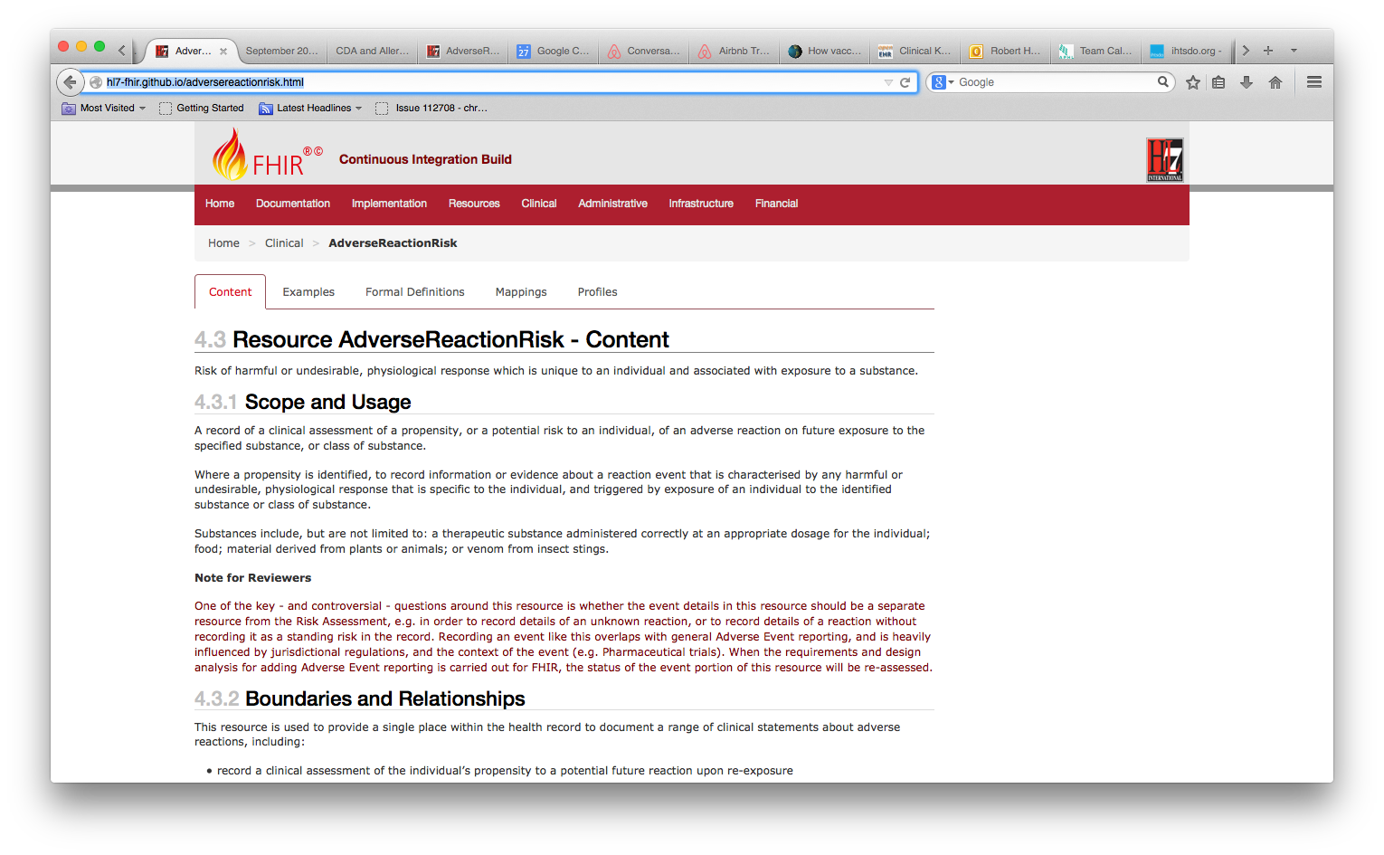
FHIR

Slide 9
S&I Substances WG
Collaboration around various terminologies
  RxNORM
  SNOMED
  UNII
  Other
Use of Structured Product Labels
  Drugs
  Enterals
  Food

Slide 10
Ongoing Project Calls
Standing PC WG Allergy/Intolerance Calls
  Every other Wednesday at 5 PM EDT

Slide 11
Parting Thoughts/Questions
Determining the information model and terminology boundaries for these concepts
  What might terminology be able to offer to support a concise information model useful for clinical documentation?
Where should the context reside – information model or terminology?
  An extension to the previous question on terminology and information model boundaries

