Slide 1
Mapping SIG Conference Call
December 8, 2014
2000 UTC
https://global.gotomeeting.com/join/685801021

Slide 2
Agenda
Welcome, apologies and conflicts of interest(JRC)
Review and agree agenda (JRC)
Minutes, action log and 2015 workplan (JRC)
Thanks to Krista….identification of scribe (ALL)
Mapping Service Team report (BH)
NRC Extension Maps report (KWF, GT)
Audio recording of MapSIG calls (ALL)
Workplan
  Allergy / adverse sensitivity implementation guide; Call scheduled for 12/10
  Tooling and support for NRCs
Quality assurance activity deferred to February (HB,KG)

Slide 3
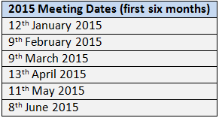
Upcoming Meetings
Next meeting:
12th January 2015 2000UTC
IHTSDO Spring Business meeting Copenhagen 4/26-29, 2015

Slide 4
Adverse sensitivity call
Gotomeeting details for the allergy/adverse sensitivity implementation guide discussion is
https://global.gotomeeting.com/join/891582181
The meeting is 12/9 at 2100 UTC.

