Slide 1
Content Development Update
Monica Harry
Senior Terminology Author

Slide 2
Maintenance

Slide 3
Release
Published timescales
Release content coordinator
Release plan in place
Release note – summarizing major changes
Review and updating of quality assurance rules and processes

Slide 4
Request management
Allocated author dedicated to SIRS requests
Target – respond to all requests within 5 days
KPI’s in place based on published figures from SIRS
Request Backlog
All requests from backlog have now been reviewed
All content requests that are identified for completion will be included in January 2015 release
All content requests remaining unresolved are linked to specific content tracker items which are awaiting resolution

Slide 5
Subsets
Core problem list updated, release in line with scheduled International Release
Kaiser Permanente subsets published via Collabnet when available
Subset maintenance and development strategy (April 2015)

Slide 6
GP/FP reference sets and ICPC-2 map
Candidate baseline published in October 2014
Updating of map in line with biannual release
Changes to subsets agreed through GP/FP SIG
Map updated in line with revised subset content and supported by quality assurance processes
Subsets will be updated and published following each international release

Slide 7
SNOMED CT to ICD-10
Completion of SNOMED CT to ICD-10 map – December 2014
QA of complete ICD-10 map – January/February 2015
Publication of candidate baseline map – March 2015
Publication of baseline map – July 2015
Maintenance and updating of map in line with biannual release

Slide 8
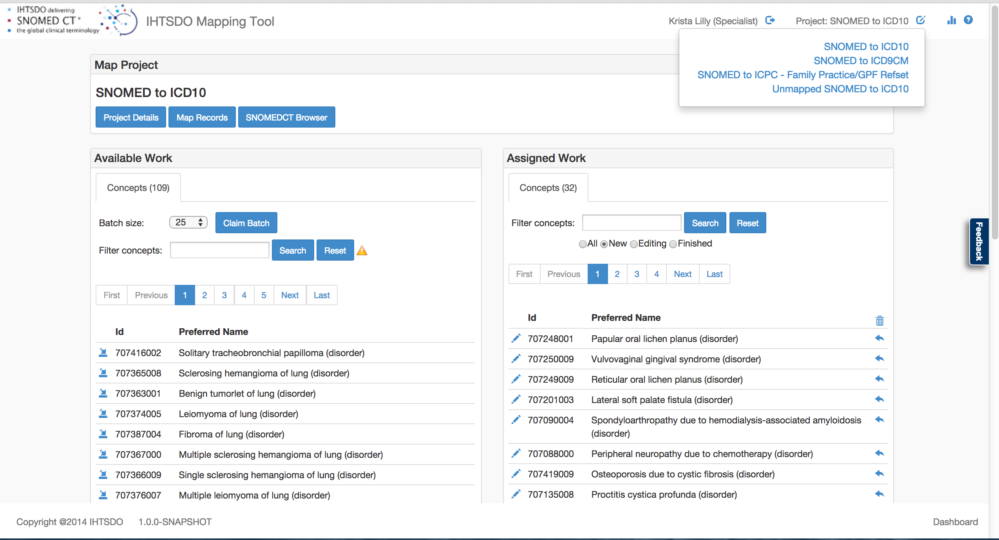
Map Tooling
Integration of new map tooling into the routine workflow

Slide 9
SNOMED CT to ICD-9CM
Regular maintenance of ICD-9CM map in line with biannual release
SNOMED CT to ICD-0
Regular maintenance of ICD-0 topography and morphology map in line with biannual release
Evaluate need for enhancing the scope of the ICD-0 morphology map

Slide 10
Developments

Slide 11
Laboratory observables (LOINC)
Technology preview of LOINC subsets (expressions and values) – October 2014
Further preview will be published mid 2015
Documentation and implementation guidance will be made available with each release
Baseline release of the data will be published as part of the January, 2016 release

Slide 12
Microbiology reporting
Project initiated in 2014
Identification of new organism content
Development of guidelines for implementation
Authoring of new content scheduled for release as part of the July, 2015

Slide 13
Substances
Alpha release – two in 2014
Technology preview proposed for July 2015 release
Target for inclusion into January 2016 International release
Molecular entity
  plan now under internal review by IHTSDO Design Authority
    new hierarchy to support substances
    align with other standards (ChEBI, Uniprot, etc)
  to support technical preview of substances in 2015

Slide 14
Pharmaceuticals
Review of pharmaceutical requirements – January 2015
Production of proposed release plan, and detailed description of release changes and artifacts – March 2015
Proposed release plan circulated to Member Forum for review – April 2015
Next steps subject to Member Forum prioritization

Slide 15
Medical devices
GMDN content now incorporated into International Release and term duplicates resolved
Resolution of conceptual duplicates
GMDN linkage table updated in line with GMDN releases
During 2015 further work will be undertaken to remove conceptual duplicates from within the medical devices hierarchy
Updates from GMDN will be incorporated in the international release, and the maps updated accordingly

Slide 16
Functioning
Project commenced – October 2014
Project manager in place
Stakeholders identified
Agreement of editorial guidance for functioning content – July 2015
Incorporation of new functioning content in International Release – January 2016

Slide 17
ICD-11 alignment
Documented review schedule in place
Review of all chapters with a WHO completed status – completion scheduled for November 2015
Process - All chapters are reviewed by an external contractor, and updates to SNOMED CT content are identified. The data is then externally reviewed by an appropriate clinical group before the changes are incorporated into the International Release
Incorporation of content into the International release following gap analysis, completion scheduled for July 2016

Slide 18
Procedures
Member Forum group
Review of sample of procedure classifications from Members
Gap analysis of SNOMED CT content relating to procedures
Authoring of new procedure content targeted for January 2016 (dependent on numbers of required additions/changes)

Slide 19
Event Condition Episode
Three main sub-projects
  Combined disorders X with Y, X due to Y
    Editorial guidance being tested and applied
  Allergy / allergic reaction / allergic disorder
    Editorial guidance already applied for existing content (2014)
    Consider refinements and adjustments based on feedback
  Observation result / life phase – plans in development
    Connected to observables project
    Connected to ICD-11 common ontology

Slide 20
Sites / laterality
Review of anatomy by University of Washington / Foundational Model of Anatomy (FMA)
  On track for completion in 2015
Support for laterality post-coordination subset development
  Planning underway

