Slide 1
SEVERITY
An ATTRIBUTE of Clinical Finding

Slide 2
Severity
May vary in interpretation relative to other values in a set:
• mild / moderate / severe
• minimal / mild / moderate / severe / very
severe
• mild / mild to moderate / moderate /
moderate to severe / severe / life threatening
/ fatal

Slide 3
Severity
Defined relative to the expected degree of intensity or hazard of the Clinical finding
that is being qualified.
A severe cold might be considered less intense
or hazardous than a mild pneumonia.

Slide 4
Severity
Some disorders that are life-threatening do not ordinarily have a severity assigned to them
Cancer is generally not subclassed according to mild, moderate and severe types, but rather is subclassed according to stage or grade.

Slide 5
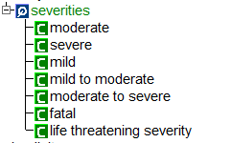
Severity
Used in post-coordination as a qualifier
ATTRIBUTE
VALUES
Example
66383009 | gingivitis | : 246112005 | severity | = 24484000 | severe |

Slide 6

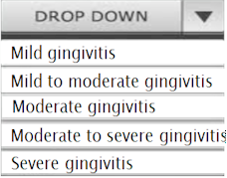
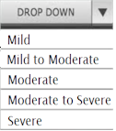
Severity
EHR interface
Dx: Gingivitis
Backend
66383009 | gingivitis | : 246112005 | severity | = 24484000 | severe|

Slide 7
Reference
http://www.snomed.org/eg.pdf
Section: 6.1.2.7 SEVERITY

Slide 8
May not apply to caries
Extent of caries
Incipient
Occult
Cavitation
Caries based on tissue involvement
Initial caries (demineralization)
Superficial caries
Moderate caries
Deep caries
Deep complicated caries
Sizes of carious lesions
Minimal (involvement of dentin)
Moderate (involve of dentin)
Enlarged
extensive

