Slide 1
Supernumerary teeth
Defined as teeth additional to the normal dentition
Classified according to their morphology and location
Occurs in both the permanent (*predominant) and the primary dentition
In the permanent dentition, there are four different morphological types: conical, tuberculate, supplemental, and odontoma
Occurs in almost all regions of the dental arch
Most are found in the anterior maxilla, either as mesiodens or supernumerary lateral incisors

Slide 2
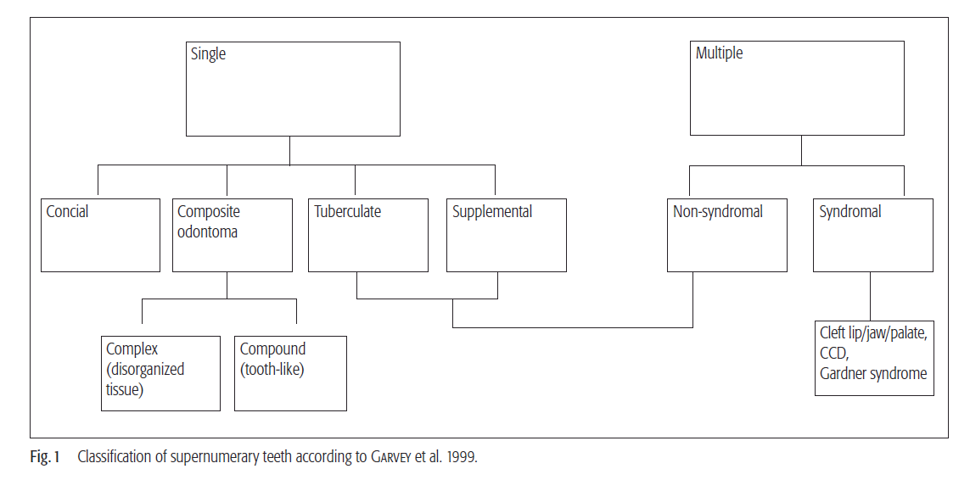

Slide 3
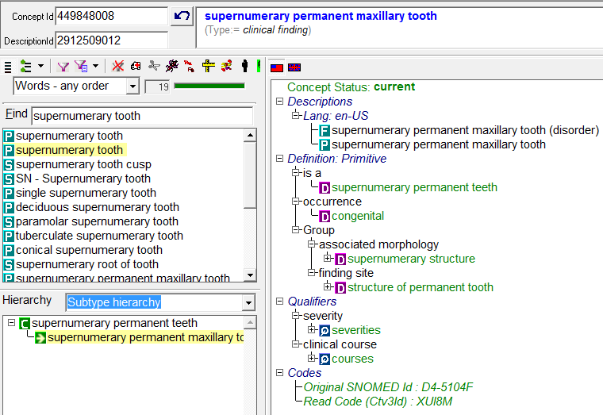
Is a
Supernumerary permanent maxillary left canine tooth (disorder) | 2611000124100

Slide 4

Morphologic types
Conical: small peg-shaped
Tuberculate: more than one cusp or tubercle
Odontoma: hamartomatous malformation
Supplemental: duplication of teeth in the normal series
Can refine
http://www.cda-adc.ca/jcda/vol-65/issue-11/612.html

