Slide 1
Currently available SNOMED CT terms for caries severity
Mark Jurkovich
August 2, 2014

Slide 2


Slide 3
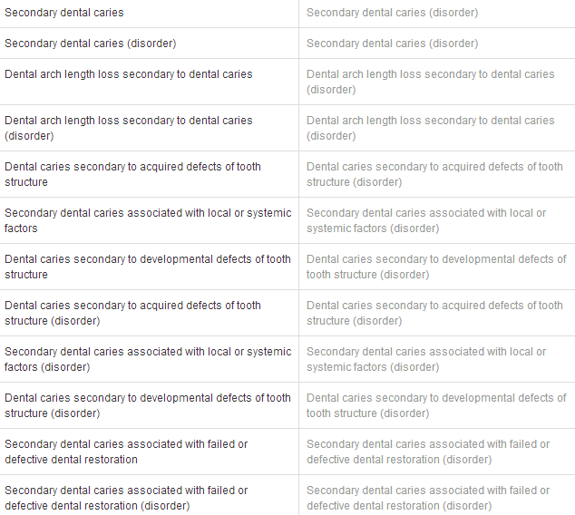

Slide 4


Slide 5
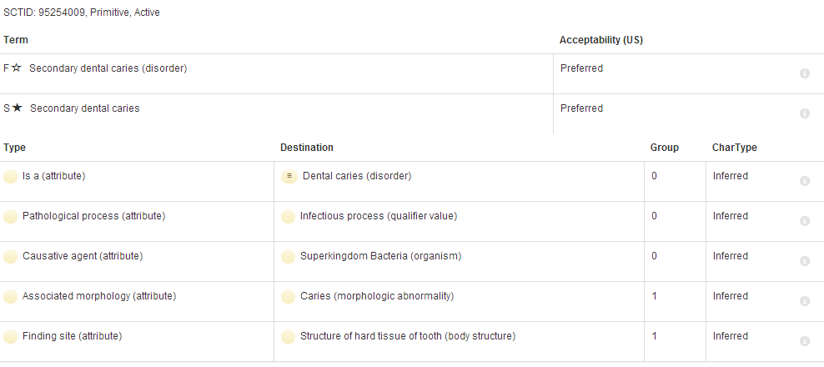

Slide 6


Slide 7
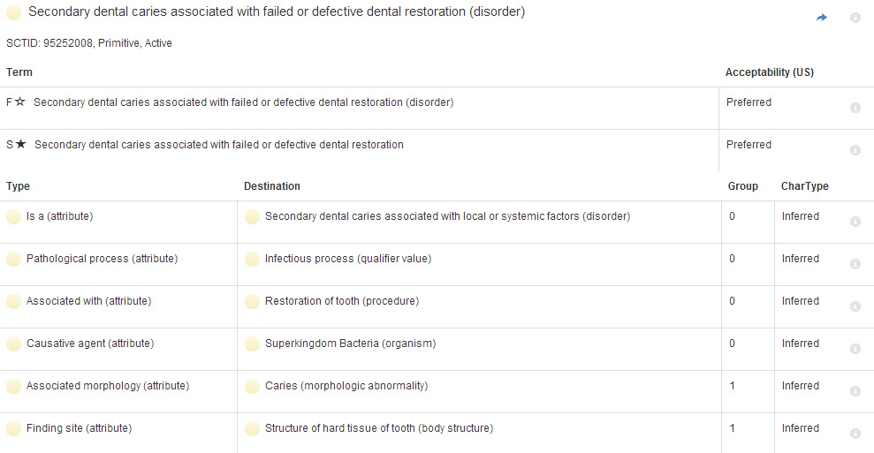

Slide 8
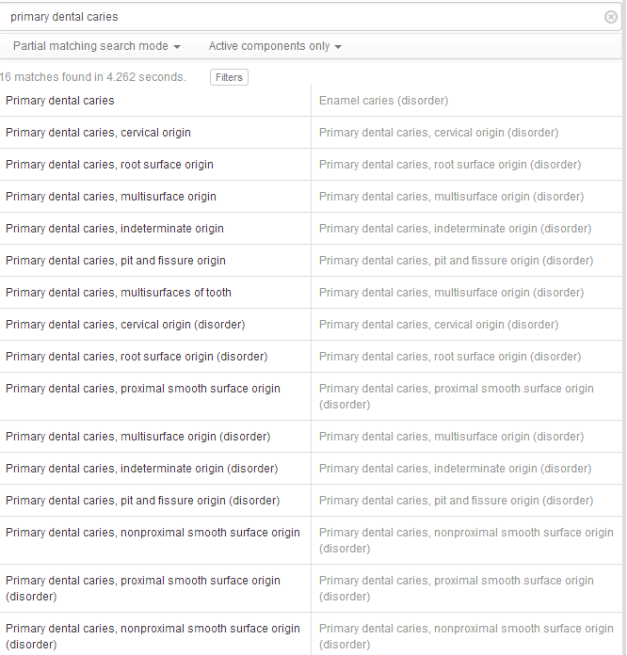

Slide 9
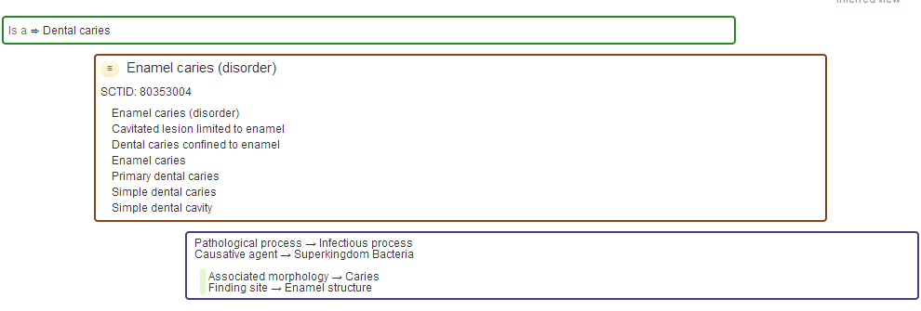

Slide 10
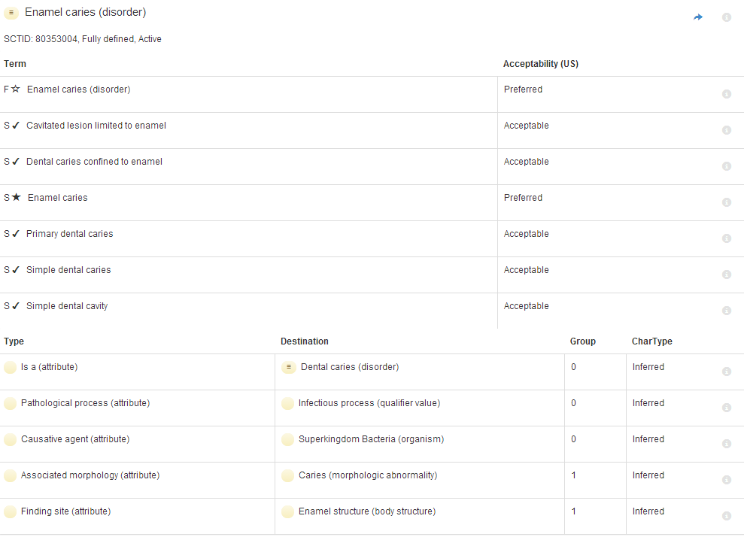

Slide 11


Slide 12
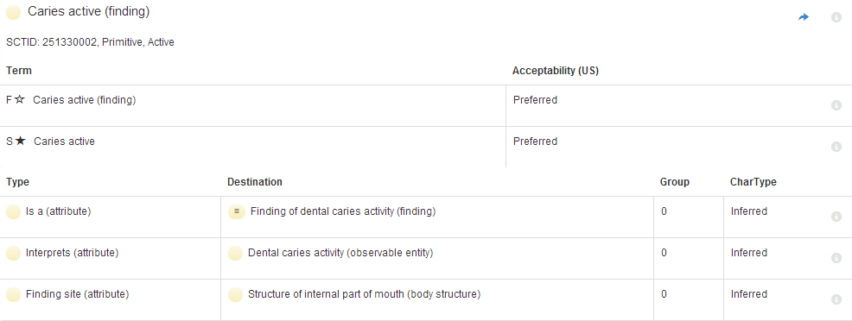

Slide 13


Slide 14
