Slide 1
UMLS Resources and Nursing Webpage
Judith J. Warren, PhD, RN, FAAN, FACMI

Slide 2
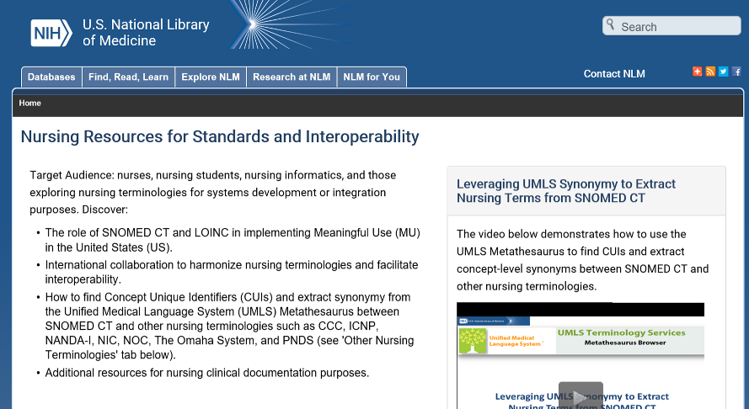
Nursing Resources for Standards and Interoperability at the NLM
https://www.nlm.nih.gov/research/umls/Snomed/nursing_terminology_resources.html

Slide 3
What is the UMLS?
The UMLS, or Unified Medical Language System, is a set of files and software that brings together many health and biomedical vocabularies and standards to enable interoperability between computer systems.
https://www.nlm.nih.gov/research/umls/quickstart.html

Slide 4
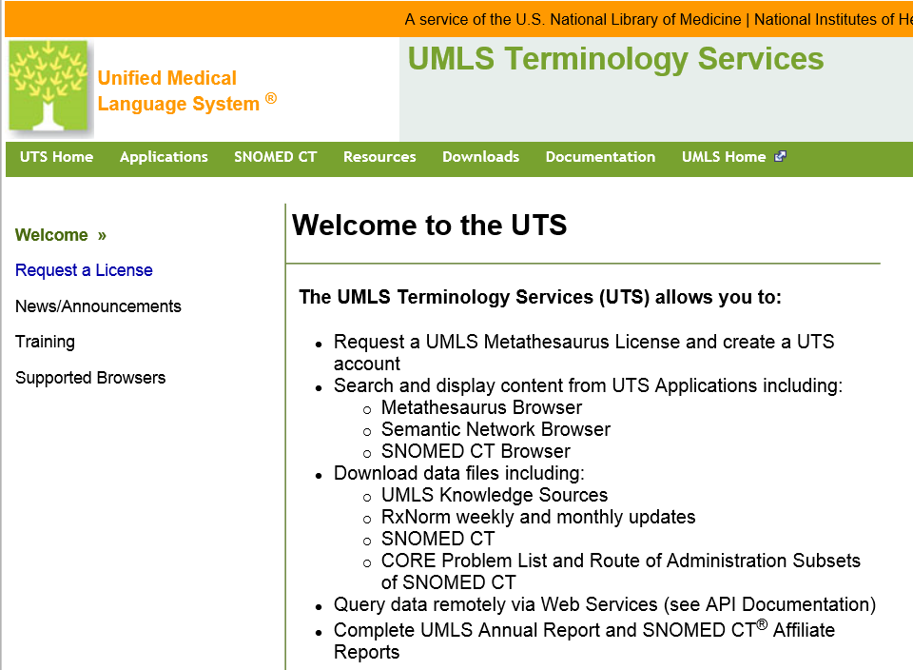
To Request a UMLS License
https://uts.nlm.nih.gov/home.html#
License is free to all, not just US citizens.

