Slide 1
HL7 Care Plan
Domain Analysis Model
Laura Heermann Langford, RN PhD
On behalf of
HL7 Patient Care Work Group

Slide 2
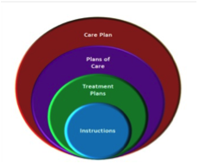
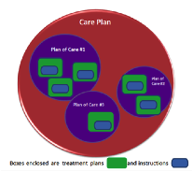
HL7 Patient Care DAM
(Influenced by S&I Framework LCC)
Contents of Care Plan
Structure of Care Plan

Slide 3
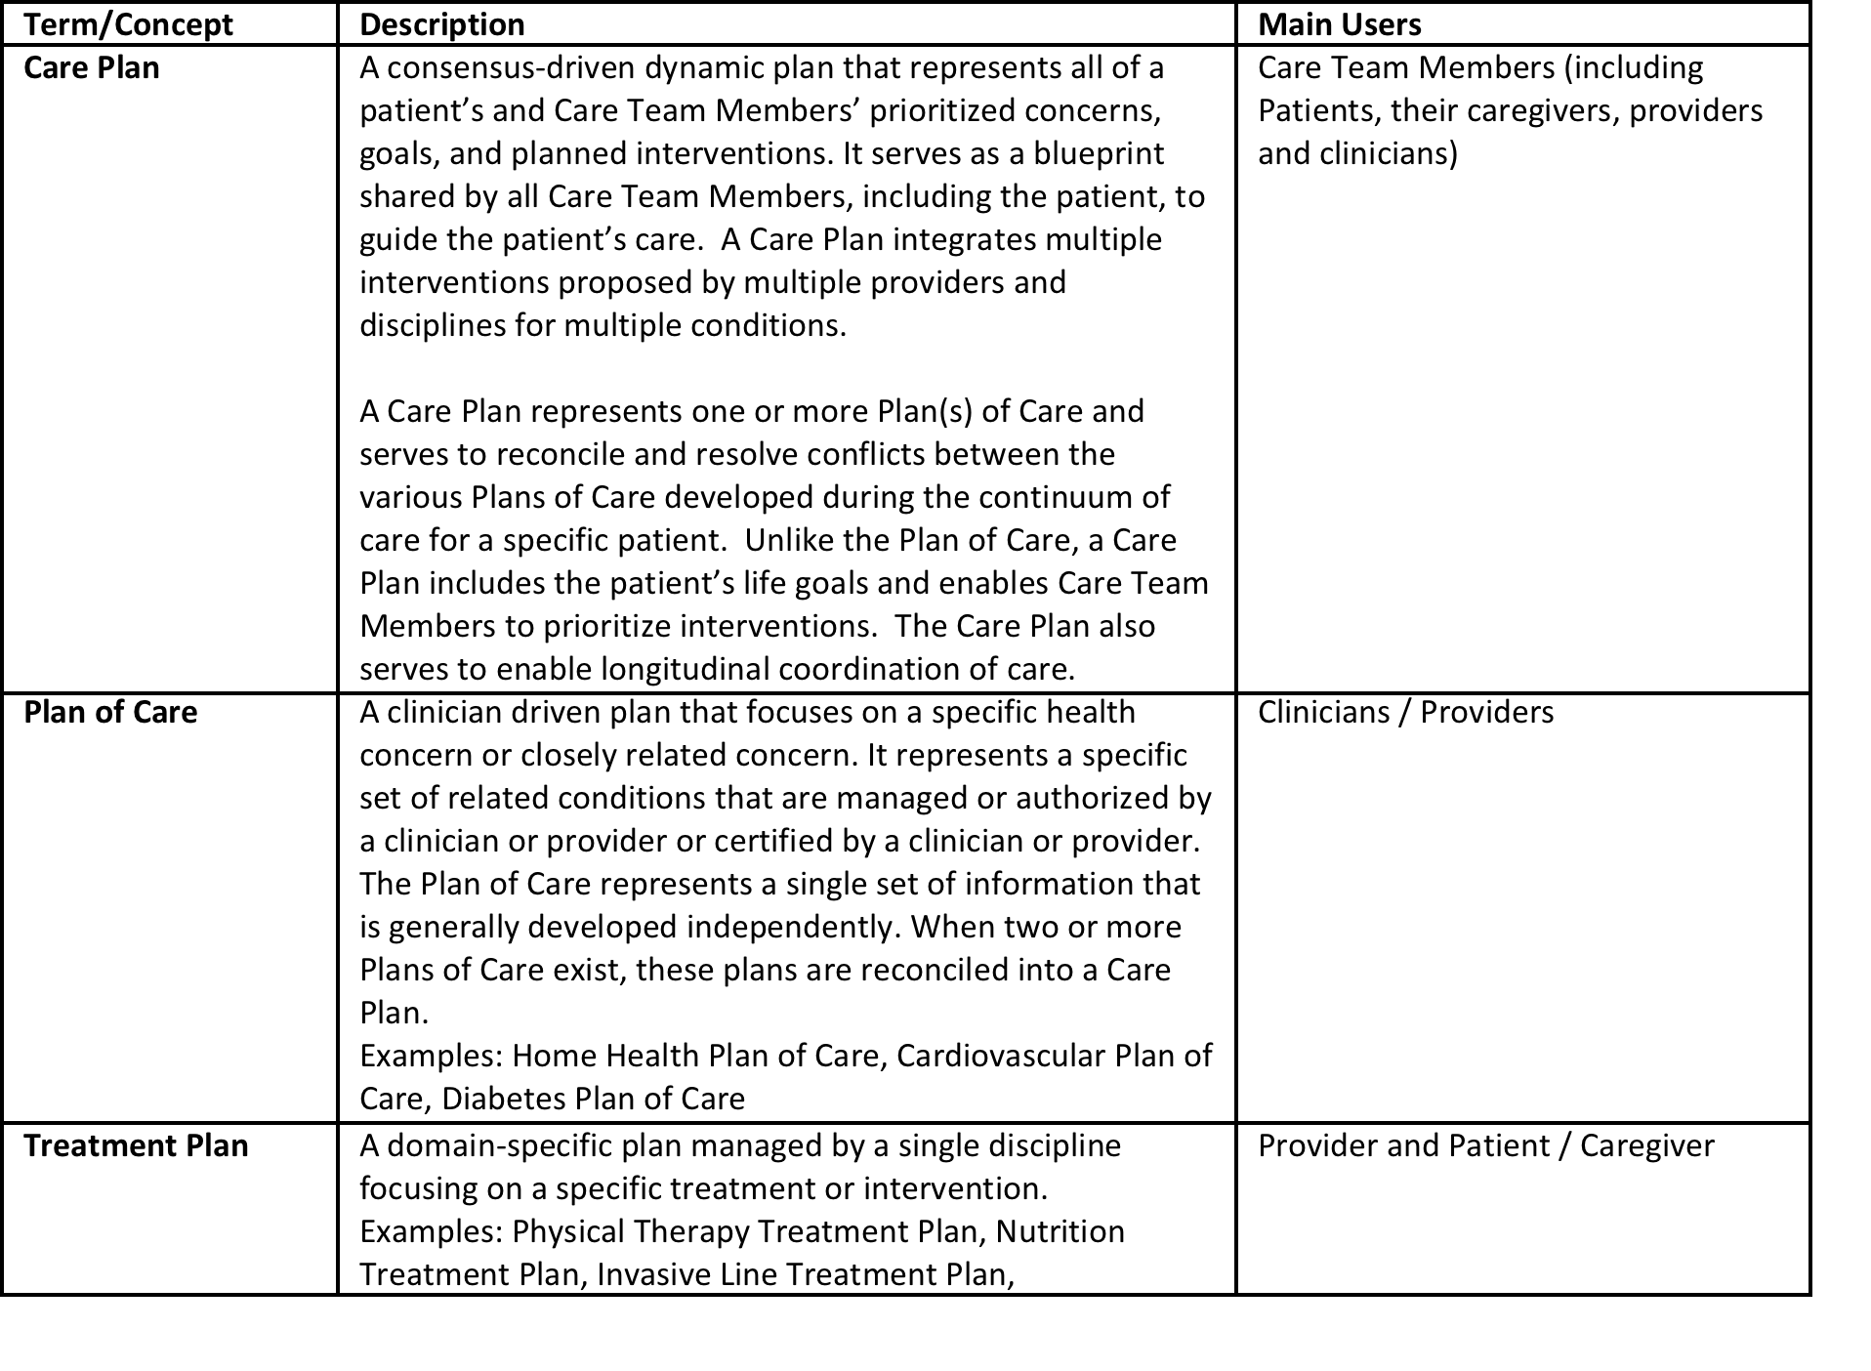

Slide 4
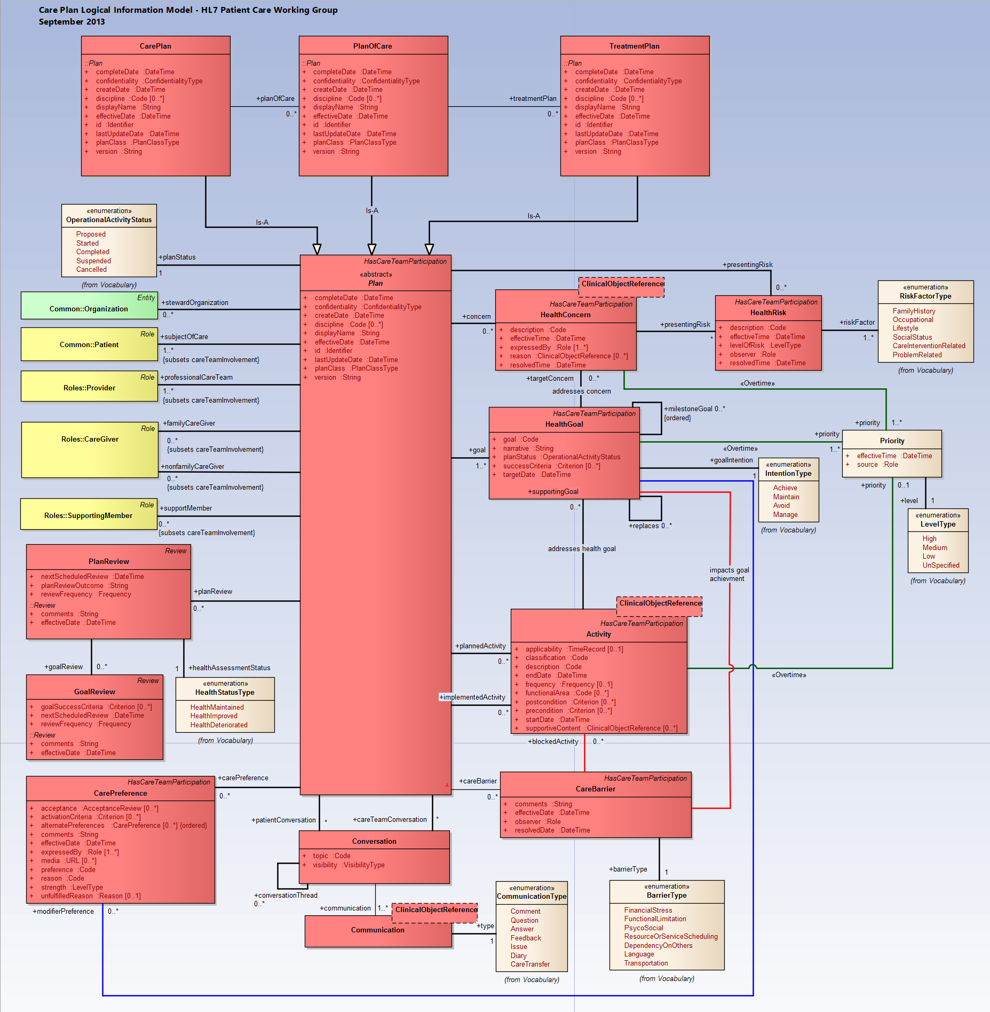

Slide 5
Storyboards
Chronic Conditions
Home Care
Pediatric Allergy Care
Pediatric Immunization
Perinatology
Stay Healthy Health Promotion
Acute Care

Slide 6
Questions?

Slide 7
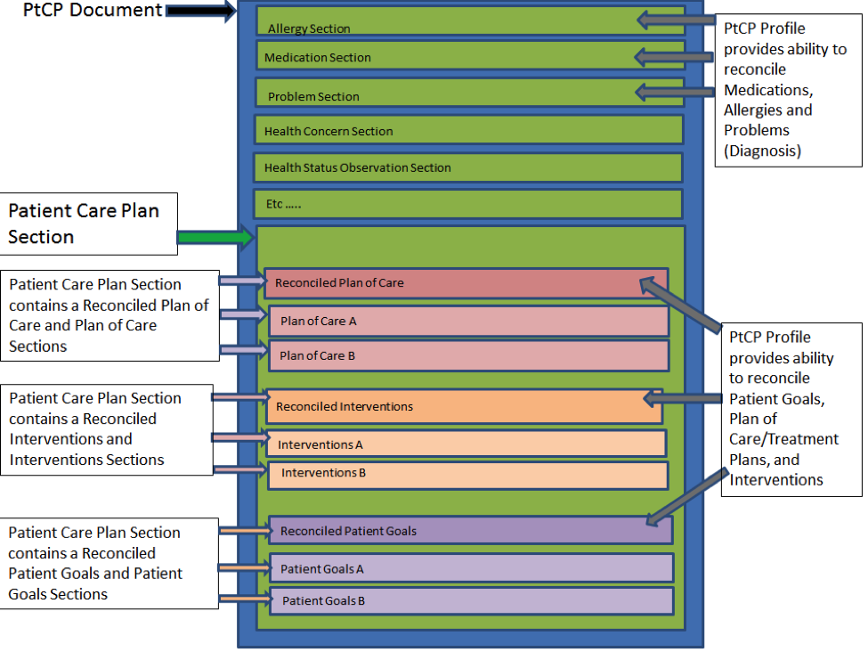
IHE Patient Centered Care Plan (PtCP)

Slide 8
IHE PtCP Profile
The LOINC codes in the document and the ones needed.
  Care Plan DOCUMENT LOINC (???)
    (Should match C-CDA Document Code)
  Care Plan SECTION LOINC (???)
  Treatment Plan LOINC - 18776-5 (Plan of treatment)
    (also used by plan of care and reconciled plan of care)
  Patient Goals LOINC - 61146-7 (Goals)
  Reconciled Patient Goals LOINC - 61146-7 (Goals)
  Interventions LOINC - 62387-6 (Interventions)
  Reconciled Interventions LOINC - 62387-6 (Interventions)
Question:
  For products not constructing a level 3 care plan document, can they use the new care plan LOINC code for an unstructured document that is a Care Plan (e.g. use with XDS-SD)

Slide 9
Care Plan Document LOINC (should match C-CDA Document Code
56447-6
LOINC ???
LOINC 18776-5
LOINC 18776-5
LOINC 18776-5
LOINC 62387-6
LOINC 62387-6
LOINC 62387-6
LOINC 61146-7
LOINC 61146-7
LOINC 61146-7

