Slide 1
Functional status and activities of daily living concepts
Zac Whitewood-Moores
Vice Chair – Nursing Special Interest Group (IHTSDO)
Clinical Data Standards Specialist
Health and Social Care Information Centre (UK)

Slide 2
Glossary of terms
Functional status is variously defined in the health field, by clinicians with different emphases as well as in different policy contexts
Functional ability is the actual or potential capacity of an individual to perform the activities and tasks that can be normally expected
Activities of daily living (ADLs) are the most basic and fundamental functions of self-care, and they are used to describe the functional status or functional ability of a person
There are several dimensions of ADLs and people can be classified as independent or dependent on each of them
The International Classification of Functioning, Disability and Health (ICF), is a classification of health and health-related domains

Slide 3
Related work item requests
WHO/IHTSDO Joint Advisory Group and Joint Collaborative Group – work plan activity support, specifically ICF
Analytics of data with SNOMED content
Problem List - Content Development
  Nursing problem list
Pre-coordination roadmap and expression library
Exchanging constrained SNOMED CT expressions as post-coordinated expressions
Observables and assessments
C-HOBIC

Slide 4
Not just our concern
World Health Organization
Professional Special Interest Group
  Physicians (predominantly elderly medicine)
  Allied Health Professions
    College of Occupational Therapists (UK)
Canadian Health Outcomes for Better Information and Care

Slide 5
Use in clinical practice
Assessment of current status
  At beginning of care process
  Progress towards desired outcome/goal
  At completion of care process
Desired outcome/goal setting
  Findings using SNOMED CT contextual modification (+/- HL7 mood)
  Situations using HL7 mood
  Observable entities + value using HL7 mood
Outcome/goal achievement

Slide 6
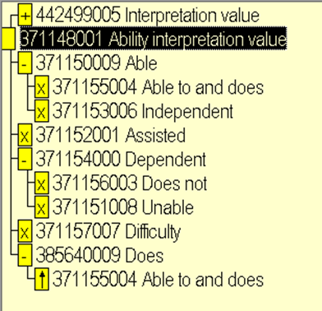
Representation in SNOMED CT
Are these all abilities?
  Does and does not
  Independent, assisted and dependent
Three axis
  Ability
  Dependence
  Occurrence
Compositional
  Able to and does

Slide 7
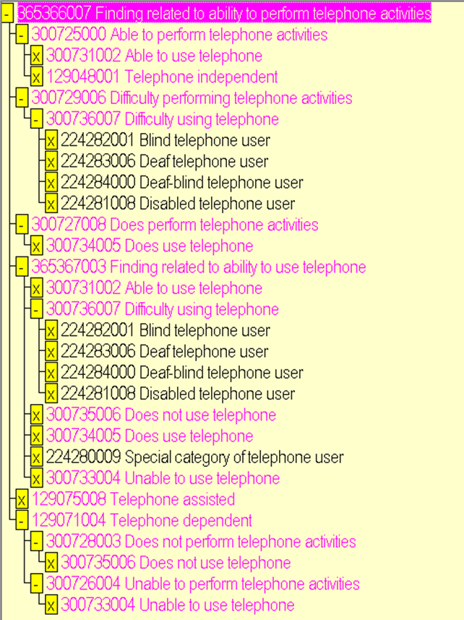
Inappropriate assumptions?
Special category of telephone user has no subtypes, but…
Does a blind or disabled person have difficulty using telephone?
Deaf is probably fair?

Slide 8
This is not a blame game!!
SNOMED CT has been compiled and evolved from multiple legacy and current terminologies and classifications across multiple disciplines
SNOMED CT should harmonise semantically equivalent content in a single concept
SNOMED CT should separate semantically disparate content
A pre-coordinated solution may be required
A post-coordinated approach should be possible

Slide 9
Challenges with current representations
Inconsistency of representation
Difficulty transferring between differing models interpretation
The granularity reflected in some schemes appear difficult to reflect conceptually in an intuitive way, e.g. maximal assistance and total dependence
Analysis challenging as modelling does not consistently include levels of abilities, dependence or occurrence
Mappings have sometimes described dependence but mapped to abilities or vice/versa
Different ranges in vocabularies being mapped may result in many-to-one or one-to-many maps to/from SNOMED CT

Slide 10
More later!
C-HOBIC
Review of Inception Document for “Functional status and activities of daily living concepts”
Nursing Problems

