Slide 1
Care planning model and content
A reflection on the NHS experience
Presented by
Zac Whitewood-Moores

Slide 2
Major drivers for NHS Care Planning Content
Complex patient pathways across multiple care providers
Requirement for NHS content for clinical applications
Earlier discharge with community follow up
Active management of long-term conditions
Supporting delivery of national care standards
Supporting commissioning standards
Enabling controlled localisation of content
Professional standards suggest using structured unambiguous multidisciplinary clinical terminology within electronic applications
NHS has initiated roadmap for migration to SNOMED CT http://www.isb.nhs.uk/documents/isb-0034/amd-26-2006/index_html

Slide 3
ContSys – ISO 13940
ContSys | NHS Care Planning | SNOMED CT
Care plan | Care plan templates | Record artifact
 | Care plan template content | Regime/therapy Procedure
Healthcare activities bundle | Activity bundle templates | Regime/therapy Procedure
 | Activity bundle template content | Regime/therapy Procedure Finding Situation
Health issue | Health issues | Disorder Finding Situation
Need for healthcare | Needs | Regime/therapy Procedure
Healthcare goals | Goals | Finding Situation
Healthcare activity | Activities | Regime/therapy Procedure
Health objective | Health objectives | Finding Situation

Slide 4
Outline of high level relationships
Care Plan Template
Activity Bundle Template
Need
Activity Bundle Template
Need
Need
Activity Bundle Template
Need
Need
Activity Bundle Template
Need
Need
Need

Slide 5
Outline of low level relationships
NEED
GOAL
ACTIVITY
At least one need, goal and activity is present in an activity bundle,
this may be in a referenced sub-bundle

Slide 6
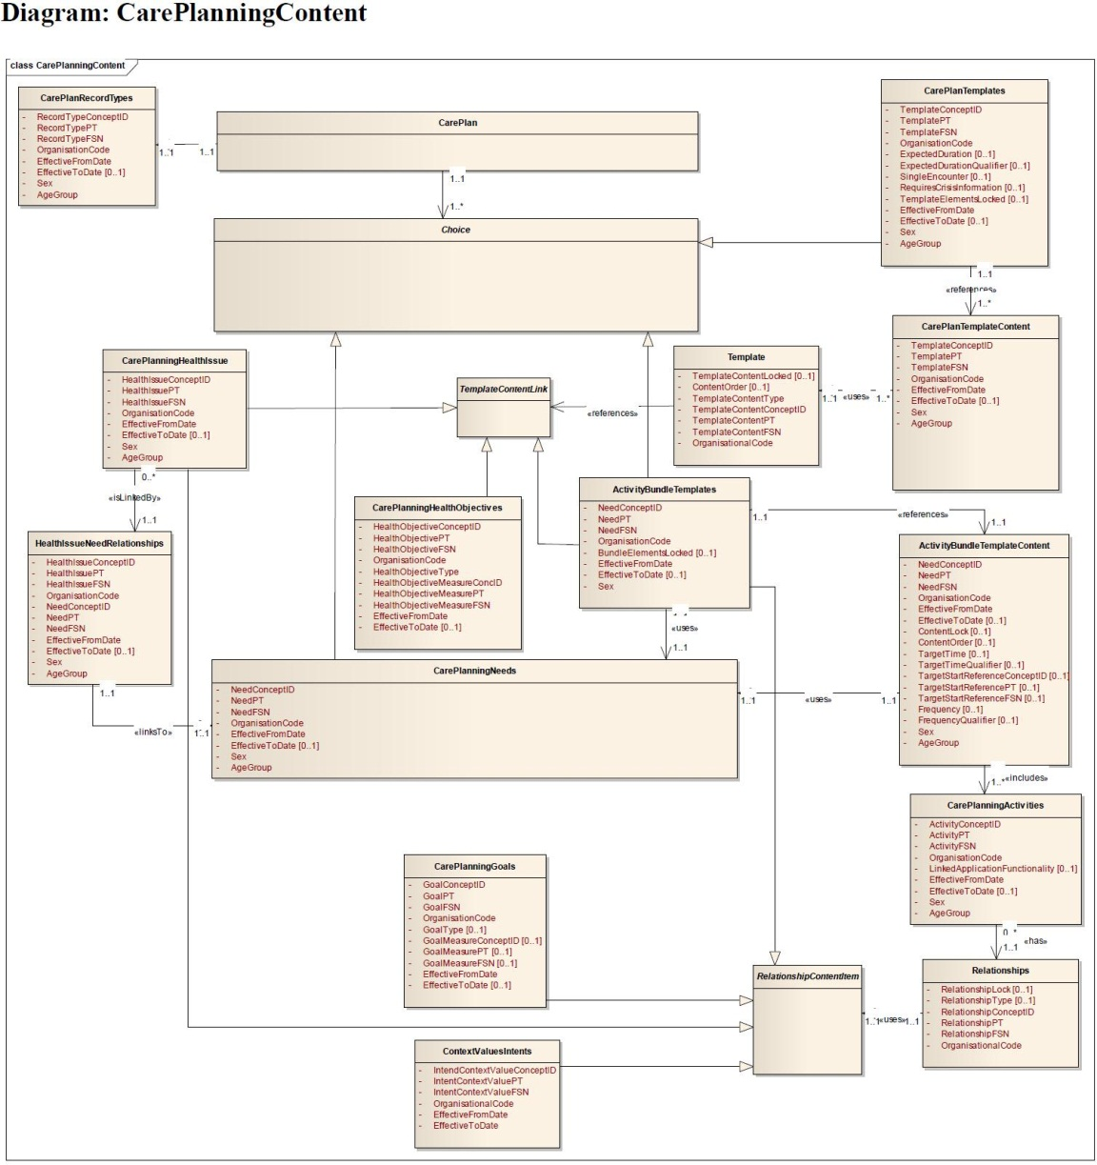
Outline model of content

Slide 7
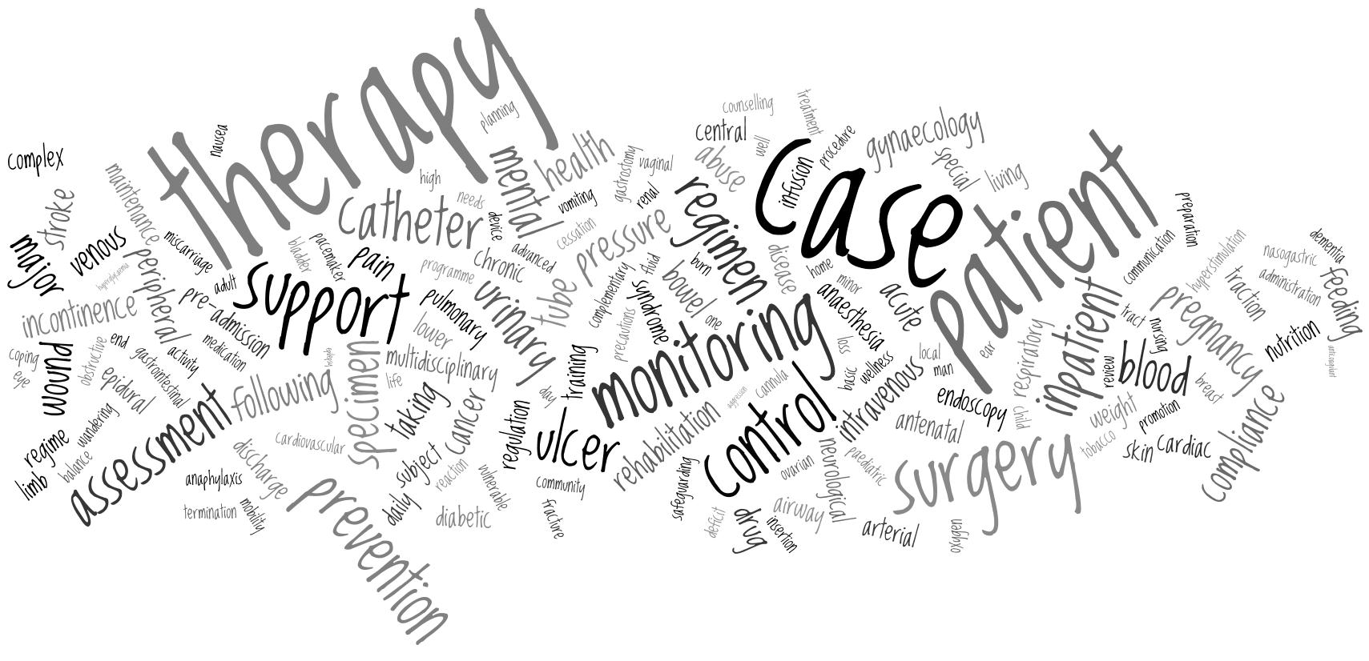
Current content (activity bundle needs)
care and management removed for clarity of actual content to be displayed

Slide 8
Additional metadata to SNOMED CT concepts
Sex
Age group
Linked functionality
Most tables except goal/health objective
Most tables except goal/health objective
Activities table only

Slide 9
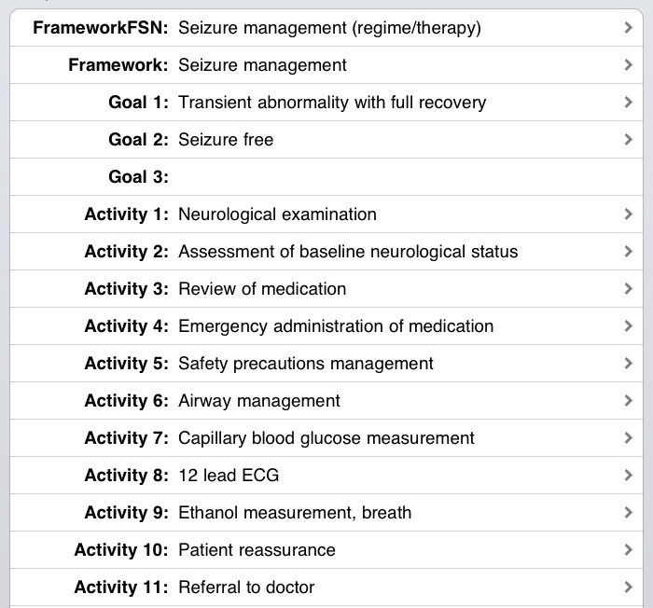
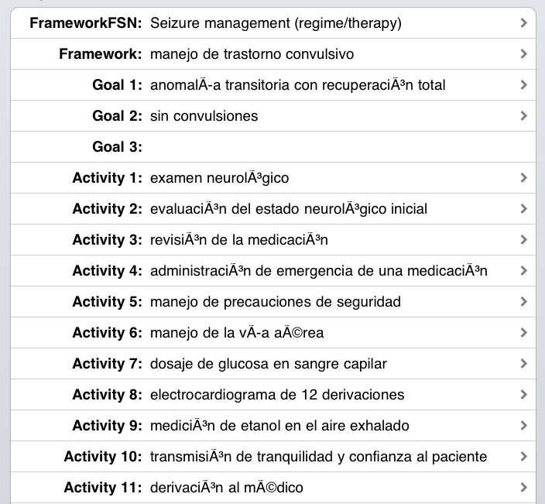
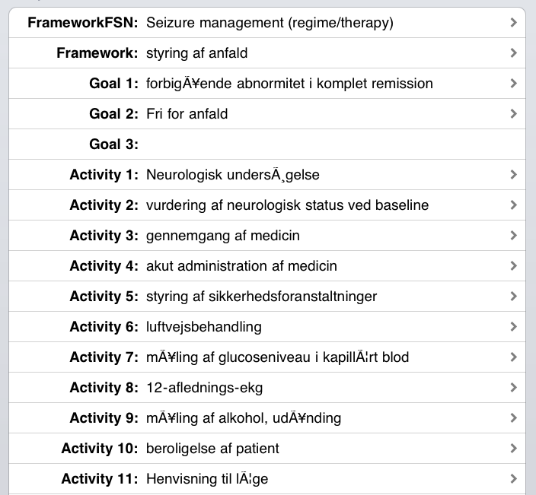
Multilingual possibilities

Slide 10
Challenges
Clinical acute care largely paper based or in fragmented bespoke applications
Clinical applications need content
Most care is not unique but may be uniquely expressed
Lack of natural clinical engagement
Lack of vision of the benefits of eCare
Lack of health informatics specialism in UK
Historically medically skewed health informatics
Lack of multi-disciplinary professional oversight

Slide 11


The future

Slide 12
The future
Care planning content pack in October 2013 release is the last agreed
Large amount of discussion in government and NHS England for delivery of personalised digital care planning by 2015
Commissioning of a centralised service not yet forthcoming
Need for professional ownership of an interoperability model in the multidisciplinary clinical environment

