Slide 1
Genomic Definition by Reference Mapping
James R. Campbell MD
W. Scott Campbell PhD
Departments of Internal Medicine and Pathology
University of Nebraska Medical Center
Mapping SIG; IHTSDO

Slide 2
Acknowledgements
Allison Cushman-Vokoun MD PhD
Geoffrey Talmon MD
Audrey Lazenby MD
Raj Dash MD
Mary Kennedy
Jay Pedersen MS

Slide 3
Outline
Terminology challenges created by Personalized Medicine
Precision medicine terminology use cases
Harmonized model for observables and observations
Progress report: MP content development and deployment

Slide 4
Revolution in healthcare
Sequencing of human genome has led to flood of new observational data appearing in scientific literature and now…clinical records
Majority of this clinical data is unstructured and not useful for decision support in the EHR or clinical research
Understanding of genetic and molecular basis of human disease now having impact on diagnosis and therapy
Challenge posed by precision medicine - to have sufficiently detailed molecular genetics observations and diagnostic data in treatment of cancer, infectious disease, pharmacogenetics and …

Slide 5
Precision Medicine
Terminology Use Cases
Health maintenance alert for BRCA1 or BRCA2 positive patients
Retrieve all colon cancer tissue specimens which had BRAF gene testing
Alert cardiologist for CYP2C19 negative patients prior to angioplasty to adjust clopidogrel dosing
Which patient with cystic fibrosis should be treated with Ivacaftor at $300,000 per year?

Slide 6
Limitations of ONC terminologies for Human Genomics
Research community
HUGO; Human Gene Nomenclature Committee
UniProt; Ensemble; Cosmic
NCBO: OMIM; Orphanet; Protein Ontology
Clinical community
SNOMED CT:
  No concept model for subcellular anatomy or molecular structure
  No concept model for Observable entity or molecular basis of disease in Clinical findings
  Little content, all primitives
LOINC 2.54:
  1275 PCR; 1406 MOLGEN; 116 FISH; 1502 CELL MARKERS
  Concept model inadequate to fully define what is being result
  Provides only tag-level interoperability of molecular data
No meaningful bridge joining genetic scientific findings with clinical concept models

Slide 7
Reference Data Bases
HGNC: Human Gene Organizing committee agreeing standard nomenclature and compiling reference resources
UniProt: Catalogue of proteins with genetic references
NCBO: GO and PRO do not appear to organize ontologies in clinically useful manner
Ensemble: Secondary resource with sequence data
COSMIC: catalogue of somatically acquired mutations in human cancer
OMIM: Relates genotypic data to phenotypic disease

Slide 8
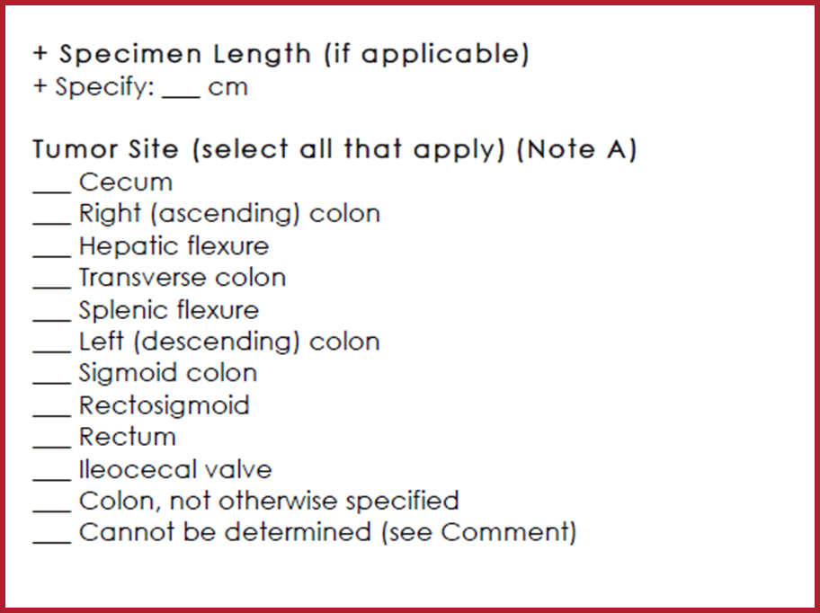
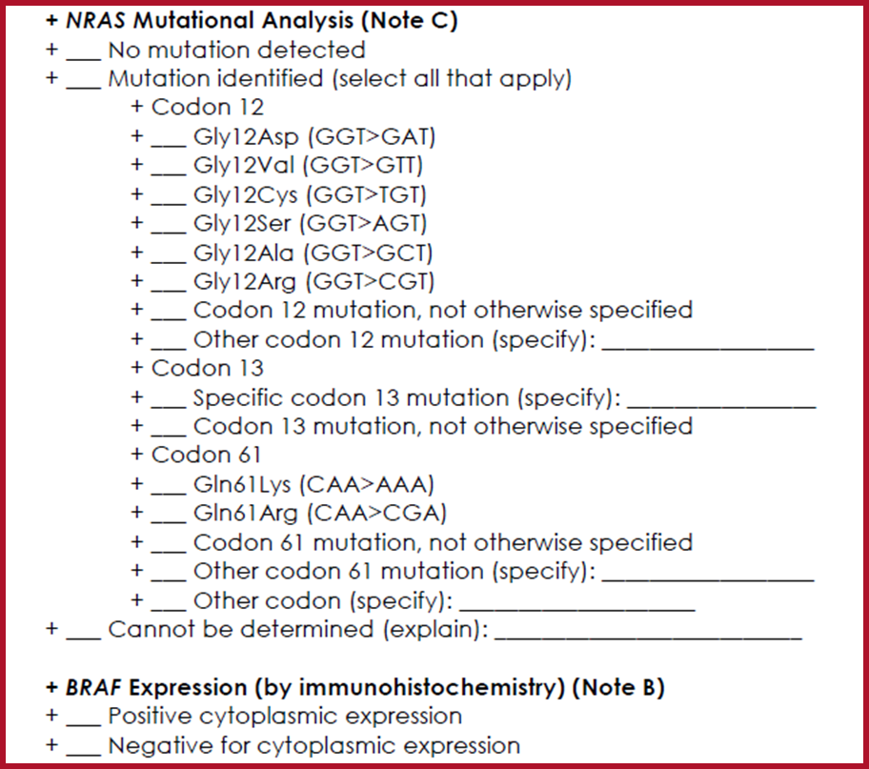
UNMC: Project for structured encoding of AP/MP cancer reports
Objective: Detailed structured reporting of all anatomic and molecular pathology observations for all CAP synoptic cancer worksheets (82 types of malignancies)
Proposal: Analyze detailed semantics of CAP worksheets; apply harmonized concept model to develop terminology requirements; deploy as real-time structured reporting from COPATH system interfaced to tissue biobank and EPIC
Tooling: Nebraska Lexicon© extension namespace; SNOWOWL authoring platform; SNOMED CT International + US Extension + Technology preview; ELK 0.4.1 DL classifier
Penciled into IHTSDO workplan for 2017

Slide 9
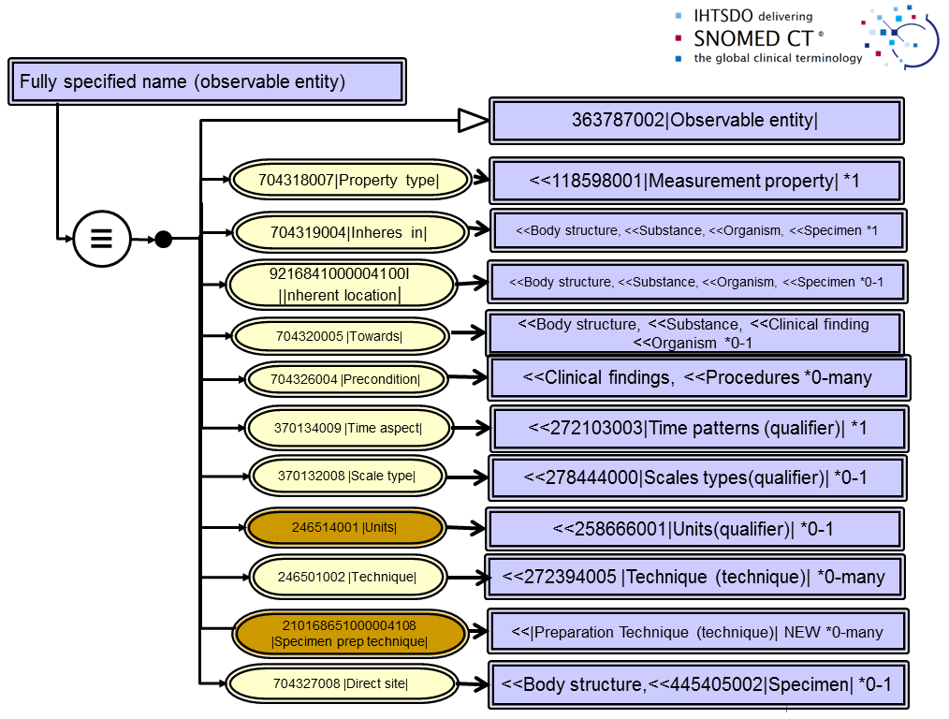
Observables Project:
Concept model draft

Slide 10
SNOMED CT Content Extensions for Molecular Genetics
Body structures>>Cell structures>>Nucleotide sequences and Named Genes
Substances>>Proteins
Qualifiers>>Techniques>> AP and MP methods
Qualifiers>>Measurement Properties>>AP and MP properties
Observable entity>>AP and MP observables
Clinical findings>>Anatomic and molecular genetic observation results and disorders

Slide 11
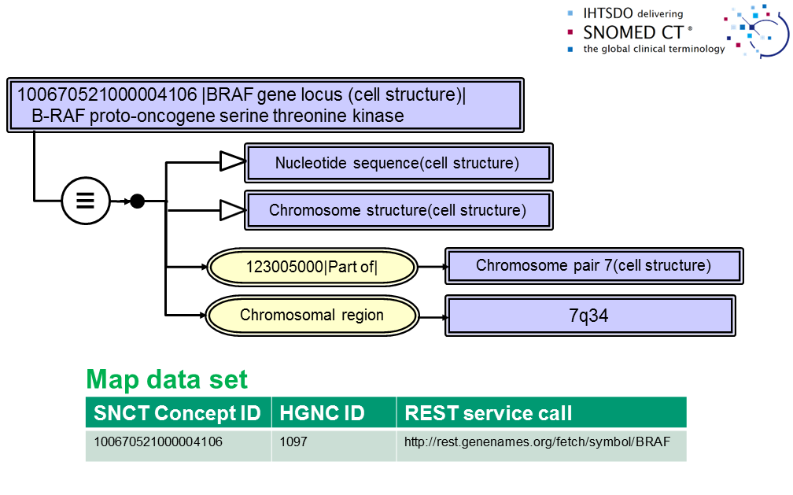
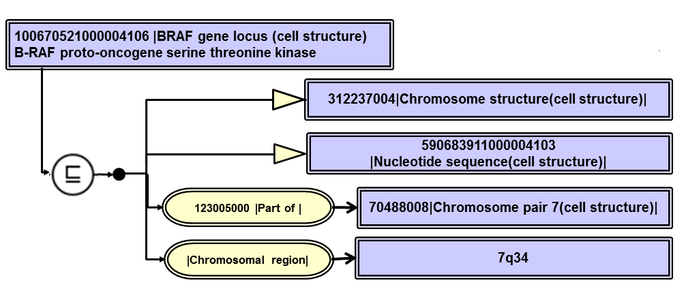
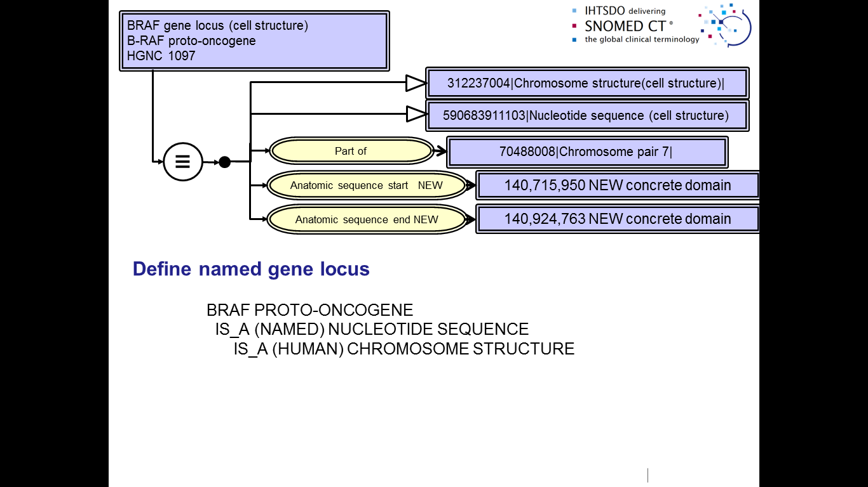
Developments for MP:
Genes and proteins

Slide 12
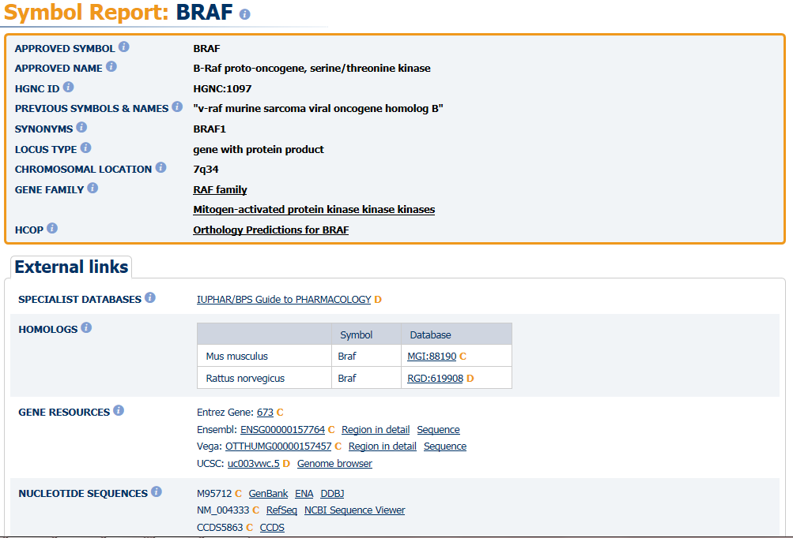
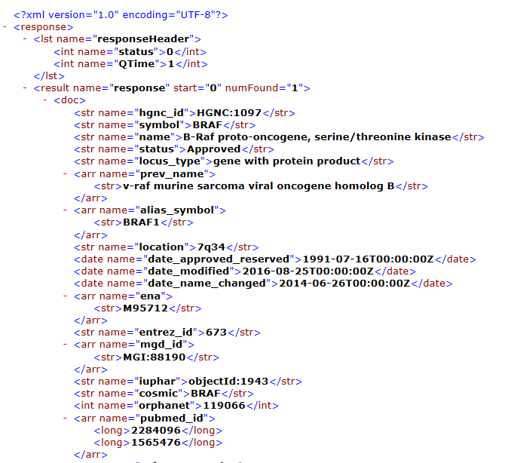
HGNC Resources & References

Slide 13
Potential Attributes for Reference Mapping (and definition) of Human Genes
?Organism(s)
(part of) Chromosome
Chromosome region
Locus type (eg: gene with protein product)
Gene family
Genome map reference:
  Nucleotide address start
  Nucleotide address end
Transcription Protein products: {Uniprot names and IDs; SNOMED CT ID}
?Phenotype mappings: {Colorectal cancer, somatic; Noonan syndrome 7;…; SNOMED CT ID}
HGNC ID; Ensemble ID; ….

Slide 14
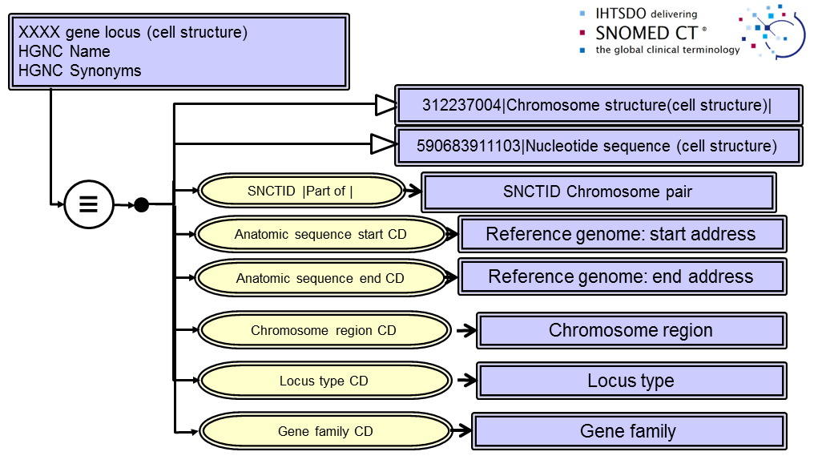
Gene locus definition (draft)

Slide 15
Proposal for Reference Mapping Definition Deployment
Genomic extension data to be published with map reference definitions from scientific data bases
New version maintenance
Install latest version of SNOMED CT and relevant extensions
Employ mapping refset and supplied procedure to populate refernce definitions for genomic concrete domains
DL Classify to fully define gene loci and proteins employing scientific databases

Slide 16
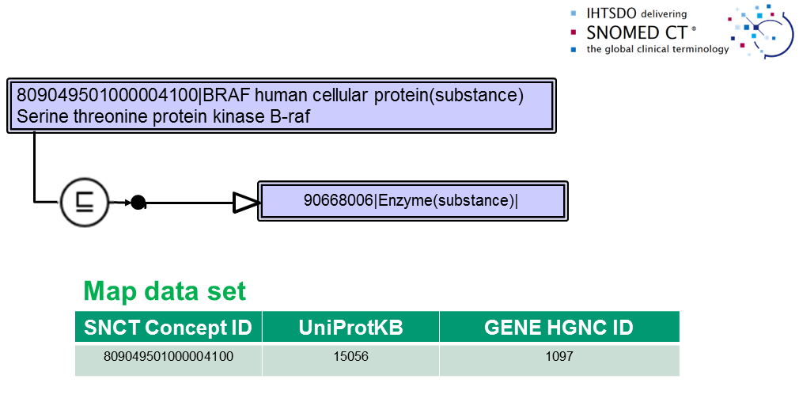
Application to MP:
Proteins

Slide 17
Potential attributes for reference definition of proteins
Metabolic/catalytic activity (role)
Gene Transcription source
Cofactors
GO: molecular function
GO: biological processes
Organism(s)

Slide 18
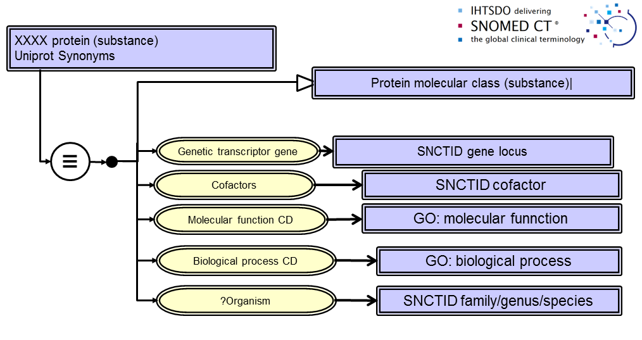
Protein model (draft)

Slide 19
Questions?
Discussion…

