Slide 1
Substance and drug abuse and misuse findings/disorders in SNOMED CT: resolving ambiguity, modelling issues and hierarchy rationalisation
Malcolm H Duncan
Presented at
UK Terminology Centre Edition Committee Meeting
7 Sept 2016

Slide 2
Substance misuse/abuse ONLY
Sexual assault
Physical assualt

Slide 3
Summary
In some instances the terms ‘{substance} abuse’ and ‘{substance} misuse’ are synonyms
In some instances the terms ‘{substance} abuse’ and ‘{substance} misuse’ denote different concepts
Additional redundant concepts exist e.g. ‘illicit {substance} use’
Concepts often have (other) erroneous or misleading hypernyms and hyponyms
Concepts scattered across hierarchies
  proximal common parent of 361055000 | Misuses drugs | and 66214007 | Substance abuse| is Clinical Finding!
Where concept attributes are modelled (i.e. author stated) there have been multiple inconsistent approaches

Slide 4
Concepts where ‘Foo misuse’ and ‘Foo abuse’ are synonyms
conceptId | syn1 | syn2 | fsn
15167005 | Alcohol abuse | Alcohol misuse | Alcohol abuse (disorder)
802411000000109 | Analgesic abuse | Analgesic misuse | Analgesic misuse (disorder)
371435006 | History of drug abuse | History of drug misuse | History of drug abuse (situation)
371422002 | History of substance abuse | History of substance misuse | History of substance abuse (situation)
169941005 | Maternal drug abuse | Maternal drug misuse | Maternal drug abuse (finding)
66214007 | Substance abuse | Substance misuse | Substance abuse (disorder)

Slide 5
Concepts where ‘Foo misuse’ and ‘Foo abuse’ describe discrete concepts
conceptId1 | fsn1 | conceptId2 | fsn2
84758004 | Amphetamine abuse (disorder) | 428659002 | Amphetamine misuse (finding)
231462006 | Barbiturate abuse (disorder) | 428623008 | Barbiturate misuse (finding)
37344009 | Cannabis abuse (disorder) | 428823006 | Cannabis misuse (finding)
78267003 | Cocaine abuse (disorder) | 429782000 | Cocaine misuse (finding)
134591000119102 | Family history of substance abuse (situation) | 287351000000105 | Family history of substance misuse (situation)
In no instance where Foo abuse and Foo misuse are distinct do they subsume e.g.
http://www.diseasesdatabase.com/snomed/snomed_concept_interrelationships.asp?dblSNOMEDCodeA=37344009&dblSNOMEDCodeB=429782000

Slide 6
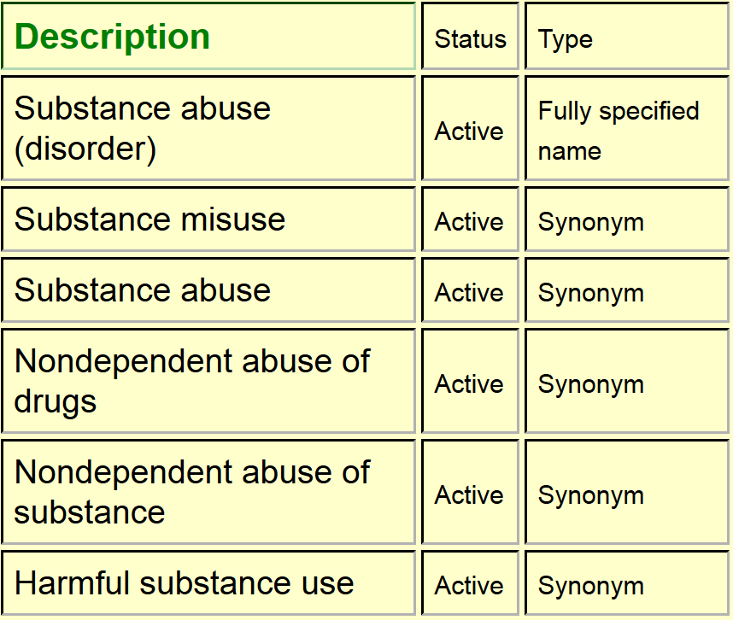
66214007 | Substance abuse (disorder) |

Slide 7
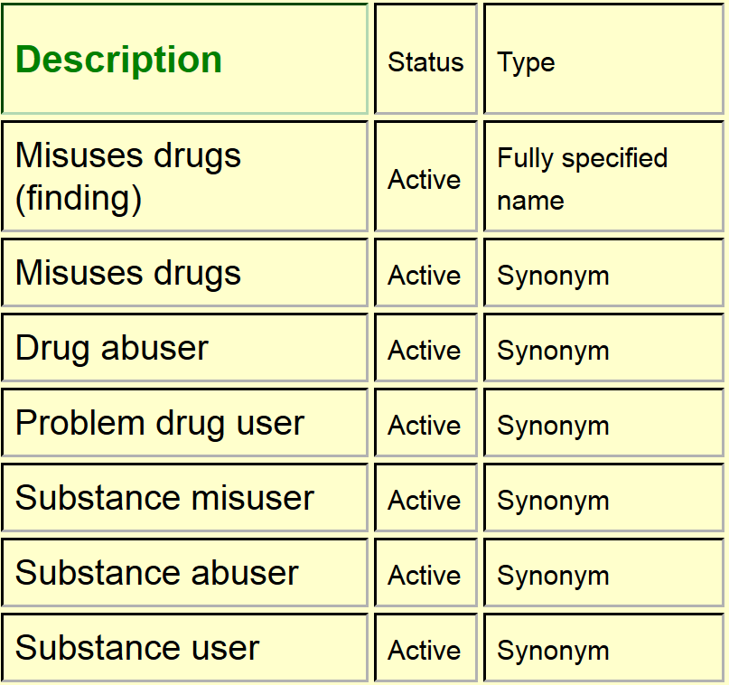
361055000 | Misuses drugs (finding) |

Slide 8
Impact
degraded browsing, searching, reporting capabilities and support of post-coordination
Some similarities to the position that previously pertained in “{substance} allergy” and “{substance} adverse reaction” domains

Slide 9
Notoriously fractal semantics
"When I use a word, it means just what I choose it to mean—neither more nor less.”
"Intentional or unintentional misuse?
  e.g. is ‘poor salbutamol inhaler technique’ drug misuse?
Intentional or unintentional professional misuse?
e.g. 'antibiotic misuse‘, wrong indication, wrong dose prescribed
Poor prescribing / compliance in general?
“Harmful"
How? e.g. physical, mental, moral, religious, ethical, financial, forensic.
To whom? e.g. 'subject of record' or the person 'subject of record' sells her methadone to?

Slide 10
Solution
Unlike “{substance} allergy” and “{substance} adverse reaction”
  Less ‘safety critical’
  Less brownfield content baggage e.g. other drug classifications/coding systems
  Less information model baggage
  Bad news
  Political sensitivity
  Previous inconclusive efforts

Slide 11
Presentation to NurSIG meeting April 2009-09-25: proposed definitions
“Abuse refers to the use or treatment of something (a person, item, substance, concept, or vocabulary) that is harmful. It can be classed by the target of abuse or the type of abuse. “
“Misuse refers to the use or treatment of something (a person, item, substance, concept, or vocabulary) in a wrong way. It can be classed by the target of misuse or the type of misuse."

Slide 12
Presentation to NurSIG meeting April 2009-09-25: proposed definitions
The proposed concept clarification was unanimously supported.
A member recommended that that clean up of existing hierarchies that have been released to users should be approached with
caution and mindfulness of the impact to systems that have SNOMED CT implementations live today.
‘There is an enormous impact to users when concepts are redefined, retired, replaced, or otherwise manipulated
so this should not be done unless absolutely necessary’.
Recommendation to be taken to Content Committee

Slide 13
Presentation to NurSIG meeting April 2009-09-25:
Scope included wider meanings of abuse e.g. physical, sexual
Attribute modelling barely alluded to
Existing hierarchy incoherence not mentioned
No concerted action taken

Slide 14
Consensus?
IF
substance abuse and substance misuse are deemed ‘different’
THEN
substance abuse is always a kind of substance misuse

Slide 15

“If a class has only one direct subclass there may be a modeling problem or the ontology is not complete.”
http://protege.stanford.edu/publications/ontology_development/ontology101-noy-mcguinness.html

Slide 16
WHEN
substance abuse is_a substance misuse
what is the sibling of substance abuse?

Slide 17
Only two choices for action?
EP 1: treat ‘substance abuse’ and ‘substance misuse’ as synonymous
  Action: where both active concepts exist inactivate one as ‘same as’ the remaining active concept
EP 2: treat ‘substance abuse’ and ‘substance misuse’ as non-synonymous
  Actions: where only one active concept exists create the other
  where a concept has conflated synonyms recreate two new ones and inactivate ‘may be’ the conflated concept
  “foo abuse” in all cases is a “foo misuse”

Slide 18
Only two modeling choices
Option1: Pick one template and use it throughout the substance abuse and substance misuse content – with ‘full’ definition mandatory
Option2: Strip out existing attributes and revert to stated ‘is a’ relationships [Deprecated]

