Slide 1
Modeling of sepsis based on the third International Consensus Definitions for Sepsis and Septic Shock

Slide 2
Sepsis-3 Definitions
The third International Consensus Definitions for Sepsis and Septic Shock (Sepsis-3) published in 2016
Key findings:
  Limitations of previous definitions included an excessive focus on inflammation, the misleading model that sepsis follows a continuum through severe sepsis to shock, and inadequate specificity and sensitivity of the systemic inflammatory response syndrome (SIRS) criteria.
  Multiple definitions and terminologies are currently in use for sepsis, septic shock, and organ dysfunction, leading to discrepancies in reported incidence and observed mortality.
  The task force concluded the term severe sepsis was redundant.

Slide 3
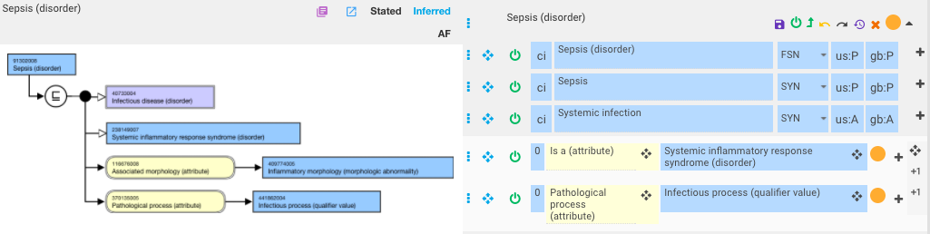
Current model of sepsis

Slide 4
Questions
Should sepsis be considered a kind of infectious disease?
What is the relationship between sepsis and SIRS?

Slide 5
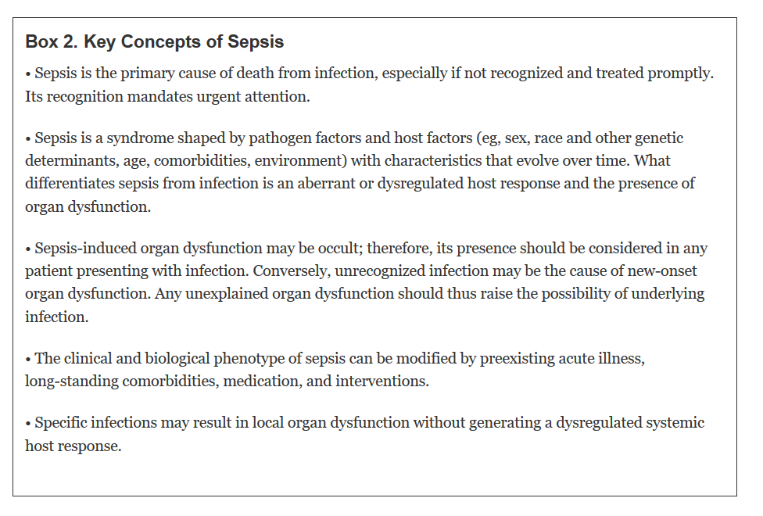
Key concepts of sepsis
JAMA Febr 2016

Slide 6
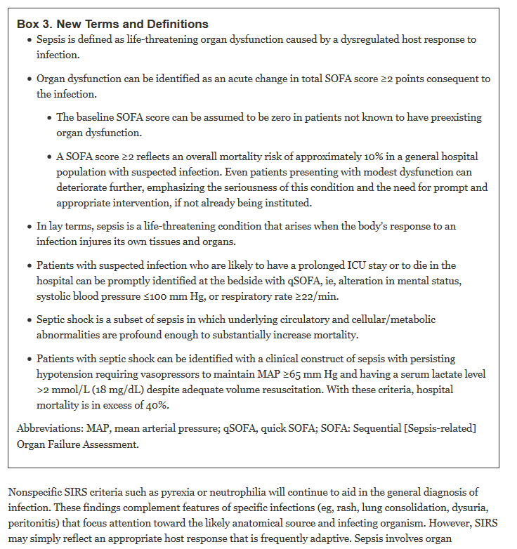
Sepsis – new terms and definitions
JAMA Febr 2016

Slide 7
Proposed modeling template
Sepsis due to infection {caused by X}/{of body site Y}
  Is A 238147009 |Organ dysfunction syndrome (disorder)|
  370135005 |Pathological process (attribute)|= Dysregulated host response (qualifier value)
  42752001 |Due to (attribute)|= Infection caused by X (disorder) / Infection of Y (disorder)

Slide 8
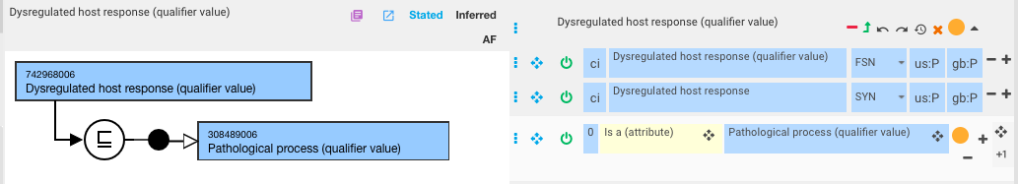
New pathological process – dysregulated host response (qualifier value)

Slide 9
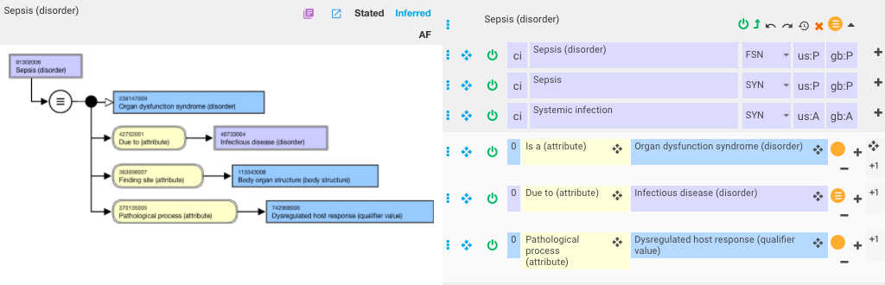
Revised model of sepsis

Slide 10
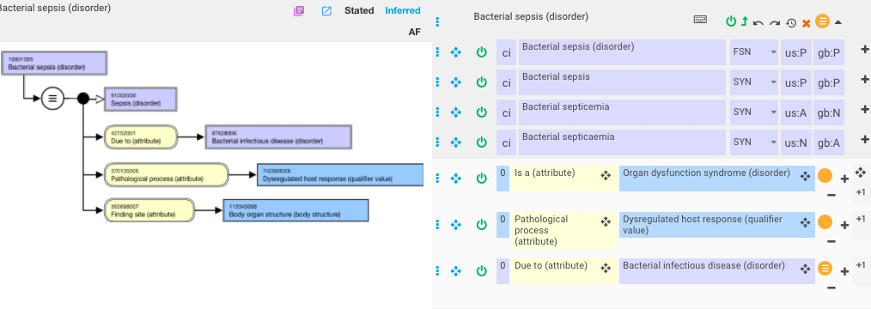
Revised model of bacterial sepsis
FSN should be revised to Sepsis due to bacterial infection

Slide 11
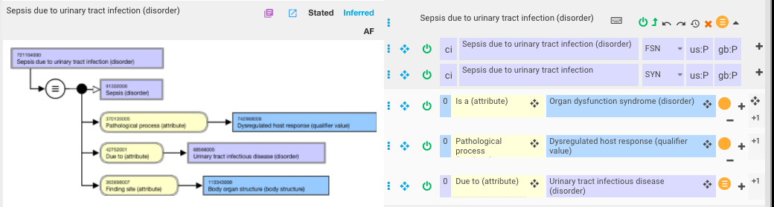
Revised model of Sepsis due to urinary tract infection

