Slide 1
Complications and sequelae update
Bruce Goldberg MD, PhD

Slide 2
Current status
Editorial guidelines approved by head of terminology
Summary of changes since last face to face meeting
  All disorder x due to (or co-occurrent and due to) disorder y
  All disorder x due to procedure y
  Will have an asserted parent of 116223007 |Complication (disorder)|
  All disorder x after disorder y
  All disorder y after procedure y
  Will have an asserted parent of 362977000 |Sequela (disorder)|

Slide 3
Summary of changes since last face to face meeting - continued
  Some sequelae will have asserted parents of both 362977000 |Sequela (disorder)|and 116223007 |Complication (disorder)|if a both a causal and temporally following relationship between the component entities is realized.
The exception to assigning a parent of 116223007 |Complication (disorder)|is if the resultant disorder is an anticipated or expected, natural progression of its cause
  Example: Myocardial ischemia due to coronary artery occlusion is not a complication of myocardial occlusion as ischemia would be expected to occur if the coronary artery blood flow is limited by occlusion.

Slide 4
Motion to inactivate During and/or after (attribute)
The default temporal context of a disorder caused by a procedure is that the disorder must occur either during, after or both during and after the procedure and is thus implied if a temporal relationship between a disorder and a procedure is not clearly stated in the fully specified name or otherwise understood from the definition of the concept.
In such cases, no temporal relationship needs to be added to the definition of the concept.
Before, during and/or after i.e. temporally related to is retained primarily to define the perioperative state.

Slide 5
Outstanding issues
Modeling complications of devices
Modeling complications of pregnancy

Slide 6
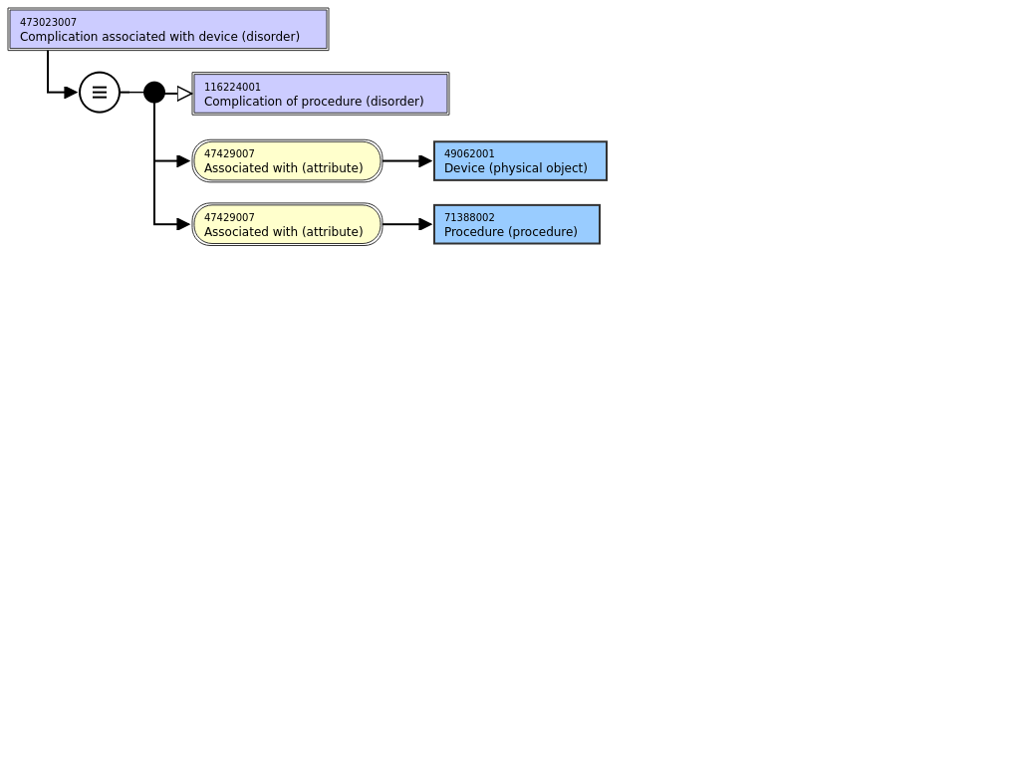
Device complications

Slide 7
Major types of concepts represented under 473023007 |Complication associated with device (disorder)|
Problem with device itself
  461431000 |Failure of cardiac valve prosthesis (disorder)|
Disorder due to presence of device
  Example: 213134006 |Internal prosthetic device causing pain (disorder)|
Disorder related to procedure to implant/insert/apply device
  723154002 |Post cerebral ventricular shunt leak (disorder)|

Slide 8
Suggested modeling of device complications 1
Problem with device itself
  These are really findings about the device
    Retire 473023007 |Complication associated with device (disorder)|
    Move 397933008 |Equipment error/failure (finding)|and 397839006 |Equipment malfunction (finding)|under 405651005 |Equipment problem (finding)|
    Alternatively create new concepts of device failure (finding) , device malfunction (finding), device problem (finding) under 373060007 device status (finding) preferred
  Move concepts of type problem with device itself under 405651005 |Equipment problem (finding) or device problem (finding)|or appropriate subhierarchies and change the semantic tag to finding
    Example:
      Before:
        461431000 |Failure of cardiac valve prosthesis (disorder)|
      After:
        397933008 |Equipment error/failure (finding)| or Device failure (finding)
          Failure of cardiac valve prosthesis (finding)|

Slide 9
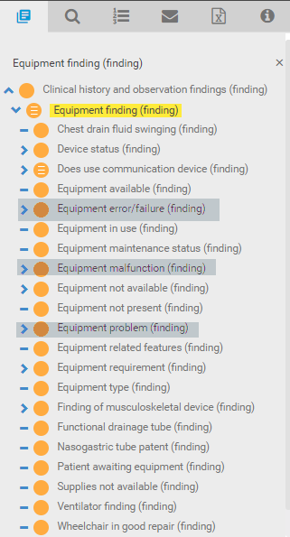
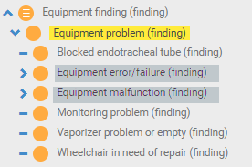
Equipment problem (finding)
Current Equipment finding subhierarchy
Proposed changes to Equipment problem subhierarchy

Slide 10
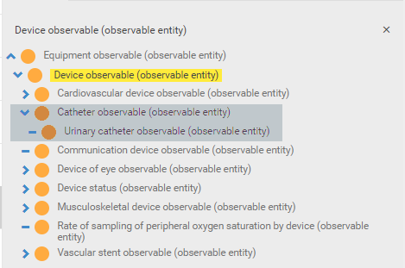
New device observables

Slide 11
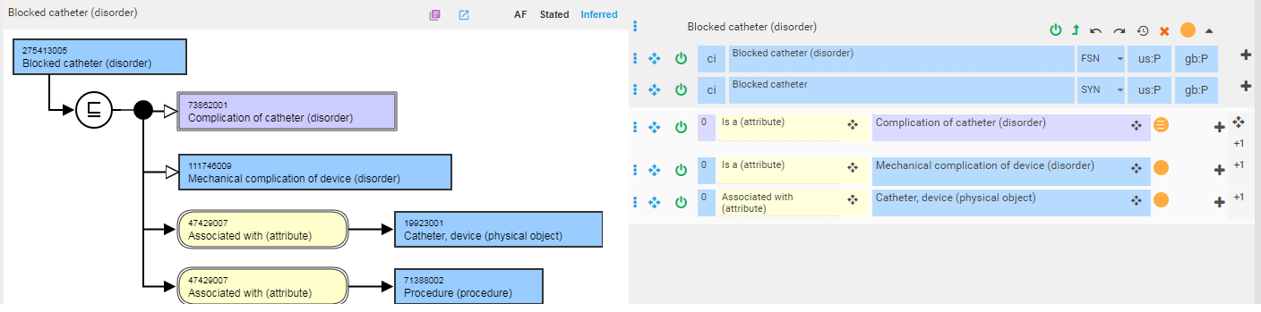
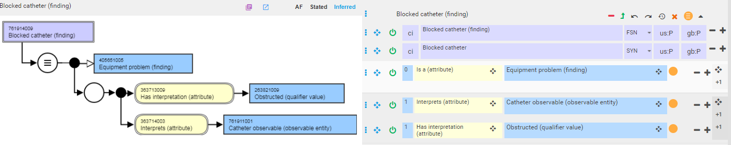
Modeling Blocked catheter as a finding
Requires range of has interpretation to be extended to include 255412001 |Appearances (qualifier value)|

Slide 12
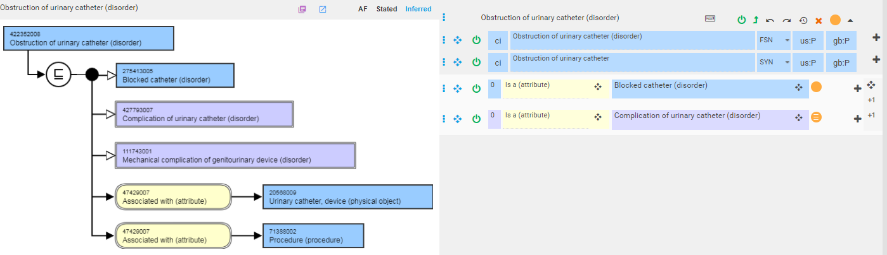
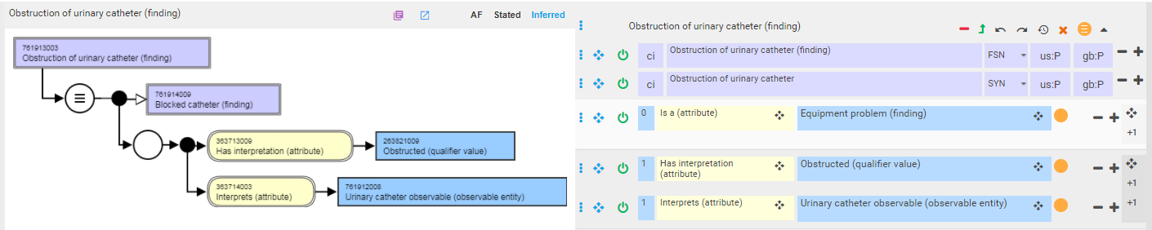
Modeling blocked urinary catheter as a finding
Test model with more specific subtypes of device observables
Requires range of has interpretation to be extended to include 255412001 |Appearances (qualifier value)|
Move obstructed (qualifier value) under finding observable (qualifier value)

Slide 13
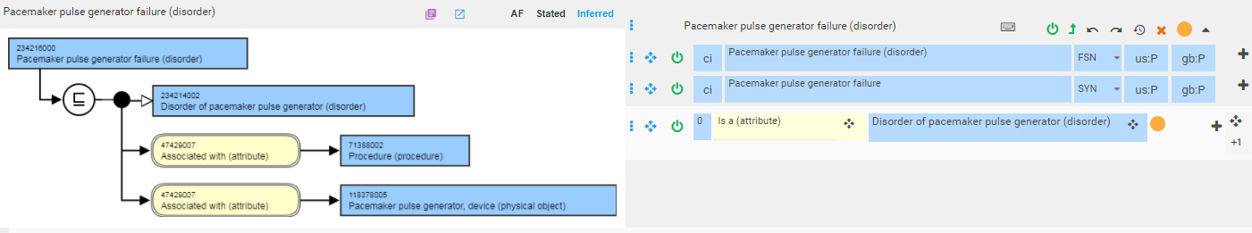
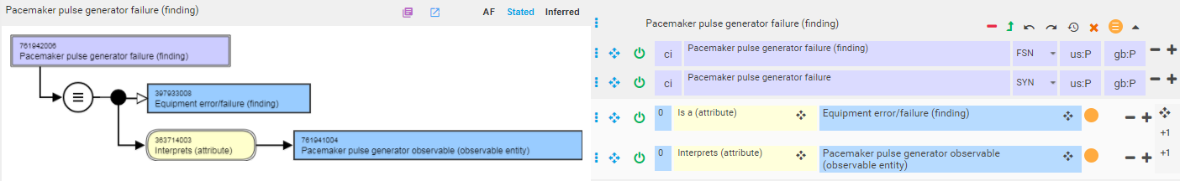
Modeling Pacemaker pulse generator failure as a finding

Slide 14
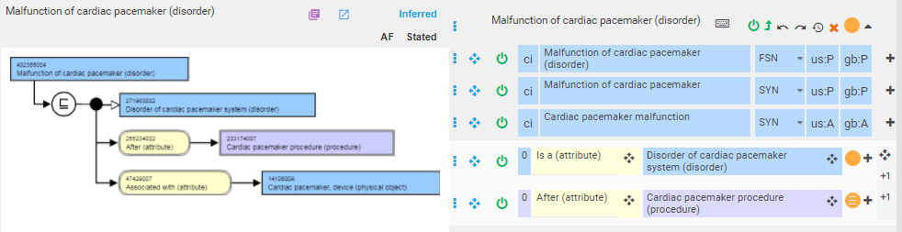
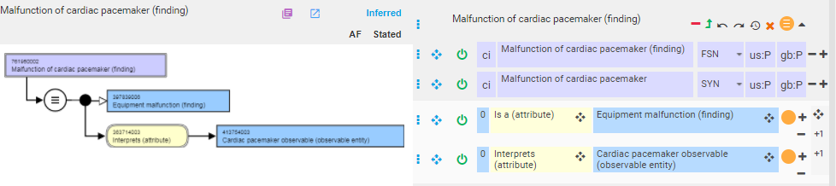
Modeling Malfunction of cardiac pacemaker as a finding

Slide 15

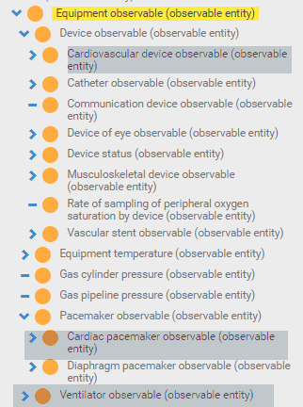
Equipment vs device
Inconsistent assignment of equipment and device observables
Medical device (brief):
An article, instrument, apparatus or machine that is used in the prevention, diagnosis or treatment of illness or disease, or for detecting, measuring, restoring, correcting or modifying the structure or function of the body for some health purpose. Typically, the purpose of a medical device is not achieved by pharmacological, immunological or metabolic means.
Medical equipment:
Medical devices requiring calibration, maintenance, repair, user training and decommissioning – activities usually managed by clinical engineers. Medical equipment is used for the specific purposes of diagnosis and treatment of disease or rehabilitation following disease or injury; it can be used either alone or in combination with any accessory, consumable or other piece of medical equipment. Medical equipment excludes implantable, disposable or single-use medical devices.

Slide 16
Suggested modeling of device complications 2
Disorder due to presence of device
  Create a new hierarchy, Complication of device (or Disorder caused by device) under 116223007 |Complication (disorder)|
  Model as:
    isA disorder due to 397578001 |Device in situ (finding)|
    Or
    isA disorder caused by 49062001 |Device (physical object)|✓

Slide 17
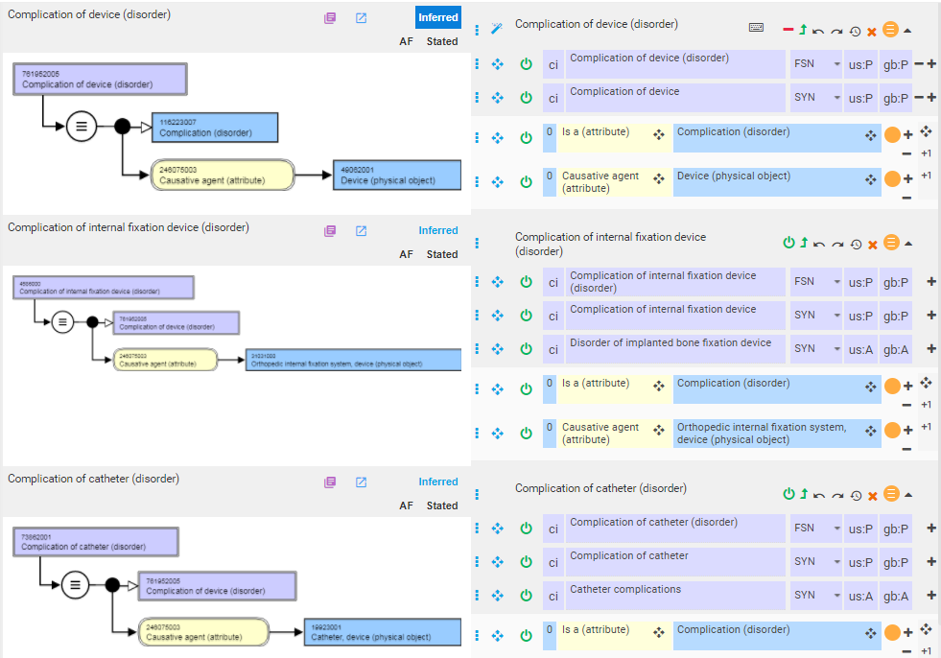
Modeling complication of device – option 1
Preferred

Slide 18
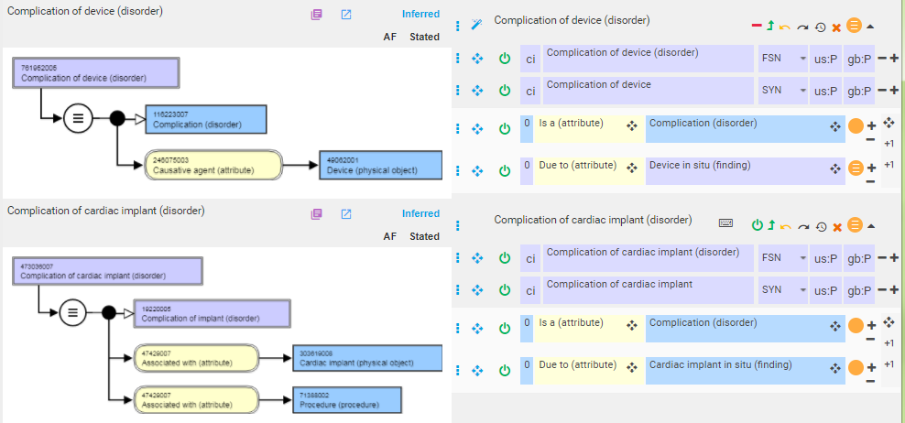
Modeling complication of device – option 2

Slide 19
Suggested modeling of device complications 3
Disorder related to procedure to implant/insert/apply device
  Model using heuristics for combined disorders with procedures

Slide 20
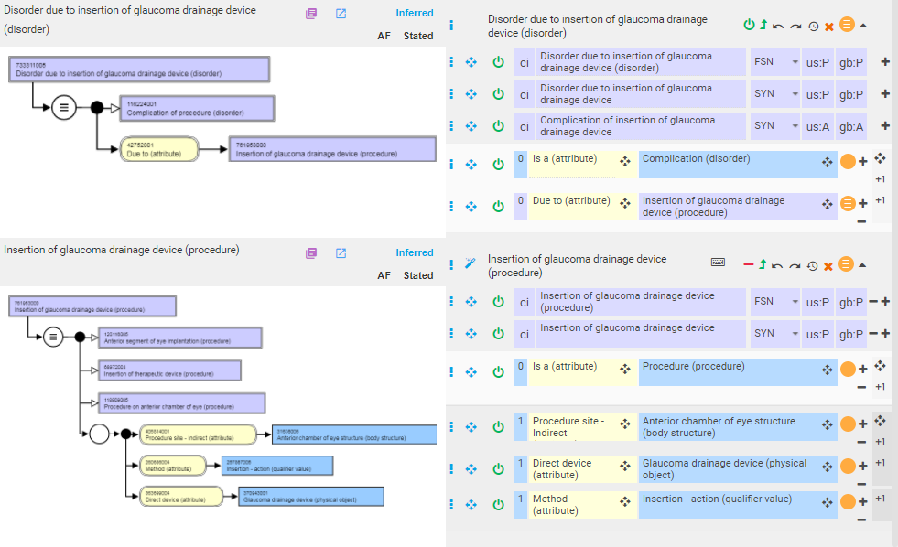
Disorder due to insertion of glaucoma drainage device (disorder)

Slide 21
Infection associated with device
Is an infection caused by presence of infectious agent on device or introduced during procedure to place the device.
Causal relationship with device is not only indirect but procedure itself or the presence of device is not sufficient to result in infection
Infection of device
  Device can’t be infected
  Meaning is likely local infection surrounding contaminated device or the contaminated device itself
May need to retain associated with relationship for infections associated with devices

Slide 22
111746009 |Mechanical complication of device (disorder)|
73 children
Descendants count, Stated: 219 concepts, Inferred: 219 concepts.
Is an intermediate primitive thus all descendants asserted
The use of the term “mechanical complication” is widespread in the literature and especially in ICD-9 and 10.
A clear definition for what is meant by mechanical complication is lacking.
Should 111746009 |Mechanical complication of device (disorder)| be retired?

Slide 23
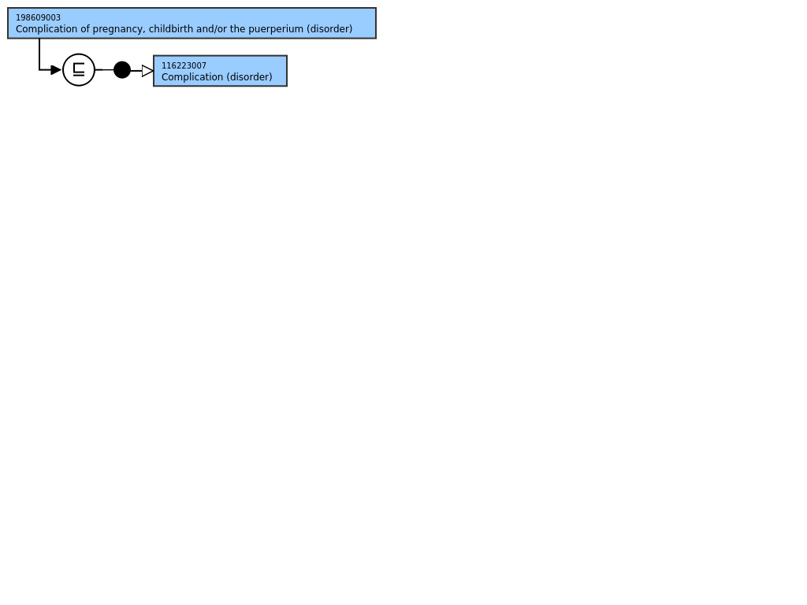
198609003 |Complication of pregnancy, childbirth and/or the puerperium (disorder)|

Slide 24
Complication of pregnancy, childbirth and/or the puerperium – main patterns
X complicating pregnancy, childbirth, labor/delivery, puerperium
Complication x of pregnancy, childbirth, labor/delivery, puerperium
Temporal relation of x to pregnancy
  Intrapartum
  Postpartum/postnatal
  Peripartum/perinatal

Slide 25
Candidate values for temporal and causal relationships representing pregnancy, childbirth and the puerperium
Pregnancy
  77386006 |Patient currently pregnant (finding)|
    Being considered for retirement.
    Intermediate primitive with 25 asserted descendants
Childbirth
  289256000 |Mother delivered (finding)|
Puerperium
  86569001 |Postpartum state (finding)|
  Can be modeled also as after mother delivered
Labor
  35874009 |Normal labor (finding)|????

Slide 26
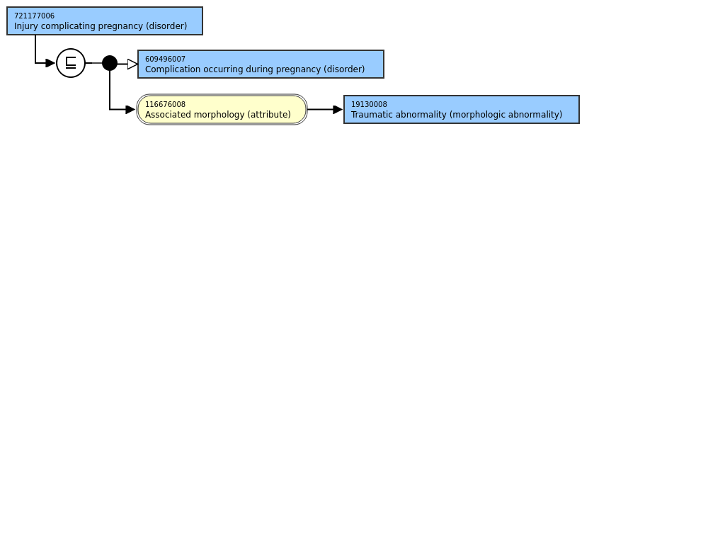
X complicating pregnancy

Slide 27
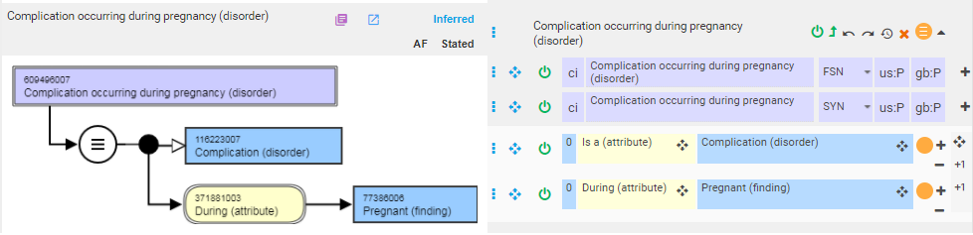
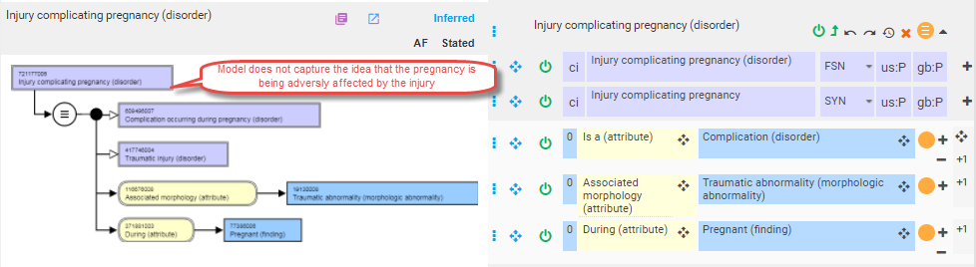
721177006 |Injury complicating pregnancy (disorder)|

Slide 28
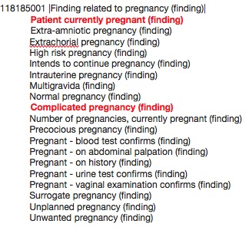
X complicating pregnancy, childbirth, labor/delivery, puerperium e.g. 721177006 |Injury complicating pregnancy (disorder)|
Model as Complicated pregnancy/childbirth/puerperium due to X

Slide 29
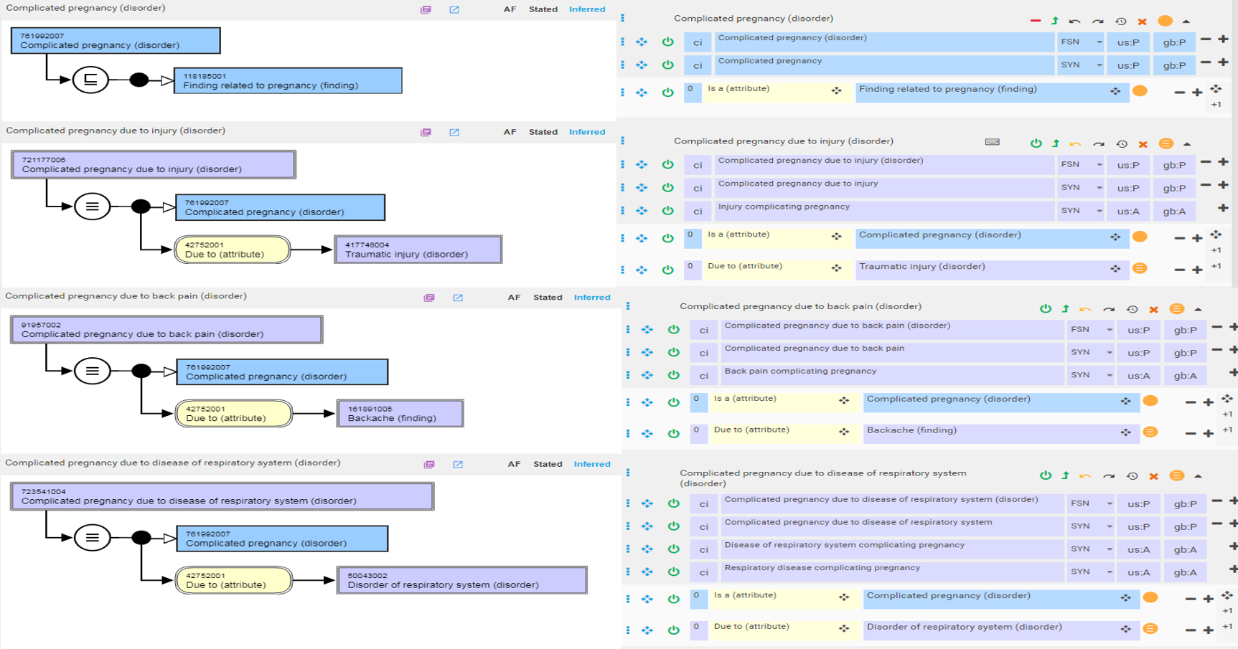
Complicated pregnancy due to x

Slide 30
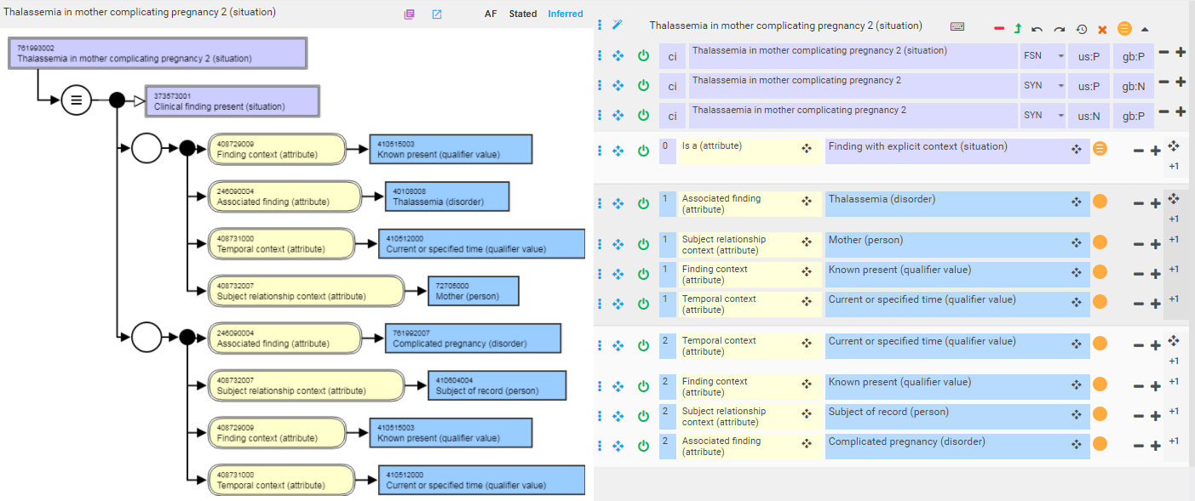
X complicating pregnancy as a situation
X complicating pregnancy is not really a distinct subtype of X but a situation in which X is present in the context of a complicated pregnancy
Model does not fully capture X as the cause of the complicated pregnancy

Slide 31
X complicating Y
Similar patterns can be applied to x complicating childbirth/puerperium

Slide 32
Complication x of pregnancy, childbirth, labor/delivery, puerperium e.g. 106004004 |Hemorrhagic complication of pregnancy (disorder)|
Model as X due to pregnancy/childbirth/puerperium due to X

Slide 33
Temporal relation of x to pregnancy
Intrapartum
Postpartum/postnatal
Peripartum/perinatal
Recent presentation by Phil Brown on extending range of occurrence attribute brought up the following issues:
  Pregnancy time periods refer to specific intervals that may be defined differently in different countries (there are no standard definitions)
  The proposed solution does not clarify distinguishing maternal from fetal/infant conditions
  It is unclear if there is a difference between postpartum and postnatal and between peripartum and perinatal

