Slide 1
What is Useful? Publishing Support for Precision Medicine
James R. Campbell MD
W. Scott Campbell PhD MBA
October 17, 2017
Nebraska Medicine
University of Nebraska Medical Center

Slide 2
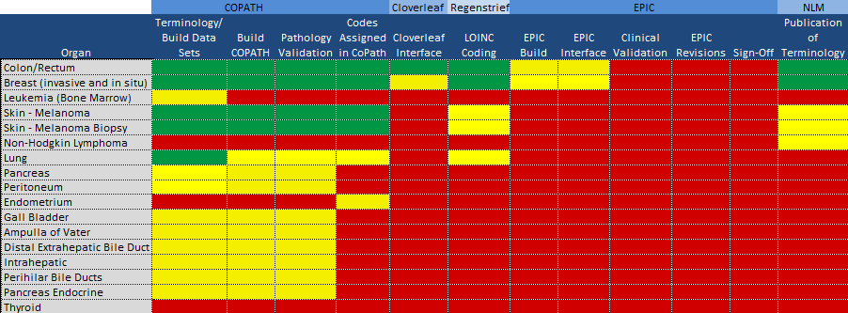
BD2K Project
Work Summary

Slide 3
Terminology development summary:
CAP Cancer checksheets
SNOMED CT hierarchy | Anatomic Pathology Concepts | Molecular Pathology Concepts | Exemplar molecular extension concepts
Observable entities | 120 | 41 | “BRAF nucleotide sequence detected in excised malignancy”
Body Structures | 16 | 104 | “BRAF gene locus” “Distal surgical margin”
Clinical findings | 6 | 7 | “BRAF V600E variant identified in excised malignancy”
Techniques | 4 | 7 | “Gross examination” “Nucleotide sequencing”
Property types | 8 | 2 | “Sequence property”
Scale types | 0 | 9 | “Variant call format”
Substances | 0 | 21 | “BRAF human cellular protein”
Attributes | 2 | 3 | “Chromosomal region”
TOTALS | 156 | 194

Slide 4
Structured pathology reporting: Nebraska architecture
Molecular Labs
FISH
Epic
One Chart
HL7 V2.X
HL7 V2.51
ETL
COPATH Anatomic Pathology
Immune stn
HL7 V2.3
Interface Engine
i2b2
SQL
HL7 V2.51
HL7 V2.51
ETL
Genom- Oncology
SEER
Registry
NAACCR
Ion-Torrent
Sequencer
In development
NECares
Biobank
In production

Slide 5
Cancer Results:
AP & Immunohistochemistry
OBX|10|CWE|912335981000004102^Colon-Margins: Proximal^SCT||384614008^Proximal margin uninvolved by invasive carcinoma^SCT||||||F
OBX|12|CWE| 323569801000004105^Colon-Procedure used to obtain specimen ^SCT||26925005^Transverse colectomy^SCT||||||F
OBX|17|NM| 170409341000004104^Colon-Number of lymph nodes involved by carcinoma^SCT||^^^^2|nodes|||||F
OBX|18|NM| 896002551000004103^Colon-Number of lymph nodes microscopically examined^SCT||^^^^8|#|||||F
OBX|21|CWE| 5574201000004102^Colon-Site of excised tumor^SCT||485005^Transverse colon^SCT||||||F
OBX|22|CWE|156707831000004105^MLH1-IHC testing for Mismatch Repair (MMR) Proteins^SCT||782951581000004109^MLH1: Intact nuclear expression^SCT||||||F
OBX|23|CWE| 194831101000004102^MSH2-IHC testing for Mismatch Repair (MMR) Proteins^SCT||782951581000004109^MSH2: Intact nuclear expression^SCT||||||F
OBX|24|CWE|^MSH6-IHC testing for Mismatch Repair (MMR) Proteins^SCT||782951581000004109^MSH6: Intact nuclear expression^SCT||||||F
OBX|25|CWE|^PMS2-IHC testing for Mismatch Repair (MMR) Proteins^SCT||782951581000004109^PMS2: Intact nuclear expression^SCT||||||F
OBX|26|CWE| 271920001^IHC Interpretation for mismatch repair genes^SCT||117444000^No loss of nuclear expression of MMR proteins: low probability of Lynch syndrome or sporadic mismatch repair deficiency.^SCT||||||F

Slide 6
Cancer sequence results
Somatic sequence variants
MSH|^~\&|GenomOncology Workbench|UNMC|20170913223645||ORU^…
R01^ORU_R01|701|P|2.5.1|1505342205103
PID|1||126456||Doe^John^J||19500101|M
OBR|1||Integration3-Lung|55232-3^Genetic analysis summary panel^LN|||201709132236
OBX|1|FT|51969-4^Genetic analysis summary report^LN||
OBR|2||Integration3-Lung|55207-5^Genetic analysis discrete result panel^…
LN|||201709132236|||||||||^Dr. Onco M.D., Ph.D.
OBX|1|CWE| 911752361000004100^KRAS sequence variant identified in excised…
malignant neoplasm (observable entity)^…
SNM|1| KRAS NP_004976.2:Q61H NM_004985.3:c.183A>C|||Pathogenic |||F
OBX|2|CWE| 911752361000004100^KRAS sequence variant identified in excised…
malignant neoplasm (observable entity)^…
SNM|2| KRAS NP_004976.2:Q61Y NM_004985.3:c.181_183del…
CAAinsTAC|||Likely Pathogenic|||F
OBX|3|CWE| 911752161000004103^EGFR sequence variant identified in excised…
malignant neoplasm (observable entity)^…
SNM|1| EGFR NM_005228.3:c.(=)|||Normal|||F

Slide 7
Take-aways
Campbell WS, Karlsson D, Vreeman DJ, Lazenby AJ, Talmon GA, Campbell JR. A computable pathology report for precision medicine: extending an observables ontology unifying SNOMED CT and LOINC. JAMIA; 0(0), 2017, 1–8 doi: 10.1093/jamia/ocx097
https://academic.oup.com/jamia/article/doi/10.1093/jamia/ocx097/4157681/A-computable-pathology-report-for-precision?guestAccessKey=ee8ed0e2-8e9f-44bd-a467-bfbcb3e3a2c0
Annotated CAP checksheets with LOINC observables and SNOMED CT valuesets
https://unmc.edu/pathology/informatics/tdc.html

Slide 8
Current Publication of Observables Development
Current content published and shared via US NLM website for review and comment twice yearly
  RF2 Nebraska extension refset with LOINC concept codes (no SNOMED CT IDs)
  Procedures for implementing extension refset in SNOMED CT system
  Annotated cancer checksheets with Observables content and SNOMED CT valuesets
  Observables ontology for frequently used laboratory (expanded technology preview) and pathology

Slide 9
Use Cases for Deployment and Publication
Support EHR vendor software structured around SNOMED CT or LOINC
Interoperable deployment of ICCR checksheets across all SI members
(Pre-coordinated) Results concept definitions for laboratory medicine and (AP&MP) pathology results
  Communication
  Interoperation and query
  Decision analytic
Molecular Pathology support for FHIR(Post-coordinated)

Slide 10
Publication Proposal
RF2 extension set for (expanded) technology preview and AP/MP; deployment software
Classified LOINC lab/AP/MP ontology in OWL format
Synoptic reports (AP & MP) in HL7 CDA format supported by implementation guide
MP map of genomic observables to post-coordinated FHIR dataset with implementation advice

