Slide 1
SNOMED CT, Synoptic Observables and Clinical Genomics
James R. Campbell MD
W. Scott Campbell PhD
Departments of Internal Medicine and Pathology
University of Nebraska Medical Center

Slide 2
Acknowledgements
Geoffrey Talmon MD
Audrey Lazenby MD
Allison Cushman-Vokoun MD PhD
Raj Dash MD
Mary Kennedy
Observable project team
iPaLM SIG; RCP, RCPA, Pathologists of Sweden

Slide 3
Outline
Phase 1
Observables development for Molecular Pathology (MP) in Synoptic reports
Observables development for Anatomic Pathology (AP) in Synoptic reports
Publication and draft comments
Phase 2
International collaboration and standardization

Slide 4
UNMC: Project for structured encoding of Pathologist cancer reports
Objective: Detailed structured reporting of all anatomic and molecular pathology observations for all CAP synoptic cancer worksheets (82 types of malignancies)
Proposal: Phase 1- Analyze detailed semantics of CAP worksheets; apply harmonized concept model to develop terminology requirements; deploy as real-time structured reporting from COPATH system interfaced to tissue biobank and EPIC
Tooling: Nebraska Lexicon© extension namespace; SNOWOWL authoring platform; SNOMED CT International + US Extension + Observables Technology preview; ELK 0.4.1 DL classifier
Phase 2 - Expand project in collaboration with RCP, RCPA, Sweden, ICCR to include international standardization of cancer synoptic reporting

Slide 5
SNOMED CT Content Extensions for Pathology
Body structures>>Cell structures>>Nucleotide sequences and Named Genes
Substances>>Proteins
Qualifiers>>Techniques>> AP and MP methods
Qualifiers>>Measurement Properties>>AP and MP properties
Observable entity>>AP and MP observables
Clinical findings>>Anatomic and molecular genetic observation results and disorders

Slide 6
Molecular pathology (MP) Use Case
6.1.1.1 Iteratively analyze semantics in CAP work sheets; define content and FSN for observables; review with iPaLM domain experts for subject matter
6.1.1.3 Extend the SNOMED CT concept model and add content in Body Structures and Substances to include genes and proteins needed for MP use case
6.1.1.4 Bind Genes and proteins by reference to NCBI ontologies and classify
6.1.1.5 Vet analyzed content with Observables project for definition; define use cases and develop consensus templates for application of concept model; document for editorial guide

Slide 7
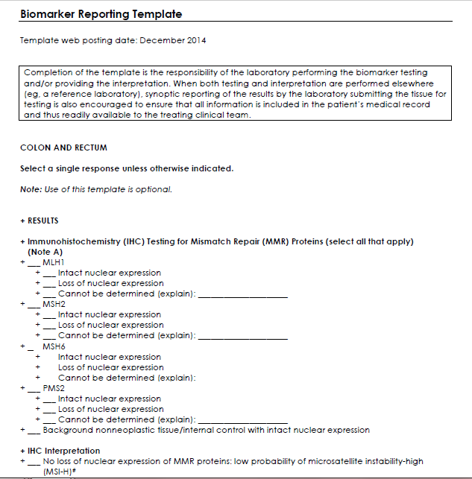
MP: CAP Checksheet Source Material

Slide 8
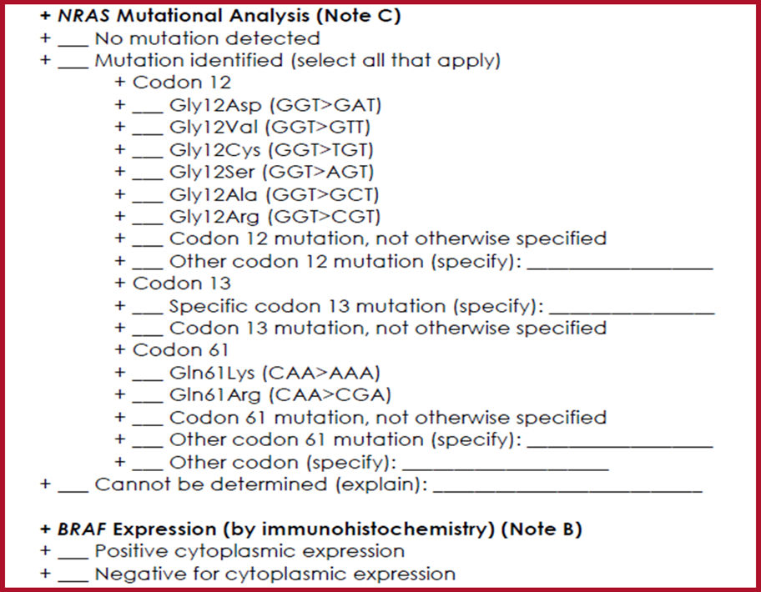
6.1.1.3 Analyze semantics
“Tumor expression of BRAF protein as measured by immunohistochemistry stain”

Slide 9
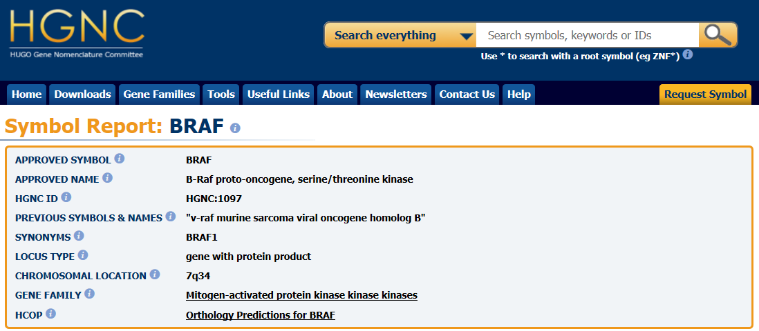
6.1.1.1 Extend the SNOMED CT concept model to include genes and proteins
Reference material at National Center for BioOntologies

Slide 10
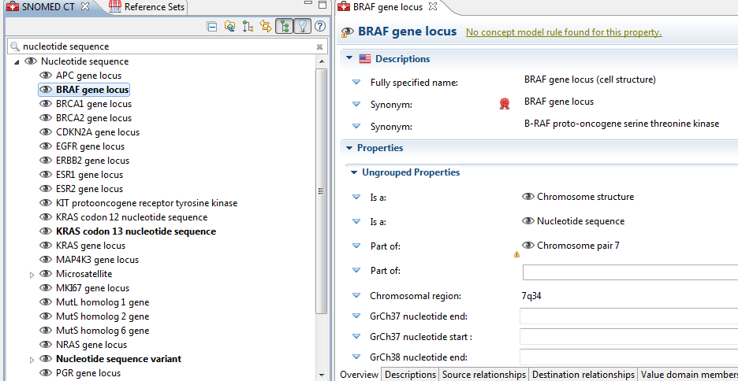
6.1.1.1 Extend the SNOMED CT concept model to include genes and proteins
Add genes to body structures and proteins to substances as required by use case

Slide 11
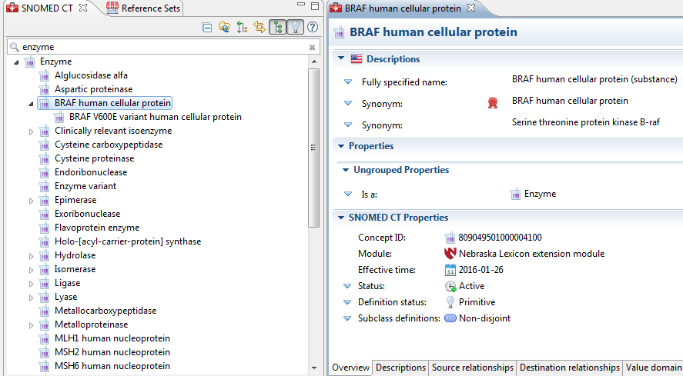
6.1.1.1 Extend the SNOMED CT concept model to include genes and proteins
Add genes to body structures and proteins to substances as required by use case

Slide 12
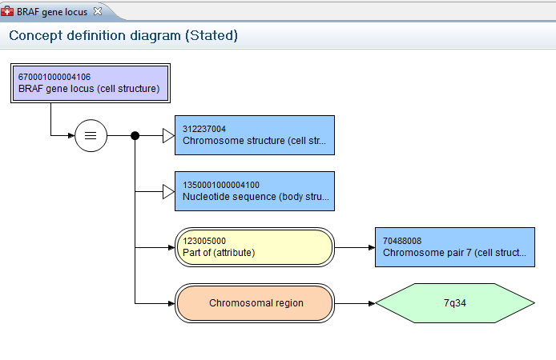
SNOMED CT Content Extensions for MP
Body structures>>Cell structures>>Nucleotide sequences and Genes
Substances>>Proteins
Qualifiers>>Techniques>> AP and MP methods
Qualifiers>>Measurement Properties>>AP and MP properties
Observable entity>>AP and MP observables
Clinical findings>>Anatomic and molecular genetic observation results and disorders
Define genes and related subcellular structures by
mapped reference to scientific ontologies classified
in conjunction with SNOMED CT & LOINC Observables

Slide 13
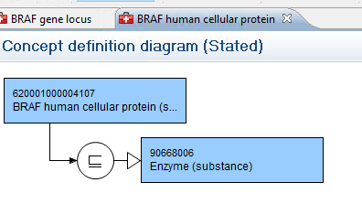
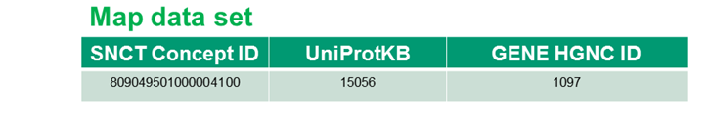
SNOMED CT Content Extensions for MP
Substances>>Proteins
Qualifiers>>Techniques>> AP and MP methods
Qualifiers>>Measurement Properties>>AP and MP properties
Observable entity>>AP and MP observables
Clinical findings>>Anatomic and molecular genetic observation results and disorders
Define proteins and related molecular structures by
mapped reference to scientific ontologies classified
in conjunction with SNOMED CT & LOINC Observables

Slide 14
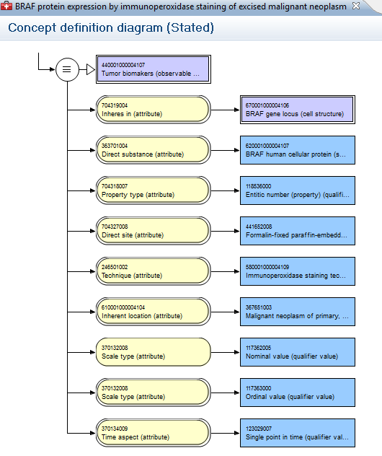
6.1.1.5 Vet analyzed content with Observables project

Slide 15
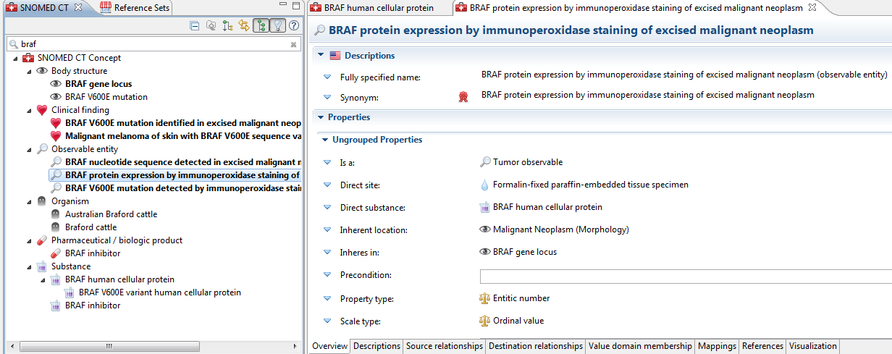
6.1.1.6 Deploy and test new content in Nebraska Lexicon© extension namespace

Slide 16
6.1.1.8 Work with LOINC committee to map all Observables content to LOINC codes
As Observables content is authored in harmonized model, search RELMA to identify pre-existing LOINC codes
Submit unmapped content to LOINC committee once Observables definition agreed
Review and vet LOINC term development for semantic alignment and conformance to SNCT FSN

Slide 17
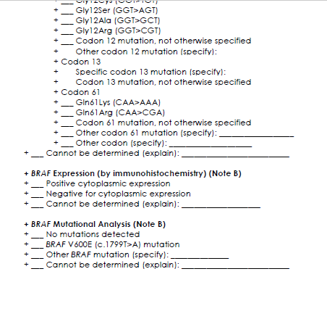
6.1.1.9 Publish RF2 and OWL content in NLM UMLSKS

Slide 18
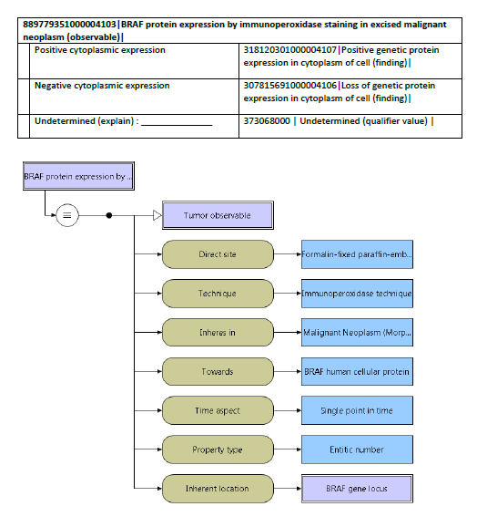
6.1.1.9 Publish RF2 and OWL content in NLM UMLSKS with SNOMED CT valuesets

Slide 19
Anatomic pathology (AP) Use Case
Workplan is identical except that modelling of genes and proteins are generally not required
Extensions to Techniques and Body structures more frequent requirement for pathology services and anatomical detail

Slide 20
Anatomic pathology (AP) Use Case
6.1.1.1 Iteratively analyze semantics in CAP work sheets; define content and FSN for observables; review with iPaLM domain experts for subject matter
6.1.1.2 Extend the SNOMED CT concept model and add content in Body Structures and Substances to include genes and proteins needed for MP use case
6.1.1.3 Bind Genes and proteins by reference to NCBI ontologies and classify
6.1.1.5 Vet analyzed content with Observables project for definition; define use cases and develop consensus templates for application of concept model; document for editorial guide

Slide 21
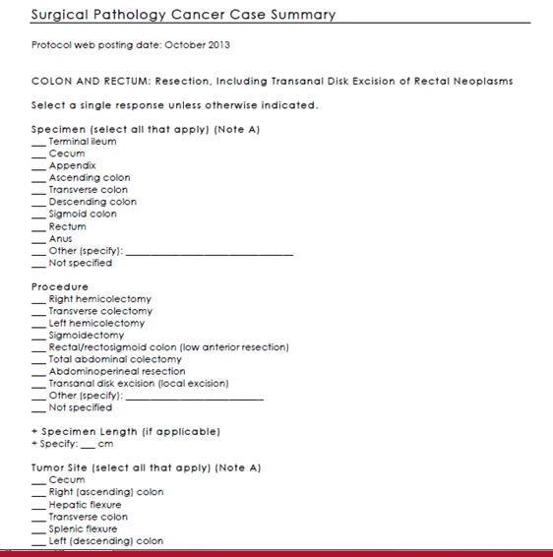
Anatomic pathology (AP) Use Case
Workplan is identical except that modelling of genes and proteins are generally not required
Extensions to Techniques and Body structures more likely required for pathology services and anatomical detail

Slide 22
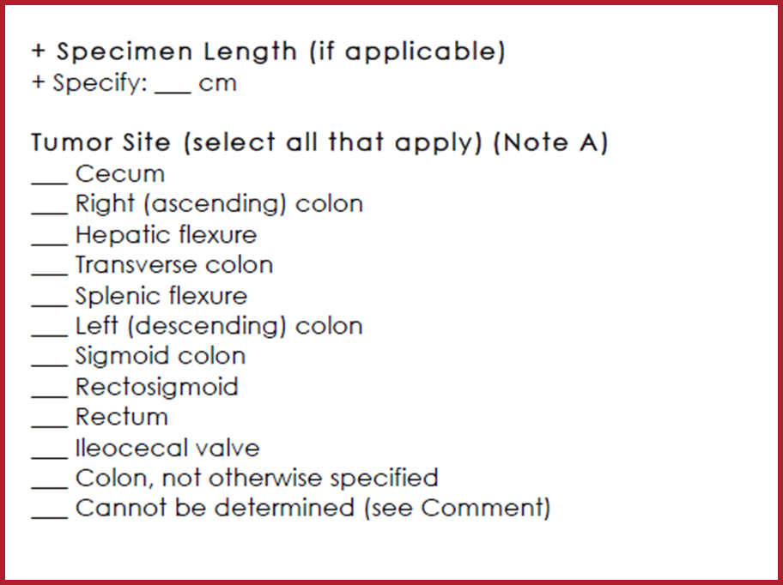
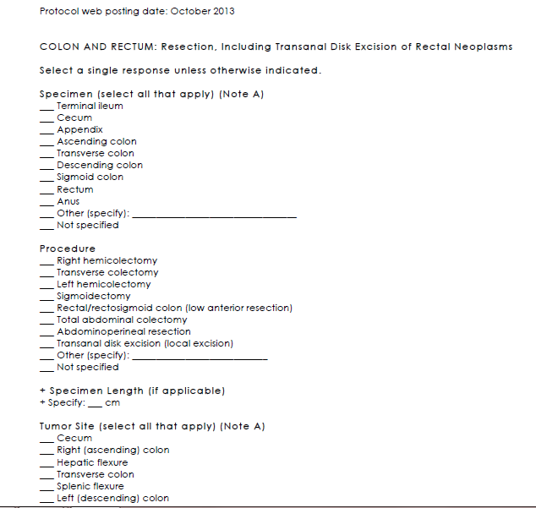
Anatomic pathology (AP):
Source – CAP worksheets

Slide 23
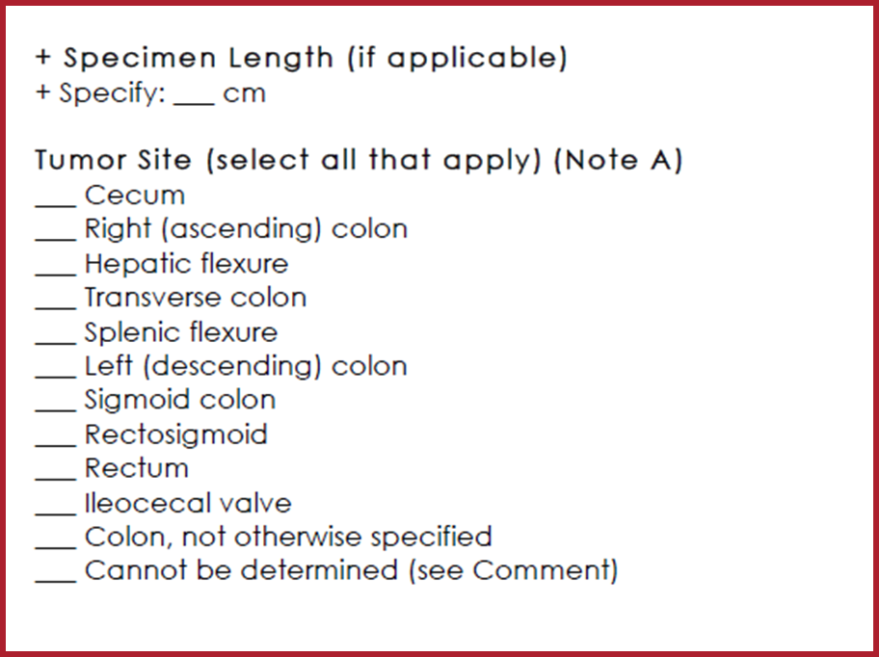

6.1.1.1 Analyze semantics
What was the anatomic location of the tumor that was resected?

Slide 24
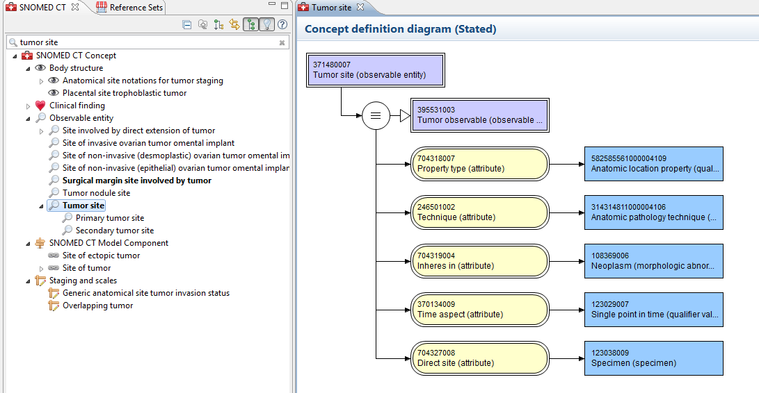
6.1.1.5 Vet analyzed content with Observables project

Slide 25
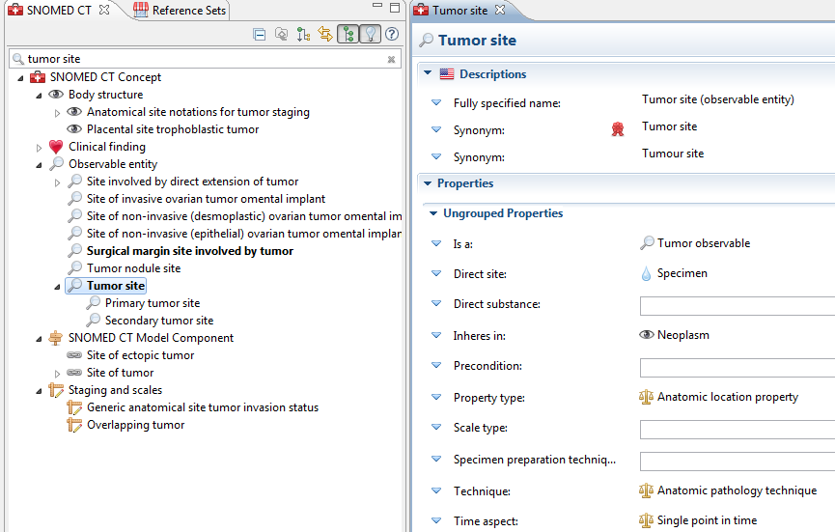
6.1.1.6 Deploy and test new content in Nebraska Lexicon© extension namespace

Slide 26
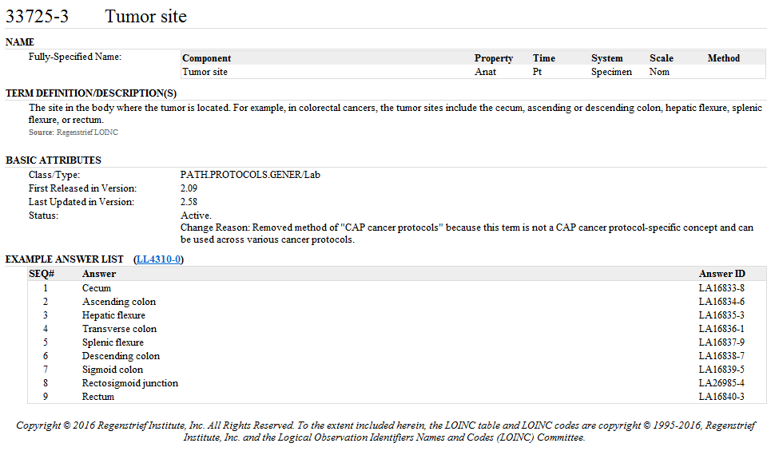
6.1.1.8 Work with LOINC committee to map all Observables content to LOINC codes
As Observables content is authored in harmonized model, search RELMA to identify pre-existing LOINC codes
Submit unmapped content to LOINC committee once Observables definition agreed

Slide 27
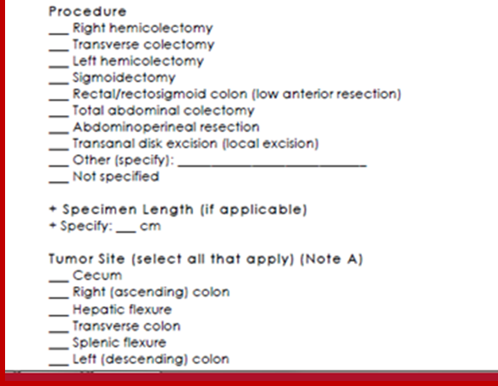

6.1.1.9 Publish RF2 and OWL content in NLM UMLSKS

Slide 28
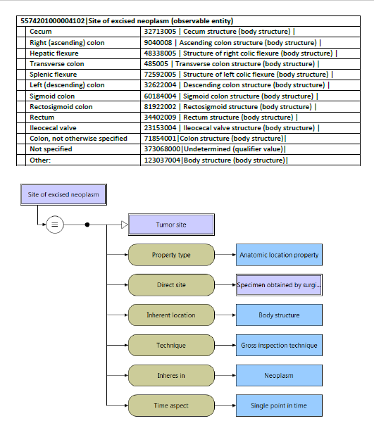

6.1.1.9 Publish RF2 and OWL content in NLM UMLSKS

Slide 29
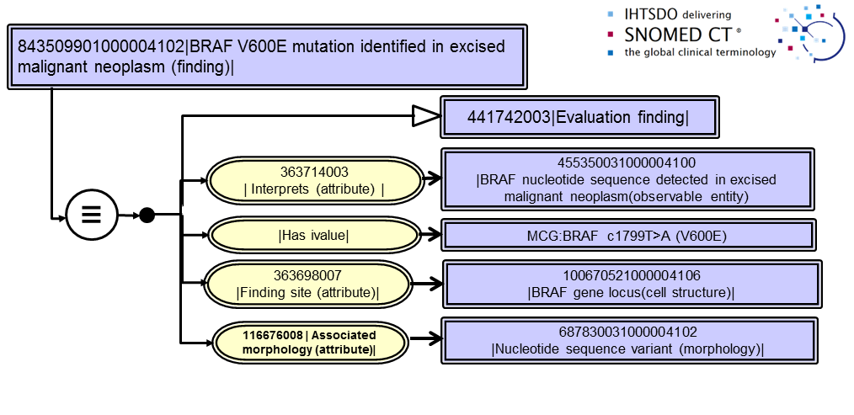
Molecular Pathology Finding
Fully defining observations of sequence variants

Slide 30
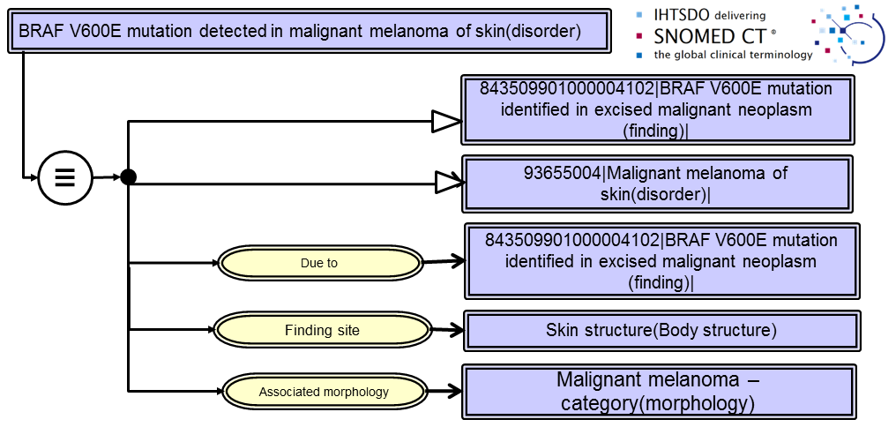
Patient Condition includes MP finding of tumor

Slide 31
Terminology development summary:
CAP Colorectal and Breast Cancer checksheets
SNOMED CT hierarchy | Anatomic Pathology Concepts/Primitives | Molecular Genetic Concepts/Primitives | Exemplar molecular extension concepts
Observable entities | 61/1 | 32/3 | “BRAF nucleotide sequence detected in excised malignancy”
Body Structures | 10/9 | 29/3 | “BRAF gene locus”
Clinical findings | 6/2 | 7/3 | “BRAF V600E variant identified in excised malignancy”
Procedures | 2/1 | 0
Techniques | 4/4 | 7/7 | “Pyrosequencing”
Property types | 8/8 | 2/2 | “Sequence property”
Scale types | 0 | 9/9 | “Variant call format”
Situations | 1/0 | 0
Substances | 0/0 | 11/11 | “BRAF human cellular protein”
Attributes | 2/2 | 3/3
Qualifiers | 2/2 | 0
TOTALS | 88/29 | 100/41
Genes modeled for SNOMED CT/LOINC extension:
APC, BRAF, BRCA, ERBB2, ESR1, ESR2, KIT, KRAS, MKI67, MLH1,
MSH2, MSH6, NRAS, PGR, PIK3CA, PMS2, PTEN, SLC7A8
+ codons + microsatellites

Slide 32
6.1.1.9 Publish for comment
Nebraska Lexicon Publication package
  Release notes
  Annotated CAP protocols
  Map refset: LOINC codes
  Terminology refset: RF2 snapshot of Nebraska Lexicon© with LOINC codes substituted for SNCT ConceptID
  (Software to load terminology refset into extension namespace of recipient)

