Slide 1
Observables ontology: Return On Investment
James R. Campbell MD
W. Scott Campbell PhD
Departments of Internal Medicine and Pathology
University of Nebraska Medical Center
Observables Project Group and iPALM SIG; IHTSDO

Slide 2
Observables ontology: Return On Investment
FOR WHOM?
James R. Campbell MD
W. Scott Campbell PhD
Departments of Internal Medicine and Pathology
University of Nebraska Medical Center
Observables Project Group and iPALM SIG; IHTSDO

Slide 3
Outline
Observable entity: Why an ontology?
Use case: Organization and query of research metadata
Use case: Query functionality of research biobank
Use case: Access and organization of data for clinical care
Use case: Decision support for clinical quality assurance
Proposal

Slide 4
Where can I find an Observable entity?
IHTSDO
“Observables are considered to be partial observation results, where there is a defined part of the observation missing.”
  Primitives; no concept model; no domain ontology support for queries serving decision support, research or public health
  Limited content due to agreement with Clem McDonald from days of SNOMED Editorial board
Regenstrief institute
“…a set of universal names and ID codes for identifying laboratory and clinical test results”
  Lack of fully specified name contributes to misassignment errors
  Underspecified definitional model contributes to ambiguity
  No domain ontology support for queries

Slide 5
LOINC – SNOMED CT Harmonization of Observable entities
2008 agreement between Regenstrief (RI) and IHTSDO
https://loinc.org/collaboration/ihtsdo/agreement.pdf
  Extend and harmonize a shared concept model for 363787002|Observable entity|
  Map and instantiate LOINC parts in SNOMED CT content
  Jointly publish expression data set defining (lab) LOINC concepts within the harmonized concept model
  Technology preview alpha January 2016
Assertion: What is needed to support clinical decision making and research in clinical care and pathology is a unified domain ontology for Observable entities spanning clinical and research content including genomics

Slide 6
Nebraska Lexicon
LNC-SNCT Ontology Build
Snow Owl: AP and MP build for colorectal and breast cancer currently total 270 new concepts; ~25 fully defined concepts in Observable entity
Add and revise Technology Preview RF2 set of expressions
  Add LOINC long name with semantic tag as FSN
  Add supertype relationships to department groupers defined mostly by Nebraska
  Assign NeLex extension identifiers
Classify Observable entities hierarchy 13000+ concepts
Published last week and on Confluence as RF2 snapshot with LOINC IDs for concept identifiers; LOINC map set; annotated CAP checksheets

Slide 7
Observables Ontology Use Cases
SNOMED CT Observable entity ontology
LOINC community ontology
Research data warehouse management
Clinical data retrieval and decision support
Tissue biobank indexing and case retrieval

Slide 8
Research Metadata Requirements
Organization of observables by laboratory department
Groupers for common orderables (panels)
Groupers to aggregate common multi-method testing
(Microbiology grouping by target organism)
(Gene testing by target gene)

Slide 9
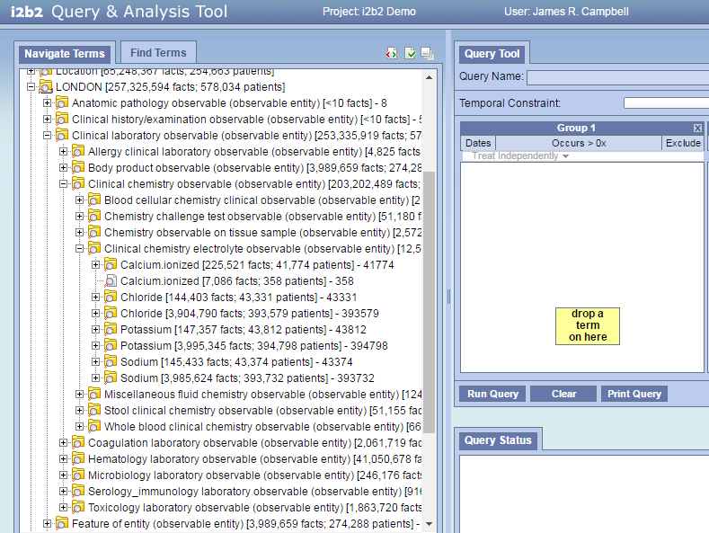
Demonstration

Slide 10
Proposal for Clinical Decision Support Ontology
Develop SNOMED CT compliant FSN and PT for all modelled content
Grouper/methodless concepts to be developed to serve validated use cases
Groupers for all quality measures and validated decision support questions where results span many methods
Publications of value set groupers on NLM Valuesett Authority

Slide 11
Proposal for LOINC Ontology
LOINC terms to deploy FSN in place of long clinical name
Validated set of 2-3000 common labs (and physical findings and clinical scales) with support for validated valueset groupers as previous
OWL publication published twice yearly as well as RF2 release set for SNOMED community

Slide 12
Proposal
All development and grouper definitions go into tech preview and are exempted from restrictions on publication
All pathology development goes into Tech preview when assigned LOINC code
As RI validats acceptance and use of ontology for LOINC community….
Regenstrief and IHTSDO work out the details of how to publish ontology content for SNOMED community and use within their systems

Slide 13
Technology Preview Assessment
1599 discrete lab tests (LOINC coded) deployed in data warehouse with occurrence > 100
669 LOINC terms from technology preview match this set(947 MISSING)

