Slide 1
Observables Implementation Issues
Observables and Investigation Model Project Group Face to Face Meeting
London, April 2017
Suzanne Santamaria and Farzaneh Ashrafi

Slide 2
Topics
Precondition attribute and values
Upper level Observable entity hierarchy clean up

Slide 3
Precondition attribute and values
Current range:
Precondition attribute definition:
  “The precondition attribute specifies the context of the feature that is observed, or some state co-occurring with the observation, and thus has effect on the result of observation.” (I/E doc)
    So perhaps it does not imply before (“pre-”)? Does this attribute need to be renamed then?
  “This attribute is used to specify body state, timing, challenges, and other situations that must be true of the entity to be observed.” (Int. Rel.)
LOINC Components containing CHALLENGES
  Interpret “challenge” (or loading or tolerance) tests; physiologic challenges (e.g., calorie fasts, exercise and fluid restrictions); pre and post immunization
  Mapped with Component + Precondition attributes in SNOMED CT
|PRECONDITION| | << 404684003 |Clinical finding| << 703763000 |Precondition value| << 71388002 |Procedure|
Notes:
Range from general to specific

Slide 4
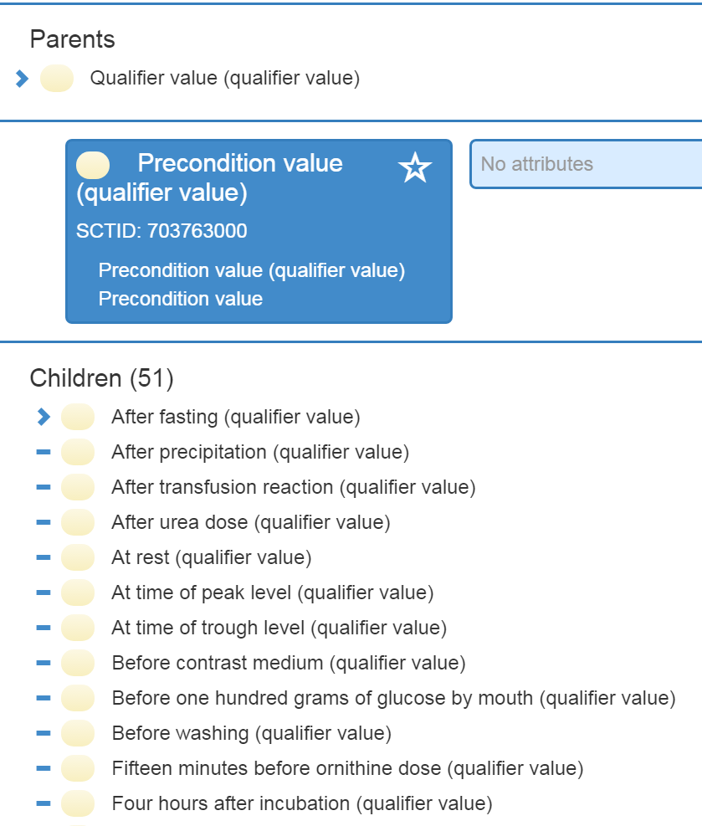
Precondition attribute and values
Precondition value subhierarchy initiated in 2014

Slide 5
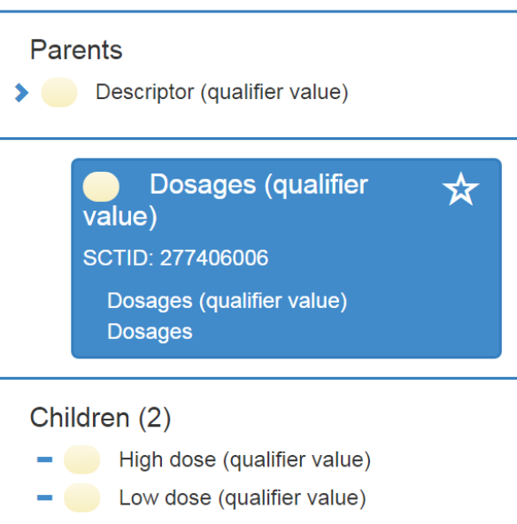
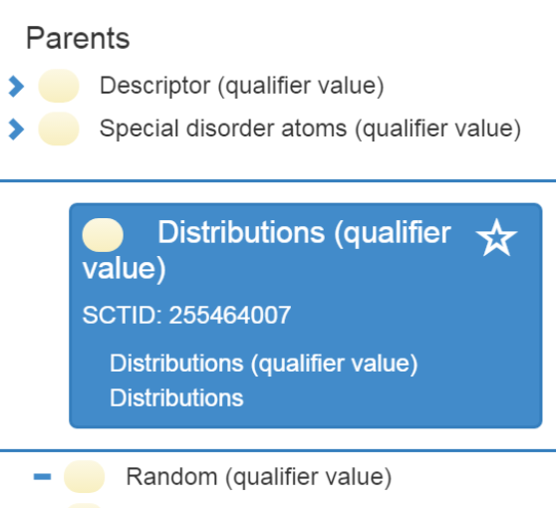
Precondition attribute and values
Consider expanding the range for Precondition attribute:
  TBD: upcoming discussions in this slide deck (life stage)
  To cover all qualifier values
    Existing SNOMED CT content not in Precondition subhierarchy
    E.g., LP Components with a CHALLENGE would include maps to
      LP30871-5 ‘High dose’ to High dose (qualifier value)
      LP30872-3 ‘Low dose’ to Low dose (qualifier value)
      LP20405-4 ‘Random’ to Random (qualifier value)
        LOINC Terms with “Random” are discouraged
Notes:
Discourage use.
Reason for status: The serum antibiotic term with "random" in the name is duplicative of the term that does not speak to the time between doses. It is better to map to the term that does not specify anything about peak/trough/random. Replace with LOINC # 35669-1: Amikacin [Mass/​volume] in Serum or Plasma
Requires MRCM update

Slide 6
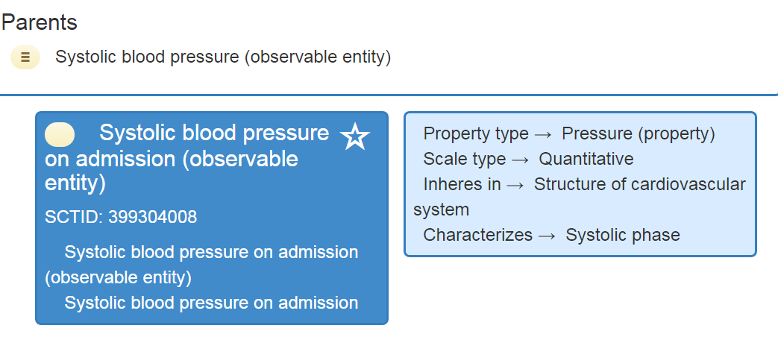
Precondition attribute and values
Generic place where observable occurred: consider as Precondition?
  E.g. Systolic blood pressure upon admission, Average home diastolic blood pressure
      “On admission” and “at home” originally considered Preconditions in initial work. Review by Head Terminologist: leave primitive for now. Are these preconditions? How to model them?

Slide 7
Upper level Observable entity hierarchy clean up: Principles
Is the concept URU?
Does it meet the current definition of an observable entity?
Can it be defined using the model? If not, why? Does the model need expanding?
Is it used to define any other concepts in SNOMED CT besides is a?
Could it be used to define any existing concepts in SNOMED CT?
What effect does it have on classification of content?
Would it be helpful to classify LOINC Terms?
Does it map to any LOINC Terms?
From EAG: Any grouper that can be fully defined MAY be retained if it provides a solution to a particular use case. This is not always the case although one can usually come up with a theoretical use case for a grouper.

Slide 8
Upper level Observable entity hierarchy clean up: Existing groupers types
X generic body entity/normal observable, examples:
  Body product observable
  Substance observable
  X body fluid observable
  X body part observable, e.g. Hair observable
  X body system observable, e.g. Respiratory observable
X process observable, e.g. Respiration observable
Feature of X, e.g., Feature of X body product, Feature of sperm
Study observable, e.g. Hematology observable
Sample observable, e.g., Semen sample age
X pathologic entity observable, e.g. Tumor observable
X procedure observable, e.g. Dialysis detail observable
X very broad descriptor observable, e.g. General characteristic of patient (observable entity)
Life stage observable, e.g., Neonatal observable
……

Slide 9
Upper level Observable entity hierarchy clean up: Grouper types going forward
It will be very hard to define observables "somehow related to X“
  Do we need to group? e.g. any measurements during cardiopulmonary bypass and observables characterizing cardiopulmonary bypass?
Justification for groupers in the past was that Observables was a primitive hierarchy
  We can be more judicious in the use of groupers now that we are defining them
Guidelines for grouper concepts in Observables hierarchy? …..

Slide 10
Upper level Observable entity hierarchy clean up: Detail observables
For July 2017 release:
  Renamed 5 “X detail observables (observable entity)” concepts to “X observable” for clarity
    “Detail” not meaningful and cannot be defined. Concepts had no relationships to concepts in other hierarchies.
    E.g., 364669000 | Cardiopulmonary bypass detail (observable entity) - changed FSN to Cardiopulmonary bypass observable (observable entity)
    58 detail observables, but only 6 in scope
  Retired 1 “X detail observable” as ambiguous:
    Ventilation detail observable (observable entity) – if renamed as above becomes indistinguishable from Respiration observable (observable entity)
  Retired 1 ambiguous grouper: Perfusion / dialysis observable (observable entity). Does not define any other concepts.
    Retired Perfusion and dialysis finding (finding) as ambiguous.

Slide 11
Upper level Observable entity hierarchy clean up: Former detail observables
How to model/define the updated concepts that are observables referencing a procedure? (Cardiopulmonary bypass observable, Peritoneal dialysis observable, Hemodialysis observable, Dialysis observable, Extracorporeal gas exchange observable)?
  Model this as Precondition = descendant of Procedure (procedure), e.g., Cardiopulmonary bypass operation (procedure)?
  Model this as Characterizes = descendant of Procedure (procedure), e.g., Cardiopulmonary bypass operation (procedure)?

Slide 12
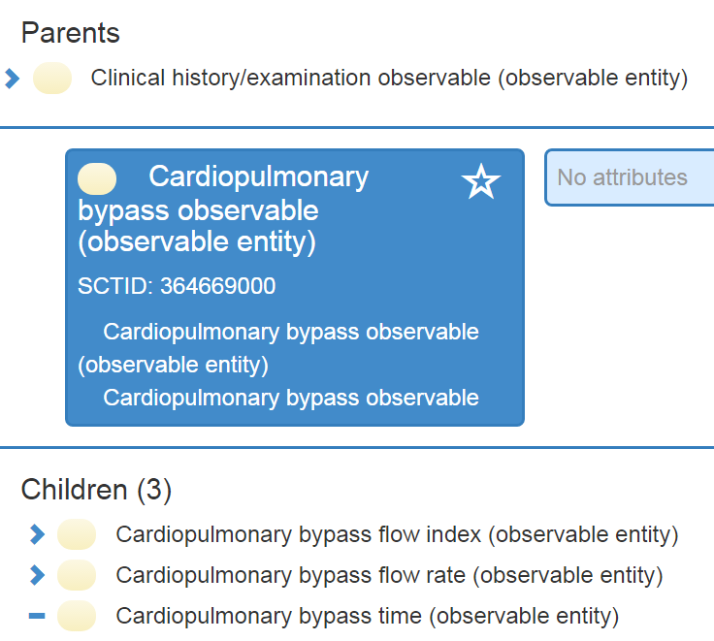
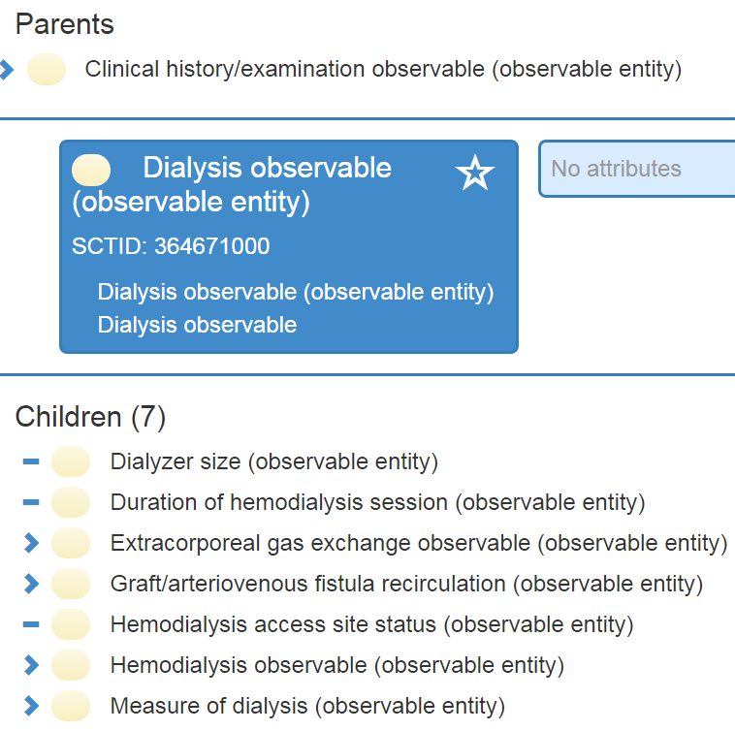
Upper level Observable entity hierarchy clean up: Former detail observables

Slide 13
Upper level Observable entity hierarchy clean up: Former detail observables
How to model/define the updated concepts
  Model this as Precondition = Cardiopulmonary bypass operation (procedure)?
    Procedures are allowed as value for Precondition attribute
    Procedure not necessarily performed or finished yet
    Precondition definition: “The precondition attribute specifies the context of the feature that is observed, or some state co-occurring with the observation, and thus has effect on the result of observation.”
      So perhaps it does not imply before (“pre-”)? Does this attribute need to be renamed then?
      Since parents define the children, all subtypes of Cardiopulmonary bypass observable (observable entity) must relate to observations following a cardiopulmonary bypass if we go down the precondition route as the context of procedure is "done"

Slide 14
Upper level Observable entity hierarchy clean up: Former detail observables
How to model/define the updated concepts?
  Model this as Characterizes = Cardiopulmonary bypass operation (procedure)?
    Characterizes definition: “This attribute specifies the process which the property describes, and on which the property (of this observable) depends. The process can be very general.”
    Procedures not allowed as value for Characterizes attribute
      MRCM would need to be updated for Characterizes to extend the range to include Procedures.
      Currently only includes descendants of Process (qualifier value) are allowable values. Procedures can be considered a kind of process ontologically.
Notes:
DKA: “For these specific descendants (flow, time) I think precondition is unnecessary, and for the flow observables, the procedure is not (fully) done.
However, the reason this works is that the descendants are only process observables. If it would have been a mixed bag we would have a problem.”

Slide 15
Upper level Observable entity hierarchy clean up: Feature and measure observables
What is difference between generic observable, “measure” observable, and “feature” observables e.g., Respiratory observable vs Respiratory measure observable.
  166 measure observables
  233 feature observables
  Keep or retire measure and feature observables?
    How to define “measure” observables
      Scale = quantitative?
        What about Ordqn; Ordinal?
    How to define “feature” observables?
      Does it duplicate generic observables?
      Is it any Scale that is not quantitative?

