Slide 1
LOINC – SNOMED CT
Cooperation on Content
SNOMED International
Business Meetings - OIMP
London, England, April 24-26, 2017
Farzaneh Ashrafi and Suzanne Santamaria

Slide 2
Update on the project
Beta release published on March 31, 2017
  6629 LOINC parts linked to SNOMED CT precordinated concepts
  21971 LOINC terms linked to SNOMED CT post coordinated expressions
Production release
  Content: Beta release + applicable fixes resulted from the review
  Timing: A SNOMED CT international July 2017 release derivative → Will be published after SNOMED CT July 2017 release and before end of September 2017
Notes:
More LOINC parts in the top 2000 have been mapped since creation of beta release.

Slide 3
Discussion Items

Slide 4
LOINC Part: Challenge
Numbered specimens
  LP20166-2 1st specimen
  LP20165-4 2nd specimen
  LP20465-8 3rd specimen
LOINC Manual: 2.2.2 - Challenge test (2nd subpart)
  In addition to specifying a time elapsed since challenge, the time delay slot can be used to name a clock time when the measurement was taken, e.g., Glucose^10 AM specimen, or to specify the ordering of specimens, e.g., ^1st specimen, ^2nd specimen. Use this syntax to indicate pre- and post-immunization specimens, acute and convalescent specimens, or a series of specimens for which no more detailed information is available.
SNOMED Precondition attribute
  This attribute is used to specify body state, timing, challenges, and other situations that must be true of the entity to be observed.
Notes:
Add them as precondition. All defined.

Slide 5
LOINC Part: Challenge
Top 2000 (SI and US) – ordering of specimens
42909-2 | Hemoglobin.gastrointestinal [Presence] in Gastric fluid --1st specimen
42910-0 | Hemoglobin.gastrointestinal [Presence] in Gastric fluid --2nd specimen
42911-8 | Hemoglobin.gastrointestinal [Presence] in Gastric fluid --3rd specimen
14563-1 | Hemoglobin.gastrointestinal [Presence] in Stool --1st specimen
14564-9 | Hemoglobin.gastrointestinal [Presence] in Stool --2nd specimen
14565-6 | Hemoglobin.gastrointestinal [Presence] in Stool --3rd specimen
12503-9 | Hemoglobin.gastrointestinal [Presence] in Stool --4th specimen
12504-7 | Hemoglobin.gastrointestinal [Presence] in Stool --5th specimen
27401-9 | Hemoglobin.gastrointestinal [Presence] in Stool --6th specimen
27925-7 | Hemoglobin.gastrointestinal [Presence] in Stool --7th specimen
27926-5 | Hemoglobin.gastrointestinal [Presence] in Stool --8th specimen

Slide 6
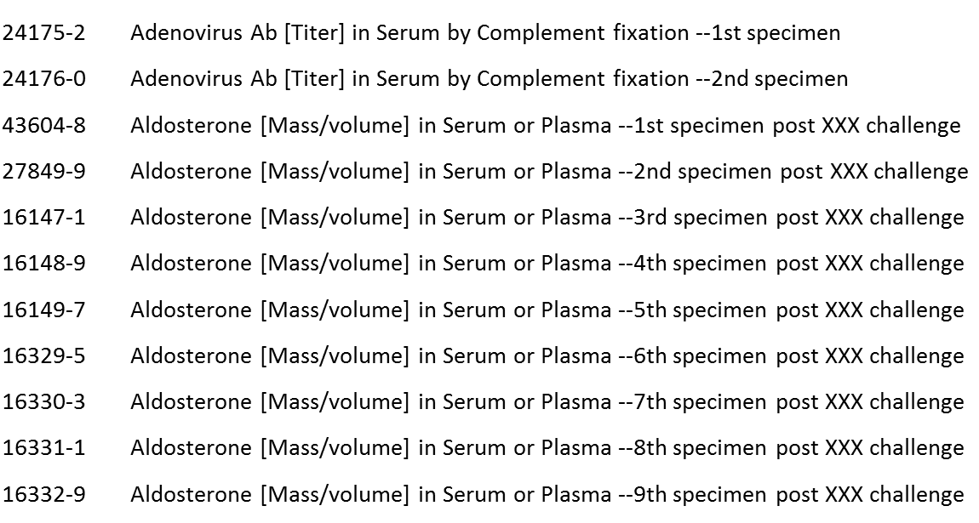
LOINC Part: Challenge
Pre- and post-immunization specimens, acute and convalescent specimens and challenge tests

Slide 7
LOINC Part: Method
LP6486-7 – Reported → Technique?
2.7.9.1 - Estimated versus measured values
  For some kinds of clinical measures we distinguish the Method Reported from Estimated and Measured. For example, reported body weight is the stated weight from a patient or surrogate. Estimated body weight is estimated by an observer, and measured would be the body weight as measured on a scale.
SNOMED CT Editorial Guideline
  This attribute is used to specify the systematic method of a procedure used to accomplish a specific activity.
  No procedure concept in SNOMED CT that uses “reported”
LOINC_NUM | LONG_COMMON_NAME | COMPONENT | PROPERTY | TIME | SYSTEM | SCALE | METHOD_TYP
21612-7 | Age - Reported | Age | Time | Pt | ^Patient | Qn | Reported
49541-6 | Fasting status - Reported | Fasting status | PrThr | Pt | ^Patient | Ord | Reported
Notes:
Create the technique

Slide 8
LOINC Component → Property?
LP18013-0 Size → Entitic volume (property) (qualifier value) | SCTID: 118537009?
LP14742-8 Clarity → Clarity of Specimen?
LOINC_NUM | LONG_COMMON_NAME | COMPONENT | PROPERTY | TIME | SYSTEM | SCALE
9802-0 | Size [Entitic volume] of Stone | Size | EntVol | Pt | Calculus | Qn
LOINC_NUM | LONG_COMMON_NAME | COMPONENT | PROPERTY | TIME | SYSTEM | SCALE
50552-9 | Clarity in Urine by Refractometry automated | Clarity | Type | Pt | Urine | Nom
49736-2 | Clarity of Cerebral spinal fluid | Clarity | Type | Pt | CSF | Nom
61193-9 | Clarity of Pleural fluid from Fetus | Clarity | Type | Pt | Plr fld^fetus | Nom
10568-4 | Clarity of Semen | Clarity | Type | Pt | Semen | Nom
33515-8 | Clarity of Unspecified specimen | Clarity | Type | Pt | XXX | Nom
32167-9 | Clarity of Urine | Clarity | Type | Pt | Urine | Nom
Notes:
Yes to both

Slide 9
LOINC Component → Property?
LP18008-0 Composition
LP19465-1 Turbidity → Turbidity of fluid?
  250433008 | Turbidity of fluid (observable entity)
LOINC_NUM | LONG_COMMON_NAME | COMPONENT | PROPERTY | TIME | SYSTEM | SCALE
9795-6 | Composition in Stone | Composition | Type | Pt | Calculus | Nom
LOINC_NUM | LONG_COMMON_NAME | COMPONENT | PROPERTY | TIME | SYSTEM | SCALE
33326-0 | Turbidity [Presence] of Amniotic fluid Qualitative | Turbidity | PrThr | Pt | Amnio fld | Ord
20513-8 | Turbidity [Presence] of Body fluid Qualitative | Turbidity | PrThr | Pt | Body fld | Ord
20512-0 | Turbidity [Presence] of Cerebral spinal fluid Qualitative | Turbidity | PrThr | Pt | CSF | Ord
40681-9 | Turbidity [Presence] of Serum or Plasma Qualitative | Turbidity | PrThr | Pt | Ser/Plas | Ord
48053-3 | Turbidity [Presence] of Synovial fluid Qualitative | Turbidity | PrThr | Pt | Synv fld | Ord
20627-6 | Turbidity [Presence] of Urine Qualitative | Turbidity | PrThr | Pt | Urine | Ord
Notes:
Composition: the nature of something's ingredients or constituents; the way in which a whole or mixture is made up.
Turbidity is the cloudiness or haziness of a fluid caused by large numbers of individual particles that are generally invisible to the naked eye, similar to smoke in air
Add with definition

Slide 10
LOINC Component → Property?
LP14750-1 Liquefaction → Liquefaction time?
LP17864-7 Character → Appearance?
LP101395-4 Sex → Biological sex?
LOINC_NUM | LONG_COMMON_NAME | COMPONENT | PROPERTY | TIME | SYSTEM | SCALE
10580-9 | Liquefaction [Time] in Semen | Liquefaction | Time | Pt | Semen | Qn
LOINC_NUM | LONG_COMMON_NAME | COMPONENT | PROPERTY | TIME | SYSTEM | SCALE
9374-0 | Character of Cerebral spinal fluid | Character | Aper | Pt | CSF | Nom
13359-5 | Character of Semen | Character | Aper | Pt | Semen | Nom
14271-1 | Character of Synovial fluid | Character | Aper | Pt | Synv fld | Nom
19244-3 | Character of Urine | Character | Aper | Pt | Urine | Nom
LOINC_NUM | LONG_COMMON_NAME | COMPONENT | PROPERTY | TIME | SYSTEM | SCALE
60478-5 | Sex of tick | Sex | Type | Pt | ^Tick | Nom
Notes:
“Semen is a thick gel at the time of ejaculation. It normally becomes liquid within 20 minutes after ejaculation. Liquefaction time is the time it takes for the semen to turn to liquid.” – WebMD

Slide 11
LOINC Component → Property?
LP28815-6 Age
LP19507-0 Gestational age
LOINC_NUM | LONG_COMMON_NAME | COMPONENT | PROPERTY | TIME | SYSTEM | SCALE
30525-0 | Age | Age | Time | Pt | ^Patient | Qn
LOINC_NUM | LONG_COMMON_NAME | COMPONENT | PROPERTY | TIME | SYSTEM | SCALE | METHOD
33901-0 | Gestational age of fetus by Amniocentesis | Gestational age | Time | Pt | ^Fetus | Qn | Amniocentesis
Notes:
Age (qualifier value) | SCTID: 397669002
To be further discussed in an upcoming OIMP call

Slide 12
LOINC Property → Property?
LP6775-3 Addr → Address
LP6844-7 Pn --> Person Name
LOINC_NUM | LONG_COMMON_NAME | COMPONENT | PROPERTY | TIME | SYSTEM | SCALE
62331-4 | Birth hospital facility address | Birth hospital facility address | Addr | Pt | Facility | Nom
68989-3 | Performing laboratory [Address] | Performing laboratory | Addr | Pt | Facility | Nom
62327-2 | Post-discharge provider practice address | Post-discharge provider practice address | Addr | Pt | Provider | Nom
LOINC_NUM | LONG_COMMON_NAME | COMPONENT | PROPERTY | TIME | SYSTEM | SCALE
79183-0 | First name of Guardian or legally authorized representative | First name | Pn | Pt | ^Guardian or legally authorized representative | Nom
72486-4 | Laboratory director name in Provider | Laboratory director name | Pn | Pt | Provider | Nom
79184-8 | Last name of Guardian or legally authorized representative | Last name | Pn | Pt | ^Guardian or legally authorized representative | Nom
62324-9 | Post-discharge provider name in Provider | Post-discharge provider name | Pn | Pt | Provider | Nom
Notes:
Create generic properties: Address and Person Name

Slide 13
LOINC Property → Property?
LP6871-0 Tele --> Telephone number
LP6788-6 Bib --> Bibliographic citation
LOINC_NUM | LONG_COMMON_NAME | COMPONENT | PROPERTY | TIME | SYSTEM | SCALE
62332-2 | Birth hospital facility phone number in Facility | Birth hospital facility phone number | Tele | Pt | Facility | Nom
75549-6 | Performing laboratory phone [Telephone number] in Facility | Performing laboratory phone | Tele | Pt | Facility | Nom
62328-0 | Post-discharge provider practice telephone number | Post-discharge provider practice telephone number | Tele | Pt | Provider | Nom
LOINC_NUM | LONG_COMMON_NAME | COMPONENT | PROPERTY | TIME | SYSTEM | SCALE
75608-0 | Citation [Bibliographic Citation] in Reference lab test Narrative | Citation | Bib | Pt | Reference lab test | Nar
Notes:
Create generic properties: Telephone number, Reference citation? (this one to be further reviewed for proper naming)

Slide 14
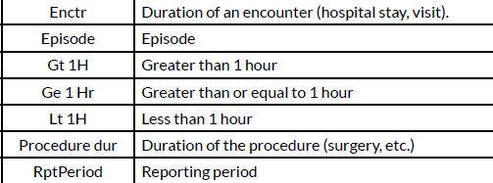
LOINC Part: Time
LP6967-6 Stdy → Duration of the study
2.4 -Time Aspect (point or moment in time vs. time interval) (3rd part):
    We also allow indirect specifications of a time window. Stdy identifies the duration of the study (without specifying an exact time); Enctr identifies the Encounter (ER visit, hospital stay, etc.).
Notes:
Follow up with Daniel via email

Slide 15
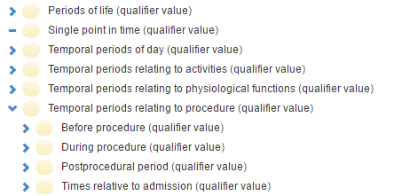
LOINC Part: Time
This attribute specifies temporal relationships for a measurement procedure.
  389001 |Time frame|
    Indefinite time (qualifier value) | SCTID: 89557005
    Indefinite period
  272117007 | Time periods (qualifier value) | -- Should be added range of acceptable values?

