Slide 1
Daniel Karlsson
Yongsheng Gao

Slide 2
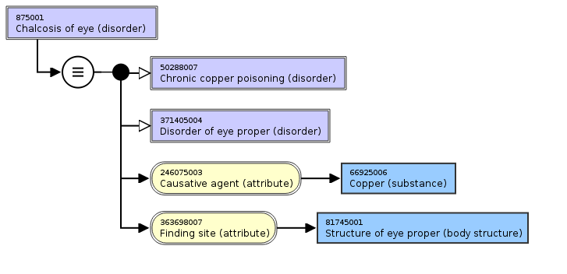
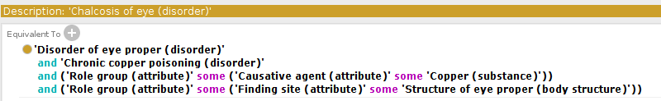
Relationship group zero (RG0)
A.k.a. ungrouped
A technique to group relationships
When an relationship is not explicitly grouped (RG0) the logic meaning is that each relationships is given an unique relationship group, “self grouping”

Slide 3
Editorial guide on relationship grouping
5.3 Relationship groups in SNOMED CT (aka Role groups)
Multiple attributes and their values can be grouped together into "Relationshipgroups" to add clarity to concept definitions.
Relationship groups refine inheritance; a grouped set of attributes is more specific than the same attributes that are not grouped.
Relationship groups are not limited to | Clinical finding | and | Procedure | concepts.
A Relationshipgroup combines an attribute-valuepair with one or more other attribute-valuepairs. Relationship groups originated to add clarity to | Clinical finding | concepts which require multiple | ASSOCIATED MORPHOLOGY | attributes and multiple | FINDING SITE | attributes and to | Procedure | which require multiple | METHOD | attributes and multiple | PROCEDURE SITE | attributes.
In the clinical findings hierarchy:
1. FINDING SITE and MORPHOLOGY are always grouped where both present - and can be further grouped with OCCURRENCE where specified.
2. If more than one CAUSATIVE AGENT is present these are grouped with FINDING SITE and/or MORPHOLOGY - and can be further grouped with OCCURRENCE where specified.
3. If an Organism then it also has to have a pathological process within that role group - can be infectious or parasitic.
3. DUE_TO and AFTER are exclusively role group 0.
4. Clinical course is not role grouped

Slide 4
RG0 inconsistency
Indicator | 404684003 | Clinical finding (finding) | | 71388002 | Procedure (procedure) | | 123038009 | Specimen (specimen) |
Percentage of concepts with attribute relationships which have relationship group 0 in distribution (inferred) form (i.e. the rest do not) | 63 % | 40 % | 30 %
Percentage of concepts with attribute relationships which have relationship group 0 in stated form (i.e. the rest do not) | 47 % | 28 % | 28 %

Slide 5
Scope/size of problem
31 673 concepts with single relationship in RG0
Two or more relationships in RG0
1 690 active concepts
  Not counting IsA, “Never grouped”, non-defining, sub-hierarchies with known proposed/implemented models (infections, hypersensitivity, education procedures, total ~ 1 000 concepts)
  Other proposed/implemented models might exist, upper bound

Slide 6
Small test
Sample of 100 concepts with 2 or more RG0 relationships
Chi2 = 78.189, p ≈ 0
 | reviewer 1 | reviewer 2
join | 93 | 29
self group | 5 | 56

Slide 7
Proposal - 1
Always explicit relationship grouping (RG1+) - no more implicit grouping
Always grouping of Clinical finding, Procedure, Specimen, Situation, Pharmaceutical/Biological products (new model) etc. hierarchy relationships
  A one-time transform to move RG0 relationships to RG1+ for these hierarchies
  Particularly, a single relationship in RG0 is explicitly “self grouped”
Relationship group 0 means not relationship grouped: Pharmaceutical/ Biological products (old model), Observables, Anatomy, etc.
Proposal to be used with other consistency-improving measures: e.g. proximal-primitive modeling

Slide 8
Proposal - 2
Benefit
  Simplified guidance, simplified MRCM, simplified logic interpretation (OWL transformation)
  Identify and improve the consistency for role grouping
Drawback
  Manual review of the 1690 RG0 concepts(?)
  Consequences for modeling and post-coordination
  Consequences for MRCM

Slide 9
Proposal - 3
For discussion
  Should we have a Condition/Process part interpretation of relationship groups?
  How to manage specific cases: e.g. multiple finding sites (757 2+ finding sites in one group)
  Consistency with current RG1+ concepts

