Slide 1
ECE update to EAG
February 17, 2017
Bruce Goldberg, MD, PhD

Slide 2
Modelling of Complications & Sequela

Slide 3
DEFINITIONS
Complication = a disorder caused by another disorder, procedure or event.
Sequela = a disorder that follows another disorder, procedure or event and where a causal relationship is specified, it may also be considered a kind of complication.

Slide 4
Issues
Based on the definition of a complication provided on the previous slide, all combined disorders and disorders combined with procedures and events for which a causal relationship exists should considered to be kinds of complications.
Based on the definition of a complication provided on the previous slide, all combined disorders and disorders combined with procedures and events for which a temporal relationship of following exists with or without a causal relationship should considered to be kinds of sequelae. If a causal relationship is also present the sequela is also a kind of complication
An exception to the above are surgical sequela which are considered an anticipated after effect of surgery and are not considered by surgeons to be surgical complications. Likewise surgeons do not consider postoperative complications to be surgical sequelae.

Slide 5
Complications and sequelae are of three types where:
The cause is specified.
Only a temporal relationship to an associated entity is specified.
Both a cause and a temporal relationship to the cause is specified.
Type | Example |  | Relationship
 | Disorder<Disorder | Disorder<Procedure
Specified cause | 116225000 Complication of injury (disorder) | 47724003 Complication of injection (disorder) | DUE_TO
Temporal only | 403216007 Sweet's disease following infection (disorder) | *22247000 Dehiscence of surgical wound (disorder) | AFTER
Causal + temporal | 236427002 Post-traumatic acute tubular necrosis (disorder) | SCTID: 73781000 Late radiation dermatitis (disorder) | DUE_TO & AFTER

Slide 6
ASSIGNING PARENTS
Concepts modeled with DUE_TO have an additional IS_A relationship to Complication (disorder) SCTID: 116223007
Concepts modeled with AFTER have an additional IS_A relationship to Sequela (disorder) SCTID: 362977000
Concepts modeled with both DUE_TO & AFTER have an additional IS_A relationship to Complication (disorder) SCTID: 116223007 & Sequela (disorder) SCTID: 362977000
COMPLICATION
DUE_TO
DUE_TO
&
AFTER
AFTER
SEQUELA

Slide 7
Tips
The first and third types of complication are often identified by the sematic pattern, complication of… for which “of” implies “due to”. [A number of SCT concepts classified as Sequela e.g. 19357001 | Late effects of trachoma (disorder) should be re-classified as DUE_TO & AFTER]
A combined disorder or disorder combined with a procedure with a causal relationship between the two is a kind of complication.
Some concepts/FSNs may explicitly state ‘complication’ or ‘sequela’ and these should be assigned with an IS_A relationship to Complication (disorder) SCTID: 116223007 or Sequela (disorder) SCTID: 362977000 unless their modeling suggests they should be modeled with both DUE_TO and AFTER.
Concepts that are modeled only with DUE_TO (and thus a ‘complication’) are sometimes where the temporal relationship cannot be ascertained with certainty and could be during and/or after.
An anticipated after effect of surgery should not be considered to be a surgical complication and thus should be assigned sequela but not complication as a parent.
A postoperative complication should not be considered to be a surgical sequela and thus should be assigned complication but not sequela as a parent.

Slide 8
Alternate approach
Eliminate the use of complication and sequela in FSNs and model all content using causal and or temporal relationships with FSNs reflecting the ECE naming conventions for combined disorders and disorders with procedures. Complication and sequela can be used as synonyms or perhaps as preferred terms as required.

Slide 9
Review of SNOMED CT models for representing allergic conditions

Slide 10
Background
From a historical perspective, allergic conditions were initially represented in SNOMED CT as three partially related hierarchies of Disorder due to allergic reaction, Allergy (modeled using has definitional manifestation = allergic reaction) and allergic reaction.
The first major revision of allergy content was accomplished in 2006 as an attempt to harmonize this area with the WAO/ EAACI nomenclature of allergic disease which specifies a broad domain of hypersensitivity while emphasizing the distinction between allergy (immune hypersensitivity) and non-immunologic hypersensitivity (pseudoallergy).
Hypersensitivity disorder was created as a parent of the 3 allergy hierarchies as well as a pseudoallergy hierarchy.
A decision was made to redefine the top-level hierarchies using pathological processes (hypersensitivity process, allergic process, pseudoallergic process) analogous to the method used to define the similar autoimmune disease.

Slide 11
Evolution of allergy models
After exploring several options, it was decided to adopt the model described by Schultz et. Al. which conflates clinical disorders as conditions with represent either pathological dispositions (propensities), pathological processes (reactions) or pathological structures[1].
Pathological structure was felt to not be applicable to allergy.
Schultz’s model also allows for the uncertainty of interpreting some clinical disorders as dispositions and processes.
The wording of existing FSNs implies the intended meaning of the allergy concepts as Illustrated below:
FSN format | Interpretation
Allergy (to X), (X) allergy | Pathological disposition
Allergic reaction (to X) | Pathological process
Allergic disease (due to X) e.g. allergic rhinitis due to pollen | Pathological disposition or process
[1]Schulz, S., Spackman, K., James, A., Cocos, C., & Boeker, M. (2011). Scalable representations of diseases in biomedical ontologies. Journal of Biomedical Semantics, 2(Suppl 2), S6. http://doi.org/10.1186/2041-1480-2-S2-S6

Slide 12
Representing the association of an allergen with an allergic disposition (allergy to x)
Simply using causative agent. This is incorrect not only from an ontological but also from a clinical standpoint. An allergy propensity to penicillin is not caused by penicillin but rather the realization of the propensity as an allergic reaction is caused by penicillin.
Creating a new role to represent the agent that causes the realization of the disposition as a process.
Associating the allergen as a causative agent within a role group with a process that is necessary for an allergic disposition to occur. This is the procedure used for the current model for allergic disposition in which the causative agent is role grouped with an after allergic sensitization (disorder) relationship. An allergy to substance X is therefore interpreted as necessarily following a sensitization (immune response to X) which is caused by X.
  Alternatively, causative agent substance and pathological process allergic process can be grouped in role group 1 and after allergic sensitization added to role group 0
Use has realization allergic reaction in a role group with causative agent substance X

Slide 13
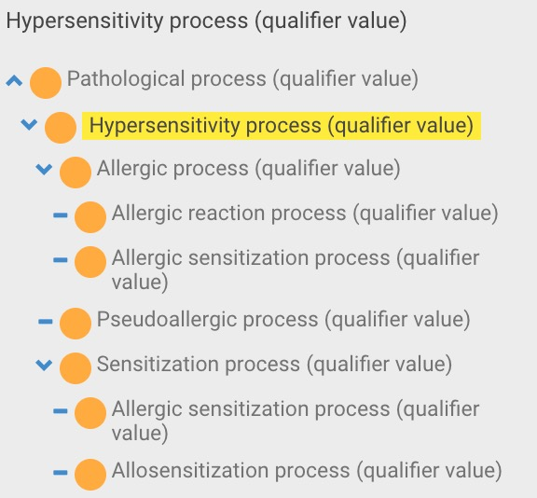
Has realization
Potential values
  Allergic reaction (disorder)
    Interpreted as a clinical life phase which includes a pathological process
  Allergic reaction to x
    Requires precoordination of many Allergic reaction to x concepts that parallel Allergy to x
  Allergic reaction process (qualifier value)

Slide 14
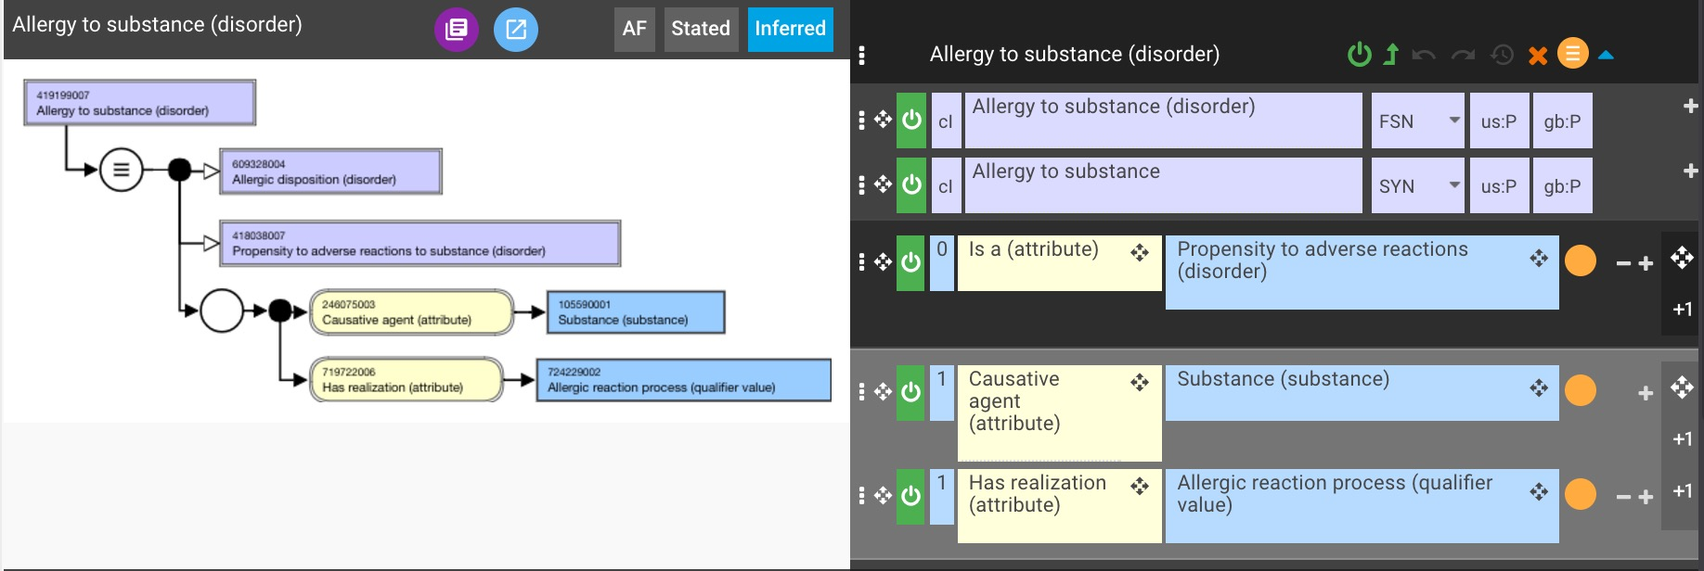
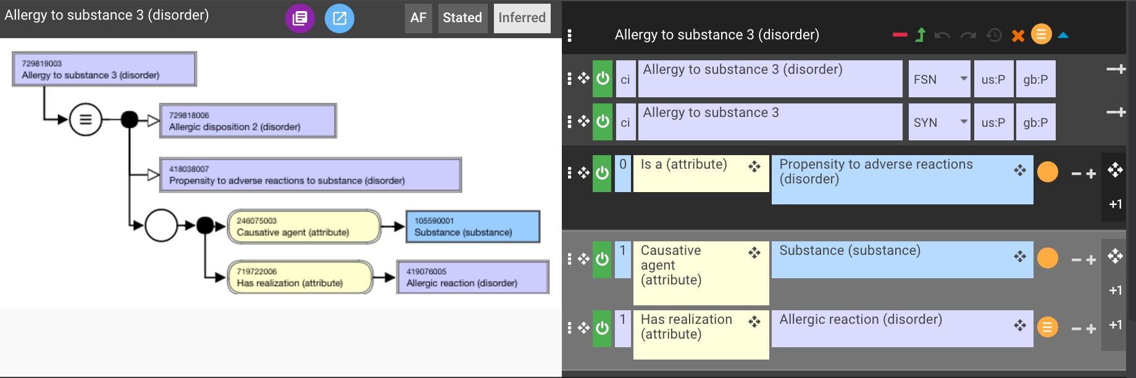
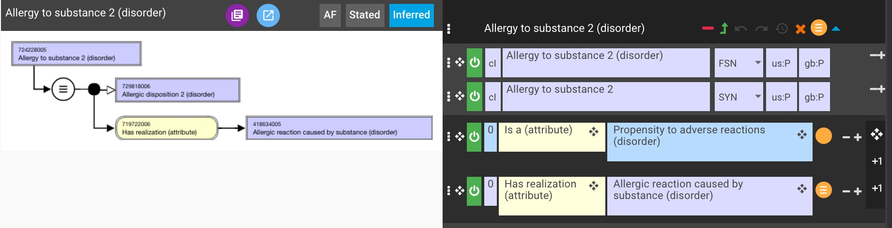
Has realization – comparison of models

Slide 15
Has realization - recommendation
Use has realization allergic reaction process (qualifier value) in a role group with causative agent substance to represent the association of an allergen with an allergic disposition
  Process is the approved range for has realization in the observables model.
  This model is applicable to any disposition associated with a material agent unlike the current model for allergic disposition which is applicable only to allergy.

Slide 16
Remaining issues with allergy model
Can the top level nodes, hypersensitivity condition, allergic condition, pseudoallergic condition which are essentially disjunctions be fully defined and if so is it appropriate to define using the pathological process role which would then be inherited by the corresponding disposition?
What about allergic disorders that are also disjunctive, representing either dispositions or processes (reactions) ?
  Recommendation is to create parallel concepts of propensity to allergic disorder (caused by X) and allergic disorder (caused by x)

