Slide 1
Target, parameter, setting, etc. observables

Slide 2
Target, etc. observables
There are JIRA tickers about targets, settings, parameters, procedure observables, e.g.
  PCP-5 - artf223120-Target range/value for <X> (observable entity)
  IHTSDO-457 - artf223119-Add concepts: Target range/value for X (observable entity)
  IHTSDO-308 - artf227339-<observable> about <finding/disorder/event/procedure> (observable entity)
  IHTSDO-39 - artf6277-Targets as observables
  PCP-85 - artf6865-<setting> on <equipment> (observable)
  IHTSDO-356 - artf7850-Observables about procedures

Slide 3
Target, etc. observables
Examples
  428420003 | Target heart rate (observable entity) |, requested | Target serum total cholesterol level (observable entity) |, etc.
  252116004 | Observation parameter (observable entity) |
  <setting> on <equipment> (observable)
  Some observables are about aspects of procedures, such as duration, start time, end time, success or lack of success
  Reason for <event, condition, result, action> (observable)

Slide 4
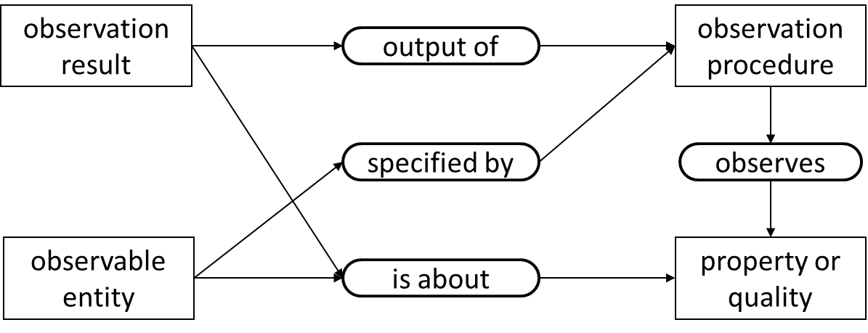
Target observables
A target
  Is about a quality (e.g. heart rate)
  Specified through clinical assessment and decision making
clinical decision
specified by
target observable entity
property or quality
is about

Slide 5
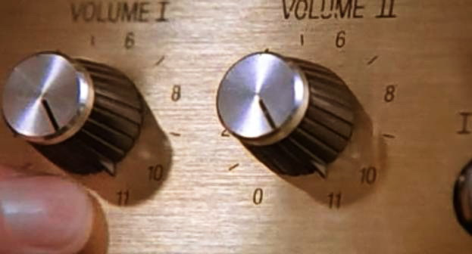
Setting observables
A setting
  Is a quality of (inheres in) some device (or device knob, slider, switch…)
  Has a value (e.g. 11)
  The setting quality (e.g. resistance) is related (often through several levels of indirection) to another quality (e.g. acoustic pressure, loudness)

