Slide 1
LOINC – SNOMED CT
Cooperation on Content
IHTSDO Business Meetings
Wellington, New Zealand
October 23-26, 2016

Slide 2
Agenda
Project Update
Discussion items
  Editorial Advisory Group
  Observable and Investigation model project
  IPaLM SIG

Slide 3
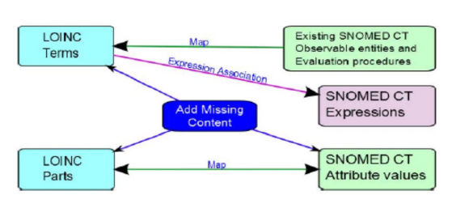
Background
Cooperative agreement between RII and IHTSDO, July 2013
  Builds on strengths of each terminology
  Minimize and manage duplication
  SNOMED CT and LOINC work better together
  Provide links between LOINC and SNOMED CT

Slide 4
Project scope
Scope
  Laboratory LOINC
  Non-Laboratory LOINC
    Vital signs
    Physiologic measurements
    Anthropomorphic measurements and evaluations
Phases
  Initial
    Top 2000 lab LOINC tests
  Subsequent
    Remainder of lab LOINC
    Vital signs and Measurements
Notes:
- Laboratory LOINC includes ~20000 LOINC parts.
- IHTSDO and RII are working together to define exactly what the non-laboratory areas (i.e. vital sign, Physiologic and Anthropomorphic measurements) cover.
- Observable modelling project for vital sign

Slide 5
Progress to date
Released draft implementation guidance
Evaluated, mapped, and created new content in SNOMED CT for top 2000 Laboratory LOINC parts (~ 4500)
Released one prototype and three alpha releases. The latest alpha release, version 3, included:
  4050 LOINC Parts in LOINC Part to SNOMED CT RefSet
  13620 LOINC Terms in LOINC Term to Expression RefSet
Evaluated the feedback received on the prototype and the alpha releases regarding release format and content. Implemented changes where applicable
Issued RFP and awarded contract to external organization to undertake the alignment of a portion of LOINC parts to equivalent SNOMED CT content

Slide 6
Next steps
  Beta release (previously know as Candidate Baseline) – Spring 2017
  Continue mapping of LOINC Parts to SNOMED CT
  Resolve known/upcoming complex content issues
  Implement SNOMED CT Observables model to define existing pre-coordinated SNOMED CT concepts:
    Pilot phase: Vital Sign, Scheduled for release in 2017
  Link the existing SNOMED CT Observables and evaluation procedures to equivalent LOINC terms

Slide 7
Alpha prototype (owl)
Roadmap
Alpha release – Phase 1-3 (Technology Preview)
Beta Release (Candidate baseline)
Map LOINC parts
to SNOMED
Map LOINC codes
to SNOMED
expressions
Develop
distribution
format
LOINC Answer sets mapped to SNOMED codes
Business Meeting
Business Meeting
Business Meeting
Business Meeting
Business Meeting
April 2014
September 2015
March, 2017
Jan 2014
October 2014
April 2016
Notes:
Question for RII: LOINC answers to SNOMED CT status

Slide 8
Contact information
General queries to IHTSDO Project Team
  info@ihtsdo.org
  Subject: LOINC – SNOMED CT Cooperation Project

Slide 9
LOINC - SNOMED CT Cooperation Project
Discussion items – EGA
, OIMP, IPaLM

Slide 10
EAG - Mapping X + Y concepts
"Examples “+”
  LP38309-8 Helminth+Arthropod identified
  LP14312-0 Monocytes+Macrophages
  LP70080-4 Alanine+Beta Alanine+Sarcosine
  LP40440-7 West Nile virus Ab.IgG+IgM
  LP57131-2 Streptococcus pneumoniae 6+26 Ab
  LP147478-4 (Gadus morhua+Mytilus edulis+Pandalus borealis+Salmo salar+Thunnus albacares) Ab.IgE
  LP97602-4 Campylobacter jejuni+Campylobacter coli Ag
  LP100196-7 Neisseria meningitidis A+B+C+w135+Y Ag
  LP39164-6 Neisseria meningitidis A+B+C+w135+Y+Escherichia coli K1 Ag
  LP145539-5 Ureaplasma urealyticum+Ureaplasma parvum DNA
  LP38526-7 HTLV 1+2 DNA
  LP65524-8 Respiratory virus DNA+RNA

Slide 11
EAG - Mapping X + Y concepts
LOINC project identified a subsumption issue involving LOINC components that contain “+” sign
  >1000 “+”s in LOINC parts related to laboratory LOINC terms in scope of agreement: Substances, Organism, Cells
    Number of such components may increase when the list of LOINC parts for other cooperative areas is received
  Confirmed with RII that “+” and means “inclusive or” i.e. disjunction
  Disjunction (“or”) is not within the SNOMED CT DL profile (EL+)
Proposed solutions by OIMP:
  Use disjunction in OWL
  Use disjunction for a subset of “disjunctive component” concepts
  Manually maintain observables
  Accept that there will be false subsumption

Slide 12
EAG Discussion – to date
Issue brief posted on the EAG Discussion forum and was further discussed in 2016-08-22 Editorial Advisory Group Conference Call and the following options were proposed:
  Combined components, being added as primitive combined concepts
  Create an extension that can be used in conjunction with the core.
  Make the observables post coordinated expressions primitive, no component is mapped.
Suggested that option 3 might be used in the immediate short term to address the need to get the Beta release (PKA candidate baseline) out

Slide 13
EAG Discussion – face to face meeting
Gain consensus on final proposal in EAG face to face meeting
  Option 3 for now: primitive expressions with no component mapped
  Retire existing substance concepts
  Forward the issue to Modelling advisory group for resolution (most probably concepts will not be added to the core. possible solution: GCI, RefSet, ..)
Organism X + Y should be reviewed again. Send a separate issue to EAG for that.

Slide 14
OIMP - Multidisk allergen assays
Mapping - Multidisk allergen assays
  “The component for the multidisk allergen assays (e.g. (Gadus morhua+Mytilus edulis+Pandalus borealis+Salmo salar+Thunnus albacares) Ab.IgE:Threshold:Pt:Ser:Ord:Multidisk) is problematic. The antibody is not a single substance directed against all of the allergen but one or more antibodies directed against one or more allergens.“
  Issues: “+” sign and the fact that antibody is not a single substance
The discussion on this is dependent on the resolution for components with “+”

Slide 15
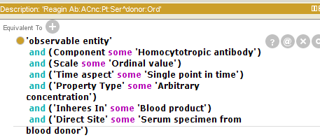
LOINC Terms containing ^donor
Mapping - Ser^donor inheres in –
  Feedback from RII: “Why is the Inheres in value “Blood product” and not “Plasma” like the non-donor Ser terms? The Direct site is “Serum specimen from blood donor”, so the donor information is still preserved”
    Example: Reagin Ab:ACnc:Pt:Ser^donor:Ord
Notes:
Direct site: Plasma
Inheres In: Blood product
Inherent location: for super-system
Or
Direct site: Serum
Inherent location: Donor
The second is a direct translation of what LOINC parts is saying, but serum from blood product?
Clarification with RII regarding the exact meaning

Slide 16
Observables defined by observables
Properties?
  Temperature → It is specified as property in LOINC). Create the concept under Property of measurement (qualifier value) SCTID: 118598001: Yes
  Osmolality → See above. Create property? Yes
  Viscosity → See above. Create property? Yes
  RBC volume → See above. Use property: Volume (property) (qualifier value)-- it is already specified in the LOINC term, therefore the use of volume in the component seems to be redundant + Component = RBC..
  RBC, WBC, and Platelet morphology findings. see above. morphology as property in SNOMED CT. Model as following:
    Property = Morphology
    Inheres In = cell type (e.g. RBC)
    inherent location = Blood (where the system is specified as blood)
Notes:
Confirm with OIMP. Color and Appearance were previously defined as property based on previous Face to Face meeting discussions. Also, there is precedent to this related to cancer synoptic reporting and creation of morphology property.
Create all properties (or map as specified above)

Slide 17
Observables defined by observables
Spermatozoa.motile:
  “To measure motility, a simple system for grading is recommended that distinguishes spermatozoa with progressive or non-progressive motility from those that are immotile. The motility of each spermatozoon is graded as follows: Progressive motility (PR): spermatozoa moving actively, either linearly or in a large circle, regardless of speed. Non-progressive motility (NP): all other patterns of motility with an absence of progression, e.g. swimming in small circles, the flagellar force hardly displacing the head, or when only a flagellar beat can be observed. [WHO laboratory manual for the Examination and processing of human semen FIFTH EDITION]”
Motility is a characteristic of some cell types?
  Create motile sperm (cell) and non-motile sperm (cell) as children of Spermatozoa (cell) SCTID: 6789008? Yes
Notes:
Create the concepts as specified above.

Slide 18
Observables defined by observables
RBC sedimentation rates
  LOINC: “The erythrocyte sedimentation rate (ESR), also called a sedimentation rate or Biernacki Reaction, is a non-specific measure of inflammation. It is commonly used as a screening test.”
Is it a process observable? No as it is not a physiological measurement. It is a quality observable and should be modelled as following:
    Property type = Volume rate? No, It is Velocity (see unit of measure)
    Characterizes = Sedimentation?
    Process output = ?
    Process agent = ?
    Component = RBC
    Techniques: Specify sedimentation in the technique. Where applicable create techniques containing sedimatation + Westergren, Wintrobe, Zetafuge.
    Mark these concepts as primitive
Notes:
http://www.medicine.mcgill.ca/physio/vlab/bloodlab/ESR.htm: “The ESR is a simple non-specific screening test that indirectly measures the presence of inflammation in the body. It reflects the tendency of red blood cells to settle more rapidly in the face of some disease states, usually because of increases in plasma fibrinogen, immunoglobulins, and other acute-phase reaction proteins. Changes in red cell shape or numbers may also affect the ESR”
Blood factors affecting sedimentation: plasma proteins 2. rbc shape 3. rbc size 4. rbc count
https://books.google.co.nz/books?id=qMgAbOHSlsMC&pg=PA216&dq=sedimentation+rate&hl=en&sa=X&ved=0ahUKEwjhyIKC_e7PAhUBK5QKHapyAPQQ6AEIJDAC#v=onepage&q=sedimentation%20rate&f=false

Slide 19
Observables defined by observables
Anion gap: currently there are 3 components in LOINC:
  Anion Gap: No definition in Relma
    Clarification with RII?
  Anion Gap 3: “is the difference between the serum sodium and the sum of the serum bicarbonate and chloride. An increased gap indicates the presence of an unmeasured anion. [(NA+)- [(Cl-)+(CO2-)]”
  Anion Gap 4: “is the difference between the sum of serum sodium + serum potasium and the sum of the serum bicarbonate+ chloride. Calculated based on the concentration of four electrolytes as follows: ([Na+] + [K+]) − ([Cl−] + [HCO3−]). An increased gap indicates the presence of an unmeasured anion”.
How to represent a calculation?
  Model as quality Observable as following:
    Component = electrolyte
    Technique = create new techniques for the calculation of anion gap, anion gap 3,anion gap 4 as the children of Calculation technique (qualifier value)
      [(NA+)- [(Cl-)+(CO2-)]
      ([Na+] + [K+]) − ([Cl−] + [HCO3−])
Notes:
http://www.acid-base.com/clinical.php#Gap:
The Anion Gap is the difference between the sum of the major anions and the major cations: Gap = Na⁺ + K⁺ - Cl⁻ - HCO₃⁻
Some causes of metabolic acidosis, e.g., lactic acidosis, release anions into the extracellular fluid which are not normally measured. When this occurs there will be an unexpected discrepancy between the sums of the principal cations and anions.
The usual sum is:
Gap = Na⁺ + K⁺ - Cl⁻ - HCO₃⁻
15 = 140 + 5 - 105 - 25 mMol/L
In addition to Cl⁻ + HCO₃⁻ there are extra unmeasured anions, e.g., lactate, phosphate, sulphate, which increase the "gap". A gap greater than 30 indicates a significant concentration of unmeasured anions. Because this calculation relies upon the accuracy of the other measurements, small errors in these large numbers cause a disproportionately great error in the "gap". If information is required about the unmeasured anions, it is probably more appropriate to measure their concentration, i.e., lactate in tissue hypoxia, 3-hydroxybutyrate in diabetic ketosis, and phosphate or sulfate in renal failure.

Slide 20
Observables defined by observables
Base Excess and Base Deficit
  LOINC: “In human physiology, base deficit refers to a decrease in the total serum concentration of bicarbonate…”
  LOINC: “Base excess refers to the amount of a strong acid required to bring back the blood pH to the normal value of 7.4. The term and concept were first introduced by Astrup and Siggaard-Andersen in 1958 as a way to measure the metabolic component of an acid-base disturbance.”
Calculation of the base excess or deficit is a way of quantifying HCO₃⁻
Quality Observable?
  Component = HCO3? Yes
  Technique = Base delta (excess or deficit) calculation? Yes
Notes:
“It can be indicative of metabolic acidosis (acidosis describes the abnormal conditions that results from an excess of acid within the blood such as in a case of lactic acidosis due to anaerobic metabolism) or compensatory respiratory alkalosis (alkalosis describes a conditions that results from an excess alkali (base) within the blood). A base deficit indicates an excess of acid. It refers to the amount of base needed to titrate a serum pH back to normal (healthy human-arterial blood pH varies between 7.35 and 7.45) when the contribution of respiratory factors is taken out of the equation.
Base deficit is usually reported as a negative base excess. Therefore a base excess of -5 is a base deficit of 5.”
http://www.acid-base.com/terminology.php#BE2: “… Astrup and Siggard-Andersen in 1958 introduced Base Excess as a better method of measuring the metabolic component. In essence the method calculated the quantity of Acid or Alkali required to return the plasma in-vitro to a normal pH under standard conditions - Dose to return plasma to normal (mEq/L)”
http://www.globalrph.com/abg_analysis.htm
The base excess indicates the amount of excess or insufficient level of bicarbonate in the system
https://media.lanecc.edu/users/driscolln/RT127/Softchalk/Acid_Base_Lesson/Acid_Base_Lesson10.html:
Calculation of the base excess or deficit is a way of quantifying HCO₃⁻.

Slide 21
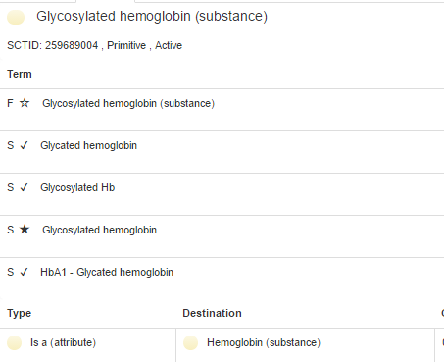
IPaLM – Glycosylated hemoglobin
259689004 | Glycosylated hemoglobin (substance) has a synonym of "Glycated hemoglobin". This concept also has a synonym of “HbA1 - Glycated hemoglobin”.
Notes:
Possibly to EAG too?

Slide 22
IPaLM – Glycosylated hemoglobin
Although these terms seem to be used interchangeably, they refer to different substances :
  Glycosylation is an enzyme catalyzed process of adding sugar/saccharides and is part of the post-translational modifications of proteins. The modified protein becomes functional.
  Glycation is a non-enzymatic process of adding sugar/saccharides, and is a form of protein damage as glycated proteins have reduced functionality.
  HbA1c is the glycated hemoglobin, through a non-enzymatic reaction occurs between glucose and the n-terminal of hemoglobin beta chain.

Slide 23
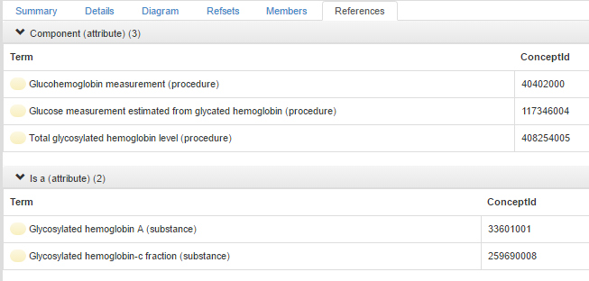
IPaLM – Glycosylated hemoglobin
The concept is being referenced in a few other concepts. There appears to be inconsistency in their usage as well as misspelling and modelling errors:
There are a few other concepts that might be affected; e.g. concepts containing HgA1c.

Slide 24
IPaLM – Glycosylated hemoglobin
IPaLM SIG discussion forum:
  What is in common usage may not match up with what is listed as chemically accurate.
  Even though old textbooks and articles use the glycosylated hemoglobin to describe what actually is glycated hemoglobin (HbA1c) I think it should remain a synonym.
Options to consider:
  We need one concept; the FSN should accurately define the chemical component being measured. Keep the other two terms as synonyms.
  We need three separate concepts to represent Glycated hemoglobin, Glycosylated hemoglobin, and HgA1c (possibly as a child for Glycated hemoglobin).
Notes:
Change the FSN: HbA1c
Synonyms: Glycated and Glycosylated
Fix the modelling for all related concepts and

Slide 25
Required changes
LOINC-147:
  Temperature: Create the concept under Property of measurement (qualifier value) SCTID: 118598001 → see newly created concept 722490005
  Osmolality: Create the concept under Property of measurement (qualifier value) SCTID: 118598001
  Viscosity: Create the concept under Property of measurement (qualifier value) SCTID: 118598001
  Morphology: Create the concept under Property of measurement (qualifier value) SCTID: 118598001
  Create new techniques for the calculation of anion gap, anion gap 3,anion gap 4 as the children of Calculation technique (qualifier value)
  Create sedimentation technique, which subsumes existing Westergren and Wintrobe techniques and new Zetafuge technique

Slide 26
Required changes
LOINC-165
  Create Base delta calculation technique and its children, base deficit and base excess calculation techniques. Create the new technique under existing calculation technique.
LOINC-170
  Create motile sperm (cell) and non-motile sperm (cell) as children of Spermatozoa (cell) SCTID: 6789008
IPaLM SIG discussion item:
  Change the FSN for 259689004 | Glycosylated hemoglobin (substance) to HbA1c (expanded version)
  Synonyms: Glycated and Glycosylated
  Fix the modelling and spelling for related concepts

