Slide 1
Hydration and Grouper CDs
Thoughts and examples to support the discussions

Slide 2
Hydration
The standard “poster child”
CD (precisely)
Amoxicillin 250 mg oral capsule
Amoxicillin (as amoxicillin trihydrate) 250 mg oral capsule
RCD (precisely)

Slide 3
Hydration (II)
But what about others?
CD (precisely)
Alendronic acid (as alendronate sodium) 10 mg oral tablet
Alendronic acid (as alendronate sodium monohydrate) 10 mg oral tablet
RCD (precisely)

Slide 4
Hydration (III)
And here?
But the delivered dose is actually 10mcg of tiotropium for both RCDs! ?Another type of grouper?
CD (precisely)
Tiotropium (as tiotropium bromide) 18 microgram/actuation powder for inhalation
Tiotropium (as tiotropium bromide) 16 microgram/actuation powder for inhalation
Tiotropium (as tiotropium bromide monohydrate) 18 microgram/actuation powder for inhalation [SPIRIVA]
Tiotropium (as tiotropium bromide) 16 microgram/actuation powder for inhalation [BRALTUS]
RCD (precisely)

Slide 5
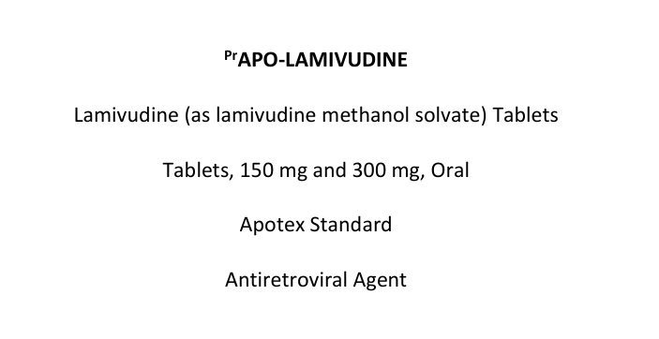
Solvation
So rarely described we are probably unaware of it for
Paroxetine
Atorvastatin calcium
Lamivudine
Cabazitaxel
Nirmatrelvir
Darunavir
Tiotropium
So, since it has so little clinical relevance, it has been deemed to be excluded for the definition of a precise active ingredient substance
https://pdf.hres.ca/dpd_pm/00071342.PDF

Slide 6
Grouper CD examples for discussion

Slide 7
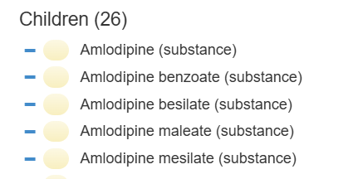
Amlodipine
CD (grouper)
Amlodipine 5 mg oral tablet
Amlodipine (as amlodipine maleate) 5 mg oral tablet
Amlodipine (as amlodipine mesilate) 5 mg oral tablet
Amlodipine (as amlodipine besilate) 5 mg oral tablet
Real products exist to instantiate these CDs
CD (precisely)
What does “Amlodipine (substance) mean?
What would “Amlodipine 5 mg oral tablet “ mean?

Slide 8

Amitriptyline
Grouper CD???
CD (precisely)
Amitriptyline hydrochloride 25 mg oral tablet
Amitriptyline 25 mg oral tablet
Real products exist to instantiate these CDs
Not currently present in SCT
How could a user distinguish that the Amitriptyline CD here is a different type of concept from the Amlodipine grouper concept on the previous slide?
Remember: users see pick lists not hierarchies

Slide 9

Irbesartan
Grouper CD???
CD (precisely)
Irbesartan (as irbesartan hydrochloride) 150 mg oral tablet
Irbesartan 150 mg oral tablet
Real products exist to instantiate these CDs
Not currently present in SCT
How could a user distinguish that the Irbesartan CD here is a different type of concept from the Amlodipine grouper concept on the other slide?
Remember: users see pick lists not hierarchies

