Slide 1
Transition to RT2 – nursing refsets in Norway
Nursing CRG April business meeting 2025
Marte Rime Bø and Beate Kristiansen

Slide 2
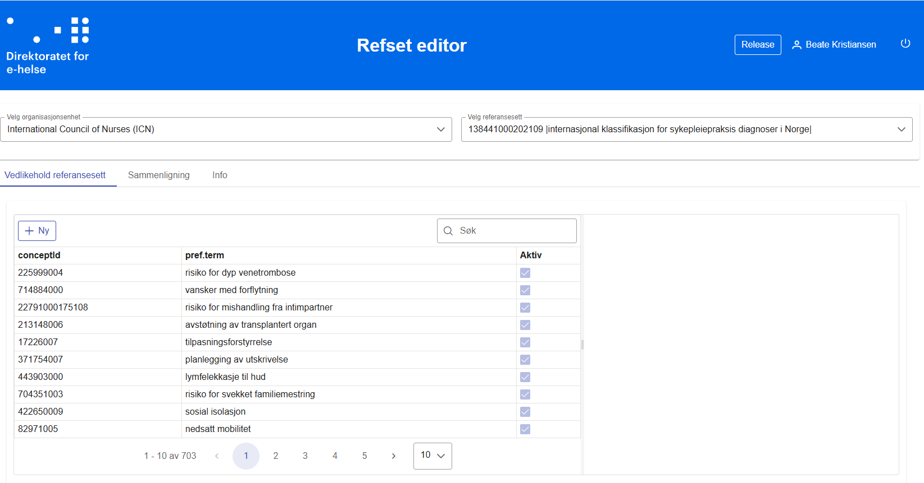
Notes:
The old refset tool was a prototype from the PKT project. We had the three Nursing reference sets here, one for diagnosis, one for interventions and one for goals.
Weaknesses: No versioning – connected to dailybuild (for quicker access to new concepts) – no alerts for showing inactive concepts, allowed duplicates – allowed trailing spaces.
When refset was to be distributed, they were exported into excel, manually checked for duplicates and inactive concepts, and sent as an excel-file via e-mail to vendors.
Lots of manual routines.

Slide 3
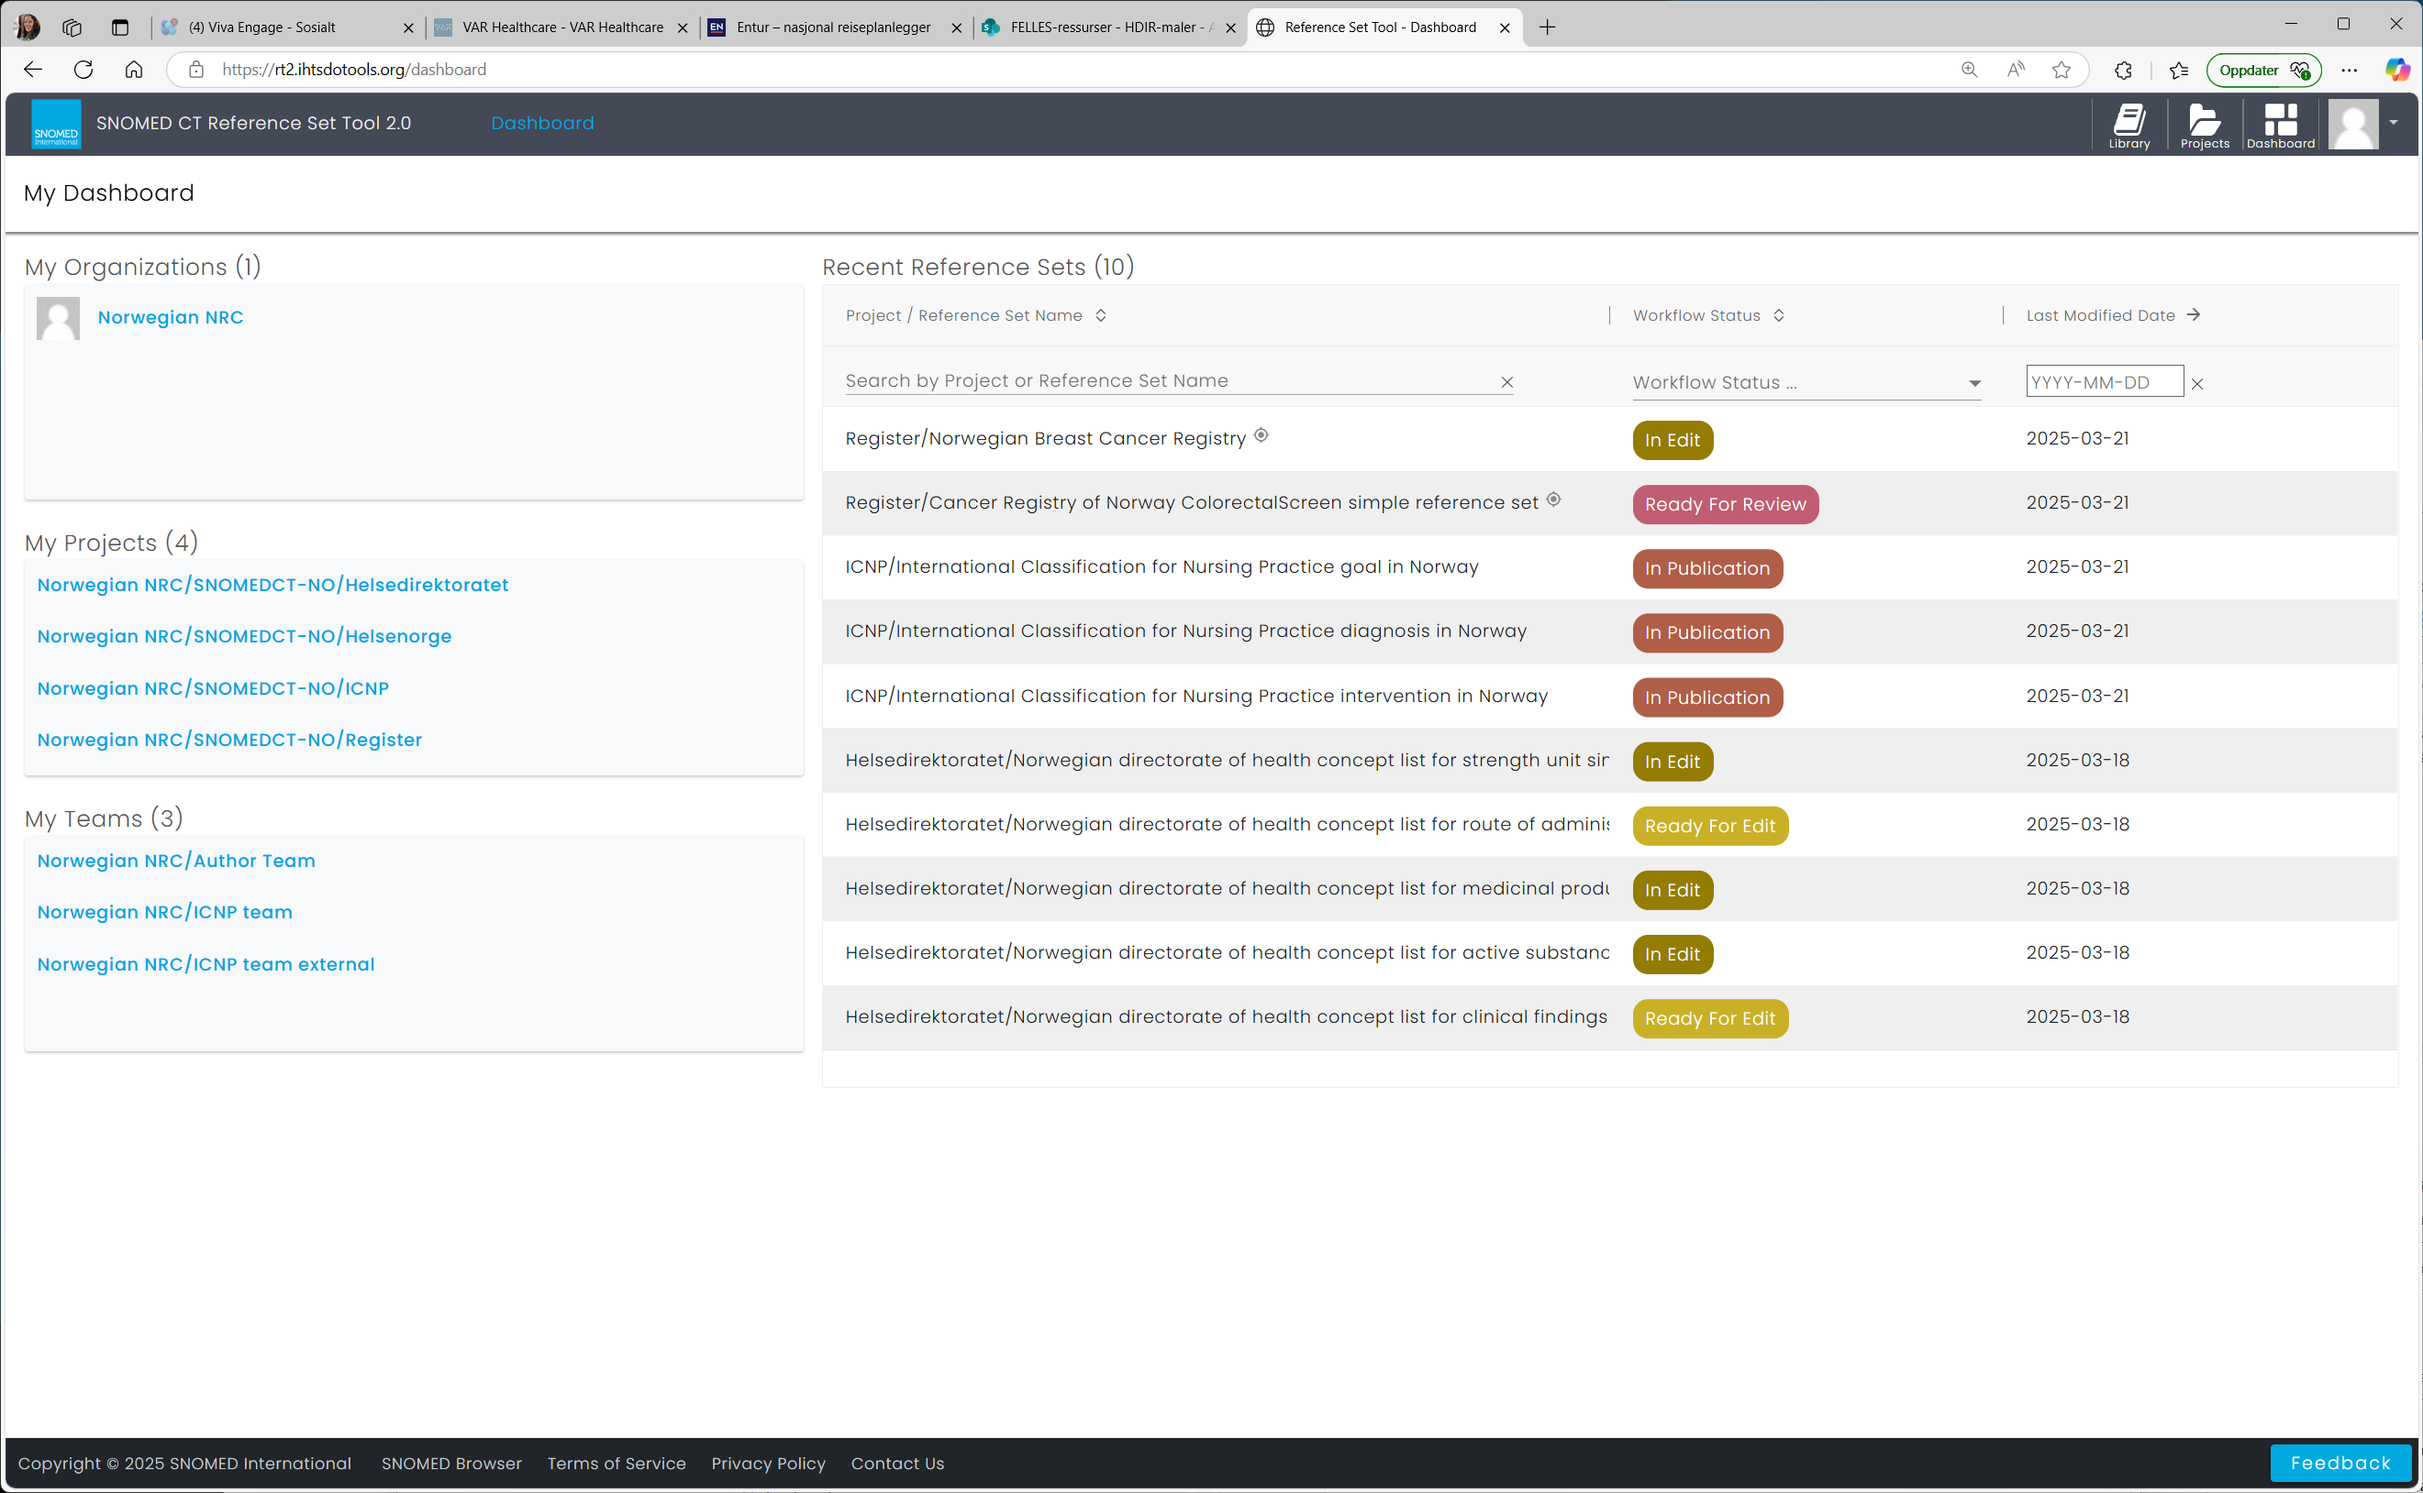
Notes:
Still three reference sets, connected to published version, frequent releases in Norway now.
First edition is April 2025 edition, no earlier versioning history have been kept, as there was no versioning in the old refset tool. We could have «cheated» an earlier version into the tool, but it would be risky and not quite true, so we decided that the published April-version will be the new official first version. The earlier work can be seen as more of a proof or concept.
There was some manual cleaning to do as there was lots of inactivated concepts we had to remove manually before loading our old refsets into RT2, and also «illegal» concepts, as the old tool accepted invalid codes being entered into the reftsets. That is codes that doesn’t have a SNOMED CT concepts connected to them, for instance ICNP codes, ICS codes or just typos or trailing spaces.

Slide 4
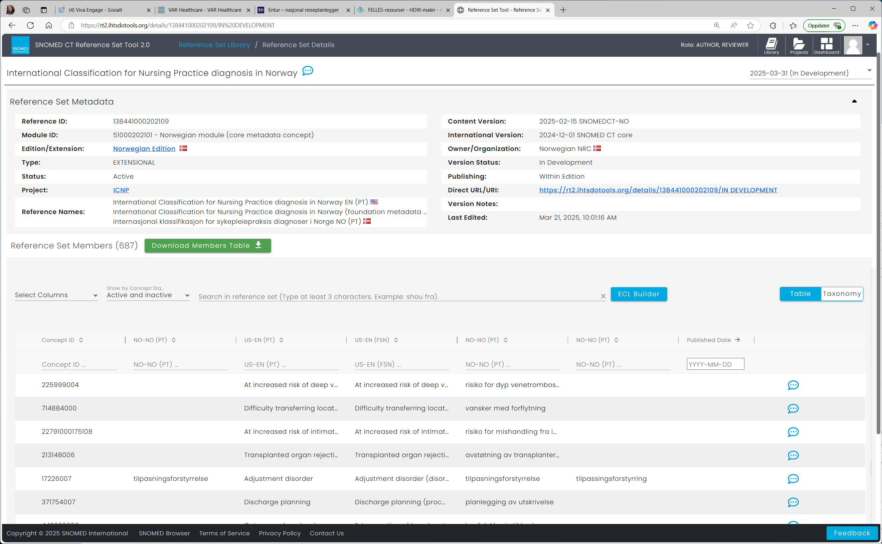
Notes:
In RT2 we have started removing and replacing all inactive concepts before the first version/edition. This will be an easier process going forward as there is probably fewer inactivated concepts per release now that they happen once a month. It is a quite handy tool for seeing the members of the refset, you can search by name or code, and you can add concepts or lists of concepts. It is also an easy way of exporting a table with all refset members. Hopefully we can also get our vendors to fetch the refsets by API in the near future.

Slide 5
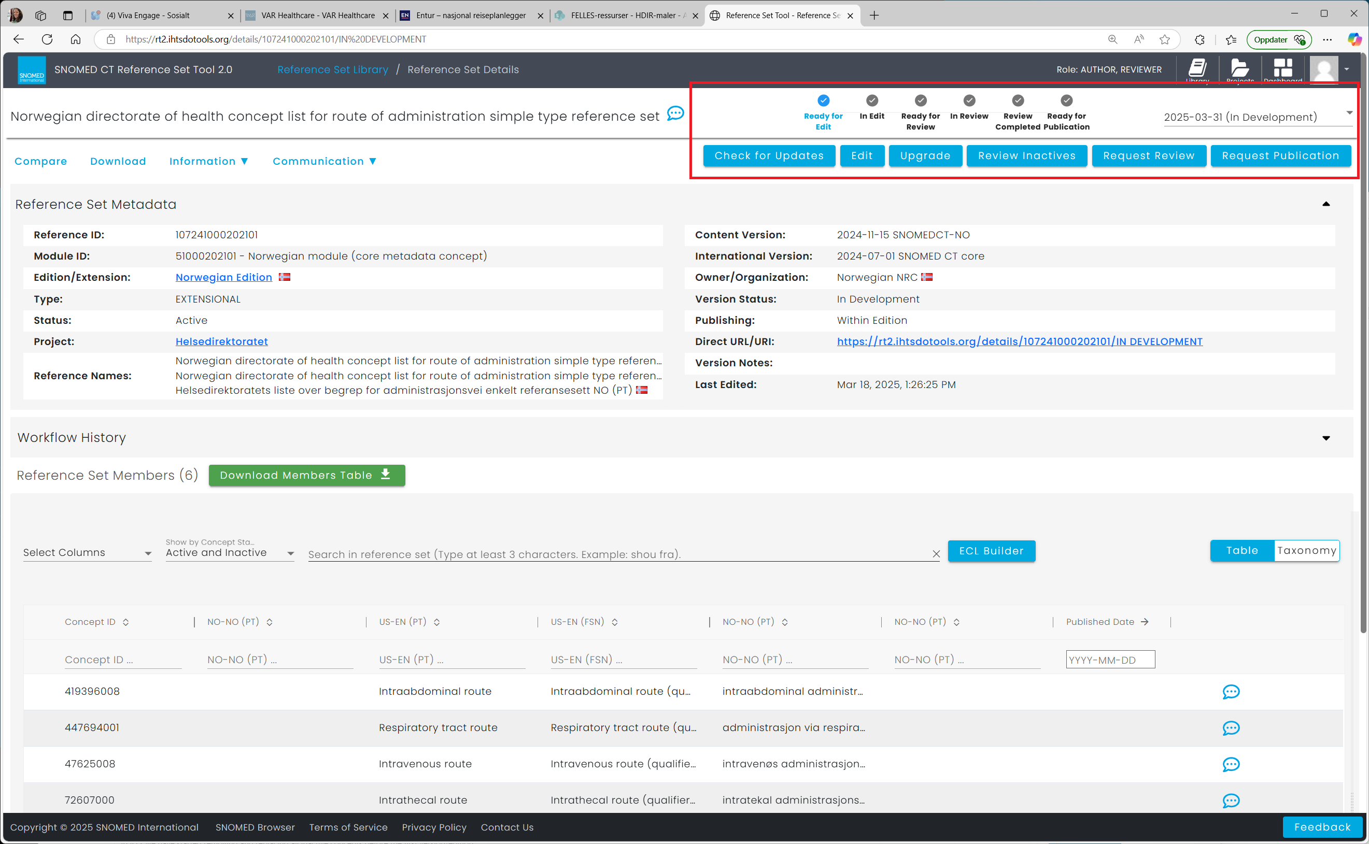
Notes:
We work in our three refsets at the same time and there is a routine for working in refsets between releases. You can edit as much as you like, and save your work between sessions. Before release you can requet a review, that can be done by other members of the NRC for quality control. For instance check for inactivated concepts, or that there aren’t any diagnosis in the intervention refset. When we are happy with the content, we can «request publication». This is the status a refset needs to have to be included automatically in the monthly release. When they are released, the new concepts in the refset gets a refset-version-ID so we can see the history of when concepts are added or removed from the refsets. So for now they all have «added in the April-release» version ID, no matter how long they have been used. But this will be a usefull feature going forward.

