Slide 1
Microorganism Name changes
IHTSDO Business Meetings
Content Advisory Group
April 2016
London, England

Slide 2
Background
Microorganism taxonomic name may change from time to time. One of the primary reasons for these changes is advances in science e.g. application of molecular techniques to compare the nucleic acid similarities among organisms, which may result in:
  An organism previously assigned to a particular taxon (e.g. Genus) is found to be significantly unrelated to other members of the taxon on a molecular basis →
  Reassessing the taxonomic groupings originally established based on phenotypic characteristics →
  Proposal to reassign the organism to a different taxon--either a new taxon or an existing one →
  Requirement for a name change

Slide 3
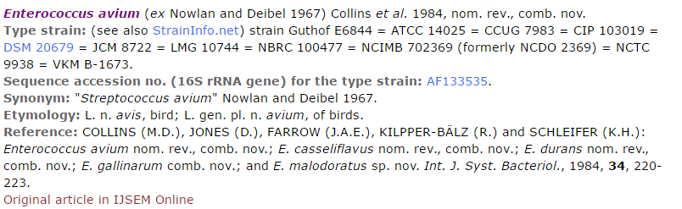
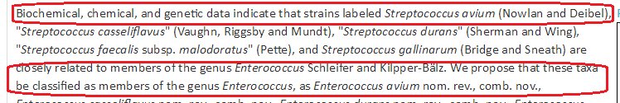
Example: Enterococcus avium
Excerpt from the IJSEM article:

Slide 4
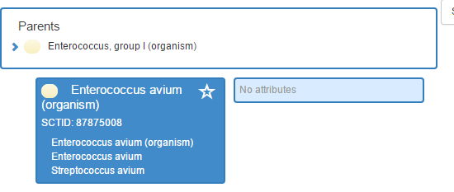
Current editorial guideline (at the time of presentation)
“When the name of one organism changes to another name (1→1), the guidance is
  To create a new concept with the current name and add the old name as a description (synonym) to the new concept. If the old concept has any prior descriptions, all of them should be moved to the new concept as synonyms.
  To retire the concept with the old name with an “OUTDATED + REPLACED BY” relationship to the new concept.”

Slide 5
Current editorial guideline (at the time of presentation)
The reasoning behind the retirement: when the organism jumps to other areas of the taxonomy, it might cause confusion for users if they see an outdated FSN as a subtype of the new parent; for example, the concept on the previous slide will change to:
  Parent: Enterococcus, group I (organism)
    FSN: Streptococcus avium (organism)
    Syn: Enterococcus avium (organism)
Note: The result of changing the concept ID requires that all concepts that use the retired concept in a relationship would need to be updated, e.g. disorders.

Slide 6
Issue description
Recent feedback on editorial guideline:
  “The current guideline doesn’t represent the reality (an incredibly fuzzy idea) of a name change particularly well. Bacteria name changes (the only place where there is a history of naming formality) are more like ‘add a synonym and change the preferred description’ as they do not ‘retire’ old names. Logically, the organism class didn't change, only the term representing it did.”
We are seeking feedback on the following options:
  Option 1: Continue with the current guideline
  Option 2: Keep the concept with the old name and add the new (current name) as the preferred name.

Slide 7
Issue Discussion
This issue was discussed during the April 2016 business meetings
  Content Advisory group feedback:
    The group reviewed the issue and suggested a 3rd option: Changing the FSN for affected concepts without changing the concept ID, while the old name is retained as a synonym.
  Editorial Advisory Group feedback:
    The group agreed that the third option, as suggested by the Content Advisory Group, is within the scope of acceptable changes in FSN.
    The group also agreed that this option is more in line with the actual change, and it also lessens the burden of change maintenance at the international level and within NRCs.

Slide 8
Issue Resolution
Based on the feedback provided by the Content and Editorial Advisory Groups, the current guideline will change to:
“When the name of one organism changes to another name (1→1), the guidance is:
  To add the current name as the new FSN for the existing concept (Concept ID remains the same)
  To retire the old FSN and add the old name as a synonym to the existing concept”

Slide 9
Summary
Current procedure at the time of presentation – Option 1:
  To create a new concept with the current name and add the old name as a description (synonym) to the new concept. If the old concept has any prior descriptions, all of them should be moved to the new concept as synonyms.
  To retire the concept with the old name with an “OUTDATED + REPLACED BY” relationship to the new concept.”
Alternative procedure – Option 2:
  Keep the concept with the old name and add the new (current name) as the preferred name.
Alternative procedure (suggested in CMAG) – Option 3:
  Change the FSN for affected concepts without changing the concept ID, while the old name is retained as a synonym.
Confirmed procedure by EAG: Option 3

Slide 10
Question for CMAG
Let us know if there are any problem with the recommended procedure (Option 3).

