Slide 1
Review of Feedback from Melissa Mary (bioMerieux) on LOINC – SNOMED CT Cooperation Project phase 3 Alpha release
Discussion for the Observables Project Group
July 25, 2016

Slide 2
Background
Melissa Mary submitted analysis of LOINC – SNOMED CT Cooperation Project phase 3 Alpha release as feedback to IHSDO on 10 June
Melissa Mary presented analysis of LOINC – SNOMED CT Cooperation Project phase 3 Alpha release to the Observables PG on 26 June, 2016
  Focus on LOINC Term classification with SNOMED CT and suitability for query and/or aggregation
  Analysis of previous project alpha releases focused on LOINC Part mapping to SNOMED CT concepts and attributes
FAS and SSA to comment on analysis in this presentation
Notes:
h

Slide 3
Classification metrics – equivalent LOINC Terms
46 LOINC Terms classified as equivalent
  14 result of 1 mismapping in original base file (LOINC Part to SNOMED CT concept map error)
  6 result of having similar bacteria identification LOINC Terms mapped similarly and designated fully defined
  20 result from duplication within LOINC
  6 result from inconsistent/unclear LOINC Terms

Slide 4
Classification metrics – equivalent LOINC Terms: 14 Amphetamine Terms
Example:
Notes:
LOINC-28 and LOINC-195

Slide 5
Classification metrics – equivalent LOINC Terms: 14 Amphetamine Terms
These 14 equivalencies a result of 1 mismapping in original base file (LOINC Part to SNOMED CT concept map error)
  Previous solution determined with input from RII and Substance Team:
    LP COMPONENT Amphetamine mapped to 703842006 | 1-phenylpropan-2-amine (substance) and
    LP mapped to 703841004 | Substituted amphetamine (substance)
  Came up during internal review again prior to release and map was changed so both LPs map to 703842006 | 1-phenylpropan-2-amine (substance)
  JIRA ticket to clarify with RII – not sure of status.
Action: Clarify with RII and remap as appropriate so equivalencies do not occur (JIRA tickets: LOINC-28 and LOINC-195)
Notes:
LOINC-28 and LOINC-195

Slide 6

Classification metrics – equivalent LOINC Terms: 6 bacteria identification Terms

Slide 7
Classification metrics – equivalent LOINC Terms: 6 bacteria identification Terms
These 6 equivalencies a result of similar Terms being mapped the same and marked fully defined
  Previous solution (2014-2015) determined with IHTSDO internal team that these should be equivalent
  Discussion in April 2016 Business Meeting that these should be mapped with different techniques such as biotyping (264788002), serotyping ( 258075003), phage typing (to be created)
Action: Create new typing technique concept and remap these Terms using the technique concepts so equivalencies do not occur (JIRA tickets: LOINC-160, LOINC-173, etc.)
Notes:
LOINC-160, LOINC-173

Slide 8
Classification metrics – equivalent LOINC Terms: 20 duplicate Terms
Examples:
Notes:
LOINC-28 and LOINC-195

Slide 9
Classification metrics – equivalent LOINC Terms: 20 duplicate Terms
These 20 equivalencies are a result of duplication within LOINC
  Have been confirmed by RII or are being considered by RII
  RII plan to deprecate most of the duplicate Parts and Terms
  For the “unadjusted” Terms, RII has already marked them as discouraged and mapped them to the generic term
Action:
  Remove duplicate Parts and Terms from project files after they are removed from LOINC (JIRA tickets: LOINC-152, LOINC-158, LOINC-149, LOINC-155)
  Update documentation to include these duplicates until the time they are removed from LOINC
  Update documentation to explain the status of the “unadjusted” Terms (JIRA ticket: LOINC-187)

Slide 10

Classification metrics – equivalent LOINC Terms: 6 inconsistent/unclear Terms
Examples:

Slide 11
Classification metrics – equivalent LOINC Terms: 6 inconsistent/unclear Terms
These 6 equivalencies seem to be duplicates at first but are actually unclear Terms within LOINC that can be clarified and improved
  Have been confirmed by RII or are being considered by RII
  RII plan to improve existing Parts and Terms
Action:
  Update maps for Parts and Terms in project files after the corrections are made in LOINC (JIRA tickets: LOINC-159, LOINC-117, LOINC-157)
  Update documentation to reference these issues until the time they are corrected in LOINC

Slide 12
Classification metrics – subClassOf inference
Classification deemed consistent overall, with 3 potential errors identified
Analyzed two main types of inference:
  1. surDefinition
    Example: increment of test definition of addition of information Challenge, Method, etc.
    Discussed in previous analysis:
      RII confirmed that these inferences are correct
      Action: Update documentation to point this out

Slide 13
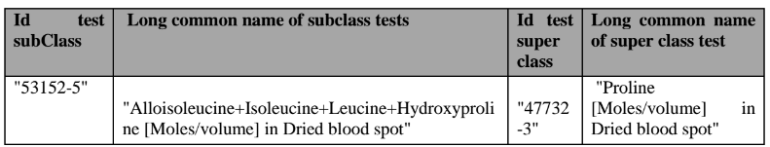
Classification metrics – subClassOf inference
Analyzed two main types of inference:
  2. subClassOf errors:
    Property hierarchy, e.g. log#/volume is descendant of #/volume
    Component hierarchy, see example below
    Action: create JIRA tickets to track issues, discuss with relevant groups (e.g., sent to Ed. Adv. Group)

Slide 14
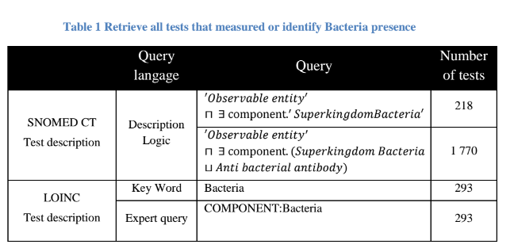
Improvement of tests query using SNOMED CT ontology
Why were Antibacterial antibody Terms included?
Why were results of query with SNOMED less than with LOINC?
What was the query set for LOINC (all of LOINC or just alpha release set)?
Can we see the results of the query?
Notes:
We would like to see more details on the tests performed here. Seeing the results would help us

