Slide 1


Clinical Engagement Strategy 2020 - 25

Slide 2
The importance of clinical engagement
“Clinicians are frequently the first to hear, see and identify patient conditions and findings that need documentation. Further, clinicians are in a unique position to see correlations between the items that need documentation. Being able to contribute to terms, definitions, and the valuable relationships available within SNOMED CT improves usability. Working with the entire design team for an EHR allows for better presentation, and proper representation that may significantly contribute to timeliness, efficiency, and, most important, improved care outcomes”.
Mark Jurkovitch, Chair, SNOMED Dentistry Clinical Reference Group
Need to include implementation and clinical collaborations

Slide 3
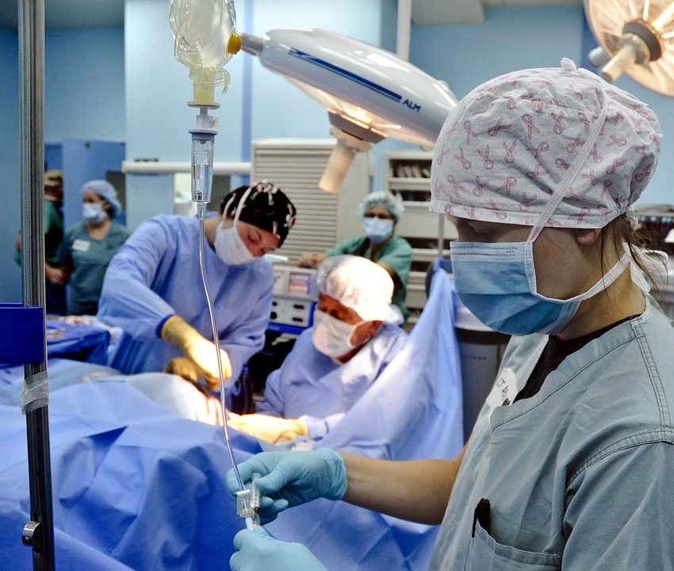

Vision of Clinical Engagement
To ensure that all activities of the IHTSDO are influenced by global clinical communities
IHTSDO’s culture has a progressive and sustainable approach to engaging clinicians

Slide 4
Principles
Raising the profile of clinical engagement within the organisation
Consistency of approach across the regions of the world in terms of clinical engagement
Clinical engagement encompasses all healthcare professional groups globally
Consistent and timely communication with National Release Centers and all relevant stakeholders
Foster and encourage a culture of open engagement and discussion between clinicians
Continuous leverage of experience and shared learning across the regions
Assuring the clinical quality and relevance of SNOMED International products and services
Act as terminology integrator to develop a common understanding
Clinical collaborations
Implementation
Tracking emerging clinical requirements to define development areas (globally and users/members)

Slide 5
Benefits of clinical engagement to SNOMED International
Informing direction of SNOMED International products and services
Improving quality, and thus clinical usability and acceptability, of SNOMED International products and services, based on clinical knowledge and expertise
Identification of clinical champions who support and endorse the implementation of SNOMED CT and related products and services
Promote collaboration across healthcare professional groups that improve SNOMED International products and services
Implementation requirements – clinical point of care and secondary uses
Feedback from implementation

Slide 6

High level model for clinical engagement
Clinical input into future developments
Timely responses to clinical advances
Clinically assured SNOMED CT content
Clinically supported derivatives (subsets/maps)
Clinical collaborations
Corporate clinical culture driving clinically supportive product development
Clinically responsive educational materials
Clinically driven implementation support
SNOMED CT, enhanced by clinicians to support current and future clinical practice
***REUSE THIS TAG-LINE
6

Slide 7
Internal stakeholders

Slide 8
Who are our clinical stakeholders?
Doctors
Allied Health Professionals
Clinical
Educators
Clinical Care Providers
Professional bodies
+
Clinical implementers
Nurses
Clinical Colleges

Slide 9
Format of the strategy
Background
Vision for Clinical Engagement
Principles
Clinical engagement objectives
Implementation plans
  International
  Regional
    AsiaPAC
    EMEA
    Americas
Appendix
  Background information

Slide 10
IHTSDO strategic directions
Demonstrate successful large-scale implementations of SNOMED CT
Remove barriers to adoption for our customers and stakeholders
Enable continuous development of our product to meet customer requirements
Provide scalable products and services that drive SNOMED CT adoption
Set new trends and shape new technologies that increase the overall use of SNOMED CT
Needs updating
Focus on low digital maturity
- links to Bahmi clinical groups ??????
- base clinical implementation guide . . . .
- links to Essential Medicines list and WHO vaccination list
*** Chat to implementation support team – links to CE in implementation strategy

Slide 11
Clinical ambassadors
CGU
  2 x Barts Health ???, more focused on management roles in Barts
  UK - Kathy Sudlow report, build on . . . (published - Sept 2024)
    Develop clinical analytic functionality as a best practice/pilot
Tina - presenting at Vitalis 2025
  Other opportunities
Research engagement
  Build on the clinical/research engagement side
  Build on links with OHDSI
Implementation
  Leverage developments
Education
  SNOMED for Clinicians - review, with potentially updating

Slide 12
CRGs - Clinical Reference Groups
IGR involved in all
  Admin
  No more . . . ????
  Alternative delivery, e.g. approach to Endocrine (terminology only)
  Twice yearly overall meeting (f2f - feedback from project groups) - wider scale engagement
Terminology only
Implementation
Vendor implementation
Clinical project group (start) - blossoms into a CRG ?????
Nursing - focus on a particular area, clarity around where Nursing CRG (QA process) fits in the ICNP structure (no link to ICNP governance process)

Slide 13
Clinical Engagement – current state
Healthcare Professions Coordination Group (HPCG)
Professional Special Interest Groups (SIG’s)
IHTSDO SNOMED CT Authoring team - experienced clinicians
Clinical collaborations e.g. ICN, WONCA, WASPaLM
Content development projects – clinicians as Subject Matter Experts
Clinical quality assurance of specific areas of SNOMED CT under review, driven by the content development roadmap
Needs updating . . . .
Clinical leads
SMT
+
ADD SLIDE – clinical collaboration

Slide 14
Clinical engagement goals/objectives to support IHTSDO strategic direction
  Raise the profile of SNOMED CT for clinicians locally/nationally/globally
Increase number and depth of knowledge of health care professional ambassadors/SMEs for SNOMED CT
Identify and gather use case examples from clinical and research perspectives to demonstrate benefits of using SNOMED CT - LINK TO “SNOMED IN ACTION” – ADD TO WORKPLAN
Increase the access to relevant SNOMED CT educational and implementation materials for healthcare professionals
Identify key clinical requirements/priorities/trends to inform IHTSDO products and services
  Demonstrate high value clinical analytics support capabilities of SNOMED CT
  Identify clinically focused implementation opportunities to demonstrate SNOMED CT usage
Review goals currently coming out of the strategy – USE WORDING FROM THE STRATEGY
Terminology integrator
Clinical collaborations
ADD SLIDE IN APPENDIX - Clinical networks and each of the goals/objectives
(Workplan – in Europe use country driven schedule for webinars, based on South American approach).

Slide 15
Work plan approach
There will be an annual international work plan which will include global clinical engagement activities
Each region will develop and agree on an annual work plan based on a common framework and the agreed goals/objectives
All clinical engagement plans will deliver on the strategic direction for the IHTSDO and will be a collaborative effort with the CSRM team functions.
All clinical engagement activities within Member countries will be undertaken only following consultation with the relevant national authority
All clinical engagement activities will need to coordinate with relevant IHTSDO Lines of Business in order to ensure appropriate and timely delivery
Each clinical engagement lead will report on activities to ensure linkages and shared learnings are optimized
REMOVE SLIDE
Use previous slide to identify workplan areas

Slide 16
Slides to ADD
Strategy 2025-30
Workplan updates on annual cycle
WORKPLANS for each of the strategy objectives
KPI’s – frequency to be defined

Slide 17
* * * General discussion/approach * * *
CRGs
  Working groups – dentistry/nutrition/cancer synoptic (started with key-project focus) issues
  Mental health, anaesthesia, pathology, (nursing) ???? lost at the moment
  * * * leadership/focus are key
  Mental health group – get Elaine to chair
  Anaesthesia – content focused, support from Jane and me, with some support from Monica (Jane to f/u)
  Pathology – no req’t for over-arching group, working groups continue (task and finish), keep in person pathology sessions (April, October)
  FUNDAMENTAL CHANGE TO PRINCIPLES - Start with project groups, then these move to CRGs
  Nursing – letting it run at the moment . . . Focus . . . NIC, NOC, NANDA at present

Slide 18
Networks
How do you engage, and maintain the interest . . .
Clinical webinars (gather interest and support), focused topics for each webinar, create shared space to encourage questions/discussions, with idea of future webinar focused on these questions/discussions

Slide 19
Workplan
  Raise the profile of SNOMED CT for clinicians locally/nationally/globally
    Network development, webinars, communications, conference presentations, links to member engagement activities, links to educational institutions
Increase number and depth of knowledge of health care professional ambassadors/SMEs for SNOMED CT
  As above, find opportunities for them to present on SI’s behalf
  Development of in-house training programme

Slide 20
Workplan
Identify and gather use case examples from clinical and research perspectives to demonstrate benefits of using SNOMED CT - LINK TO “SNOMED IN ACTION” – ADD TO WORKPLAN
  Transition towards a direct link to SNOMED In Action, expands use case to include details of delivery
Increase the access to relevant SNOMED CT educational and implementation materials for healthcare professionals
  Clinical pathway, CI guides, links to use ambassadors for educational sessions
  Clinical library – “one stop shop”
Identify key clinical requirements/priorities/trends to inform SNOMED International products and services
  Link to content development roadmap, CRG priorities (BAU, trends)
  (* * * * need to develop process * * * *)
  Internal staff need to monitor clinical trends – internal and external

Slide 21
Workplan
  Identify clinically focused implementation opportunities to demonstrate SNOMED CT usage, including high value clinical analytics support capabilities
    Identify opportunities, and work with implementation support team to develop tooling/support
    Identify and provide documentation on exemplars (feed to SNOMED In Action, also ? Ambassadors), to include lessons learned

