Slide 1
Modeling of cerebrovascular accident using GCIs

Slide 2
Differences between 3 definitions of stroke
AHA/ASA consensus definition | AHA/ASA website | UptoDate® definition¹
Description: Acute neurological dysfunction | Description: N/A | Description: Acute neurologic injury
Sites: brain, spinal cord, retina | Sites: brain | Sites: brain
Types: Ischemic (due to infarction) Hemorrhagic (intracerebral, subarachnoid) Due to central venous thrombosis | Types: Ischemic (due to a clot obstructing the flow of blood to the brain Hemorrhagic TIA | Types: Ischemic (due to thrombosis, embolism, systemic hypoperfusion, central venous thrombosis) Hemorrhagic Due to occlusion of veins that drain the brain of blood
¹The definition of transient ischemic attack is changing with recognition that transient neurologic symptoms are frequently associated with permanent brain tissue injury.
²Author of this article is one of the authors of the consensus document

Slide 3
Proposed Cerebrovascular accident upper level hierarchy
Cerebrovascular accident
  Ischemic stroke
    Occlusive
      Thrombotic stroke
      Embolic stroke
    Due to systemic hypoperfusion
  Hemorrhagic stroke
    Due to cerebral hemorrhage
    Due to subarachnoid hemorrhage
  Stroke due to cerebral venous thrombosis

Slide 4
Terming
FSN | PT | Synonym(s)
Cerebrovascular accident (disorder) | Stroke | CVA
Cerebrovascular accident due to ischemia (disorder) | Ischemic stroke | Ischemic CVA
Cerebrovascular accident due to arterial occlusion (disorder) | Occlusive stroke | Occlusive CVA
Cerebrovascular accident due to thrombus (disorder) | Thrombotic stroke | Thrombotic CVA
Cerebrovascular accident due to embolus (disorder) | Embolic stroke | Embolic CVA
Cerebrovascular accident due to intracranial hemorrhage (disorder) | Hemorrhagic stroke | Hemorrhagic CVA
Cerebrovascular accident due to cerebral hemorrhage (disorder) | Stroke due to cerebral hemorrhage | -
Cerebrovascular accident due to subarachnoid hemorrhage (disorder) | Stroke due to subarachnoid hemorrhage | -

Slide 5
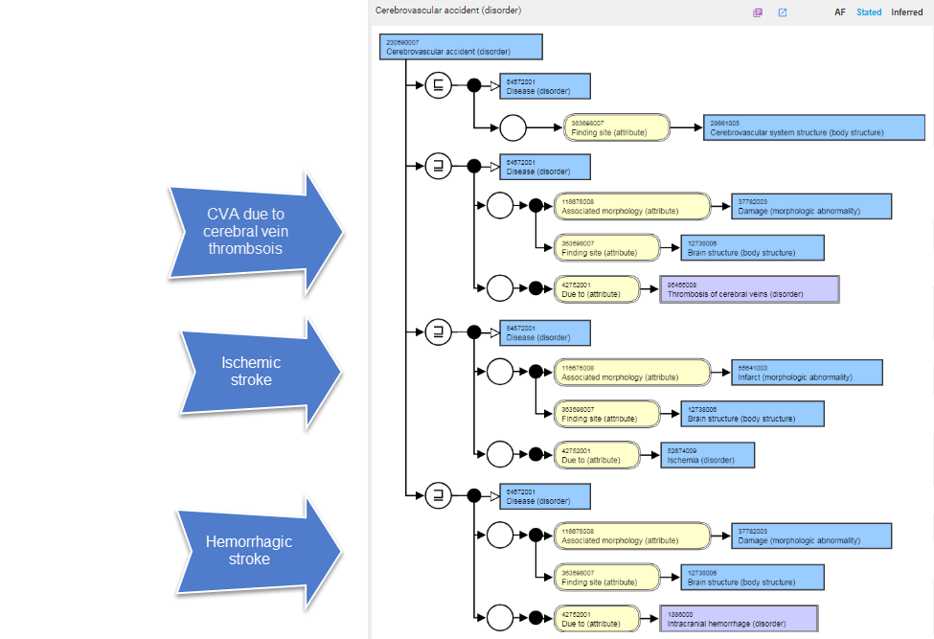
CVA model using GCIs

Slide 6
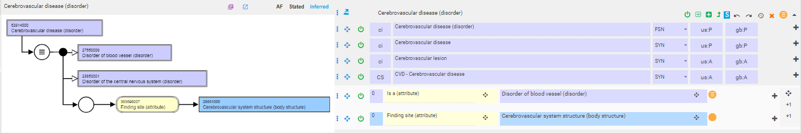
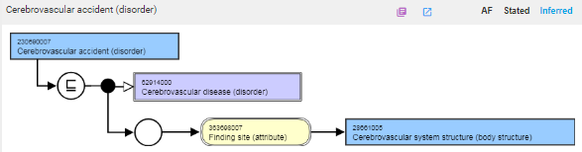
Cerebrovascular disease

Slide 7
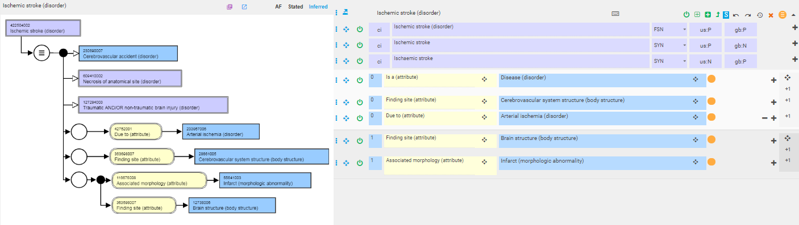
Ischemic stroke

Slide 8
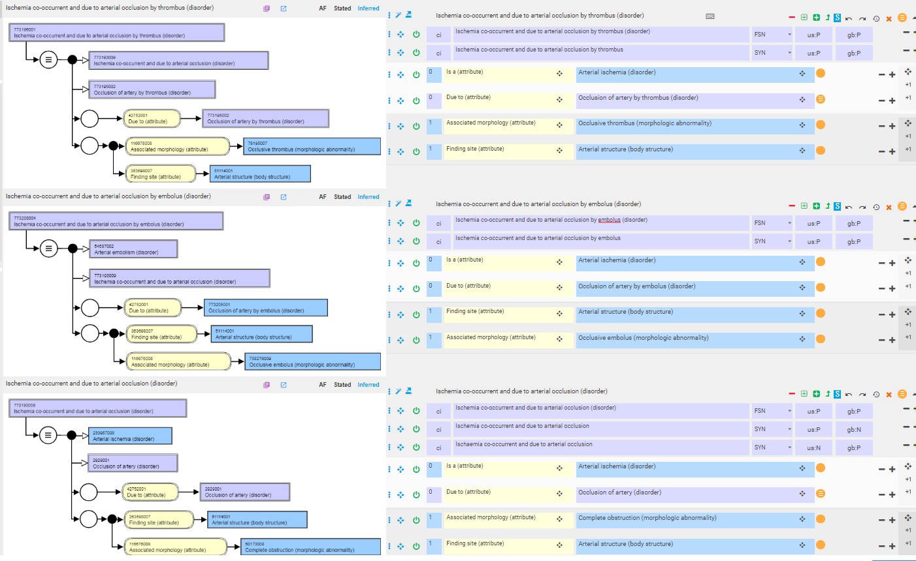
New concepts needed to model occlusive strokes as kinds of ischemic strokes

Slide 9
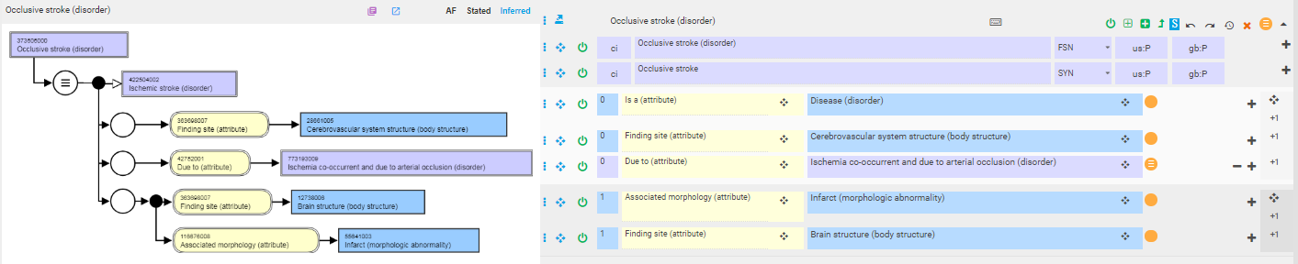
Occlusive stroke

Slide 10
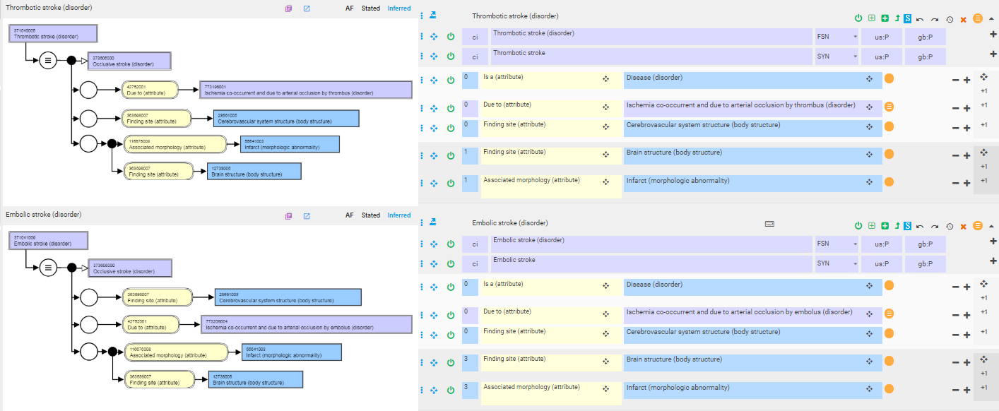
Thrombotic and embolic strokes

Slide 11
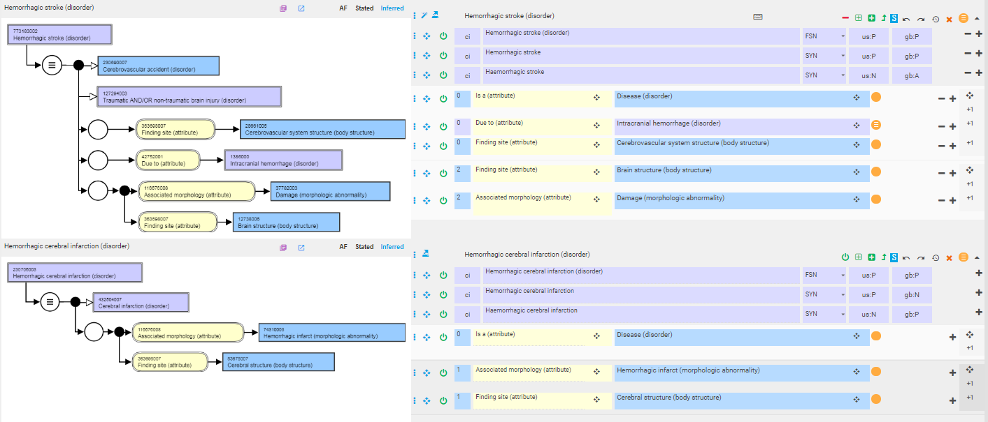
Hemorrhagic stroke (vs. Hemorrhagic cerebral infarction)

Slide 12
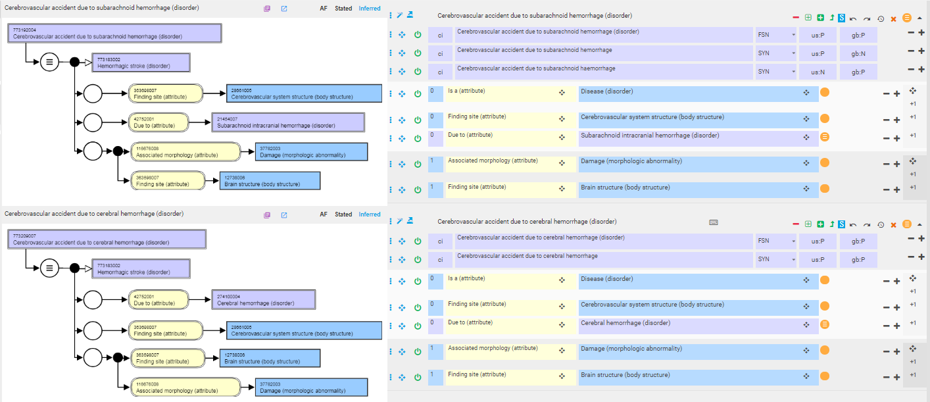
Subtypes of hemorrhagic stroke

Slide 13
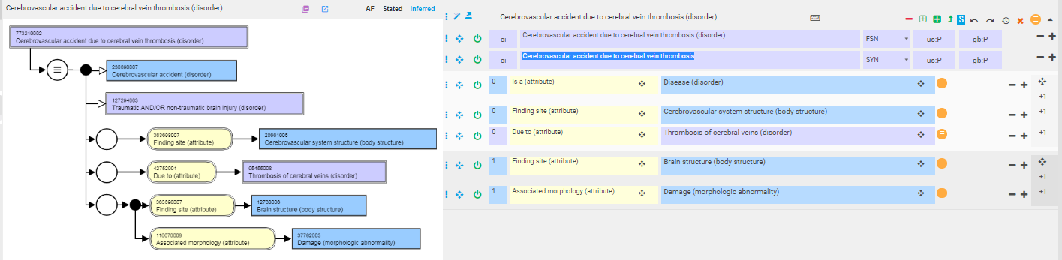
Cerebrovascular accident due to cerebral vein thrombosis

