Slide 1
Development of Standardized Anesthesia Terminology in South Korea
Jungchan Park, MD, PhD
Department of Anesthesiology and Pain Medicine, Samsung Medical Center Sungkyunkwan University School of Medicine

Slide 2
No Conflict of Interest
Notes:
First is the basics of intracranial hypotension

Slide 3
1
Background
Notes:
First is the basics of intracranial hypotension

Slide 4
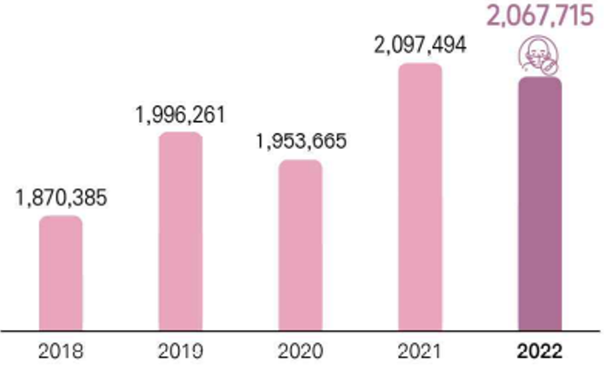
  Over 2 million cases of major surgery in Korea
  Need for standardized anesthesia record
    Facilitate data sharing
    Improve patient care
Notes:
The reasons for standardizing terminology in the field of anesthesiology are as follows:
Anesthesia is required regardless of the type of surgery or procedure, covering a wide range of medical areas. In 2022 alone, the number of major surgeries in South Korea reached 2.07 million.

Slide 5
Why Do We Need Anesthetic Data?
  BROAD and COMLPEX
  But, COMPACT

Slide 6
Components of Anesthetic Records
  Patient Demographics
  Medical History
  Surgical and Procedure Details
  Anesthetic Technique
  Monitoring Data
  Intraoperative Events
  Emergence
  Recovery
  Adverse Events
  Postoperative Outcomes
  Complications
  Long-Term Follow-Up
Notes:
Additionally, anesthesia-related records span the entire perioperative period:
Preoperative: Assessing the patient’s basic lab results and medical history to predict surgical risk
Intraoperative: Documenting the anesthesia method, drugs used, airway management, complications, and vital signs
Postoperative: Recording recovery-related information after anesthesia
Given the value of these records for research and data sharing, standardizing terminology is essential.

Slide 7
Characteristics of Anesthetic Records
  Multimodal
    Various Sources: Vital signs, Drug administration, Anesthesia machine, Other device
  Granularity
    Repeated Measurement
    Capture Subtle Change

Slide 8
Characteristics of Anesthetic Records
  Temporal
    Changes of status & Intervention over time
    Clinical Decision
  Interconnection
    Change of Variable Affect Other
    Understand this Relationship

Slide 9
Characteristics of Anesthetic Records
  Noisy
  Critical Time Sensitivity
  Limited Set of KEY Parameter
  Specific Time Period

Slide 10
2
KSA Task Force
Notes:
First is the basics of intracranial hypotension

Slide 11
Development of a standardized set of anesthesia-related terms
  Approximately 15 members actively involved across over 10 university hospitals
  Objective
    To develop a standardized medical terminology set for anesthesiology, which is closely related to the safety of surgeries and procedures, in order to ensure interoperability between medical professionals and healthcare institutions
    Additionally, to expand the foundation of medical terminology and apply it to international standards in clinical practice
Notes:
Since January 2023, the Korean Society of Anesthesiology has recognized the need for terminology standardization and established a task force team to address this.
Last year, we participated in a project led by the Korea Health Information Service to develop standardized medical terminology sets based on clinical field demands.
The purpose of this project was to develop a standardized terminology set for anesthesia, a field closely related to the safety of surgeries and procedures. The goal was to ensure interoperability between healthcare professionals and institutions, expand the foundation of medical terminology, and apply it to international standards.
The project aimed to develop a terminology set focused on frequently used terms in the anesthesia process, create a mapping table between this set and SNOMED CT, and further develop it as a reference set.

Slide 12
Development of a standardized set of anesthesia-related terms
  Goals
    Develop a standardized terminology set focused on frequently used terms in the anesthesia process.
    Ensure interoperability during data exchange.
    Facilitate communication regarding anesthesia practices with other medical institutions.
    Encourage increased communication between anesthesiologists and surgeons through terminology standardization.

Slide 13
Development of a standardized set of anesthesia-related terms
  Development of Mapping Table between the Standardized Terminology Set and SNOMED-CT
      Concepts included in the standardized terminology set as a SNOMED-CT reference set.

Slide 14
Evaluation of project outcomes
Formation of Expert TF
Continuous updates and improvements
Analysis and selection of current terminology
Promotion and education
Definition of terms and ensuring consistency
Development of a standardized terminology database
Expert discussions and reviews
Notes:
This is the research method. An expert task force (TF) was formed to develop the standardized terminology set. Frequently used current terms were analyzed and selected, followed by expert discussions and reviews, leading to the creation of a standardized terminology database.
In the future, we plan to promote and educate on the terminology, along with continuous updates.

Slide 15
Selection of current terminology
  Review of anesthesia records forms
  Selection of frequently used terms
Notes:
Looking more closely at the development method for the standardized terminology set, the current anesthesia records were reviewed to analyze existing terms. Frequently used terms were selected, and the development of the standardized terminology set was carried out through refining meanings and organizing synonyms.

Slide 16
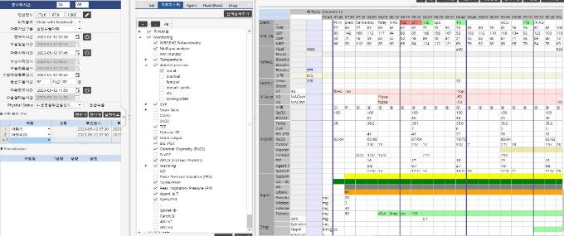
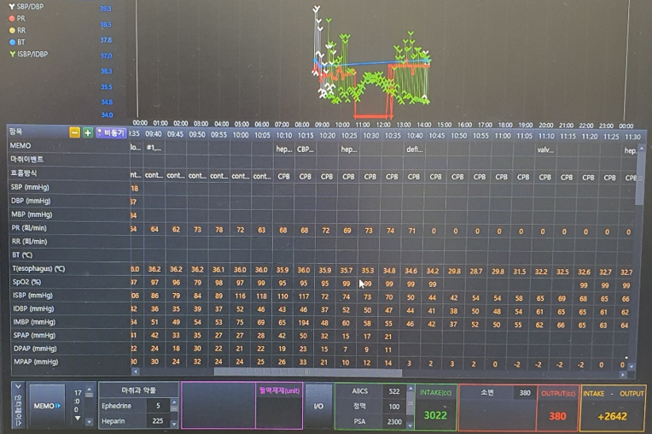
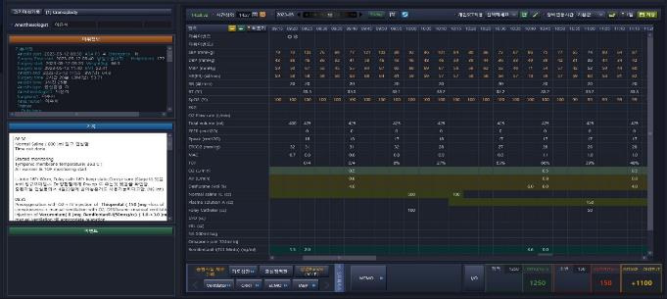
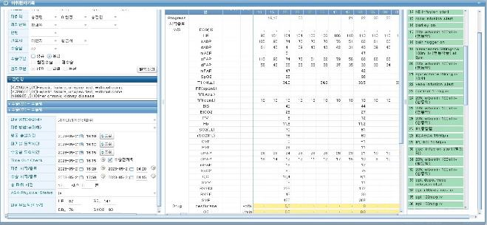
Selection of current terminology
Notes:
The anesthesia records of more than ten major university hospitals nationwide were reviewed to select frequently used terms currently in use.

Slide 17
Definition of terms and ensuring consistency
Syntatic mapping
Standardized terminology set for anesthesia related term
SNOMED CT
Semantic mapping
Terminologist 1
Terminologist 2
Final mapping
Additional discussion with terminologist
Creation of final mapping tale
  Standardized terminology set using SNOMED CT rather than EDI or KCD
Notes:
The selection of anesthesia-related terms aimed to map field-specific terms directly to SNOMED CT, rather than relying on EDI or KCD codes. While there are existing SNOMED CT mapping tables linked with EDI, which include anesthesia-related fees, this approach focused on selecting a broader range of terms used in practice. Therefore, field-specific terms were directly mapped to SNOMED CT to better reflect real-world usage.

Slide 18
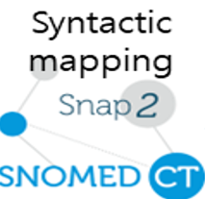
Expert discussions and reviews
Concepts in the standardized terminology set
Revisions and refinements by terminology experts
Review by anesthesiology specialists
Mismatches
Matches
Final mapping between the standardized anesthesiology terminology set and SNOMED CT
Notes:
If the mapping is reviewed and accepted by a single anesthesiology expert, it is finalized. In cases of discrepancies, the mapping is revised and refined by mapping experts to develop the final version.

Slide 19
Expert discussions and reviews
Mapping between the standardized terminology set and SNOMED CT
Adding Korean representative terms and synonyms as new descriptions in the Korean edition of SNOMED CT
Source terms matching pre-coordinated concepts in SNOMED CT
Matches
Mismatches
Adding source terms to the Korean edition of SNOMED CT by modeling them as new concepts
Source terms matching post-coordinated expressions in SNOMED CT
Matches
Mismatches
Adding necessary concepts for post-coordination modeling
Notes:
If a concept from the standardized anesthesiology terminology set matches a pre-coordinated concept in SNOMED CT on a 1:1 basis, the Korean preferred term and synonyms are added as synonyms to the corresponding concept in the Korean Extension.If a concept from the terminology set matches a post-coordinated expression in SNOMED CT on a 1:1 basis, it is modeled as a new concept in the Korean Extension and added.If a concept from the terminology set does not match a pre-coordinated or post-coordinated expression in SNOMED CT on a 1:1 basis, the necessary concepts are first modeled as new concepts in the Korean Extension, followed by the creation of the post-coordinated expression.Experts with SNOMED CT authoring experience will use the Authoring Platform provided by SNOMED International (https://kr-authoring.ihtsdotools.org/) to add synonyms and model new concepts (see Figure 2).

Slide 20
Standardized terminology database
3
Notes:
First is the basics of intracranial hypotension

Slide 21
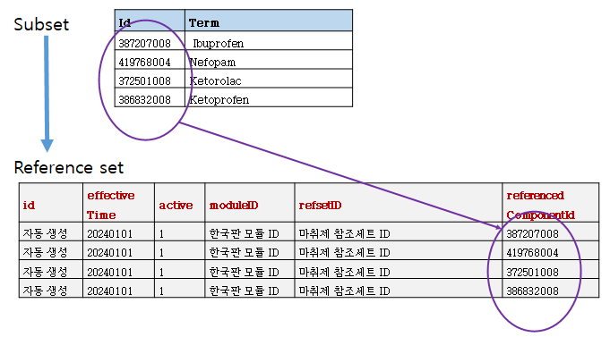
Standardized terminology database
  Development of Standardized terminology Reference set

Slide 22
Standardized terminology database
  Anesthetic Agents
  Monitoring
  Anesthetic technique
  Pre-anesthesia Evaluation and Baseline characteristics
  Procedures
  Vital Signs
  Recovery Records
Notes:
The development of the standardized terminology set for anesthesia was divided into three areas: anesthetic agents, anesthesia monitoring, and anesthesia methods. The selection criteria for each area are as follows:
Anesthetic agents: This category includes not only sedatives but also antiemetics, analgesics, cardiovascular drugs, and all other medications used during the anesthesia process.
Anesthesia monitoring: This area focuses on the monitoring elements used during the anesthesia process.
Anesthesia methods: In existing anesthesia records, methods were often documented by mixing airway management techniques with drug administration methods. However, as multiple techniques are often used together, the goal was to comprehensively select all applicable methods.

Slide 23
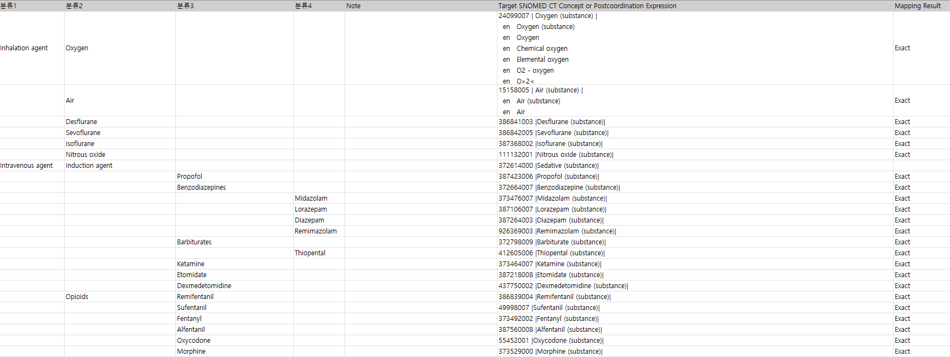
Standardized terminology database
  Anesthetic Agents

Slide 24
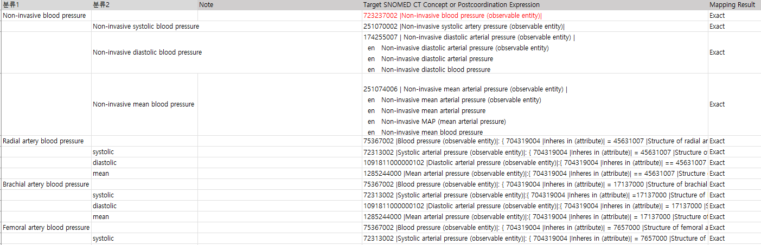
Standardized terminology database
  Monitoring
Notes:
Evaluated in numerous studies over and over again

Slide 25
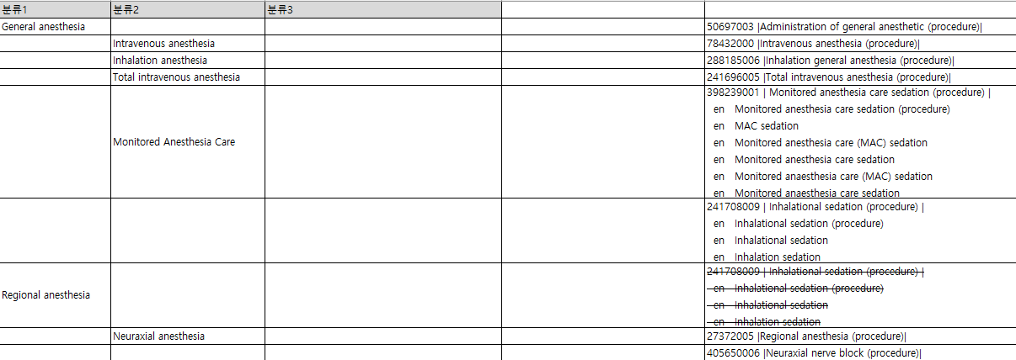
Standardized terminology database
  Anesthetic technique
Notes:
Evaluated in numerous studies over and over again

Slide 26
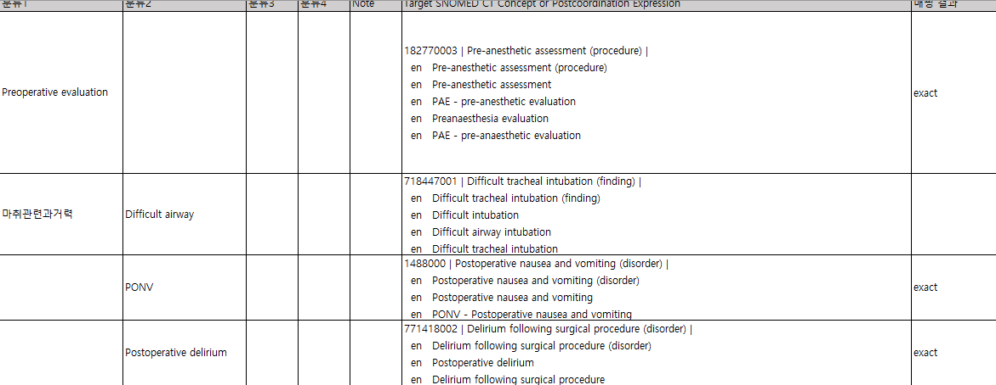
Standardized terminology database
  Pre-anesthesia Evaluation and Baseline characteristics
Notes:
Evaluated in numerous studies over and over again

Slide 27
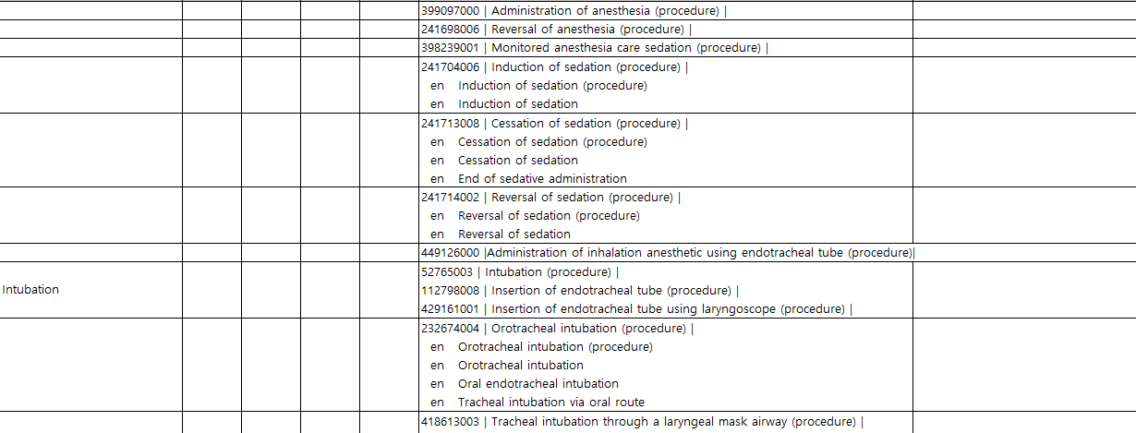
Standardized terminology database
  Procedures
Notes:
Evaluated in numerous studies over and over again

Slide 28
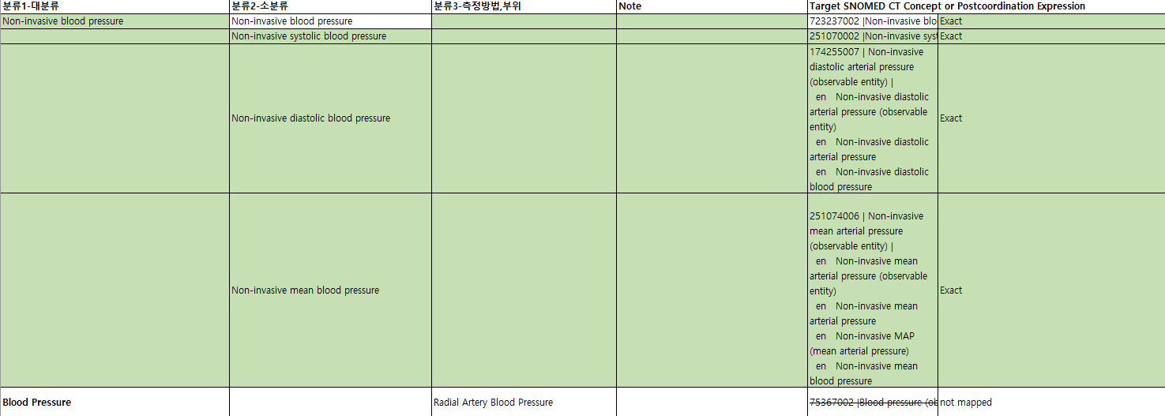
Standardized terminology database
  Vital Signs
Notes:
Evaluated in numerous studies over and over again

Slide 29
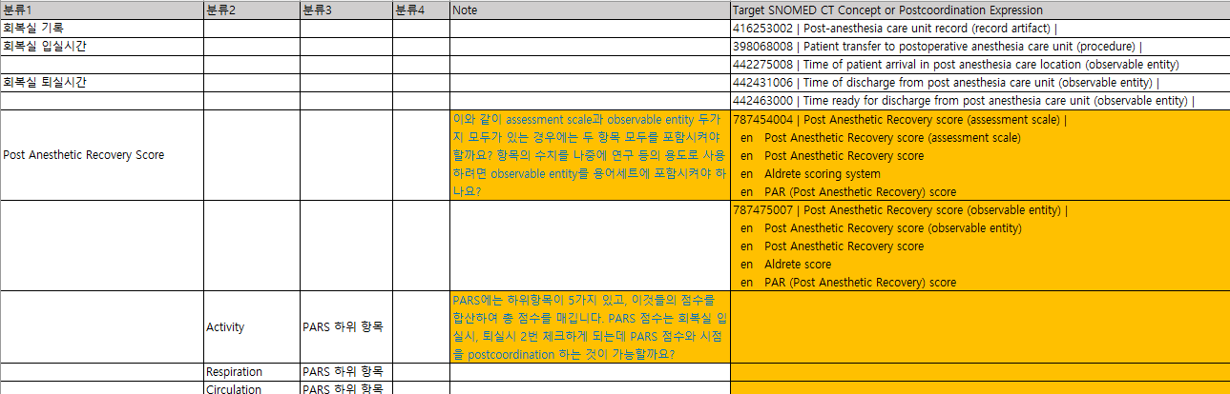
Standardized terminology database
  Recovery Records
Notes:
Evaluated in numerous studies over and over again

Slide 30
4
Conclusion
Notes:
First is the basics of intracranial hypotension

Slide 31
Conclusion
  Ongoing development of a standardized terminology set focused on frequently used terms in the anesthesia
  Laying the foundation for the standardization of anesthesia-related medical records, contributing to the sharing and utilization of surgical patient healthcare data
Notes:
Through this project, we have developed a standardized terminology set focused on frequently used terms in the anesthesia process. Standardized terminology sets were created for the fundamental areas of anesthesia records, including anesthetic agents and anesthesia monitoring. We reviewed anesthesia records from more than ten major hospitals in Korea to select frequently used terms for standardization.
This project lays the foundation for the standardization of anesthesia-related medical records, ensuring consistency, facilitating smooth communication among healthcare providers, and making record analysis easier.
We also expect this project to contribute to the sharing and utilization of healthcare data for surgical patients. In the research field, it will enable the use of nationwide research data, improve the efficiency of anesthesia-related academic knowledge and education, and strengthen

Slide 32
Expected Outcomes_Clinical Benefits
  Foundation for standardized anesthesia records
  Ensuring consistency and improving communication among healthcare providers
  Facilitating reuse, reanalysis, and data sharing
  Promoting research, data analysis, and patient-centered care
  Enhancing patient understanding and enabling personalized healthcare systems
Notes:
Evaluated in numerous studies over and over again

Slide 33
Expected Outcomes_Research domain
  Enabling nationwide research use
  Improving anesthesia education and knowledge
  Enhancing expertise and safety
  Strengthening global collaboration and standards
Notes:
Evaluated in numerous studies over and over again

Slide 34
Future directions
  Continue to develop the standardized terminology set
  Contribute to clinical and research data sharing and utilization
      establish a database, promote and educate, and provide continuous updates and improvements.
  Propose new items for expanding the designation of the Korean Core Data Interchange (KR CDI)
Notes:
The development of the standardized terminology set for anesthesia will continue. In addition to the anesthesia methods currently under review, we are drafting and reviewing terms for pre-anesthesia evaluation, basic anesthesia information, procedures, vital signs, and recovery records.
In the future, we plan to develop standardized terminology sets for specialized fields such as cardiac anesthesia, neuroanesthesia, transplant anesthesia, and pediatric anesthesia.
To ensure the effective use and management of the developed terminology sets, we plan to build a database, promote and educate users, and provide continuous updates and improvements.
Additionally, the Korean Society of Anesthesiology is working to propose new items for the expansion of the Korean Core Data Interchange. We aim to actively apply the standardized terminology set developed by our task force to these efforts.

Slide 35
Thank You
For your attention
Notes:
Thank you for your attention.

