Slide 1



BEGIN WITH THE END IN MIND:
MALAYSIA’S JOURNEY WITH SNOMED CT
20 Oct 2024 (Member Forum) | 21 Oct 2024 (Clinical Implementation in Asia)
Dr. ‘Ismat Mohd Sulaiman
Senior Principal Assistant Director
Health Informatics Centre, Planning Division, MoH Malaysia
MD, MSc (Health Informatics), PhD candidate in Public Health Informatics
drismat@moh.gov.my | Linkedin: drismat | +60162528651

Slide 2
MALAYSIA
Health Facts(2022)
Population=~ 32.5M
Growth rate= 0.4%
Elderly= 6.5% (2019) to 7.2%
Life expectancy= 73.8 years
Total health expenditure = MYR78,220M
Public Expenditure %= 57.85%
Total health expenditure as % of GDP= 5.06%
Ministry of Health (MOH) PRIVATE
Beds: 45,167 (72%) 17,781
Inpatients: 2.5 M (71%) 956,291
Hospital Outpatients: 18.3 M (71%) 3.8 M
Notes:
2892 health clinics / 8419 private health clinics (1:4)
1695 dental clinics / 3053 private dental clinicis (1:3)
Not accounting the clinical support services (ambulatory care, physio, occ therapy, speech, hearing, diet, social services, etc)

Slide 3
MALAYSIA’S JOURNEY WITH SNOMED CT
Malaysia has two teams:
  Electronic Health Record implementation: Telehealth Division / eHealth Section
  Data & Information: Health Informatics Centre (HIC - the representative to SNOMED International)
A situational analysis was conducted during the 2012 SNOMED CT Expo
  Malaysia will have show-stopping challenges in implementing SNOMED CT at the front-end (in EMR/EHR)
  Decision: Leverage the skills at hand in HIC and local ICT R&D agency
Lesson learnt:
Examine your strength, weaknesses, limitations, and quick benefits
Prepare for training
2009
2012
2013-2014
2015-2017
2017-2019
2020-2023
2024
Visit to one of the charter member country
Became the 22nd member country.
Developed a Cardiology SNOMED CT reference set.
MyHarmony v1.0 was developed.
MyHarmony v1.1 was developed with feature upgrade.
SNOMED CT Implementation in 50 clinic.
International Patient Summary (IPS) for Hajj Pilgrims.

Slide 4
MALAYSIA’S JOURNEY WITH SNOMED CT
The Health Informatics Centre (HIC) set up a team
  A tripartite arrangement: NRC, IT engineers, clinicians
Strategic approach
  Focus: Cardiology as the clinical domain
  In-depth: Content required for Cardiac Registries
    Acute Coronary Syndrome
    Percutaneous Coronary Intervention
  Aim: Automated coding with SNOMED CT → information extraction (less manual codification) for monitoring and evaluation.
Clear job scope: Cardiology Reference Set, MyHarmony as a tool, Validation
Lesson learnt:
Work with people who wants to work with you.
Gain involvement by showing actual use case
2009
2012
2013-2014
2015-2017
2017-2019
2020-2023
2024
Visit to one of the charter member country
Became the 22nd member country.
Developed a Cardiology SNOMED CT reference set.
MyHarmony v1.0 was developed.
MyHarmony v1.1 was developed with feature upgrade.
SNOMED CT Implementation in 50 clinic.
International Patient Summary (IPS) for Hajj Pilgrims.

Slide 5
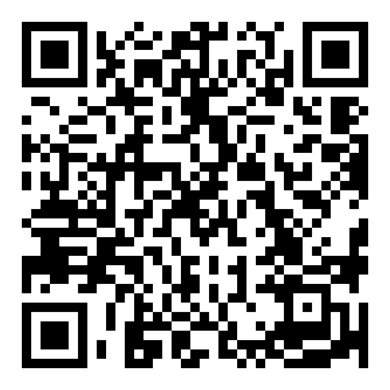
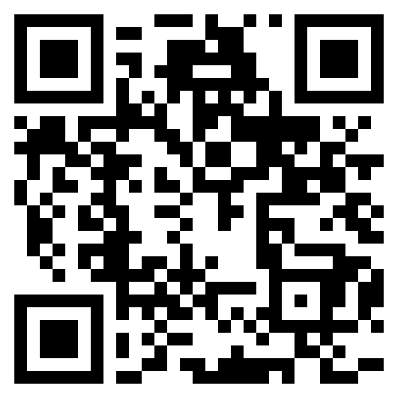
MALAYSIA’S JOURNEY WITH SNOMED CT
  MyHarmony 2017 MyHarmony 2019
Lesson learnt:
Do not forget clinical benefit when improving the tool and terminology
2009
2012
2013-2014
2015-2017
2017-2019
2020-2023
2024
Visit to one of the charter member country
Became the 22nd member country.
Developed a Cardiology SNOMED CT reference set.
MyHarmony v1.0 was developed.
MyHarmony v1.1 was developed with feature upgrade.
SNOMED CT Implementation in 50 clinic.
International Patient Summary (IPS) for Hajj Pilgrims.

Slide 6
MALAYSIA’S JOURNEY WITH SNOMED CT
Malaysia has 3000+ health clinics with ranging services
  About 1000+ are “full” health clinics (with general outpatient services, Maternal & Child Health services, laboratory, x-ray, mobile team, ancillary care).
50 clinics was equipped with a Clinic Care Management System (SystmOne by TPP).
Way Forward
  Interoperability – continuity of patient care between healthcare facilities, step-up / step-down care.
  Data analytics
Lesson learnt:
IYKYK (if you know, you know)
2009
2012
2013-2014
2015-2017
2017-2019
2020-2023
2024
Visit to one of the charter member country
Became the 22nd member country.
Developed a Cardiology SNOMED CT reference set.
MyHarmony v1.0 was developed.
MyHarmony v1.1 was developed with feature upgrade.
SNOMED CT Implementation in 50 clinic.
International Patient Summary (IPS) for Hajj Pilgrims.

Slide 7
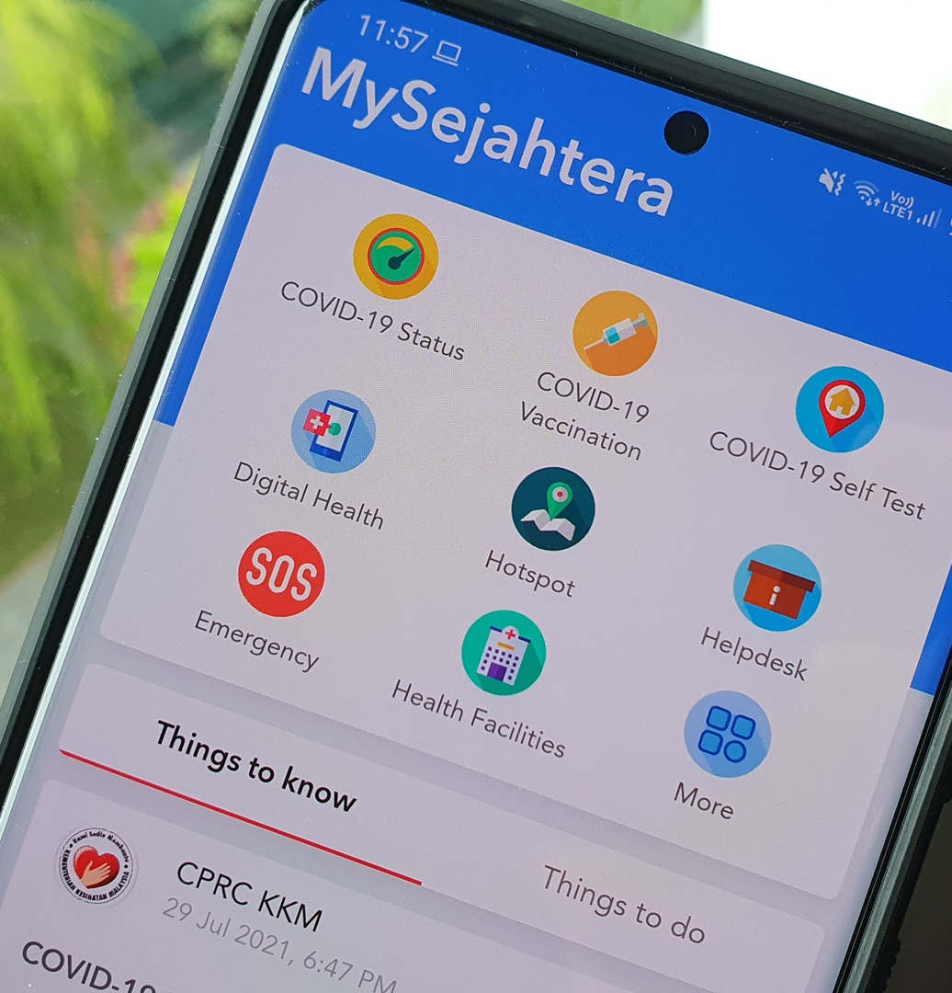
MALAYSIA’S JOURNEY WITH SNOMED CT
Provide International Patient Summary (IPS) through MySejahtera app.
Allow medical practitioners (Malaysian & Saudi government) to access basic health history and allergies.
Facilitate treatment should any medical incident occurs.
31,000+ Hajj pilgrims; 250+ MOH medical haj delegation (2023)
Lesson learnt:
Leverage existing data infrastructure & standards
2009
2012
2013-2014
2015-2017
2017-2019
2020-2023
2024
Visit to one of the charter member country
Became the 22nd member country.
Developed a Cardiology SNOMED CT reference set.
MyHarmony v1.0 was developed.
MyHarmony v1.1 was developed with feature upgrade.
SNOMED CT Implementation in 50 clinic.
International Patient Summary (IPS) for Hajj Pilgrims.

Slide 8




























THE PATIENT-CENTRIC VISION
Self Care
Patient Care
Population Care
System Care
Transforming Healthcare Service Delivery
(d)
Harnessing digital technologies
Advancing Promotive and Preventive Services
Ensuring Sustainable and Equitable Healthcare Financing
Strengthening the Health System Foundation and Governance
Malaysia Digital Economy Blueprint (MDEB)
Pelan Strategik Pendigitalan KKM 2021-2025
Pelan Strategik Pendigitalan Sektor Awam 2021-2025
National Fourth Industrial Revolution (4IR) Policy
Digital National Identification
National Digital Network (JENDELA)
“From womb to tomb”
Open Data Initiative
Omnibus Act

Slide 9
THE MOH DIGITAL HEALTH ECOSYSTEM
Hospital
Policy & Planning
Public Health
Clinic
TPC – OHCIS / CCMS
Clinical Services
CD, LIS, RIS, PhIS, BBIS, CCIS, etc.
Standards of Care
MyHDW, CaseMix, etc.
Disease Control
eNCDC, eNotifikasi, eWabak, etc.
Virtual Consultation
Outreach & Screening
Executive Services
Support Services
Registration, Billing, Record, etc.
HR & Assets
HRMIS, ASIS, MNHA, etc.
Health Research
Personal Care
Registries
PRIS, ARP, etc.
Executive Services
Management of HR, Asset, Quality
Regulatory
PRISMA, MMA, MeRITS, MedPCs, etc.
Personal Health Record
RekodSaya, MySejahtera
Research repositories
Infrastructure & Operations
Security & Privacy
Laws & Regulations
Informatics Standards
“From womb to tomb”
Self Care
Patient Care
Population Care
System Care
Notes:
2892 health clinics / 8419 private health clinics (1:4)
1695 dental clinics / 3053 private dental clinicis (1:3)
Not accounting the clinical support services (ambulatory care, physio, occ therapy, speech, hearing, diet, social services, etc)

Slide 10
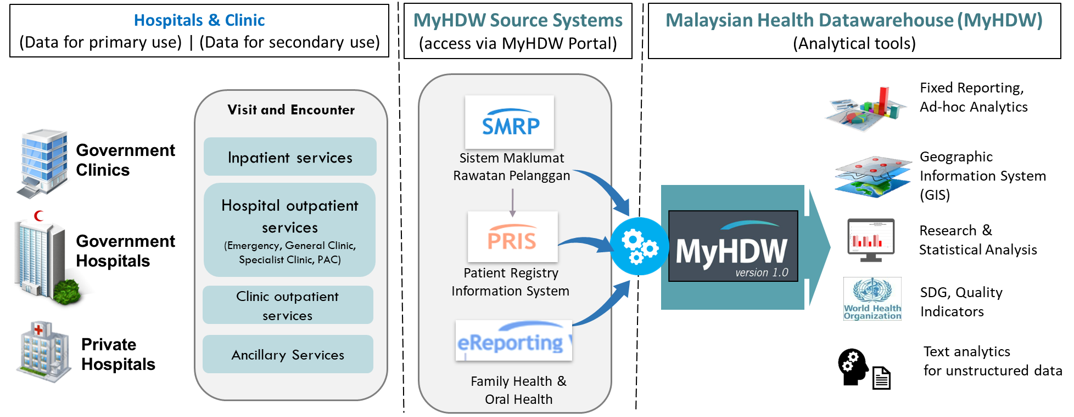

Malaysian Health Data Warehouse (MyHDW)
HIMS Blueprint
2010-2013
SMRP 1.0 & 1.1
2015-2016
MyHDW for analysis
2017-2019
GIS
2006-2007
SMRP 2.0 P1
1999
SMRP client-based
eReporting
Integration
Web-based
PRIS 1.0
SMRP 2.0 P2
MyHarmony 2.0
2023-2024
ICD11
Feature improvement
MyHarmony 1.0
IDS to HIC

Slide 11
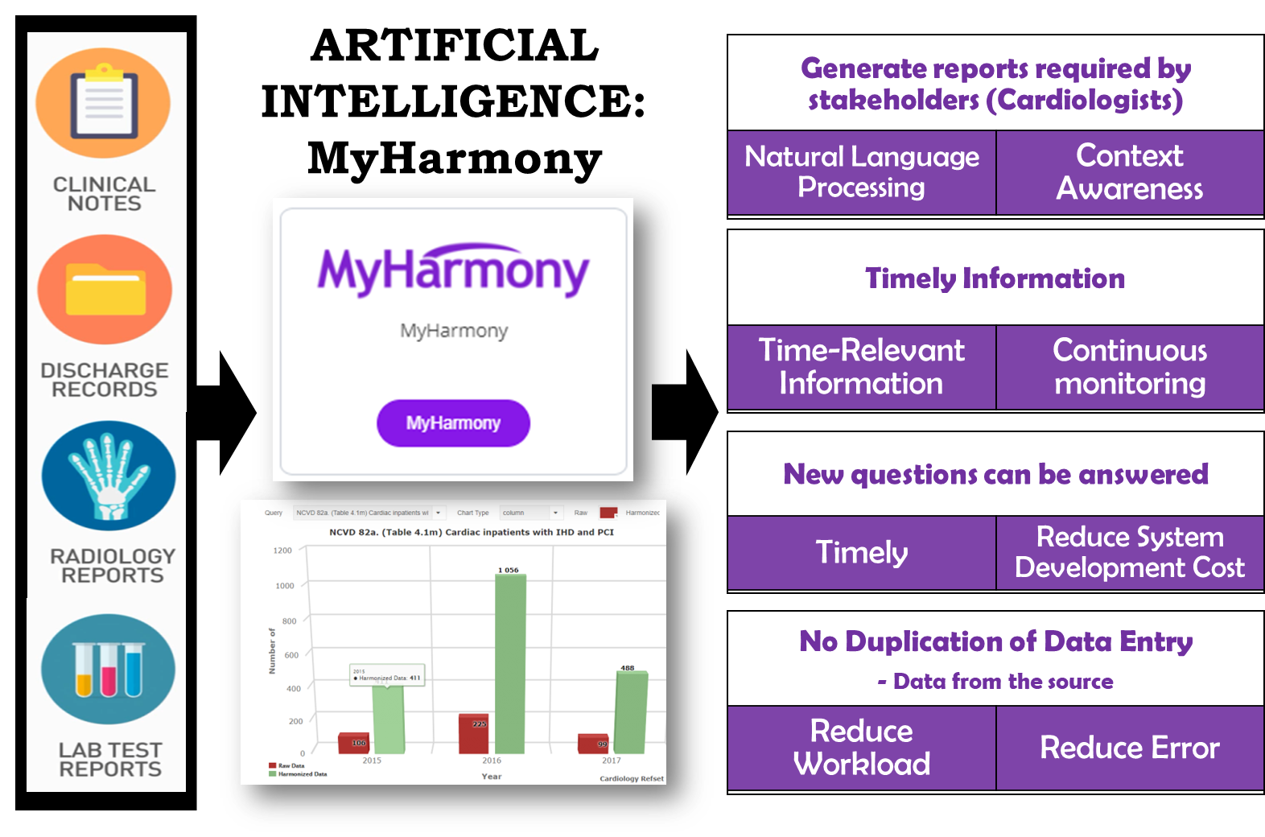
Malaysian Health Data Warehouse (MyHDW)
HIMS Blueprint
2010-2013
SMRP 1.0 & 1.1
2015-2016
MyHDW for analysis
2017-2019
GIS
2006-2007
SMRP 2.0 P1
1999
SMRP client-based
eReporting
Integration
Web-based
PRIS 1.0
SMRP 2.0 P2
MyHarmony 2.0
2023-2024
ICD11
Feature improvement
MyHarmony 1.0
IDS to HIC

Slide 12
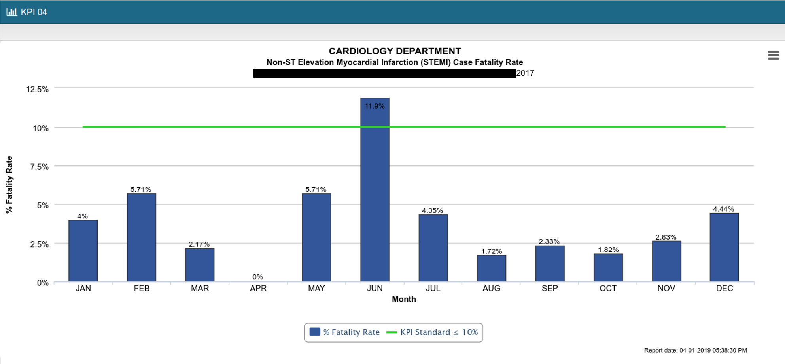
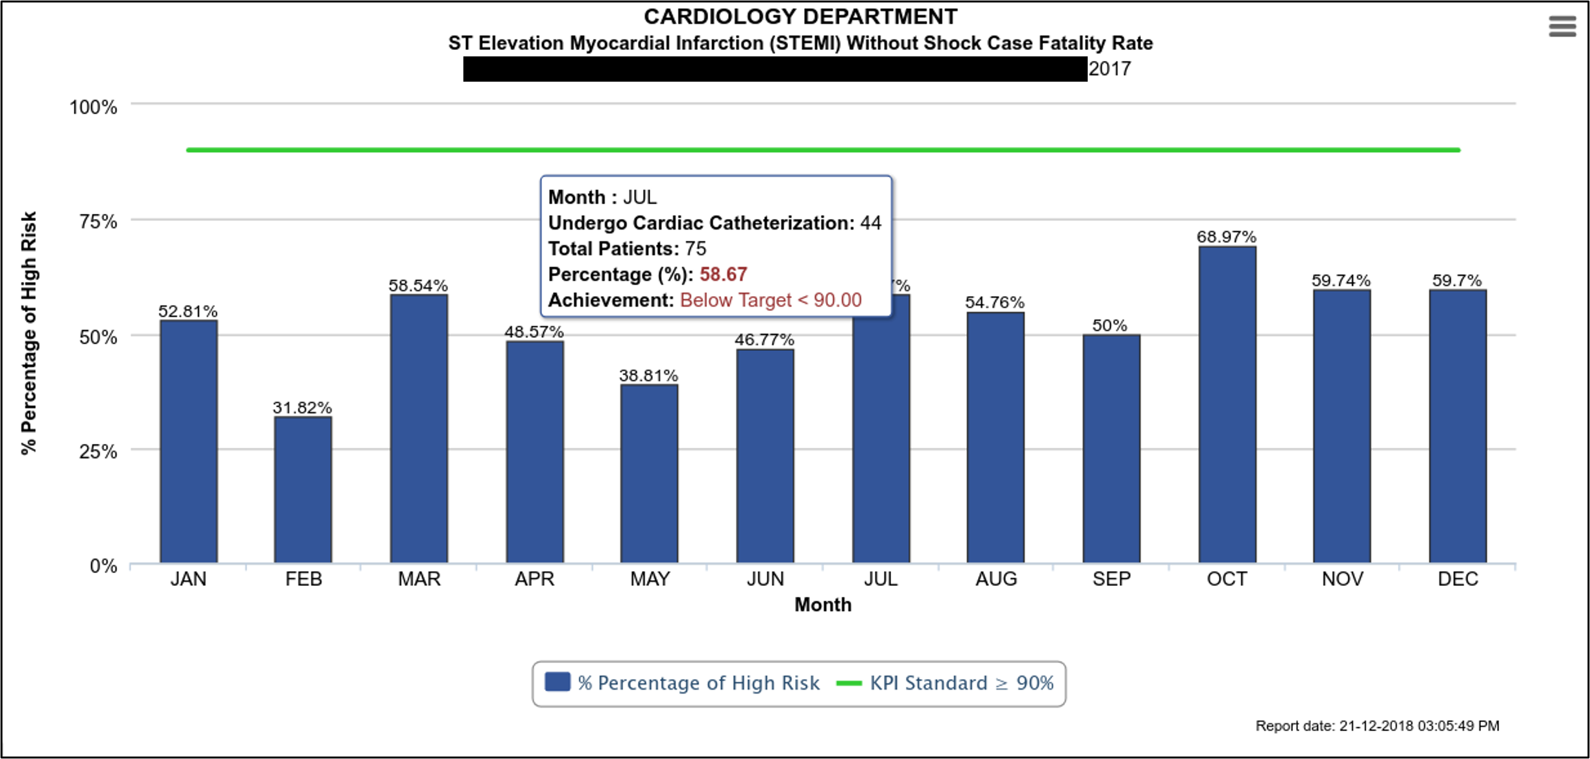
Malaysian Health Data Warehouse (MyHDW)
DAHSBOARD BENEFIT:
TIMELY – automatically updated
TIME- & COST-SAVING – automatically compiled
SELF-MONITORING – regularly monitor quality of services
FILTERable by year, sector, state, facilities
EXPORTable - Excel, PDF, image
HIMS Blueprint
2010-2013
SMRP 1.0 & 1.1
2015-2016
MyHDW for analysis
2017-2019
GIS
2006-2007
SMRP 2.0 P1
1999
SMRP client-based
eReporting
Integration
Web-based
PRIS 1.0
SMRP 2.0 P2
MyHarmony 2.0
2023-2024
ICD11
Feature improvement
MyHarmony 1.0
IDS to HIC

Slide 13
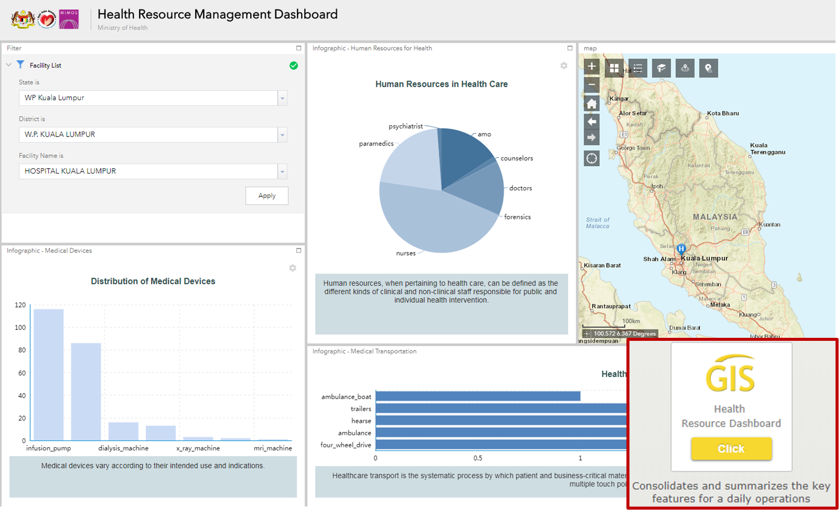
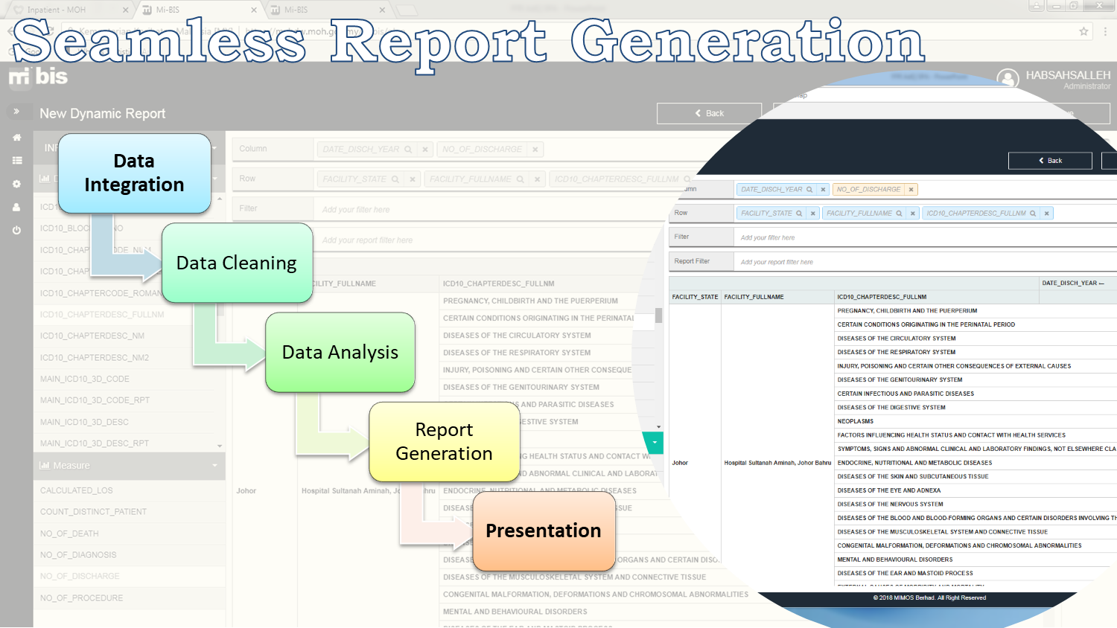
Malaysian Health Data Warehouse (MyHDW)
HIMS Blueprint
2010-2013
SMRP 1.0 & 1.1
2015-2016
MyHDW for analysis
2017-2019
GIS
2006-2007
SMRP 2.0 P1
1999
SMRP client-based
eReporting
Integration
Web-based
PRIS 1.0
SMRP 2.0 P2
MyHarmony 2.0
2023-2024
ICD11
Feature improvement
MyHarmony 1.0
IDS to HIC

Slide 14
DISCHARGE SUMMARY
60 y/o was electively admitted for holter monitoring
U/L : 1)Chronic AF sec to CRHD- Mixed Mitral valve disease predominantly MR, TR - MVR + TAP on 18/12/12 2)Hpt 3)DM 4)Gouty Arthritis 5)Eczema
e/a for holter monitoring
60 y/o Malay lady para 8 ADL independent PB : 1)Chronic AF sec to CRHD- Mixed Mitral valve disease predominantly MR, TR - MVR + TAP on 18/12/12 (IJN admission: 10 - 26/12/12) - planned for life long warfarin ( aim INR 2.5-3.5 ) - under IJN follow-up (next TCA March 2018) cardio follow up in HSNZ (next TCA 8-5-2018) 2)Hpt 3)DM 4)Gouty Arthritis 5)Eczema
o/e alert, pink conscious, not tachypneic CRT 2sec good hydration bp 142/102 pr 92 (manually) t 37 spo2 100% Under RA Lungs - Clear CVS S1S2 PSM 2/6 LLSE PA - Soft, non tender, no organomegaly
ECHOCARDIOGRAPHY (14/11/2017) EF 75% Good LV Systolic Function RWMA absent Enlarged Lt ventricle, Dilated Lt and Rt atrium prosthetic MV functioning well, no MR Severe TR, TV appear normal Thickened and calcified NCC of AV, moderate AR, no AS seen
GENERATING REPORTS using MyHARMONY (Cardiology)
Automated Report Generation from Electronic Discharge Summaries with SNOMED CT in AI

Slide 15
benefit of using MyHARMONY in generating reports from electronic discharge summary
Multiple data entries at the health facilities
Prone to transcribing error & increase workload
Manual data entry and manual submission (even for IT hospitals)
Aggregated data submitted monthly to CKPP
Result published yearly or upon request
Prone to delayed reaction and action
CONVENTIONAL
Single entry at electronic discharge summary in free text
Requires proper documentation and awareness
Semi-automated submission, automated codification, and automated KPI generation
Able to filter & drill down for every KPI due to granular data
More timely results and auto-generated results
MyHARMONY

Slide 16
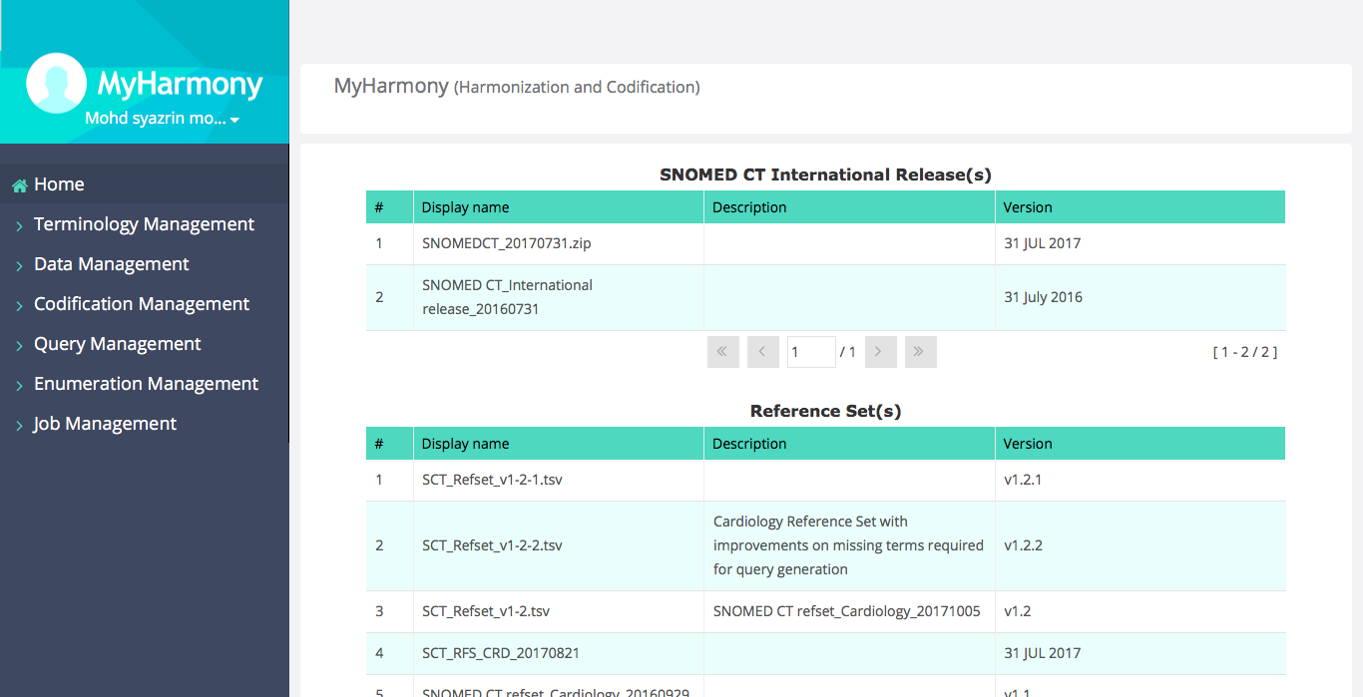
MyHarmony Interface

Slide 17
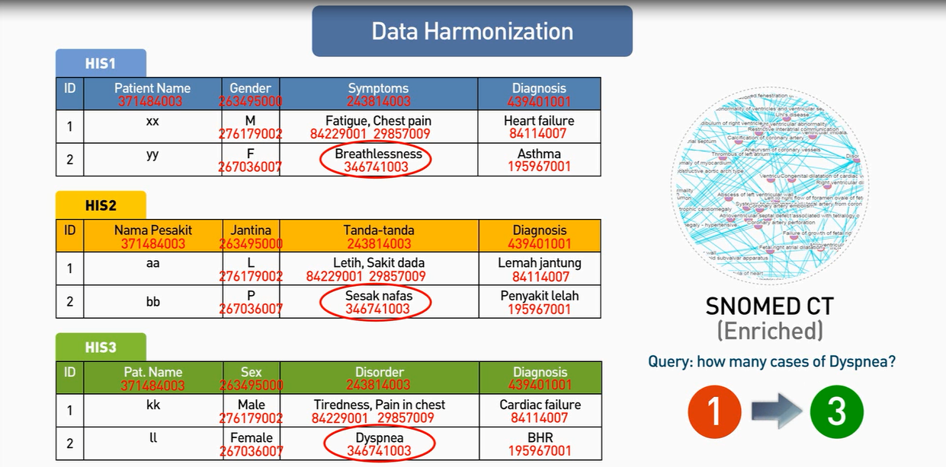
Harmonization Process
Notes:
the Implementation of SNOMED CT in MyHarmony allows for the analysis of unstructured data in the form of discharge summaries using a comprehensive clinical terminology standard. It also allows for automated interpretations that cover a wide range of specialties, disciplines and requirements, while ‘hierarchy and relationship’ components enable the combination of precise clinical concepts. MyHarmony was engineered to support direct patient care, clinical audit, research, epidemiology, management and service planning. Another key advantage of MyHarmony is that it allows the use of preferred terms that suit local preferences in addition to maintaining data quality by preventing costly errors and duplication.

Slide 18
SNOMED CT Codification
Notes:
There were three (3) major deliverables in the conceptual stage. The first part refers to the development and implementation of health terminology standards, namely SNOMED CT, which will be the knowledge bases for MyHarmony. The second part was harmonization of the medical terminology to SNOMED CT terms by way of mapping. The last part was about the development and implementation of MyHarmony to show that the application can codify relevant terms in free-text using Natural Language Processing (NLP) technique. The SNOMED CT codified data can then be analysed for information generation.

Slide 19
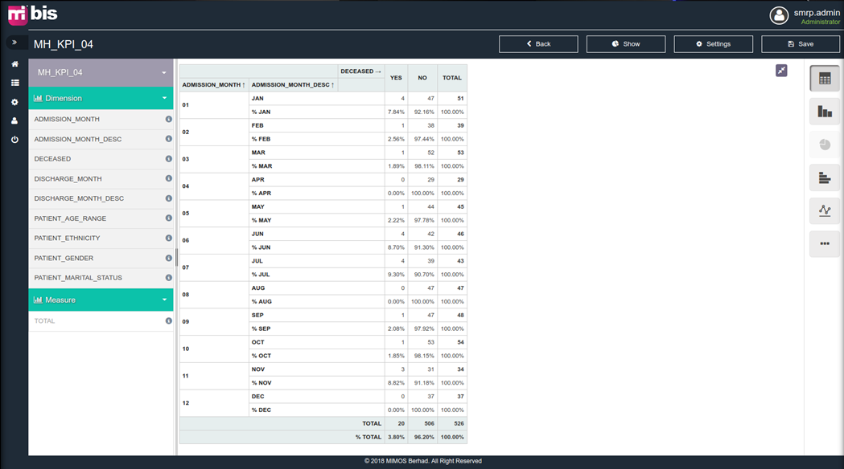
Report Generation
Notes:
There were three (3) major deliverables in the conceptual stage. The first part refers to the development and implementation of health terminology standards, namely SNOMED CT, which will be the knowledge bases for MyHarmony. The second part was harmonization of the medical terminology to SNOMED CT terms by way of mapping. The last part was about the development and implementation of MyHarmony to show that the application can codify relevant terms in free-text using Natural Language Processing (NLP) technique. The SNOMED CT codified data can then be analysed for information generation.

Slide 20
Dashboard
Notes:
There were three (3) major deliverables in the conceptual stage. The first part refers to the development and implementation of health terminology standards, namely SNOMED CT, which will be the knowledge bases for MyHarmony. The second part was harmonization of the medical terminology to SNOMED CT terms by way of mapping. The last part was about the development and implementation of MyHarmony to show that the application can codify relevant terms in free-text using Natural Language Processing (NLP) technique. The SNOMED CT codified data can then be analysed for information generation.

Slide 21
GENERATING REPORTS using MyHARMONY (dentistry)
Automated Report Generation for Dentistry with SNOMED CT in AI

Slide 22
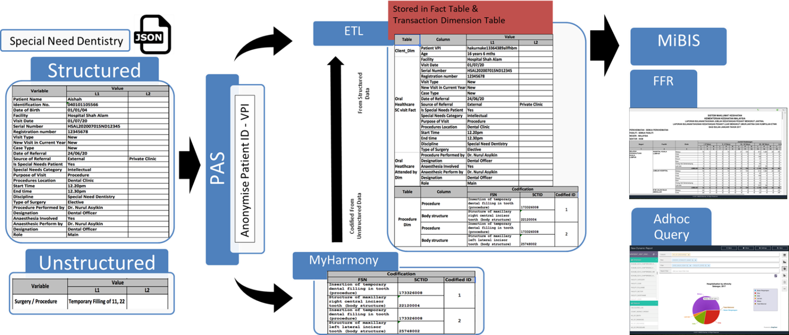
MyHarmony for Dentistry
eReporting V2.0 (Oral Health)
Malaysian Health Data Warehouse (MyHDW)
REPORTING
Notes:
There were three (3) major deliverables in the conceptual stage. The first part refers to the development and implementation of health terminology standards, namely SNOMED CT, which will be the knowledge bases for MyHarmony. The second part was harmonization of the medical terminology to SNOMED CT terms by way of mapping. The last part was about the development and implementation of MyHarmony to show that the application can codify relevant terms in free-text using Natural Language Processing (NLP) technique. The SNOMED CT codified data can then be analysed for information generation.

Slide 23
MAPPING LABORATORY INFORMATION SYSTEM TO LOINC AND SNOMED CT
Automated Report Generation for Dentistry with SNOMED CT in AI

Slide 24
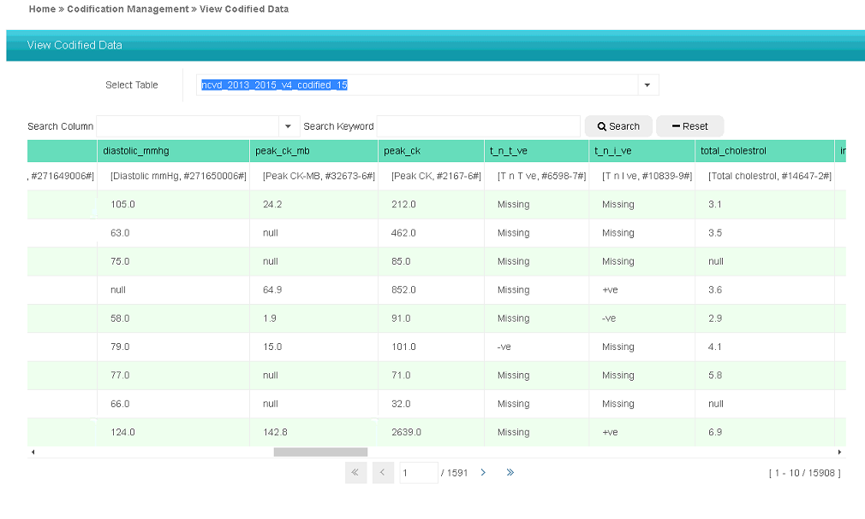
MyHarmony for Pathology
Tripartite arrangement: NRC, Pathologists, Reginstrief
Aim: Automated coding of Laboratory Information System (LIS) test name to LOINC, and test results in SNOMED CT
Challenge: Panel test which may differ in facilities.
Notes:
There were three (3) major deliverables in the conceptual stage. The first part refers to the development and implementation of health terminology standards, namely SNOMED CT, which will be the knowledge bases for MyHarmony. The second part was harmonization of the medical terminology to SNOMED CT terms by way of mapping. The last part was about the development and implementation of MyHarmony to show that the application can codify relevant terms in free-text using Natural Language Processing (NLP) technique. The SNOMED CT codified data can then be analysed for information generation.

Slide 25
BEGIN WITH THE END IN MIND:
MALAYSIA’S JOURNEY WITH SNOMED CT
20 Oct 2024 (Member Forum) | 21 Oct 2024 (Clinical Implementation in Asia)
Dr. ‘Ismat Mohd Sulaiman
Senior Principal Assistant Director
Health Informatics Centre, Planning Division, MoH Malaysia
MD, MSc (Health Informatics), PhD candidate in Public Health Informatics
drismat@moh.gov.my | Linkedin: drismat | +60162528651

