Slide 1
Revised proposal for modeling cerebrovascular accidents

Slide 2

AHA/ASA universal consensus definition of stroke*
The leadership of the AHA/ASA reached out to colleagues from the American Academy of Neurology, the American Association of Neurological Surgeons and Congress of Neurological Surgeons, the US Food and Drug Administration, the US Centers for Disease Control and Prevention, the National Institute of Neurological Disorders and Stroke, and others to establish a universal definition of stroke based on the current understanding of pathophysiology, as well as implications for clinical practice, research, and public policy.
The writing group was composed of experts in neurology, neurosurgery, neuroradiology, neuropathology, clinical research methods, epidemiology, biomarkers, policy, and global public health.
An Updated Definition of Stroke for the 21st Century https://doi.org/10.1161/STR.0b013e318296aeca Stroke. 2013;44:2064-2089
* At the end of deliberations, the final recommendations for the definition of stroke were not acceptable by the leadership of the European Stroke Organization and World Stroke Organization. These organizations declined to participate further in this statement. Their dissent was mainly associated with the inclusion of silent cerebral infarction and silent cerebral hemorrhage within the universal definition of stroke.

Slide 3
Stroke definition (WHO 1970)
Rapidly developing clinical signs of focal (or global) disturbance of cerebral function, with symptoms lasting 24 hours or longer or leading to death, with no apparent cause other than vascular origin.
The pathological background for stroke may either be ischemic or hemorrhagic disturbances of the cerebral blood circulation
Although still widely used, the World Health Organization definition relies heavily on clinical symptoms and is now considered outdated by the American Heart Association and American Stroke Association due to significant advances in the ‘nature, timing, clinical recognition of stroke and its mimics, and imaging findings.

Slide 4
Stroke definition (UpToDate® April 15, 2020)
A stroke is acute an neurologic injury that occurs as a result of one of these pathologic processes.
  Brain ischemia due to thrombosis, embolism, or systemic hypoperfusion
  Brain hemorrhage due to intracerebral hemorrhage (ICH) or subarachnoid hemorrhage (SAH)

Slide 5
Review of injury model

Slide 6
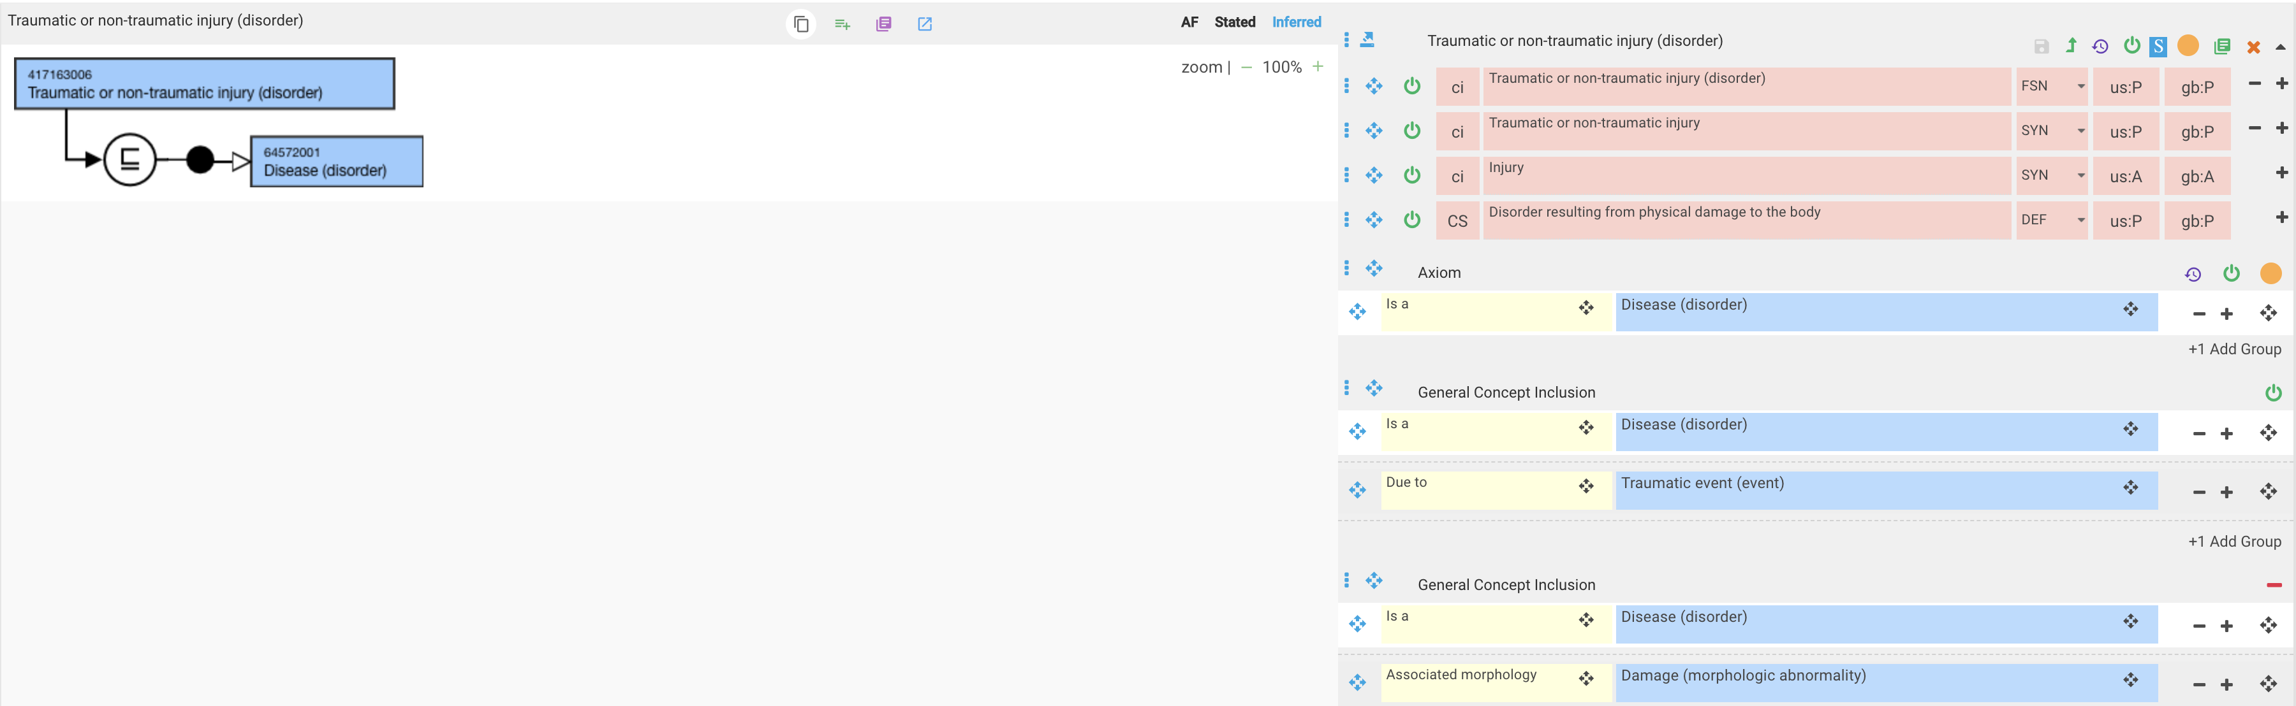
417163006 |Traumatic or non-traumatic injury (disorder)|

Slide 7
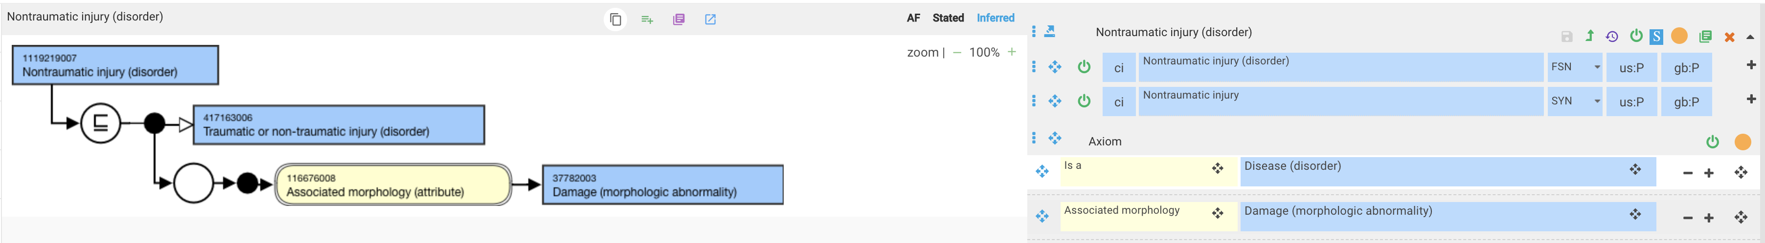
1119219007 |Nontraumatic injury (disorder)|

Slide 8
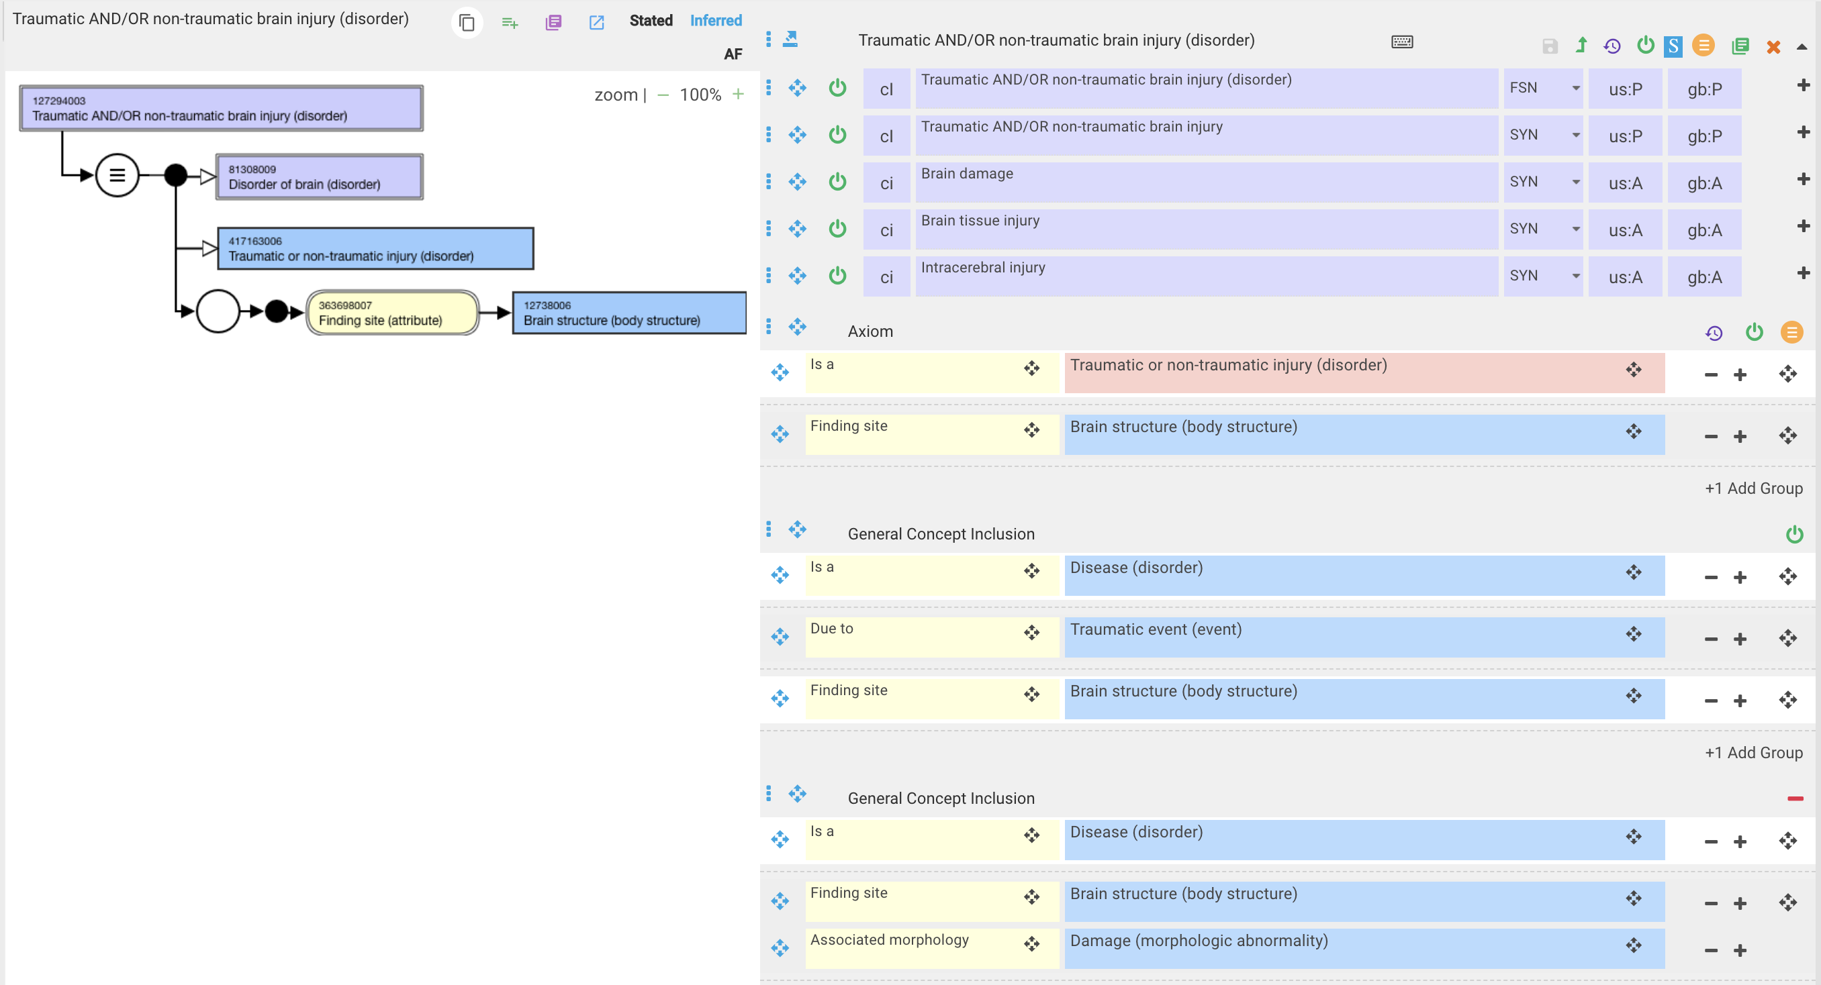
127294003 |Traumatic AND/OR non-traumatic brain injury (disorder)|

Slide 9
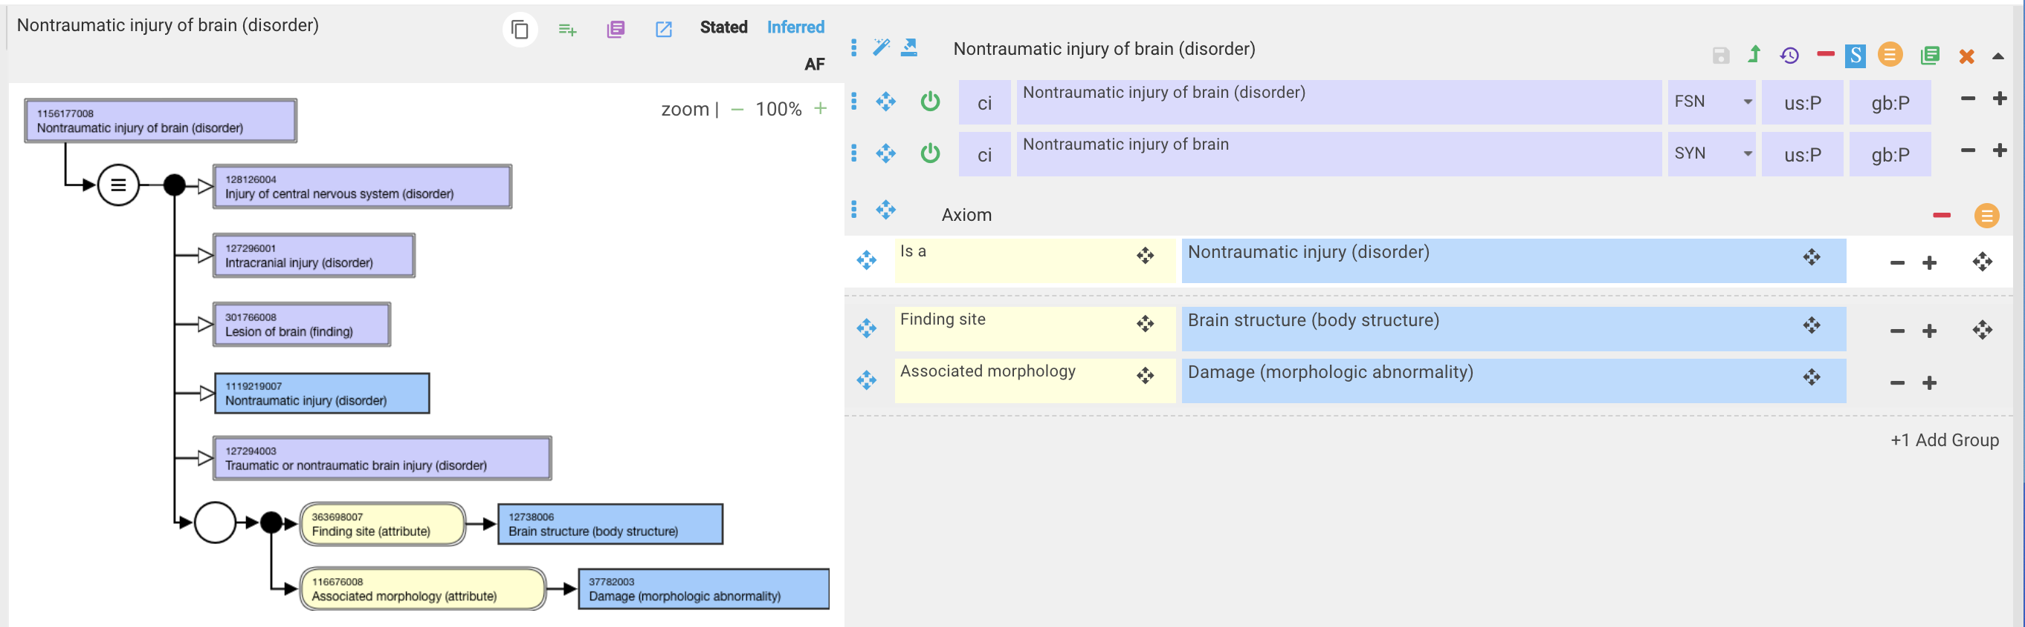
1156035006 |Nontraumatic injury of brain (disorder)|

Slide 10
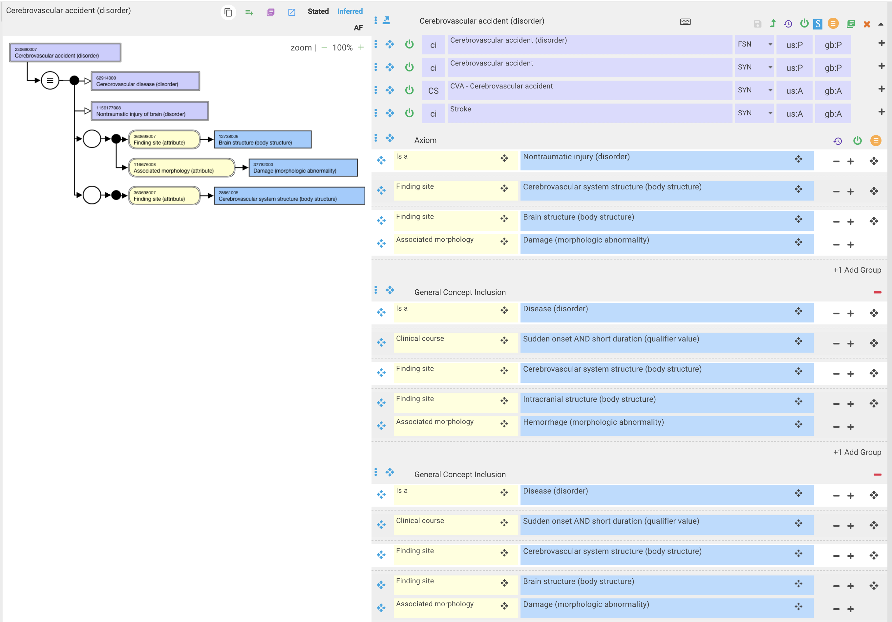
Proposed model for 230690007 |Cerebrovascular accident (disorder)|

Slide 11
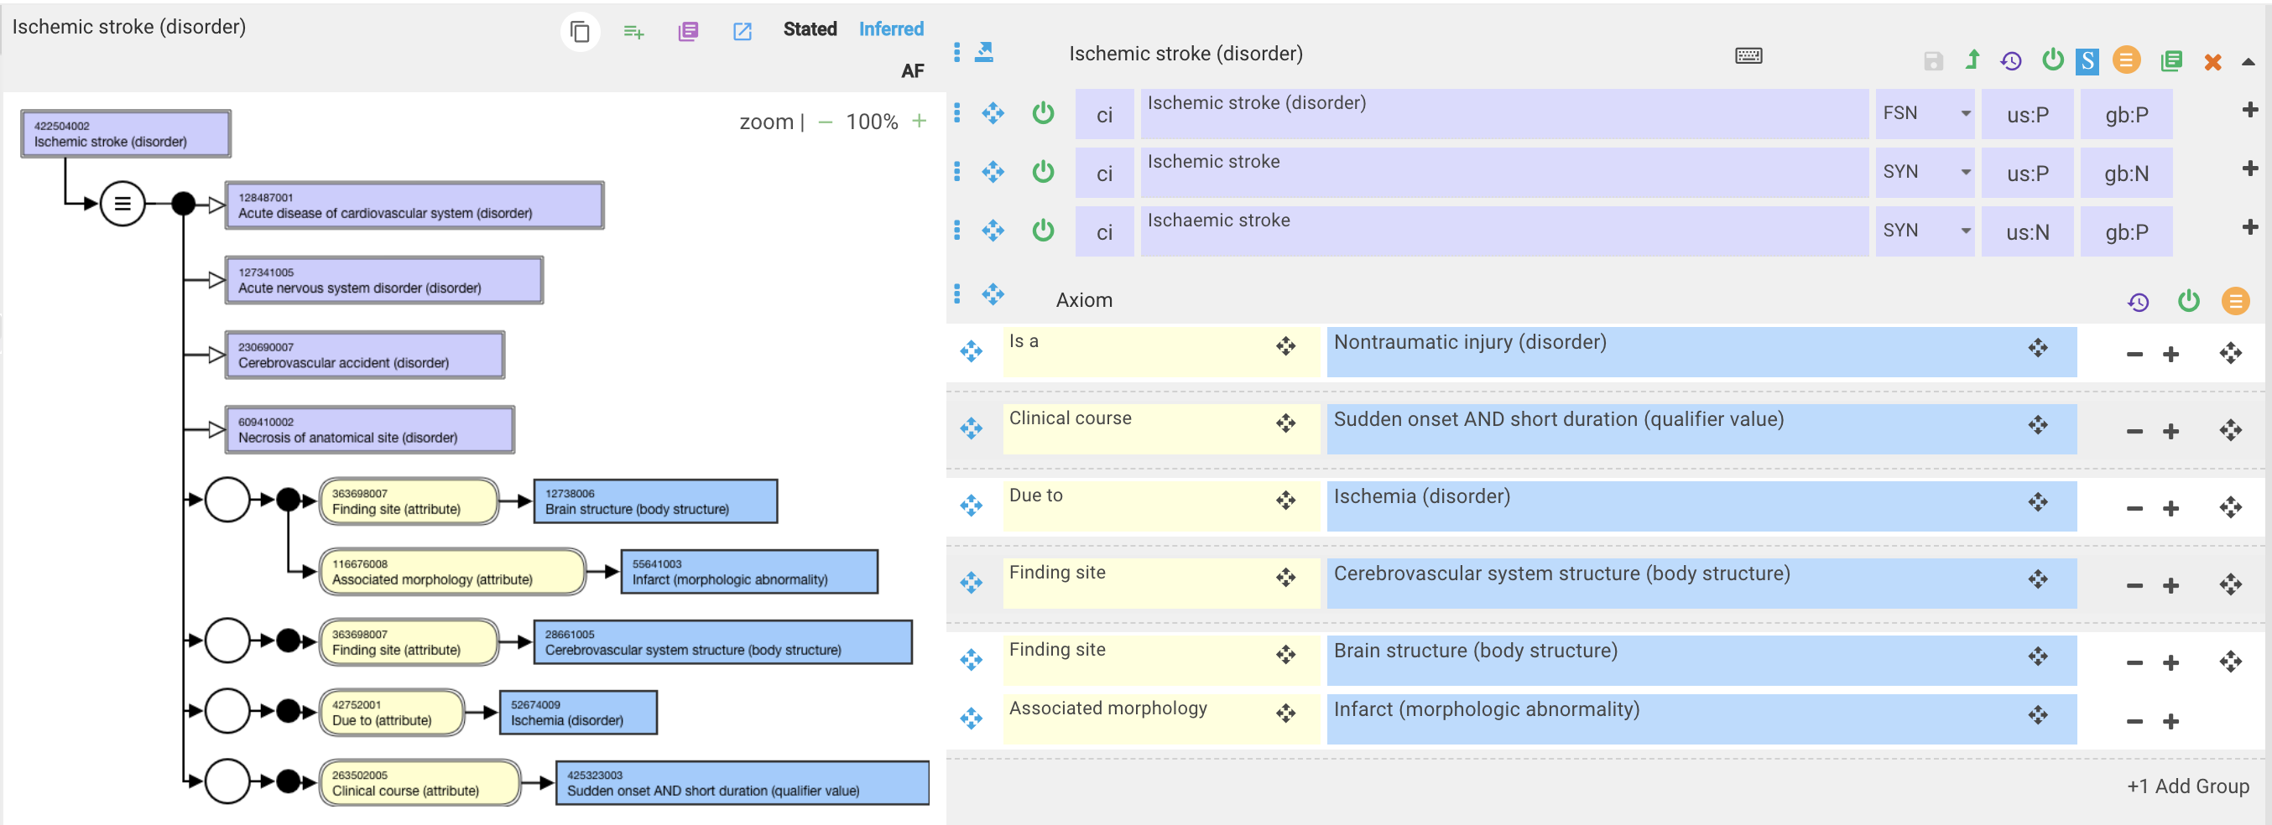
422504002 |Ischemic stroke (disorder)|

Slide 12
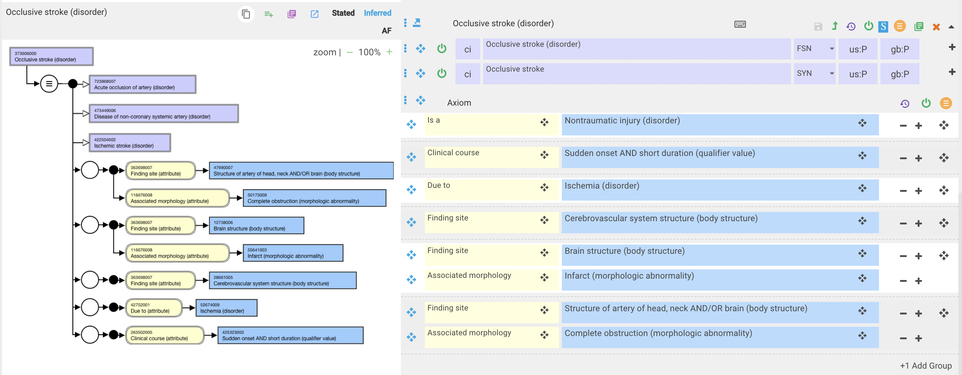
373606000 |Occlusive stroke (disorder)|

Slide 13
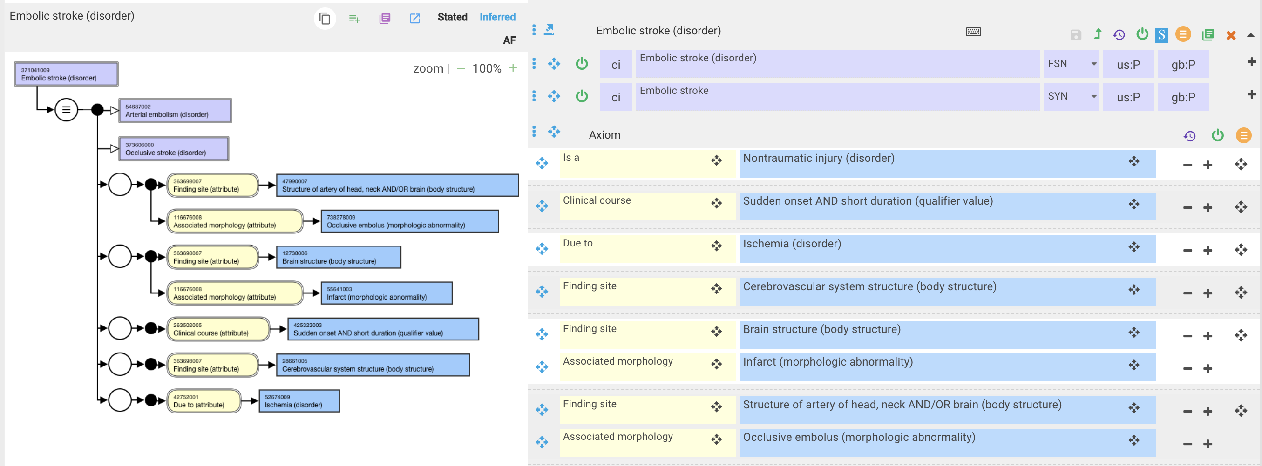
371041009 |Embolic stroke (disorder)|

Slide 14
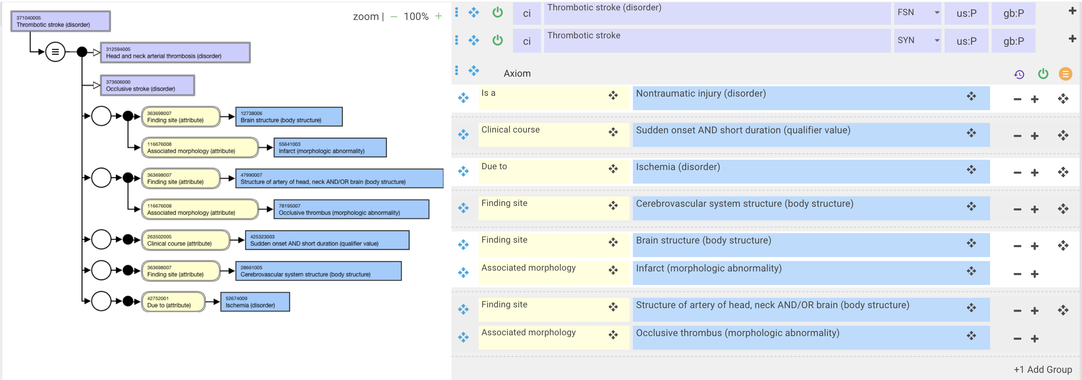
371040005 |Thrombotic stroke (disorder)|

Slide 15
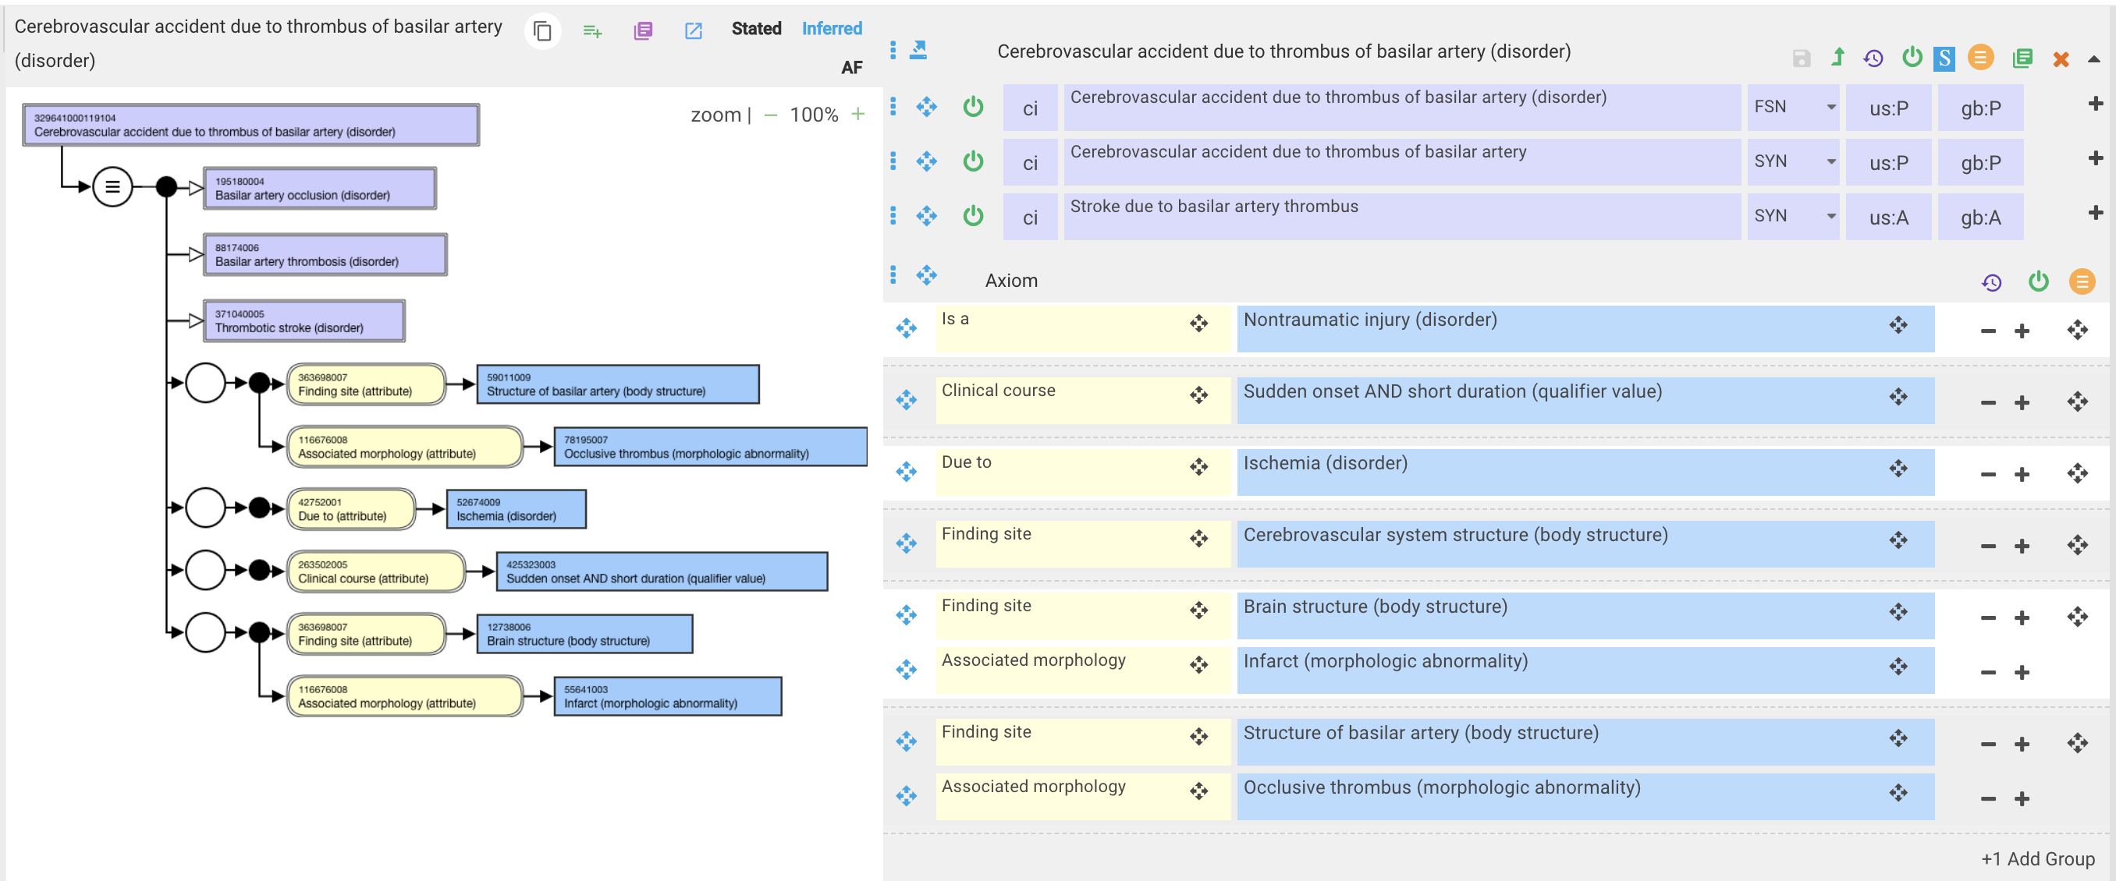
329641000119104 |Cerebrovascular accident due to thrombus of basilar artery (disorder)|

Slide 16
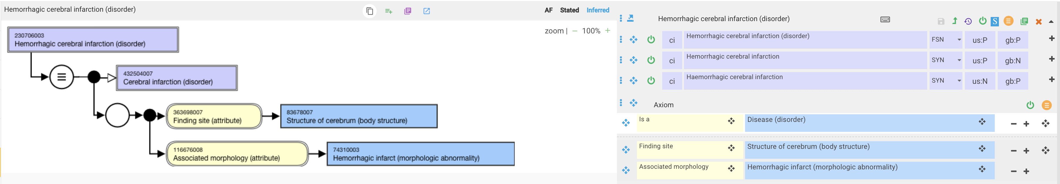
230706003 |Hemorrhagic cerebral infarction (disorder)|
A hemorrhagic cerebral infarction is not the same as a hemorrhagic stroke. Infarcts are the result of ischemic strokes. "A hemorrhagic infarct (HI) can be defined as an ischemic infarct in which an area of bleeding exists within necrosing cerebral tissue". A hemorrhagic stroke is the result of a subarachnoid or intracerebral bleed.

Slide 17
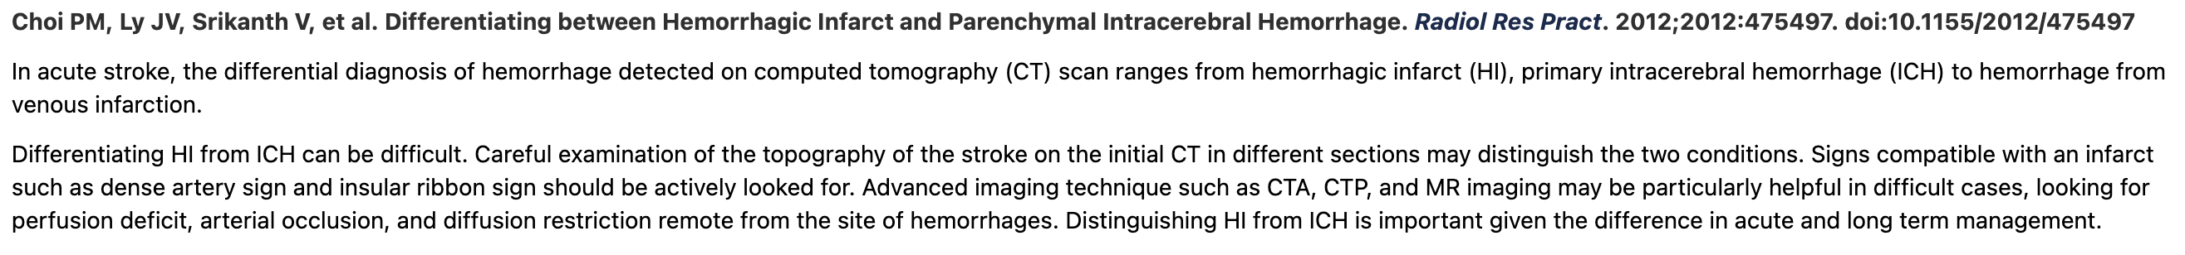
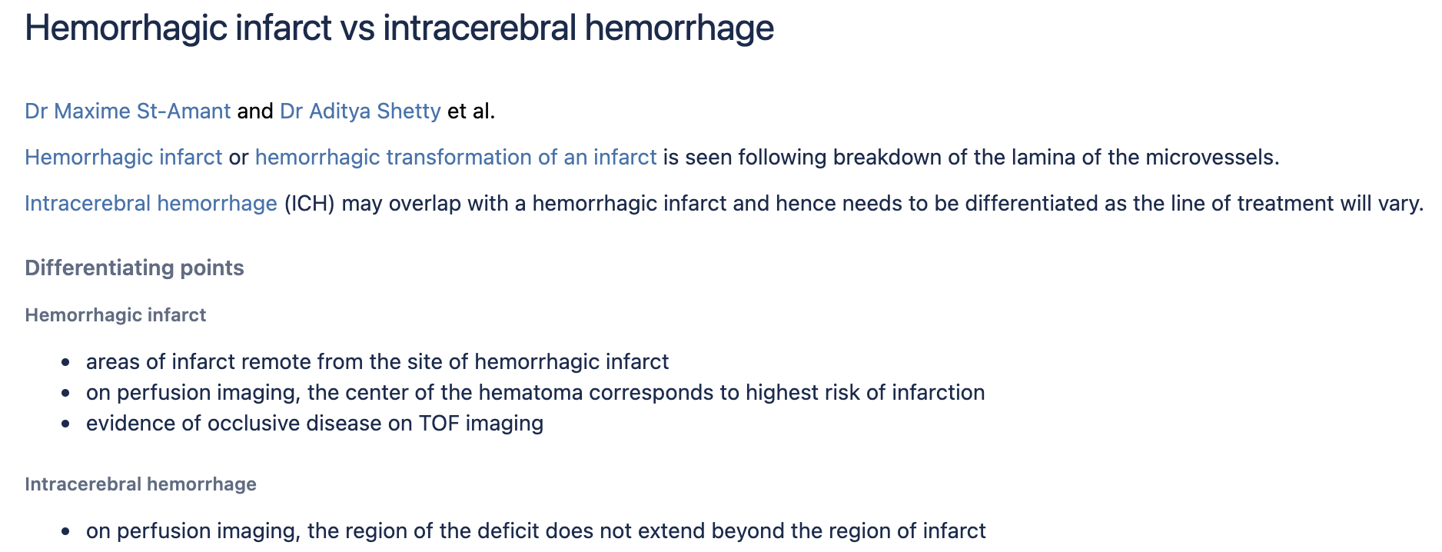
Hemorrhagic infarct vs. hemorrhagic stroke – can they be distinguished?
The two types of hemorrhagic strokes are intracerebral (within the brain) hemorrhage or subarachnoid hemorrhage.

Slide 18
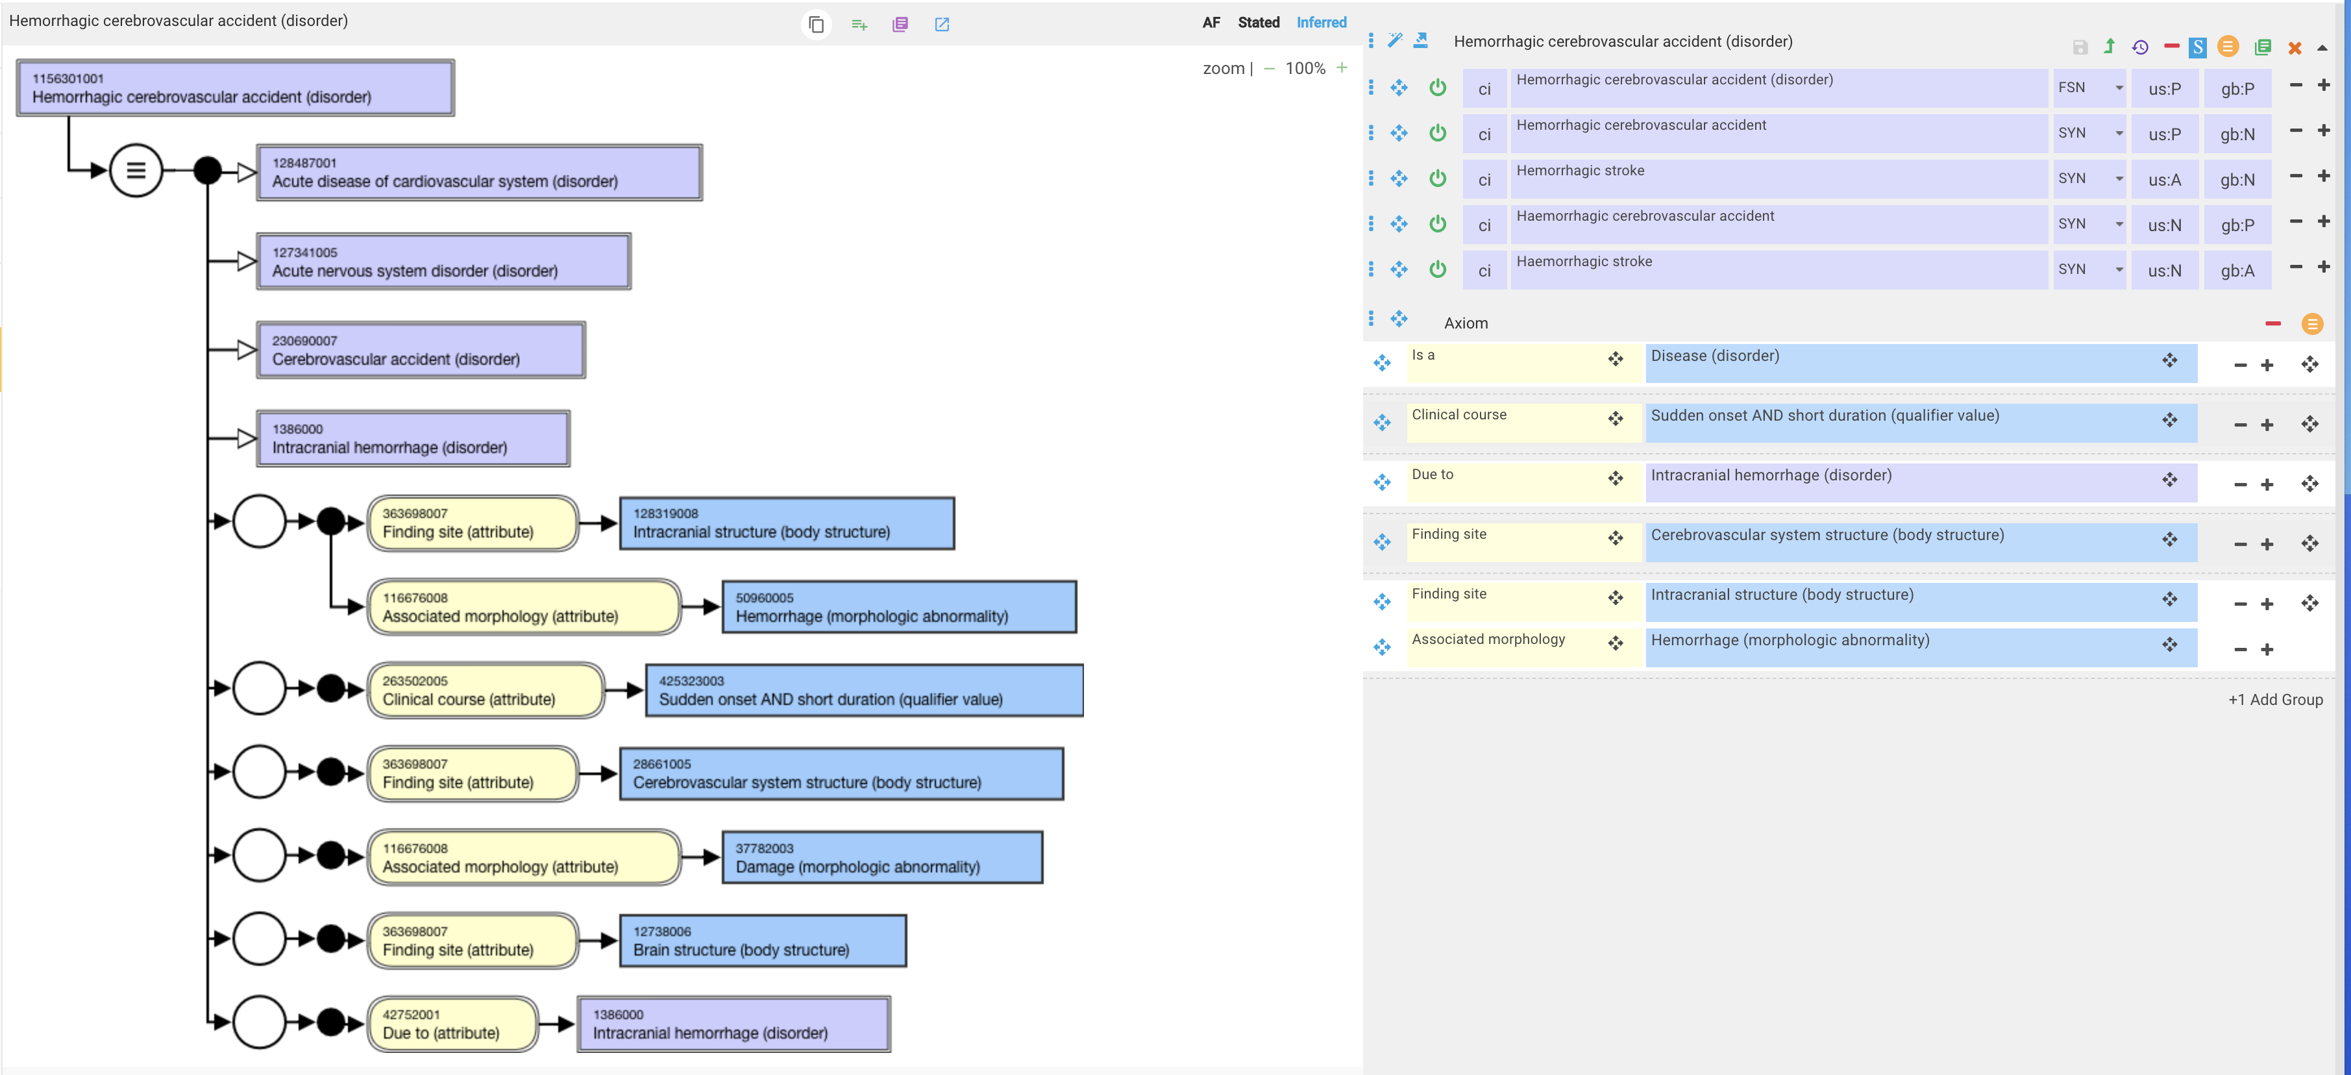
Hemorrhagic stroke – new concept

Slide 19
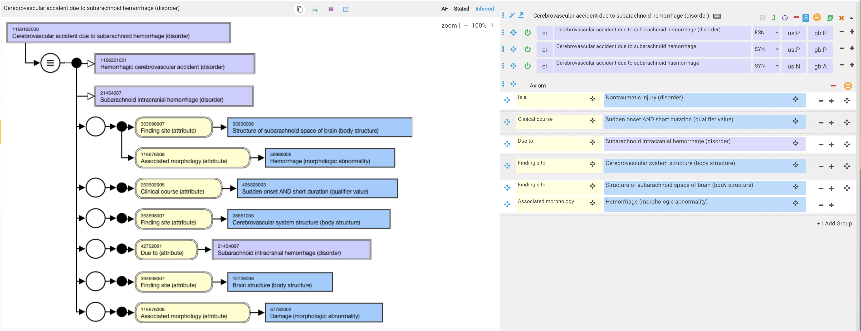
1156162000 |Cerebrovascular accident due to subarachnoid hemorrhage (disorder)|

