Slide 1
Pressure injuries

Slide 2
From Pressure Ulcers to “Pressure Injury”: Disambiguation and Anthropology¹
The Pressure Ulcer Advisory Panel (NPUAP) released a monumental change to the taxonomy of pressure ulcers that essentially abandons the use of the time-honored nomenclature that used “pressure ulcers” as the basis for its classification system. In the new regimen, the term “pressure ulcers” will be replaced by a taxonomic nomenclature referred to as “pressure injury.”
The new taxonomy is described as “injured intact skin, and the other stages beyond are described as open ulcers.”
According to the NPUAP,^{1,2} the previous staging system led to “confusion because the definitions for each of the “injury” stages were referred to as “pressure ulcers.”
¹Advances in Skin & Wound Care: July 2016 - Volume 29 - Issue 7 - p 295doi: 10.1097/01.ASW.0000484588.03086.13

Slide 3
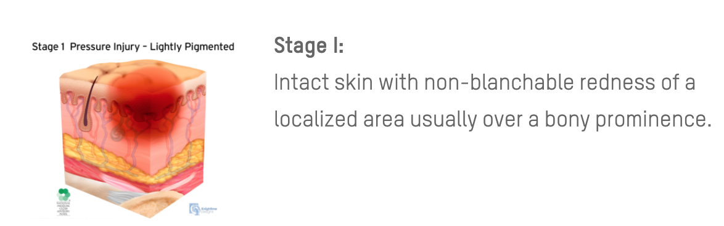
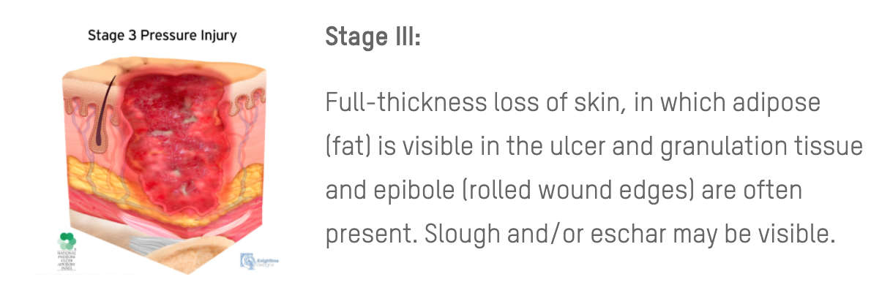
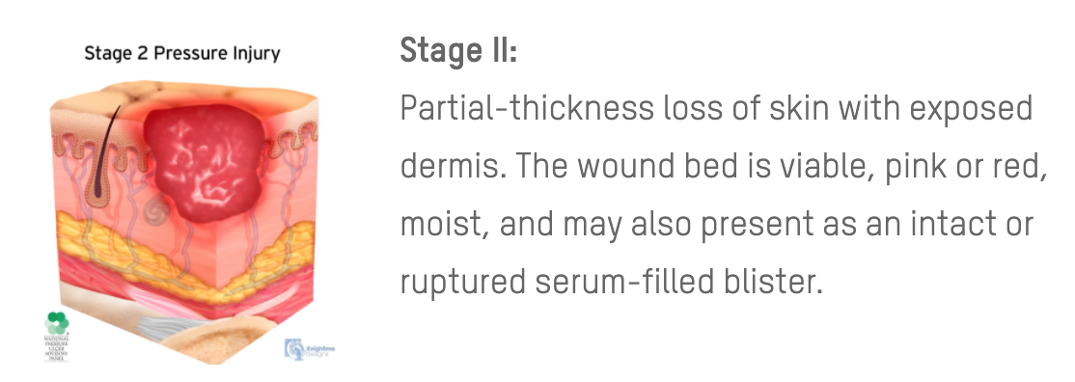
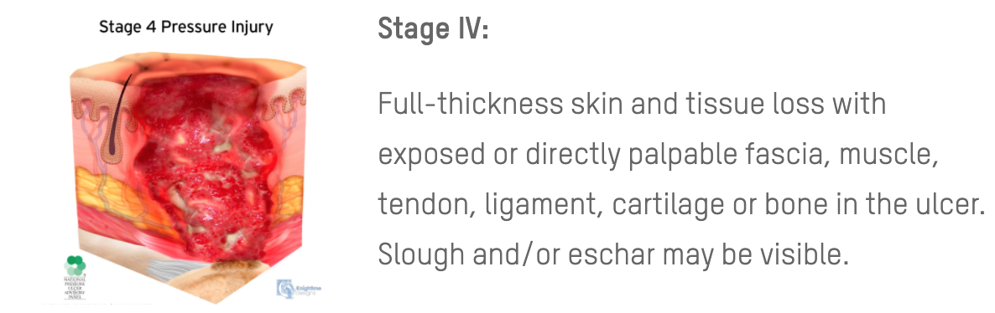
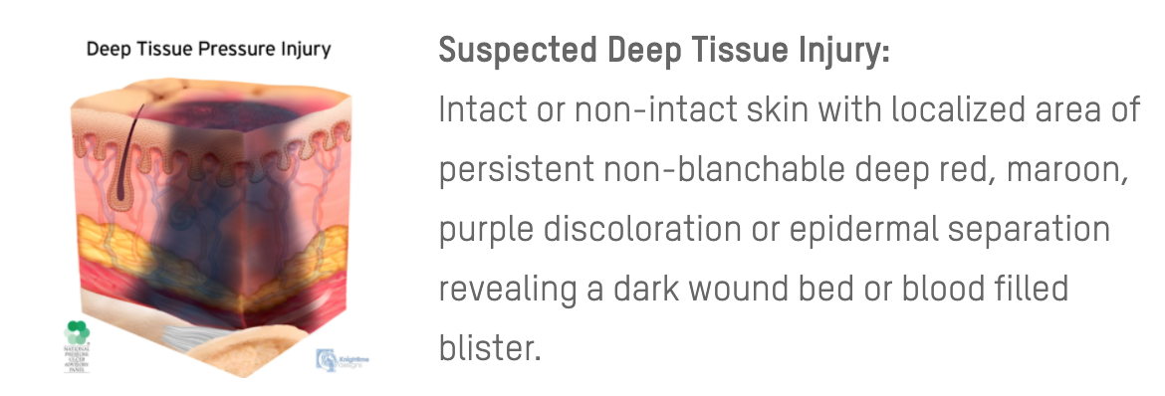
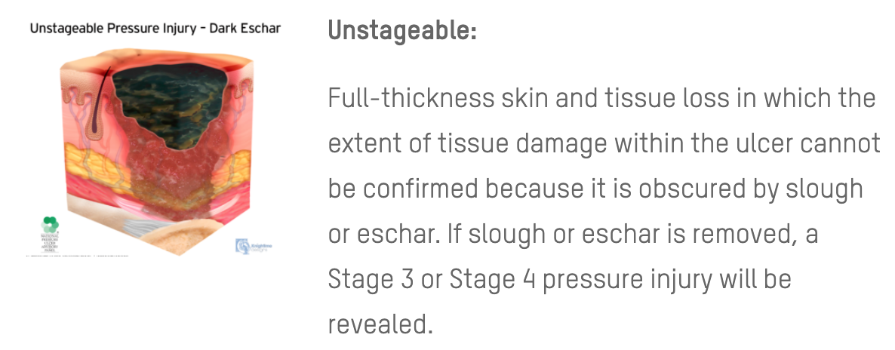
NPUAP Pressure Injury Classification

Slide 4
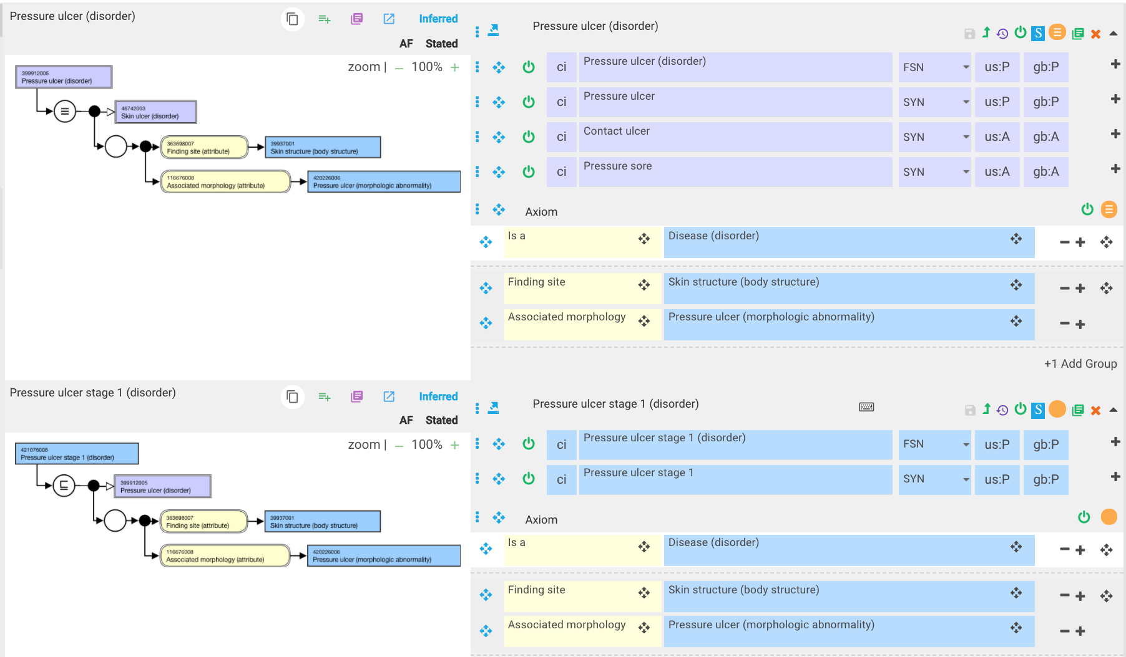
Pressure ulcers in SNOMED CT (all have morphology of 420226006 |Pressure ulcer (morphologic abnormality)|

Slide 5
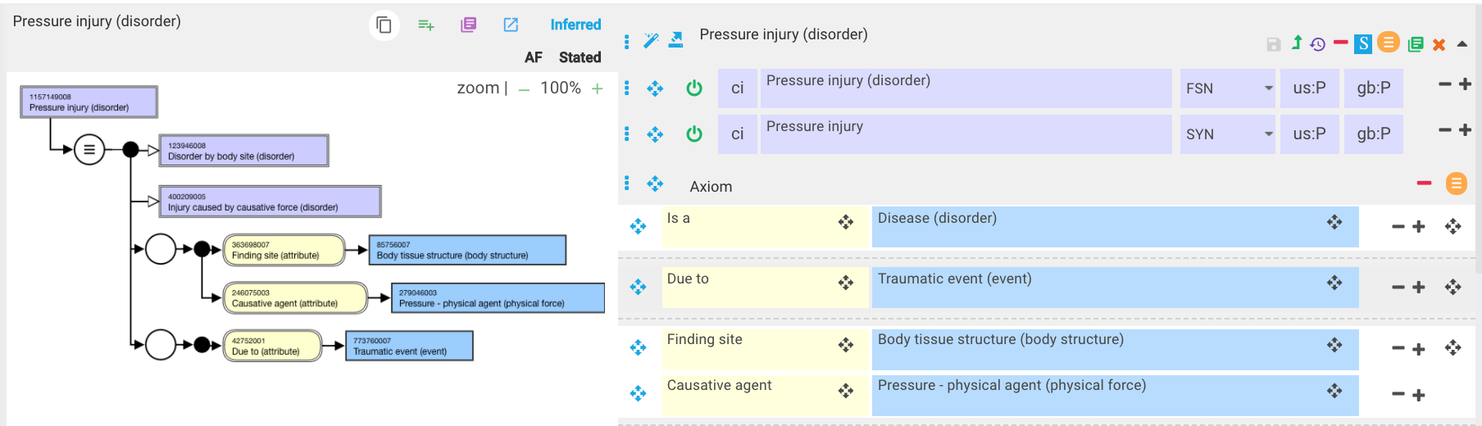
1157149008 |Pressure injury (disorder)|

Slide 6
Pressure injury is currently a synonym of Crushing injury (morphologic abnormality)

Slide 7
Are pressure injuries traumatic or nontraumatic?
A pressure injury is localized damage to the skin and/or underlying soft tissue, usually over a bony prominence or related to a medical or other device.
The injury can present as intact skin or an open ulcer and may be painful.
The injury occurs as a result of intense and/or prolonged pressure or pressure in combination with shear.
The tolerance of soft tissue for pressure and shear also may be affected by microclimate, nutrition, perfusion, co-morbidities and condition of the soft tissue.

Slide 8
Pressure injury stages
It will be difficult to SD pressure injury stages using morphologies and finding sites based on the complexity of the NPUAP definitions

Slide 9
Proposed model for pressure injuries including stages

Slide 10
Proposed model
Create new morphologies with text definitions from NPUAP :
  Damage (morphologic abnormality)
    Pressure injury (morphologic abnormality)
      Pressure injury stage 1 (morphologic abnormality)
      Pressure injury stage 2 (morphologic abnormality)
      Pressure injury stage 3 (morphologic abnormality)
      Pressure injury stage 4 (morphologic abnormality)
      Unstageable pressure injury (morphologic abnormality)
Model as Traumatic or nontraumatic injuries with morphologies of specific pressure injury stages
  Similar to current representation of burn injuries in SNOMED (see next 2 slides)
As cause of pressure injuries can be either pressure and/or shearing force, use a causative agent relationship to 78621006 |Physical force (physical force)|in the model

Slide 11
Current modeling of burn injuries in SNOMED CT
1st degree burn
3rd degree burn
2nd degree burn

Slide 12
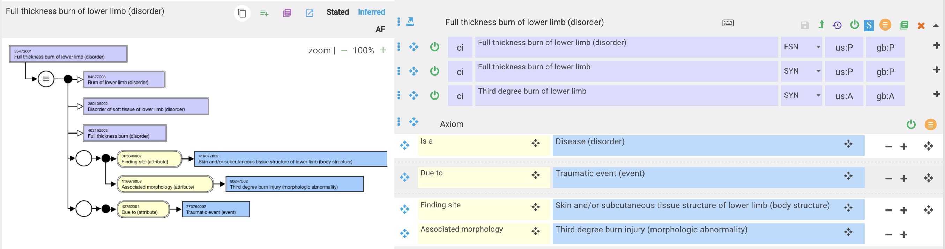
Current modeling of burn injuries in SNOMED CT - 2
Concept | Preferred Term | Id
Fourth degree burn injury (morphologic abnormality) | Fourth degree burn injury | 770400008
Third degree burn injury (morphologic abnormality) | Third degree burn injury | 80247002
First degree burn injury (morphologic abnormality) | First degree burn injury | 77140003
Second degree burn injury (morphologic abnormality) | Second degree burn injury | 46541008

Slide 13
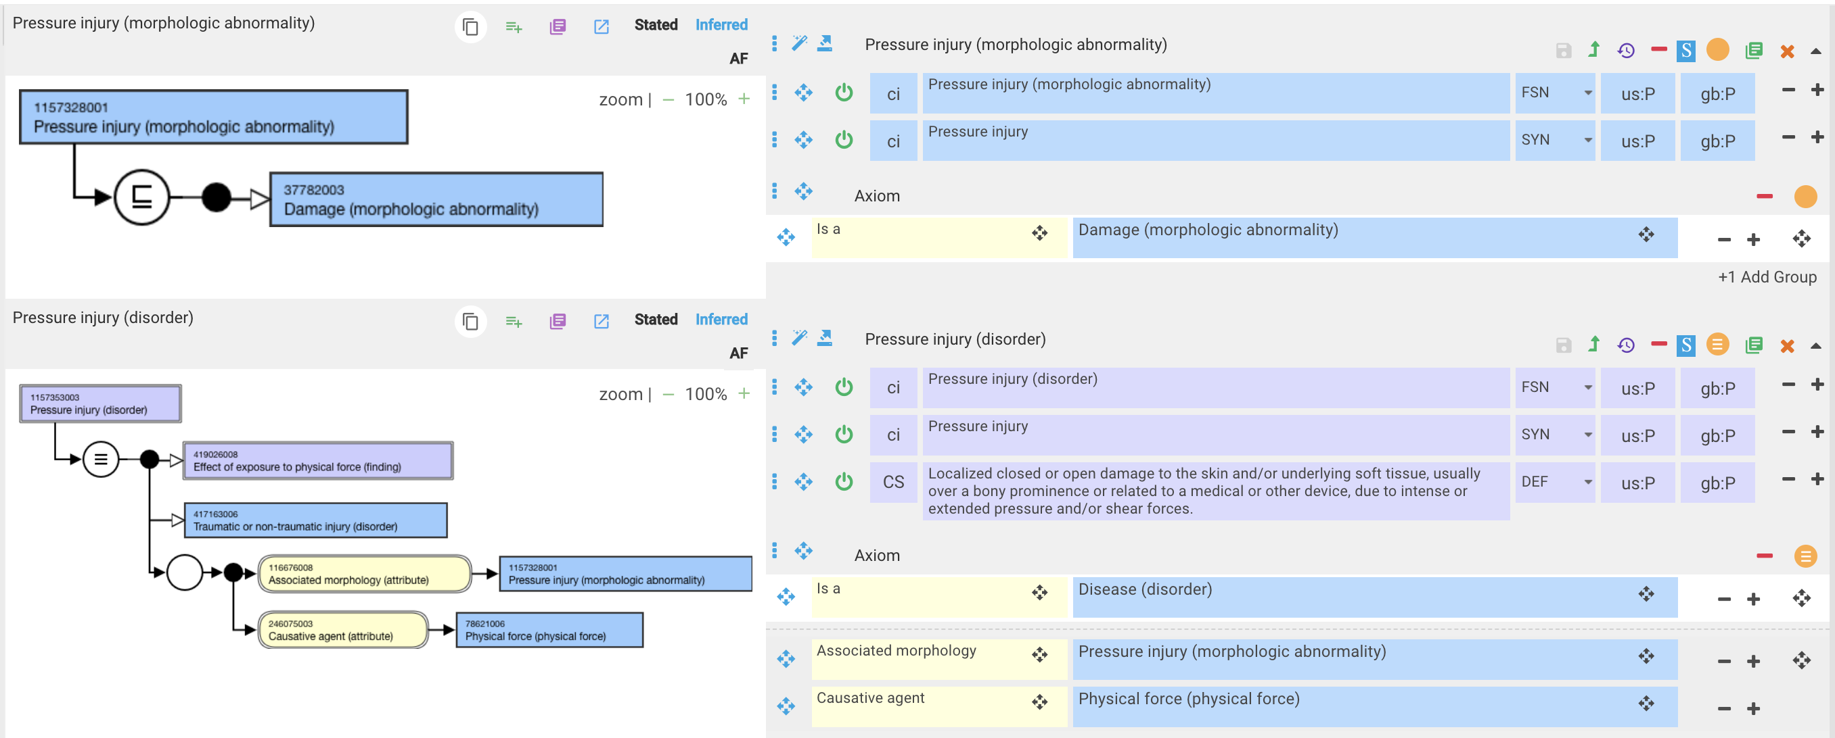
1157353003 |Pressure injury (disorder)| - proposed model

Slide 14
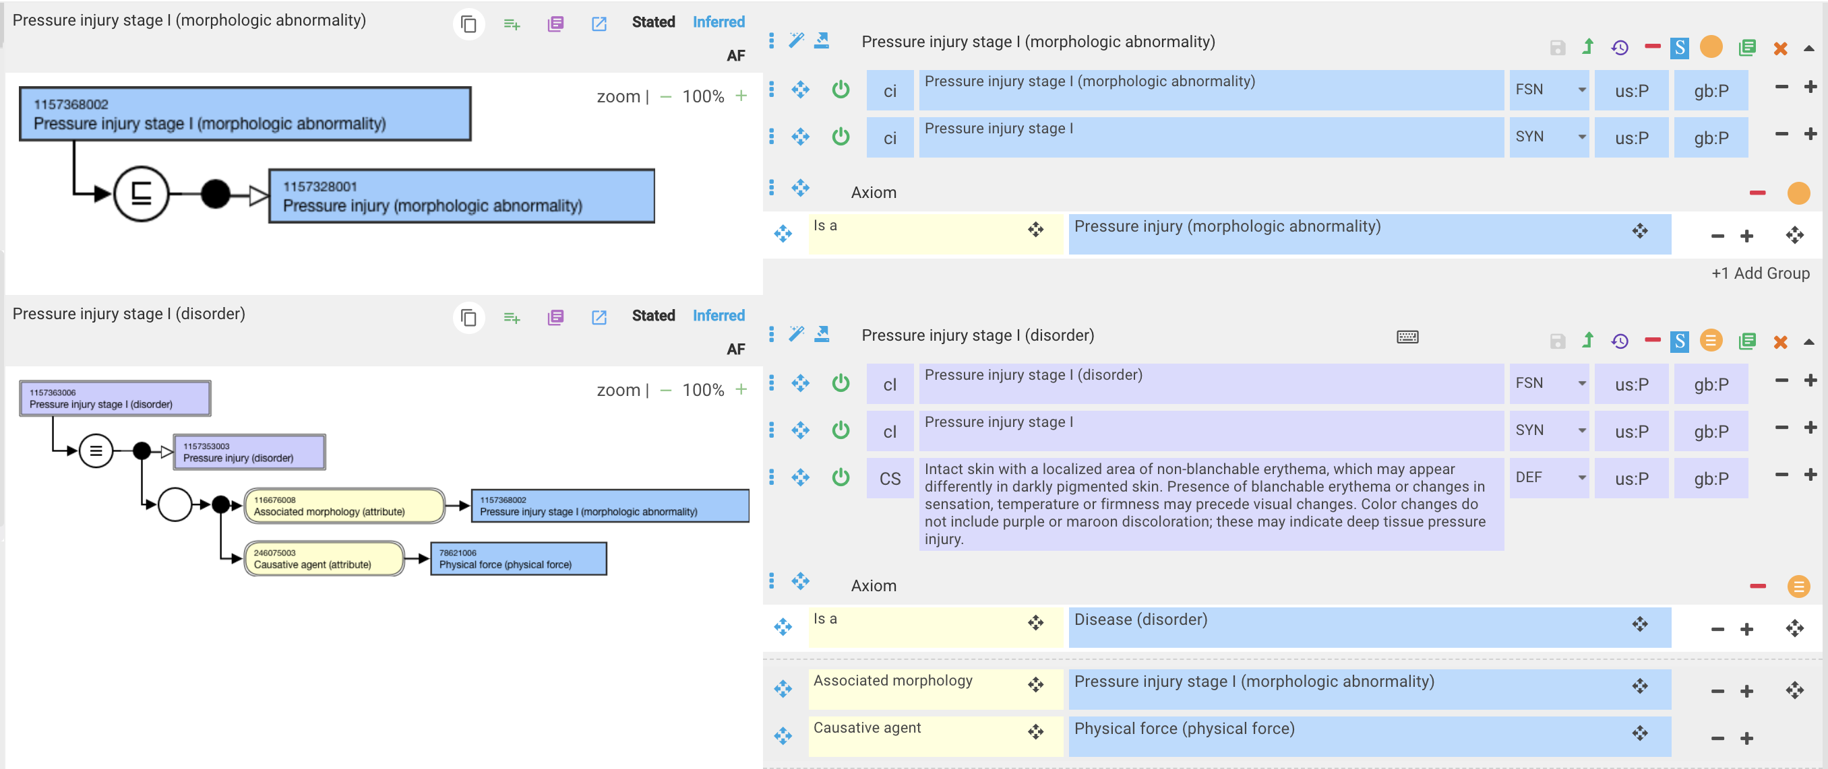
1157363006 |Pressure injury stage I (disorder)|

Slide 15
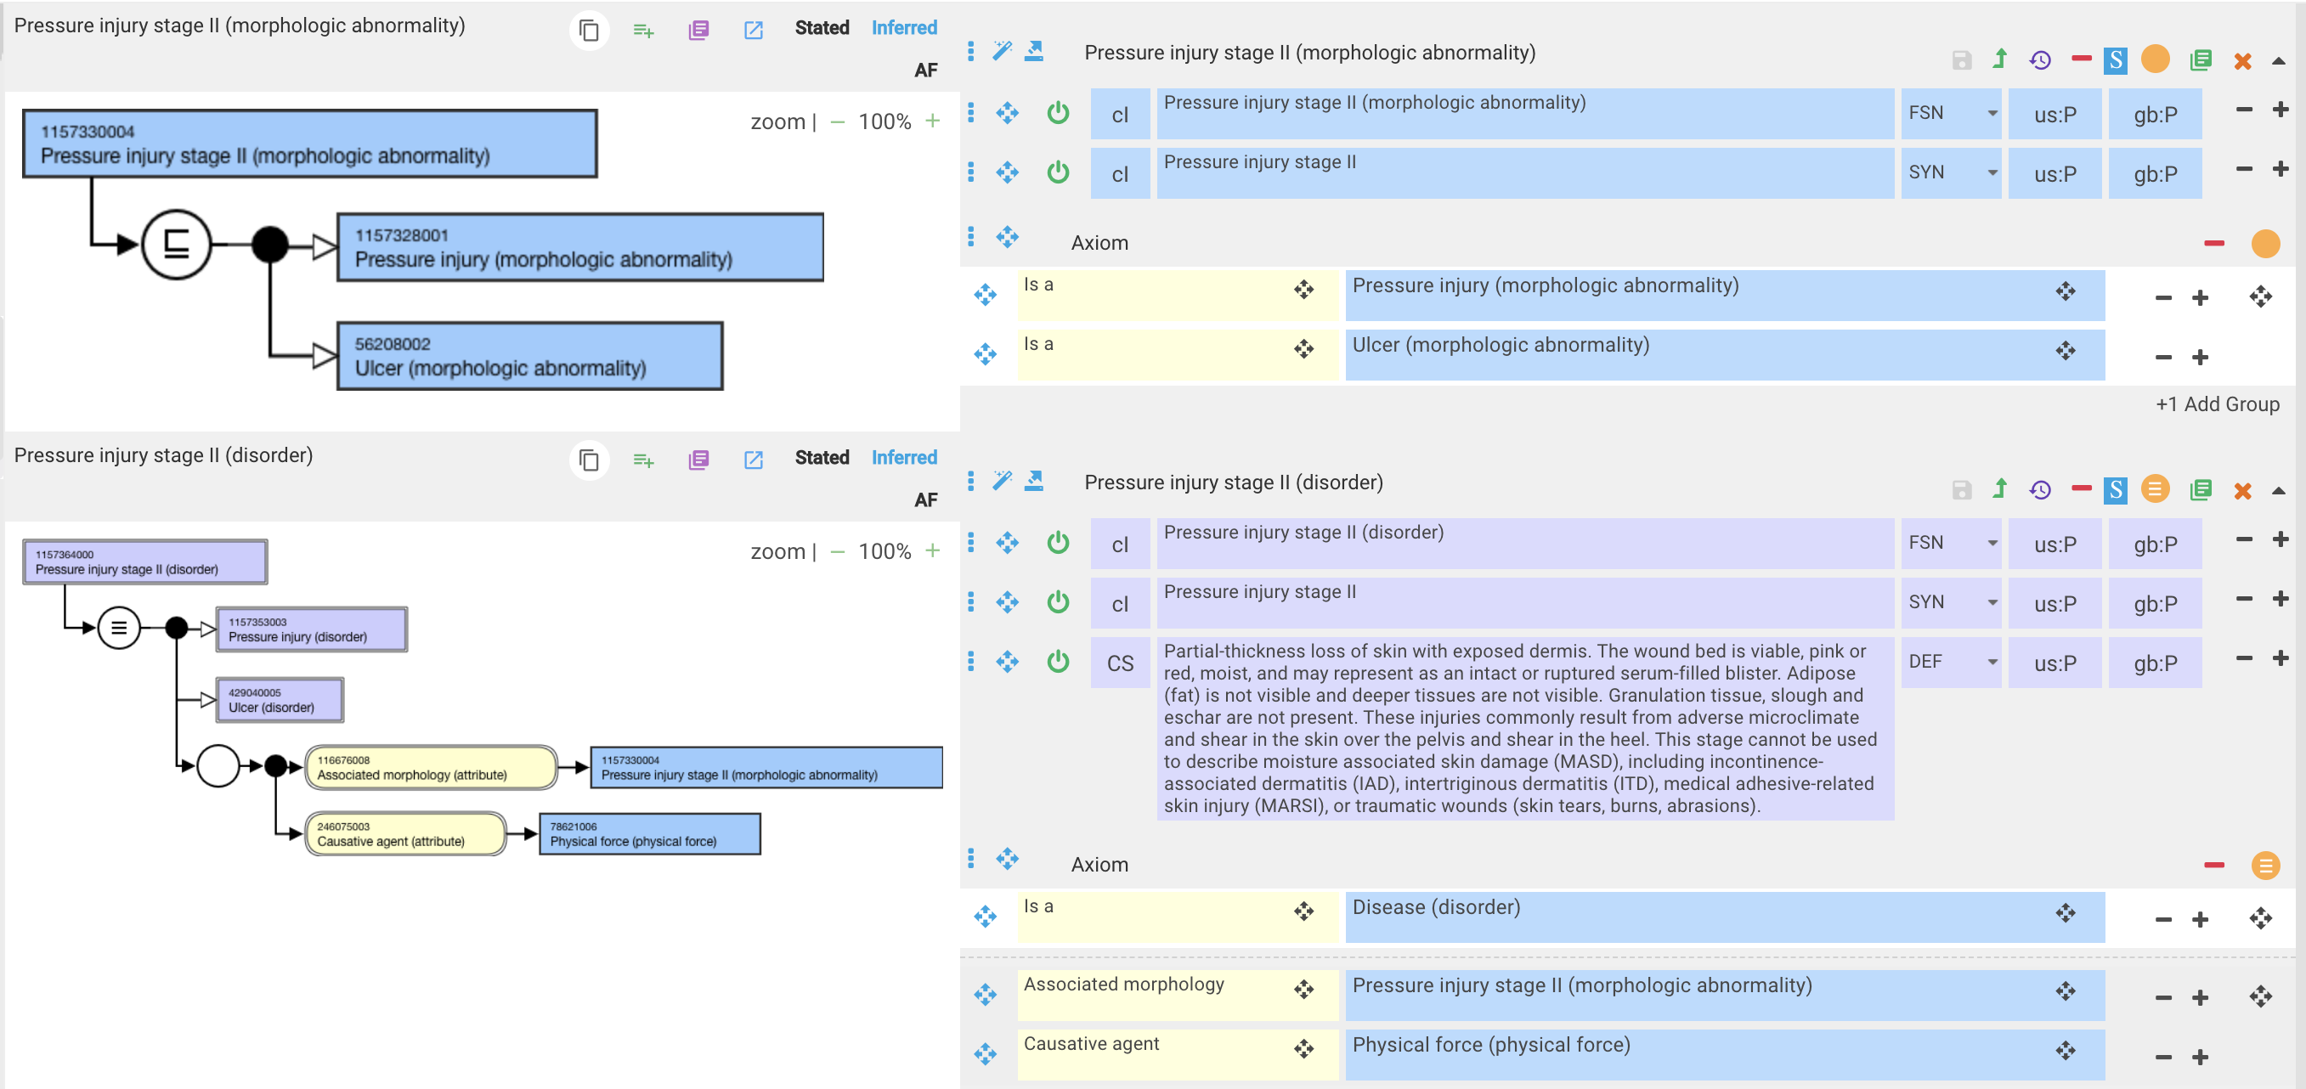
Pressure injury stage II (disorder)|

Slide 16
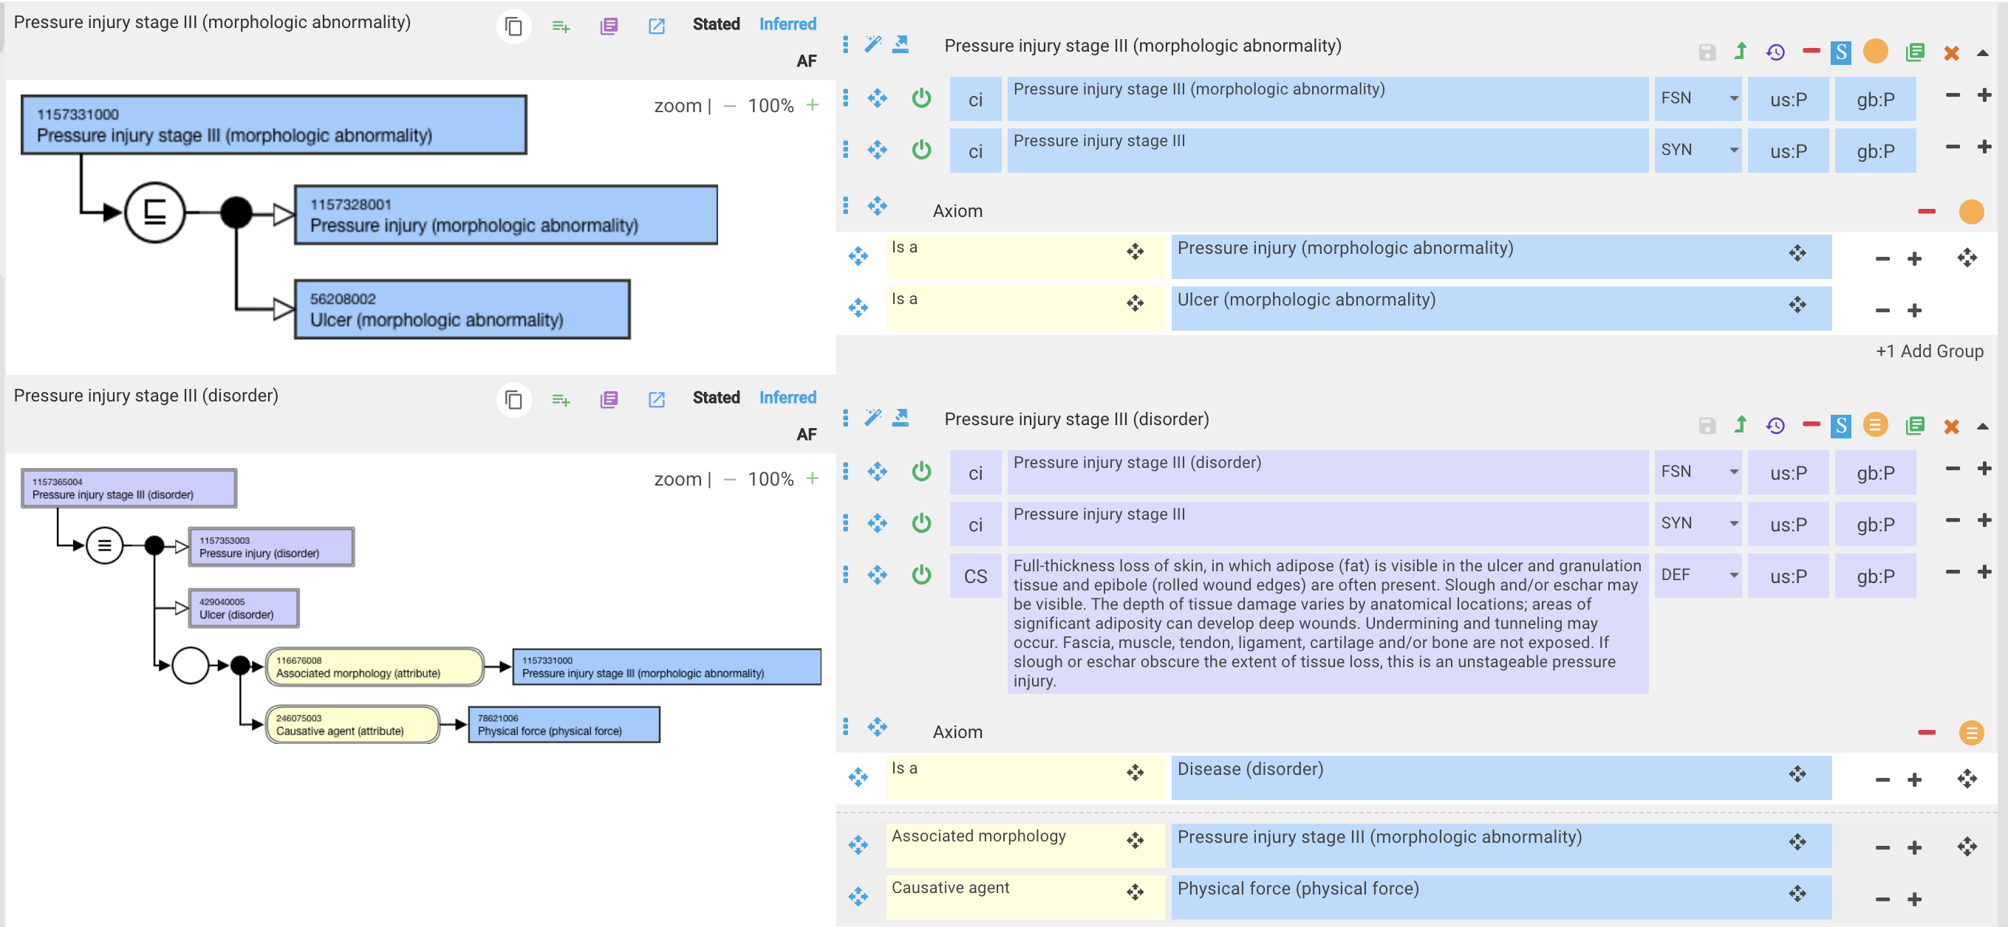
Pressure injury stage III (disorder)

Slide 17
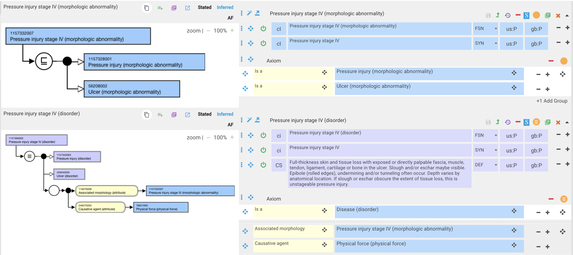
Pressure injury stage IV (disorder)

Slide 18
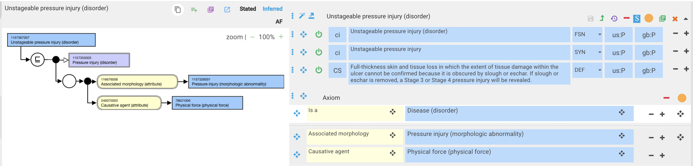
1157248006 |Unstageable pressure injury (disorder)|

Slide 19
[Suspected]/Deep tissue injury

Slide 20
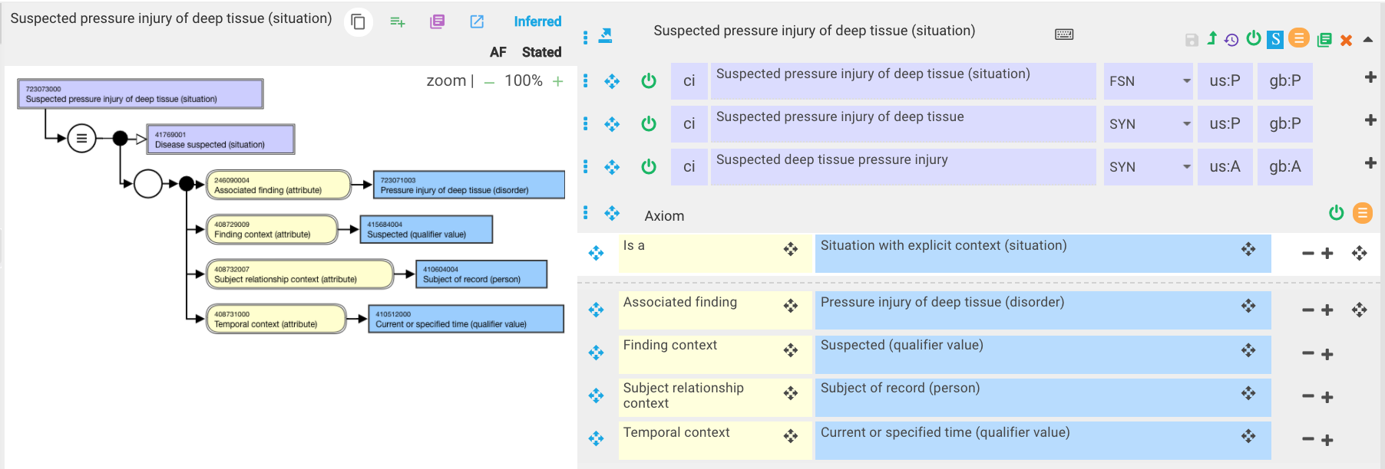
723073000 |Suspected pressure injury of deep tissue (situation)| - existing concept

Slide 21
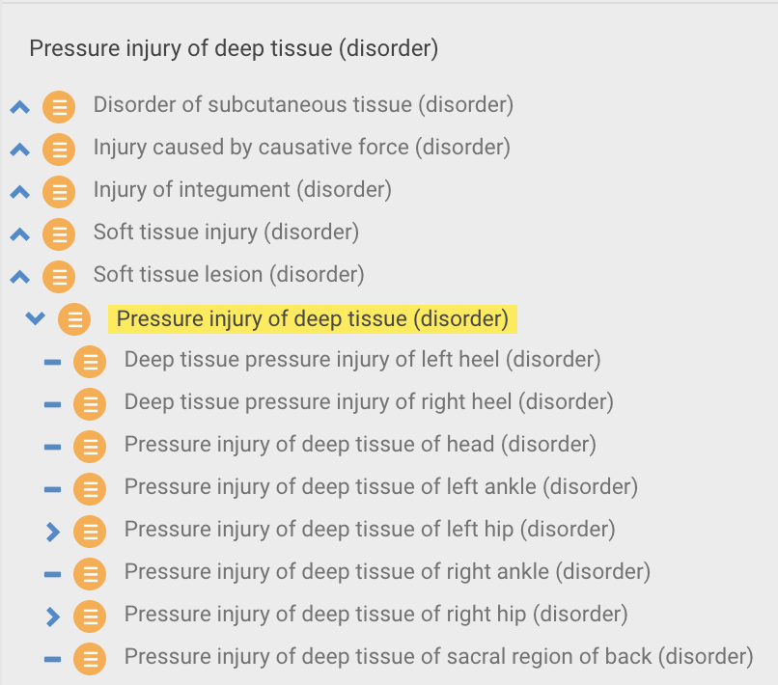
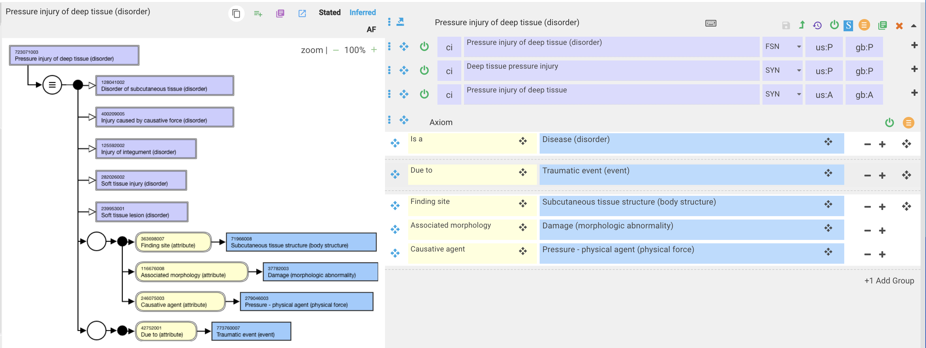
723071003 |Pressure injury of deep tissue (disorder)|

Slide 22
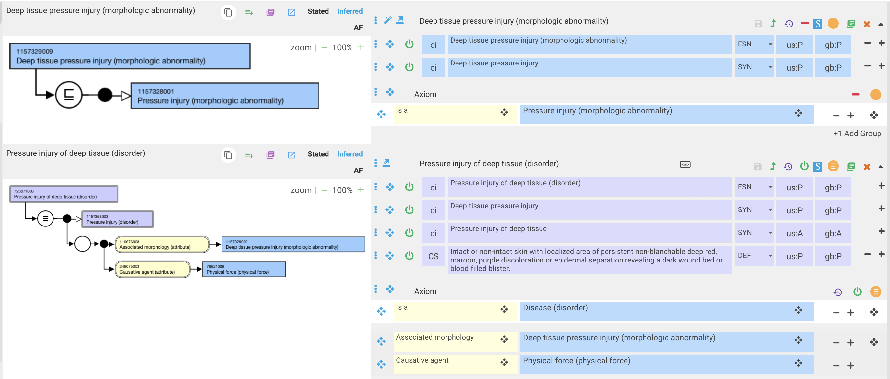
723071003 |Pressure injury of deep tissue (disorder)| - proposed model

