Slide 1
LOINC-SNOMED CT Cooperation Project
LOINC terms with component such as “xxx.identified”: Classification and answer list

Slide 2
Background
This presentation is related to an action item on agenda # 4 from the 7 March 2016 Observable Project Call.
Please note that the examples provided for the classification and answer list might not be exact matches. This is due to the fact that:
  Not all LOINC terms have been mapped to SNOMED CT as of yet
  Not all LOINC terms have an answer list
Therefore, the examples provided may be from other similar LOINC terms (since the issues are the same).

Slide 3
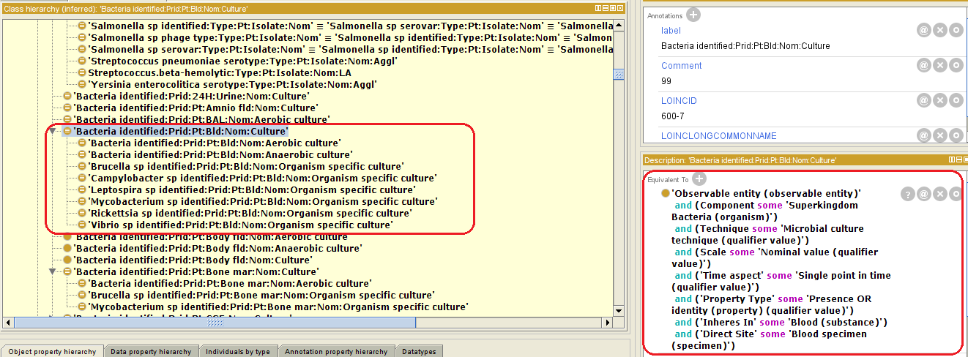
Bacteria Identified

Slide 4
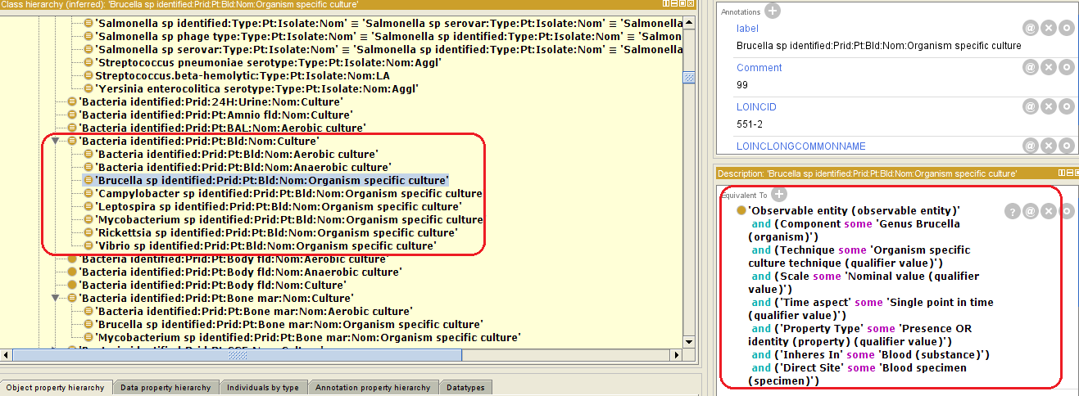
Brucella species identified

Slide 5
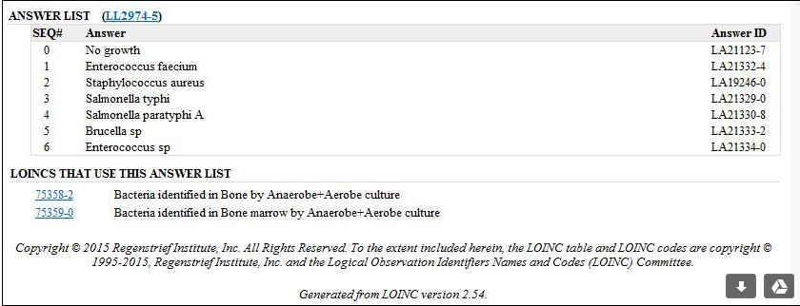
Bacteria identified – Answer list
LOINCID "60258-1“: Bacteria identified:Prid:Pt:Bone mar:Nom:Culture

Slide 6
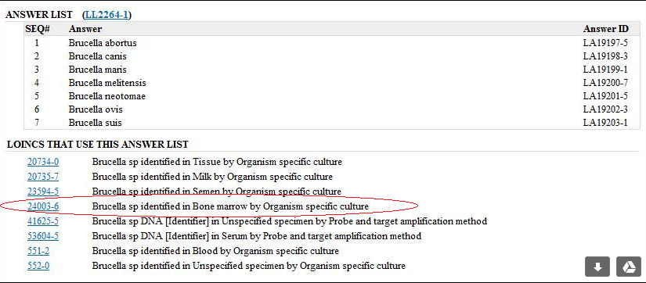
Brucella species identified – Answer list
LOINCID "24003-6“: "Brucella sp identified:Prid:Pt:Bone mar:Nom:Organism specific culture“

Slide 7
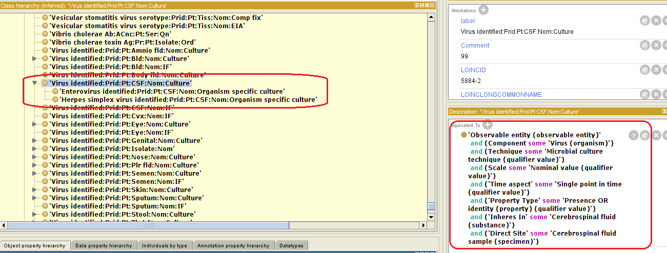
Virus Identified

Slide 8
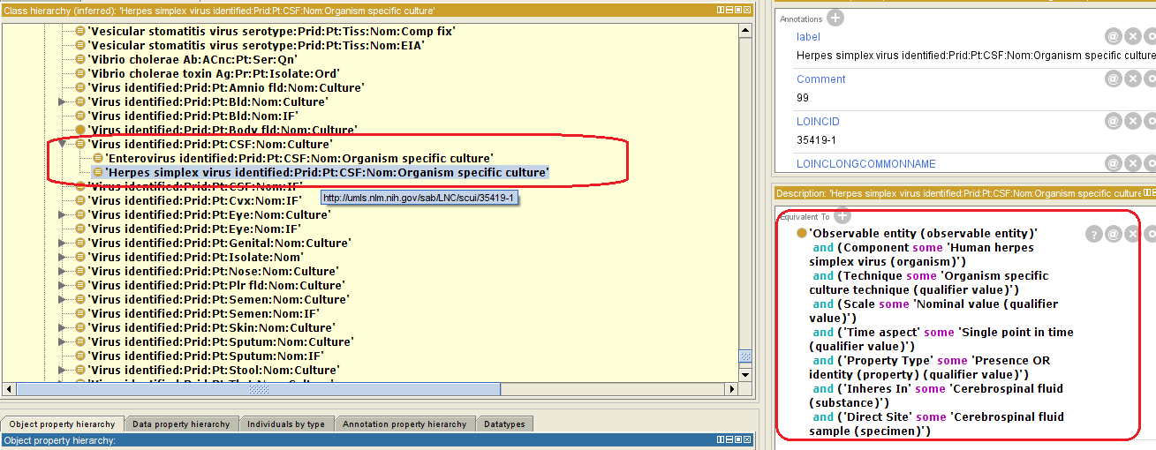
Herpes simplex virus Identified

Slide 9
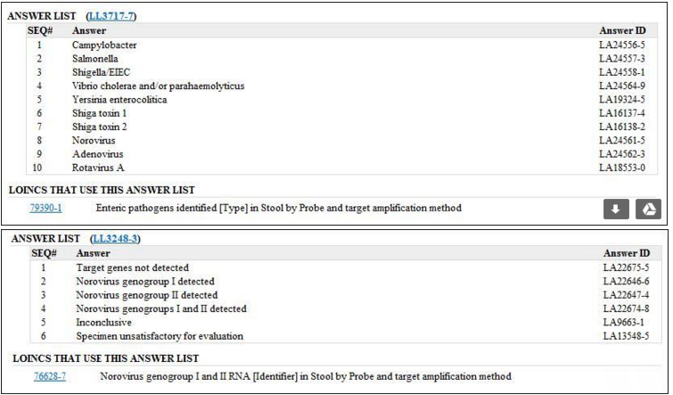
Virus Identified – Answer List - 1

Slide 10
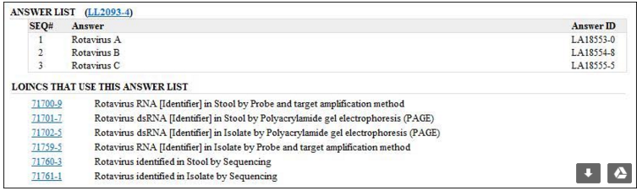
Virus Identified – Answer List - 2

Slide 11
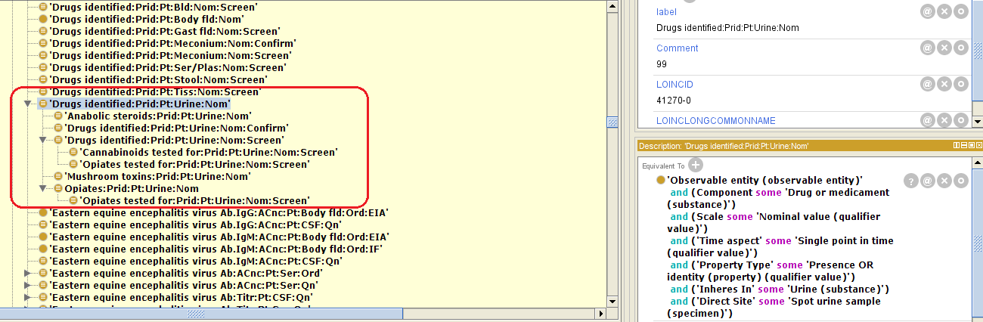
Drug Identified

Slide 12
Drug Identified - Answer list
“I was trying to find something analogous to the drugs identified versus specific drugs tested for, and I think some of the concepts in newborn screening fit, where we have the newborn conditions tested for versus newborn conditions suspected. The answer lists for these concepts are really long so I’m just putting the links to the term details here.
  Analagous to drugs identified: 57131-5 Newborn conditions with positive markers [Identifier] in Dried blood spot (http://s.details.loinc.org/LOINC/57131-5.html?sections=Simple)
  Analagous to tested for: 57719-7 Conditions tested for in this newborn screening study [Identifier] in Dried blood spot (http://s.details.loinc.org/LOINC/57719-7.html?sections=Simple)”

Slide 13
General comment by RII
“The difference between the drugs hierarchy and the bacteria/virus hierarchies in your screenshots (and the reason why the drugs hierarchy isn’t correct) is that for the bacteria/viruses, the parent is the more general concept for which bacteria or virus is identified, and the children represent the strain or subtype of a particular bacteria. For the drugs, the parent is a general concept for which drug is identified, but the children don’t represent the specific cannabinoids or opiates found, they represent the ones that the lab was testing for.”

